Slide 1

Swiggy Delivery Time Prediction using Machine Learning
Name: Tejaswi Siddagoni
Innomatics Research Labs – Data Science Program

Slide 2

Agenda
Business Understanding & Problem Statement
Dataset Understanding
CRISP-ML(Q) Methodology
Data Preprocessing & Pipeline Approach
Model Building & Comparison
Hyperparameter Tuning
Model Evaluation & Interpretation
Deployment – Streamlit Web App
Feature Importance
Business Impact
Future Scope & Conclusion
Q&A

Slide 3
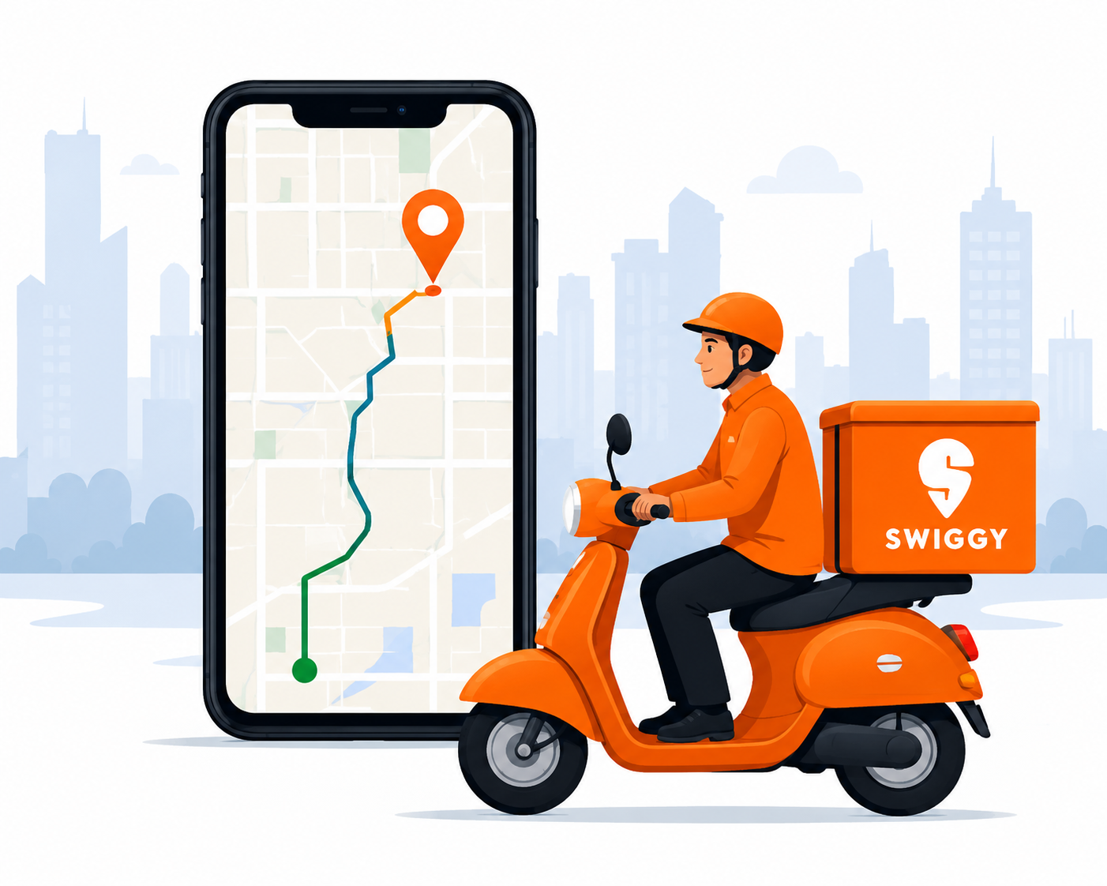
Business Understanding & Problem Statement
Business Problem
Swiggy handles millions of food delivery orders every month. Inaccurate ETAs reduce customer trust, increase cancellations, and raise operational costs.
Objective
Develop a Machine Learning model that accurately predicts food delivery time so Swiggy can provide reliable ETAs and optimize delivery operations.
Target Variable
time_taken (Minutes)
Input Features
Rider Details • Order Details • Vehicle Information
Weather & Traffic Conditions • Location Details • Time Features

Slide 4
Dataset Understanding
The dataset contains 45,502 historical delivery records across 26 columns, collected from Swiggy operations.
Feature Category | Features
Rider Details | Age, Ratings
Vehicle Details | Type of Vehicle, Vehicle Condition
Order Details | Type of Order, Festival, Multiple Deliveries
Weather & Traffic | Weather, Traffic
Location Details | Coordinates, Distance, City Type, City Name
Time Details | Order Day/Month, Day of Week, Weekend, Pickup Time, Order Hour, Time of Day

Slide 5
CRISP-ML(Q) Methodology
Project Workflow
This project follows the CRISP-ML(Q) methodology, a structured framework for developing Machine Learning solutions.
Workflow
Business Understanding
↓
Data Understanding
↓
Data Preparation
↓
Model Building
↓
Model Evaluation
↓
Deployment
↓
Monitoring & Quality

Slide 6
Machine Learning Without Pipeline
Workflow:
Raw Data ↓ Handle Missing Values ↓ Encoding ↓ Scaling ↓ Train-Test Split ↓ Machine Learning Model ↓ Prediction
Problems:
Preprocessing was done manually
Test data could affect preprocessing
Risk of data leakage
More chances of mistakes
Difficult to maintain

Slide 7
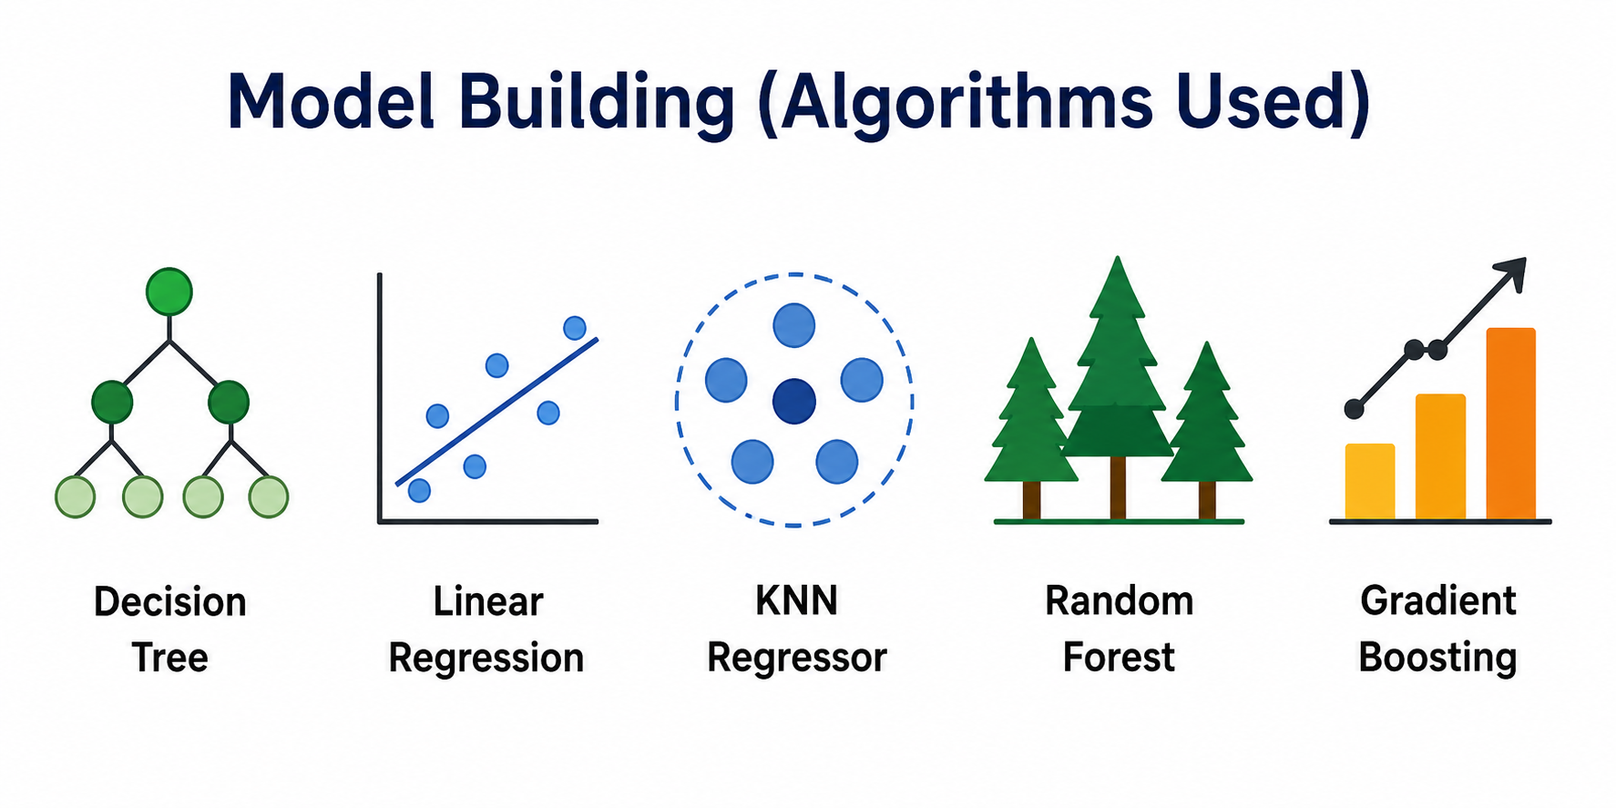
Machine Learning With Pipeline
Workflow:
Raw Data ↓ Train-Test Split ↓ Column Transformer ↓ Imputation + Encoding + Scaling ↓ Machine Learning Model ↓ Prediction
Benefits:
Prevents data leakage
Automates preprocessing
Same process for training and testing
Easy to maintain
Easy to deploy

Slide 8
Model Building & Comparison
Machine Learning Models
Five regression algorithms were trained and evaluated using the pipeline built above.
Model | R² Score | MAE (min)
Random Forest | 0.803 | 3.29
Gradient Boosting | 0.748 | 3.75
Decision Tree | 0.635 | 4.31
Linear Regression | 0.568 | 4.92
KNN Regressor | 0.529 | 5.04
Final Selected Model: Random Forest Regressor
Handles nonlinear relationships • Robust against overfitting • Strong on structured data • Interpretable via feature importance.

Slide 9
Hyperparameter Tuning
Hyperparameter Optimization
Random Forest was tuned using Optuna with 5-fold cross-validation R² as the objective.
Parameters Tuned
n_estimators (100–300) • max_depth (5–30) • min_samples_split (2–10)
Best Parameters Found
n_estimators = 210, max_depth = 13, min_samples_split = 8 (Best CV R² = 0.801)
Outcome
Test R² improved from 0.803 (baseline) to 0.807 after tuning.

Slide 10
Model Evaluation & Interpretation
Performance Evaluation
The tuned Random Forest Regressor was evaluated on the held-out test set.
Evaluation Metric | Value | Interpretation
Mean Absolute Error (MAE) | 3.26 | Predictions differ from actual by ~3.26 minutes on average.
Root Mean Squared Error (RMSE) | 4.12 | Predictions deviate ~4.12 minutes on average.
R² Score | 0.807 | Explains ~81% of the variation in delivery time.
Training R² = 0.858 vs. Testing R² = 0.807 (gap ≈ 0.05) — indicates mild but acceptable overfitting. The tuned Random Forest performs well and is suitable for real-world delivery-time estimation.

Slide 11
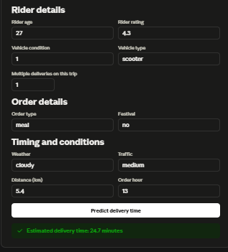
Deployment – Streamlit Web App
From Notebook to Live App
The final tuned pipeline (preprocessing + Random Forest model) was serialized with pickle as swiggy_pipeline.pkl and loaded into a Streamlit app (app.py) for real-time predictions.
App Inputs
Rider details: age, rating, vehicle condition, vehicle type, multiple deliveries
Order details: order type, festival
Location: restaurant & delivery coordinates (auto-computes distance via Haversine formula)
Timing & conditions: weather, traffic, order date, order hour, pickup time
Sample Output
✅ Estimated delivery time: 24.7 minutes — returned instantly after clicking “Predict delivery time.”

Slide 12
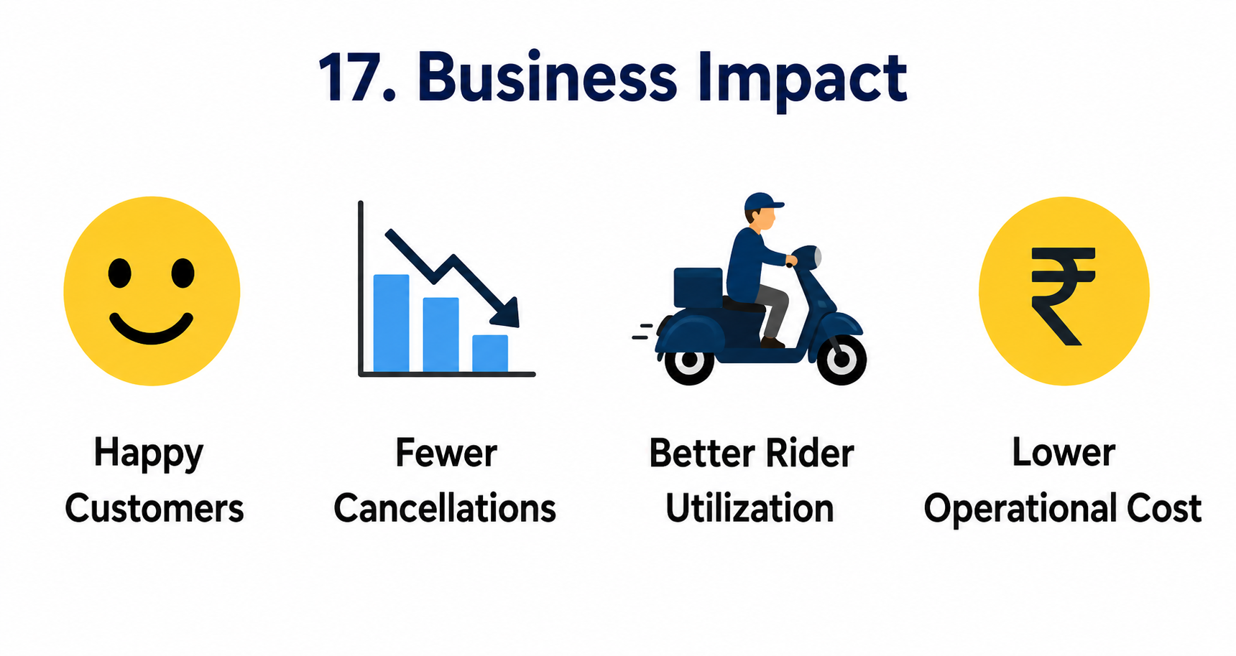
Business Impact
Business Benefits
Smarter demand forecasting
Reduced order cancellations
Better rider scheduling
Personalized customer experience
Data-driven delivery planning

Slide 13
Future Scope & Conclusion
Future Scope
Integrate live traffic and weather APIs; use Google Maps API for real-time distance and ETA.
GPS-based rider tracking; cloud deployment on AWS or Azure.
Experiment with gradient boosting variants such as XGBoost or LightGBM for further accuracy gains.
Conclusion
Built a leakage-free Scikit-learn pipeline and compared 5 regression algorithms.
Selected and tuned Random Forest with Optuna — achieved test R² of 0.807.
Deployed the model as a live Streamlit web application for real-time predictions.

Slide 14


Slide 15

THANK YOU

