Slide 1

World Wide Energy Consumption
Tejaswi Siddagoni
Batch:484

Slide 2
About me
My name is Tejaswi. I’m a B.Tech graduate in Computer Science and Engineering (AI & ML)
I want to learn Data Science to analyze data, extract meaningful insights, and build intelligent solutions using data-driven approaches. It helps me strengthen my problem-solving skills and supports my career growth in AI and analytics.
LinkedIn : https://www.linkedin.com/in/tejaswi-siddagoni/
GitHub : https://github.com/Tejaswi711

Slide 3
Agenda
Business problem
Problem statement
Objective
ER diagram
Queries
Challenges
Conclusion
Recommendation
Q&A Slide

Slide 4
Business Problem:
The organization struggles to analyze energy consumption, production, and emissions data across countries, leading to poor decision-making and lack of insights.
Problem Statement:
Analyze global energy, GDP, population, and emission data using SQL to identify trends, correlations, and improve data-driven decisions.

Slide 5
Objectives:
Store and manage energy-related data in a structured database
Analyze consumption, production, and emissions across countries
Study trends over time (GDP, population, emissions)
Perform per capita and ratio-based analysis
Generate insights for better global energy decisions

Slide 6
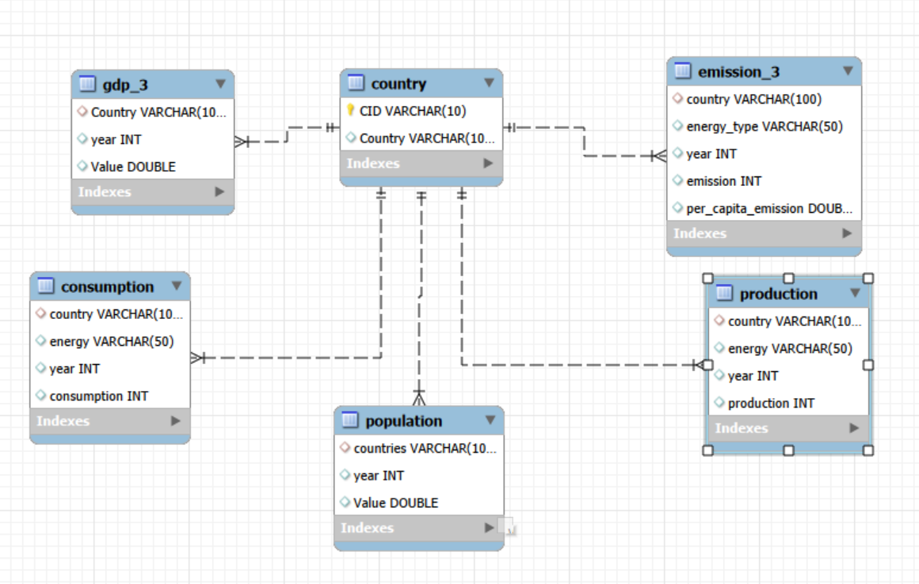
ER diagram:

Slide 7
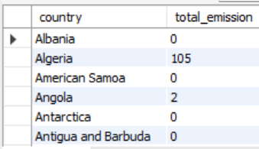
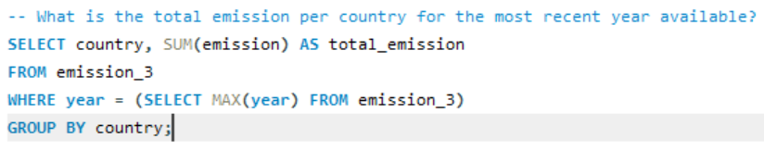
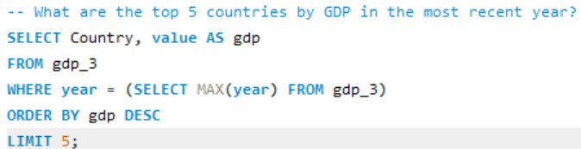
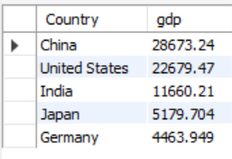
Queries : General & Comparative Analysis

Slide 8
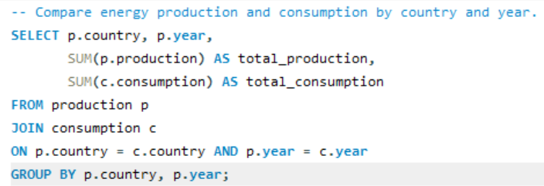
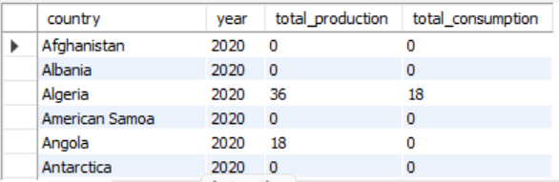
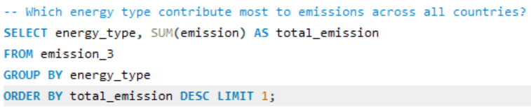


Slide 9
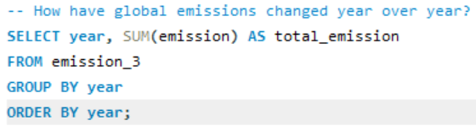
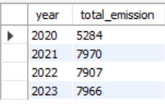
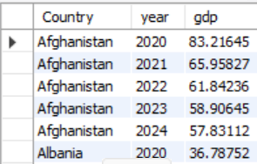
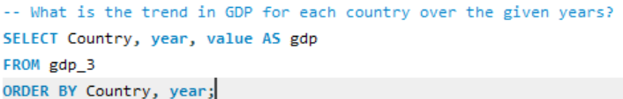
Trend Analysis Over Time

Slide 10
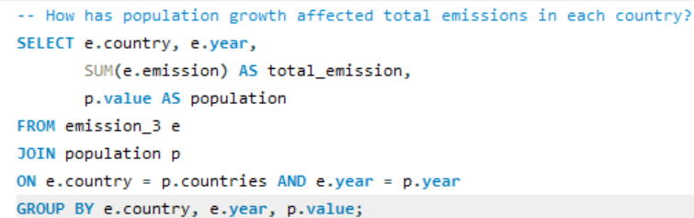
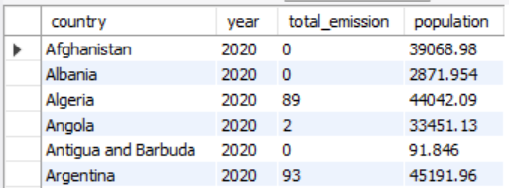
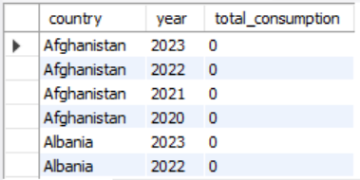
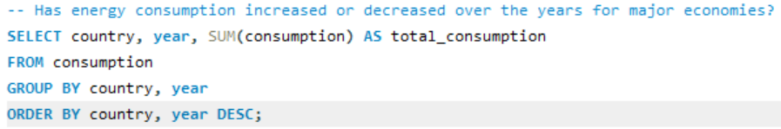

Slide 11
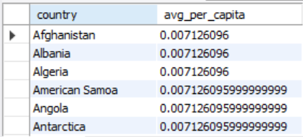
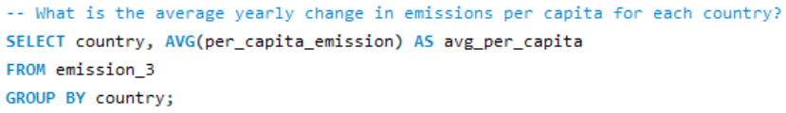
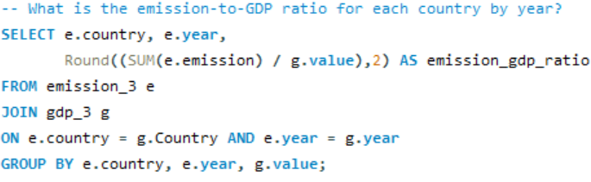
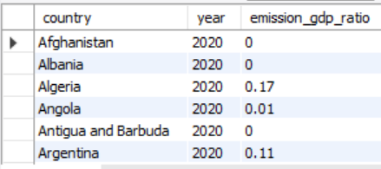
Ratio & Per Capita Analysis

Slide 12
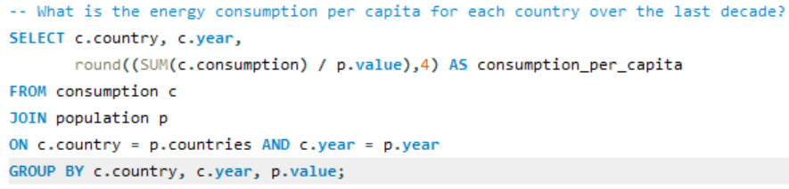
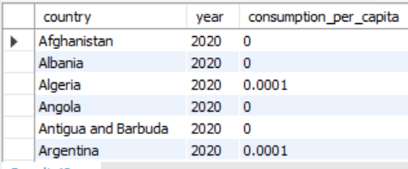
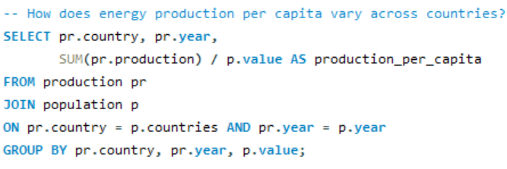
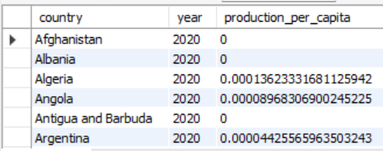

Slide 13
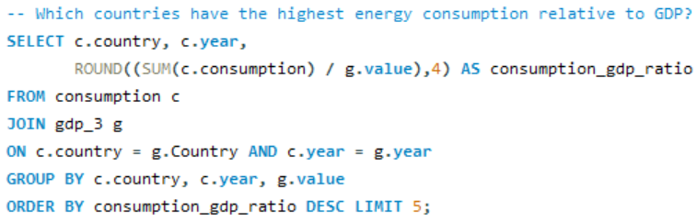
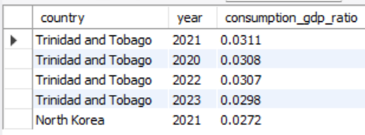
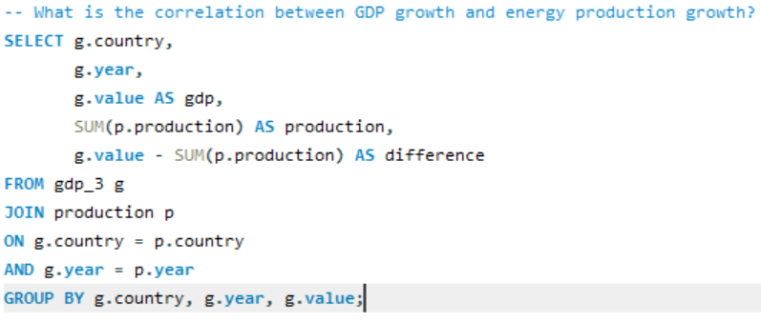
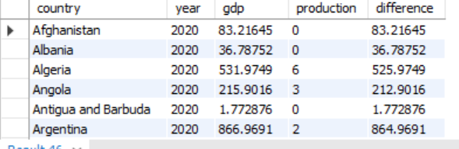

Slide 14
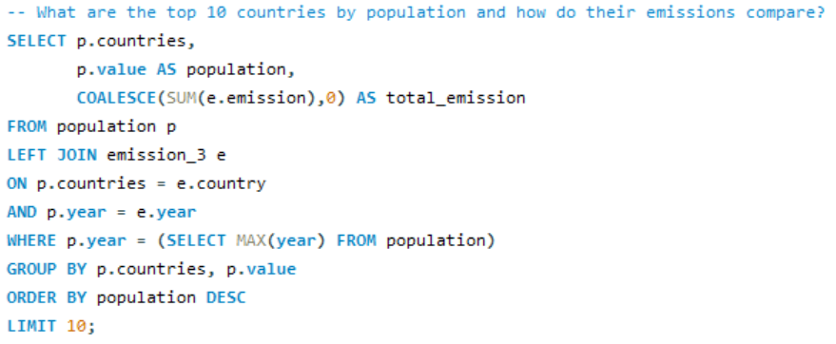
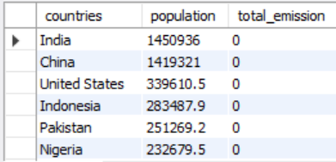
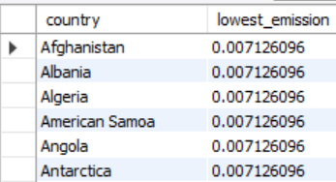
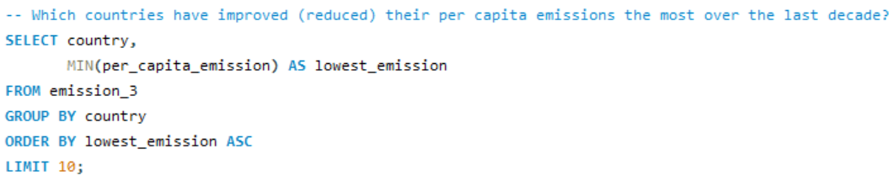
Global Comparisons

Slide 15
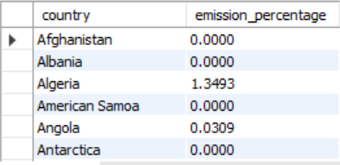
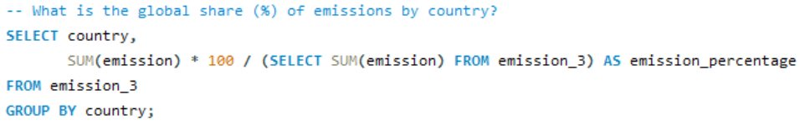
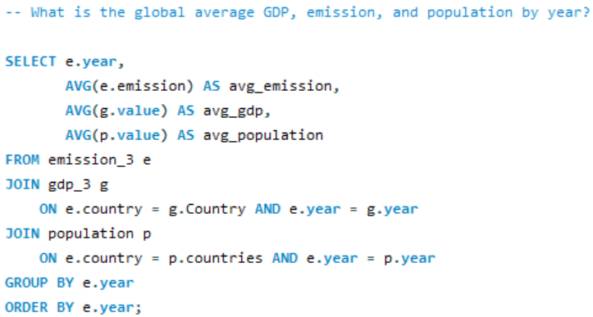
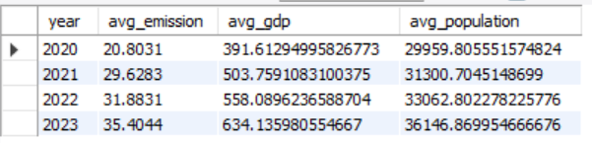

Slide 16
Challenges:
I learned that one problem can have many solutions
I chose the best approach for each query
I understood table relationships
I improved my SQL and thinking skills

Slide 17
Conclusion:
The project helps in understanding global energy patterns by analyzing consumption, production, emissions, GDP, and population data. It provides insights into trends and relationships, supporting better decision-making.

Slide 18
Recommendations:
Monitor emission trends to support sustainability goals
Improve energy efficiency based on data insights
Track per capita metrics for better comparisons
Regularly update data for accurate analysis

Slide 19


Slide 20

THANK YOU

