Slide 1



Portfolio Management System
Project Team:
Developed under the guidance of:-
Sayan saha (2153380)
Praveen Anand (2153424)
Divya Ravindra Shinde (2152188)
Monalisa Sahoo (2151585)
Tejaswi Boyapalli (2151548)
Mentor: Anish Kumar Das
Trainer: Anil Boppuri
Coach: Kanchan Bhise
INTCDE22IJ063(CDE-JAVA)
MFPE POD – 3

Slide 2

Introduction
The Portfolio Management System provides Microservice Architecture-based software solution.
It provides high Availability operations for their customers without disruption.
Different Microservices combines together to perform together as a Uniﬁed application.

Slide 3
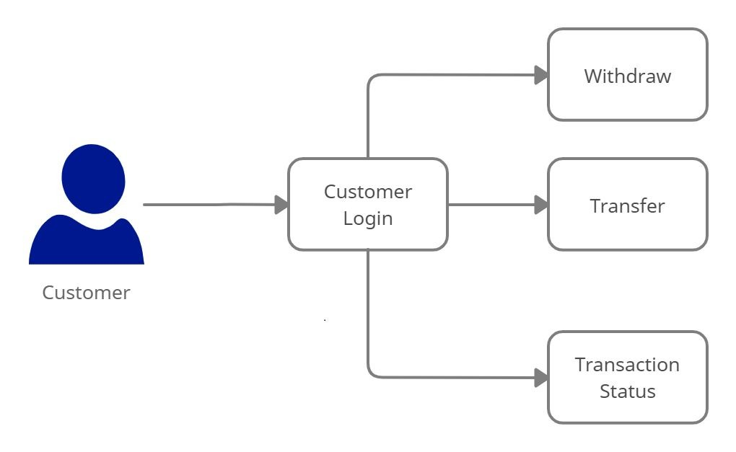
Architecture Diagram for Customer
View assets
View Assets
Current Price
Sell Assets

Slide 4
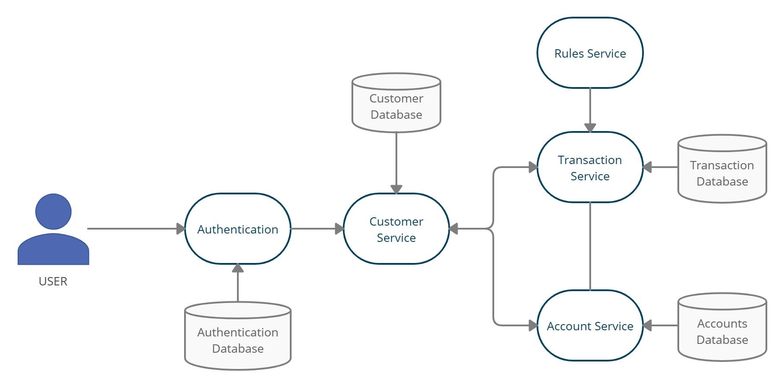
WorkFlow:
View Assets
Sell Assets
Current Price
Daily Share Database
Calculate NetWorth
Customer
Mutual Fund Details
Mutual Fund Database

Slide 5
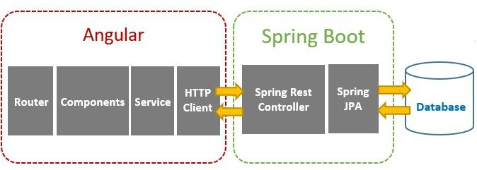
Client - Server Architecture

Slide 6
Technologies Used
Front End : Angular 8
Backend : Java 8, Spring Boot, Restful-Services
Database : H2 - database
Tools : Spring Tool Suite, Swagger, Postman, AWS

Slide 7
Working Microservices:
Authorization Microservice
Daily Share Price Microservice
Daily Mutual Fund Nav Microservice
Calculate Net worth Microservice

Slide 8
Authorization Microservice
Authorization Microservice will perform operations like:
Login &
Logout
Authorization will provide the JWT token after user’s validation.
Providing the authorization based on user’s login

Slide 9
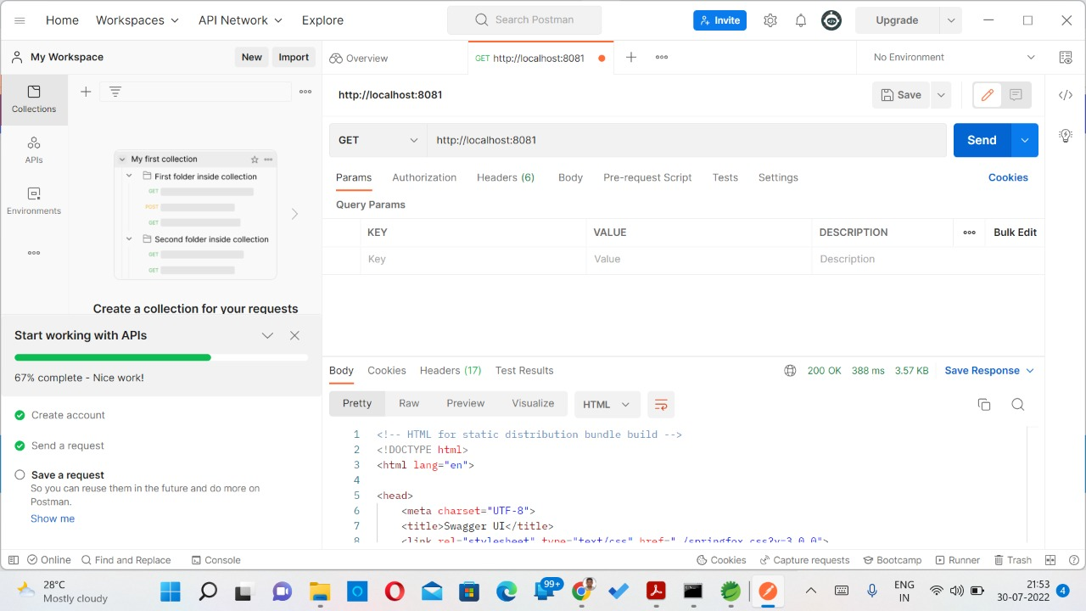
Authorization Microservice - Sample Request

Slide 10
Daily Share Price Microservice
Daily Share Price microservice will perform operations like :
Retrieve the current stock market price from database
Also, Interacts with Calculate Net worth Microservice and it will return the current price to Calculate Net worth Microservice.

Slide 11

Daily Share Price Microservice - Sample Request

Slide 12
Daily Mutual Fund Nav Microservice
Daily Mutual Fund Nav Microservices will perform operations like:
Retrieve the market value of the mutual fund NAV (Net Asset Value) from the database
Also, Interacts with Calculate Net worth Microservice and it will return the market value of the mutual fund NAV to Calculate Net worth Microservice.

Slide 13

Daily Mutual Fund Nav Microservice - Sample Request

Slide 14
Calculate Net Worth Microservice
Calculate Net worth Microservice will be responsible for the following operations:
Retrieve the stocks and mutual funds corresponds to the customer portfolio.
It will interact with the Daily Share Price & Daily Mutual fund NAV Microservices to get current market price for that stock & mutual fund and calculate the stock value & mutual fund.
The net worth is calculated as below:-
Net worth = no. of shares of Stock1 * current price of stock1 + no. of shares of Stock2 * current price of stock2 + … + no. of shares of stockN * current price of stockN] + [no. of units of Mutual Fund1 * NAV of Mutual Fund1 + no. of units of Mutual Fund2 * NAV of Mutual Fund2 + … + no. of units of Mutual FundN * NAV of Mutual FundN]

Slide 15

Calculate Net Worth Microservice – Sample Request

Slide 16
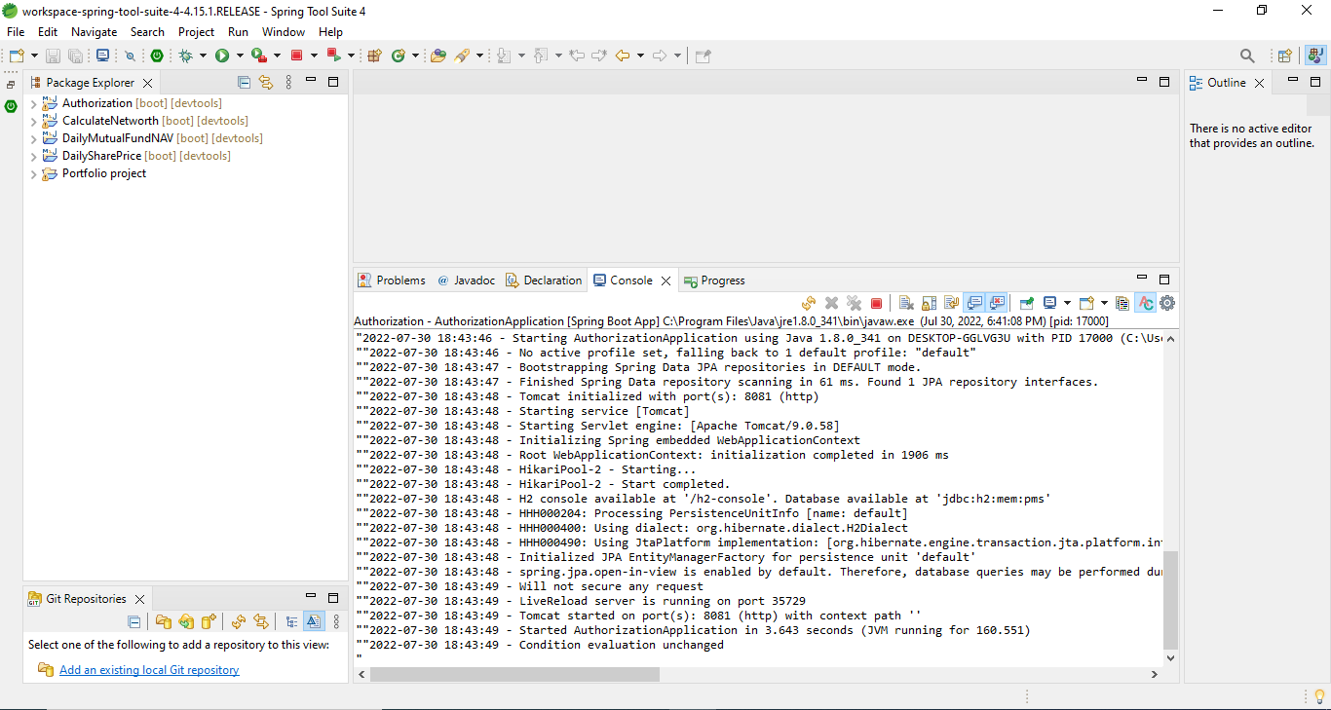
Back-end code:

Slide 17
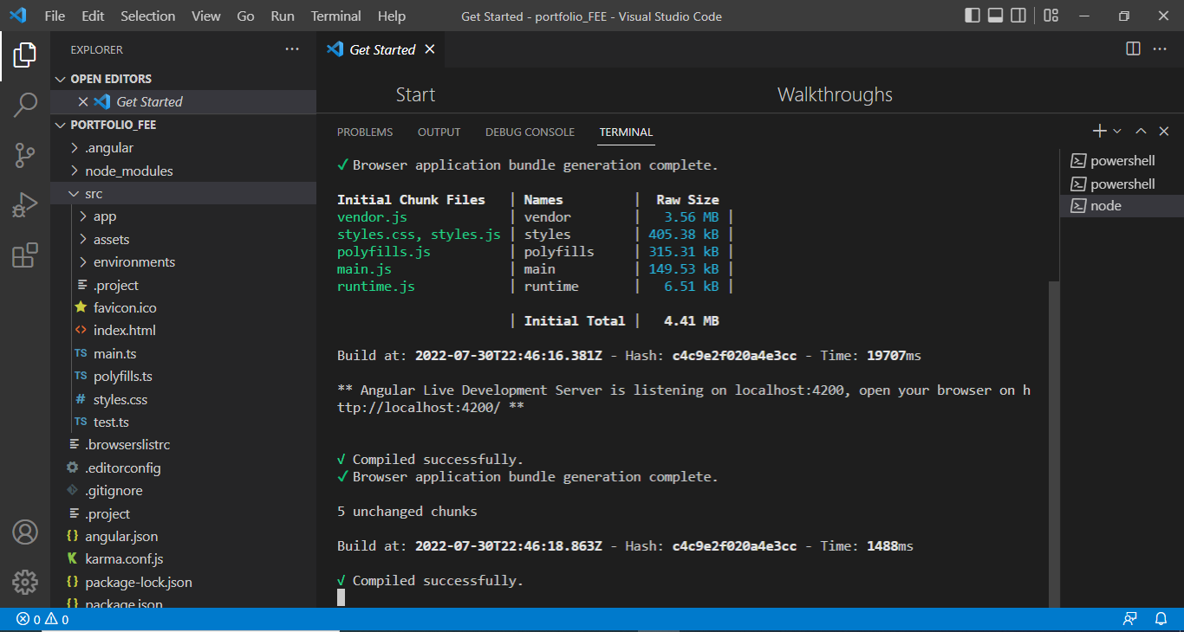
Front-end code:

Slide 18
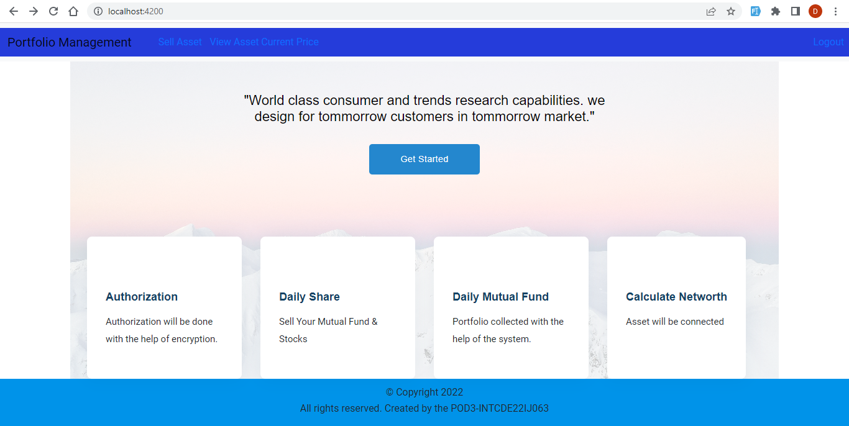
Output of Portfolio Management System:

Slide 19
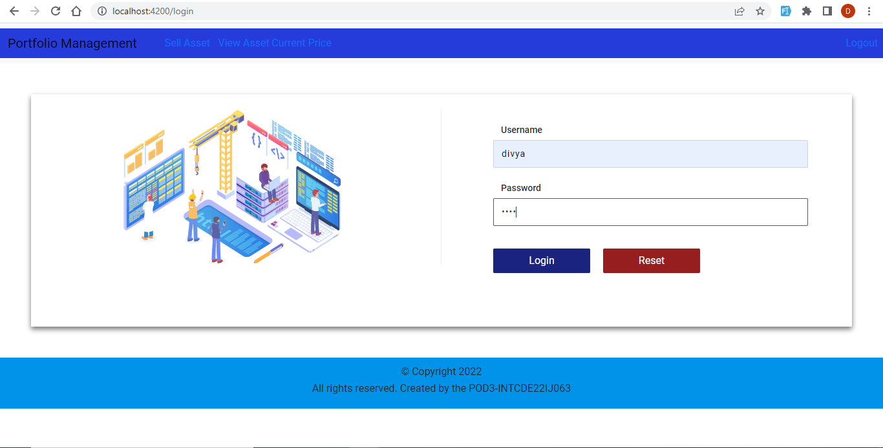

Slide 20
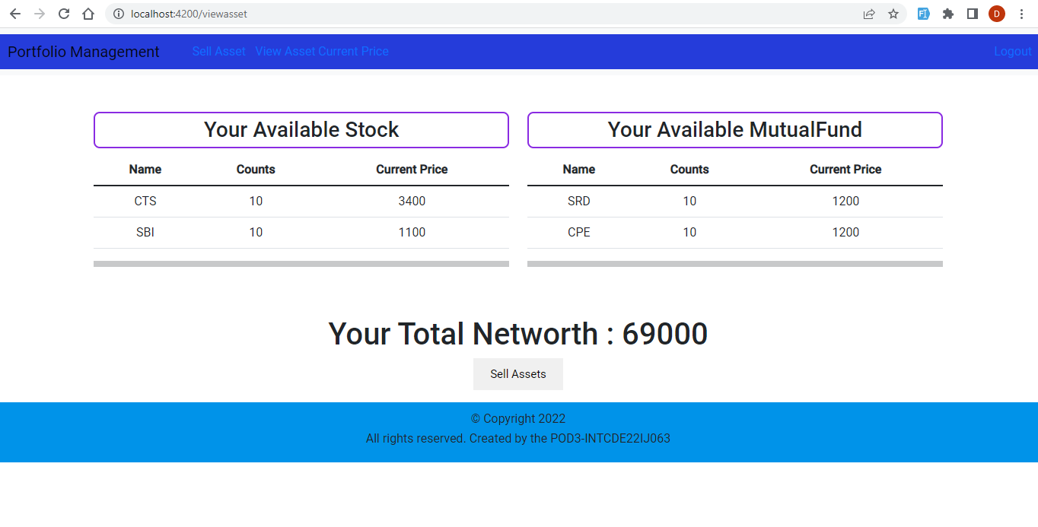

Slide 21
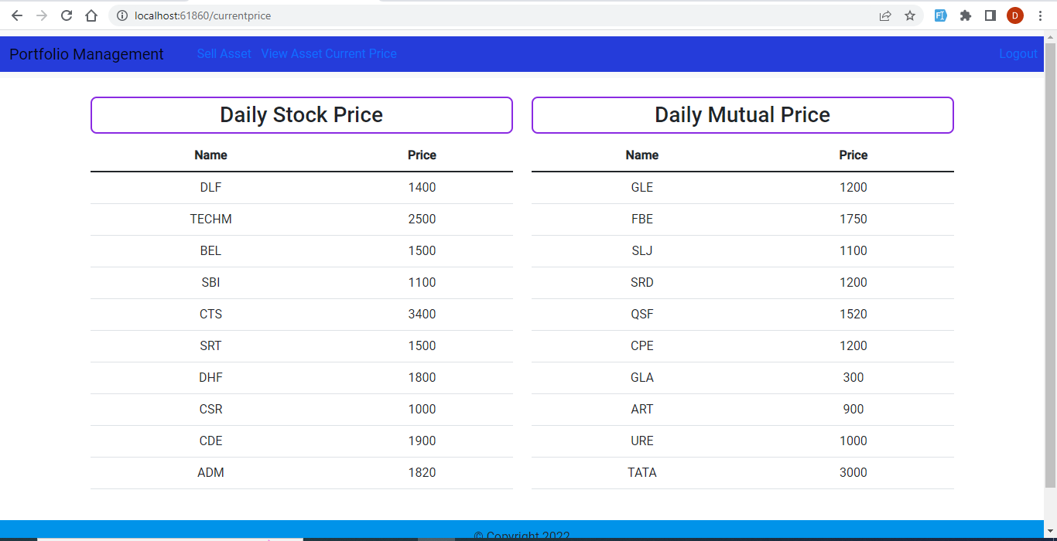

Slide 22
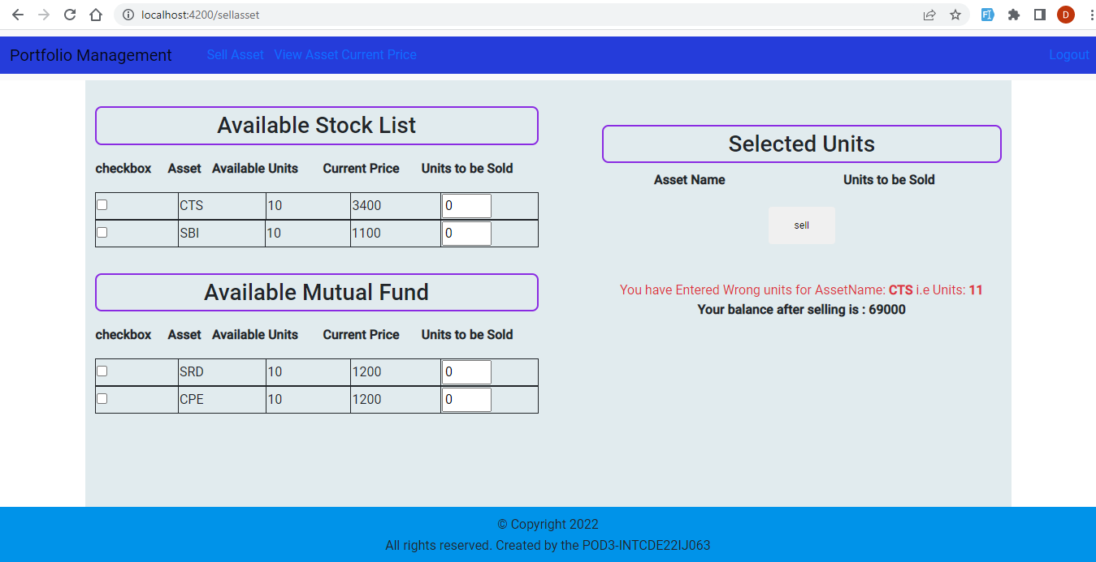

Slide 23
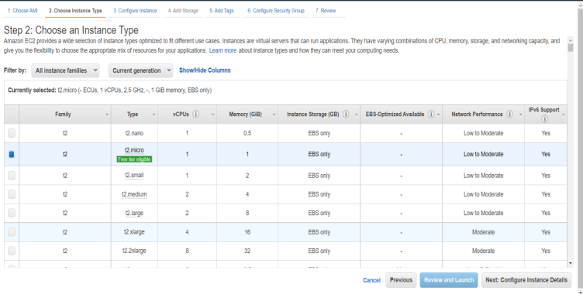
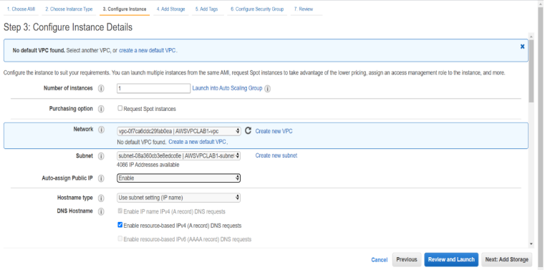
AWS Deployment-EC2 Instance Creation:

Slide 24
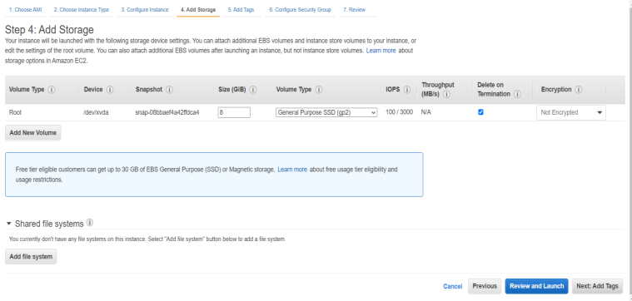
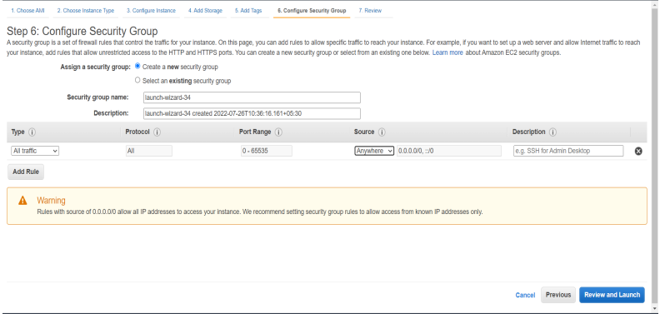

Slide 25
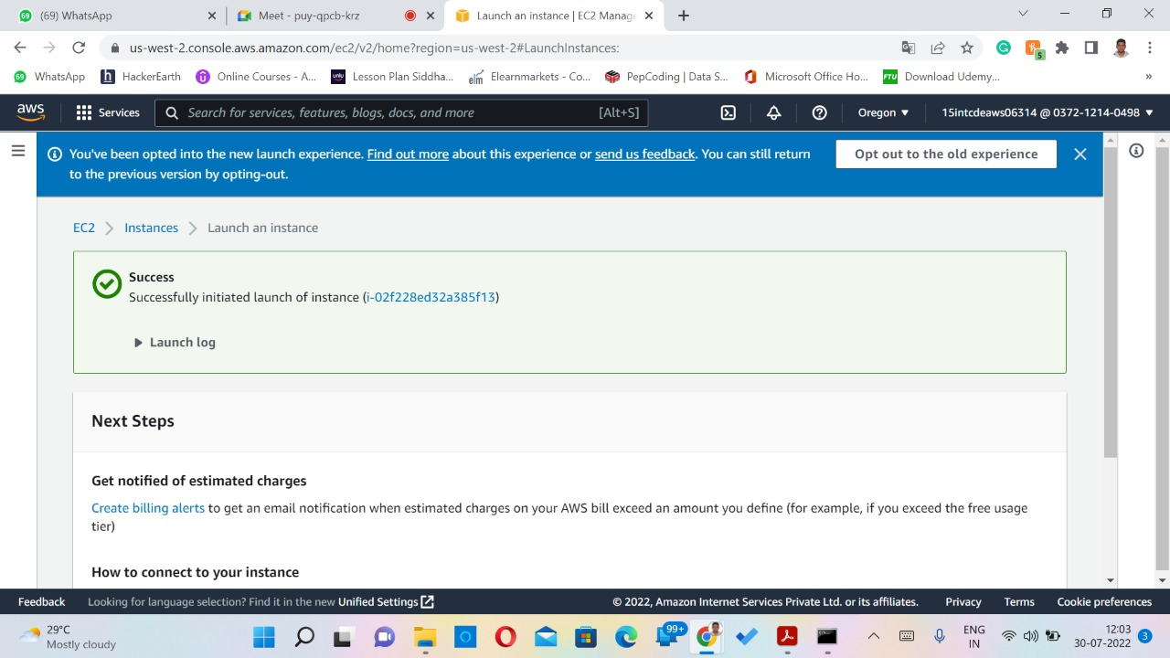

Slide 26
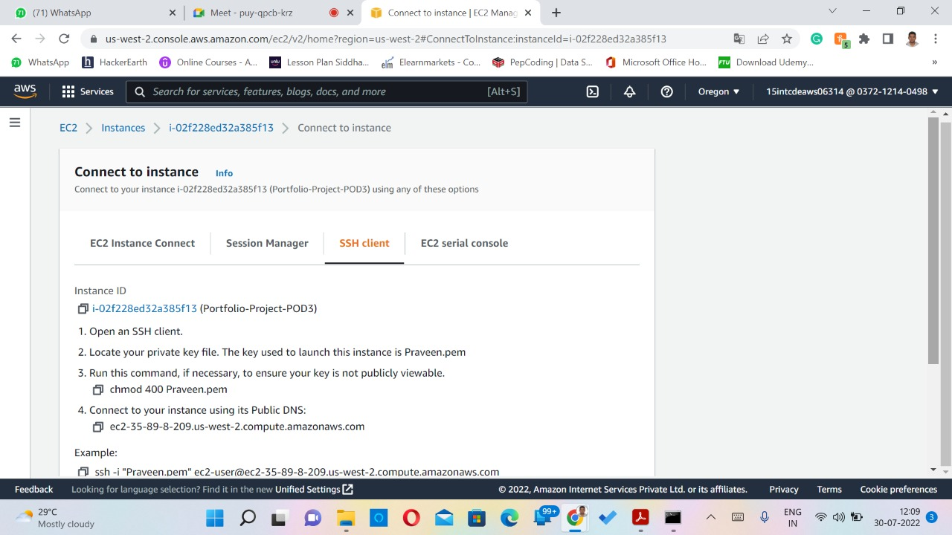
Connect EC2 to Instance:

Slide 27
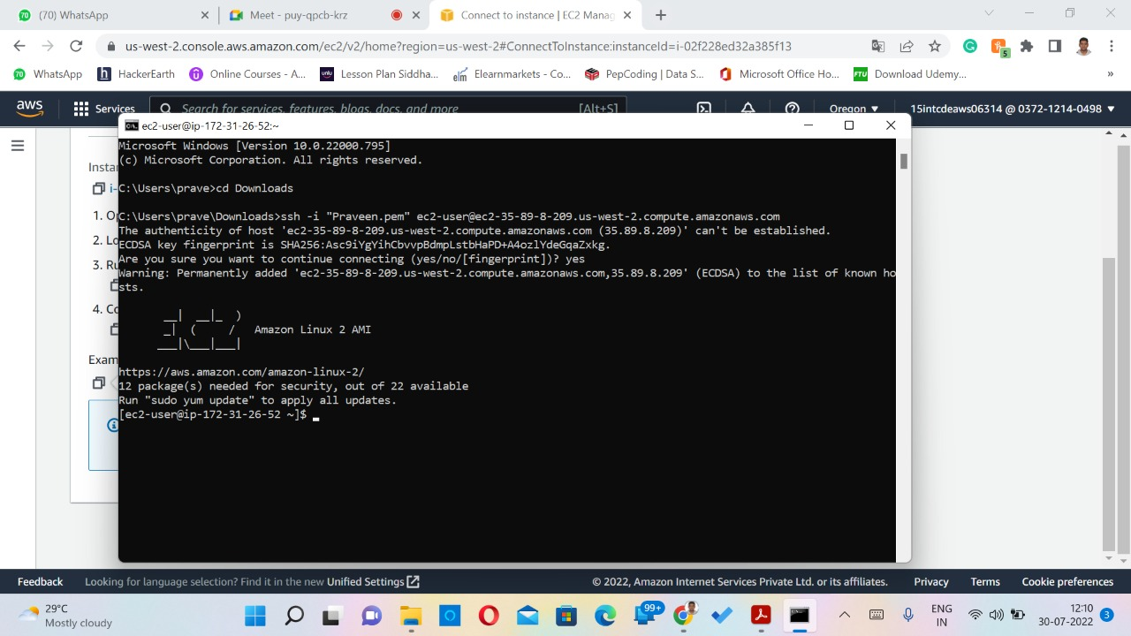
Connect EC2 to Instance:

Slide 28
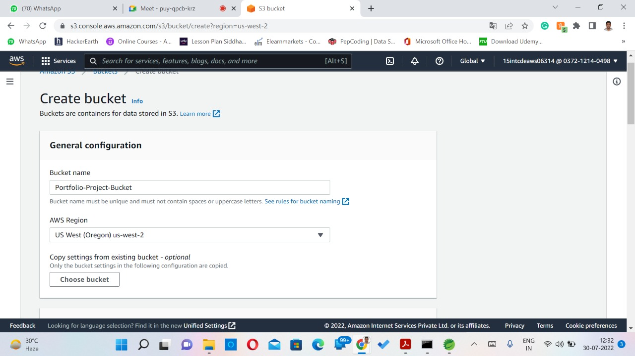
S3 Bucket Creation:

Slide 29
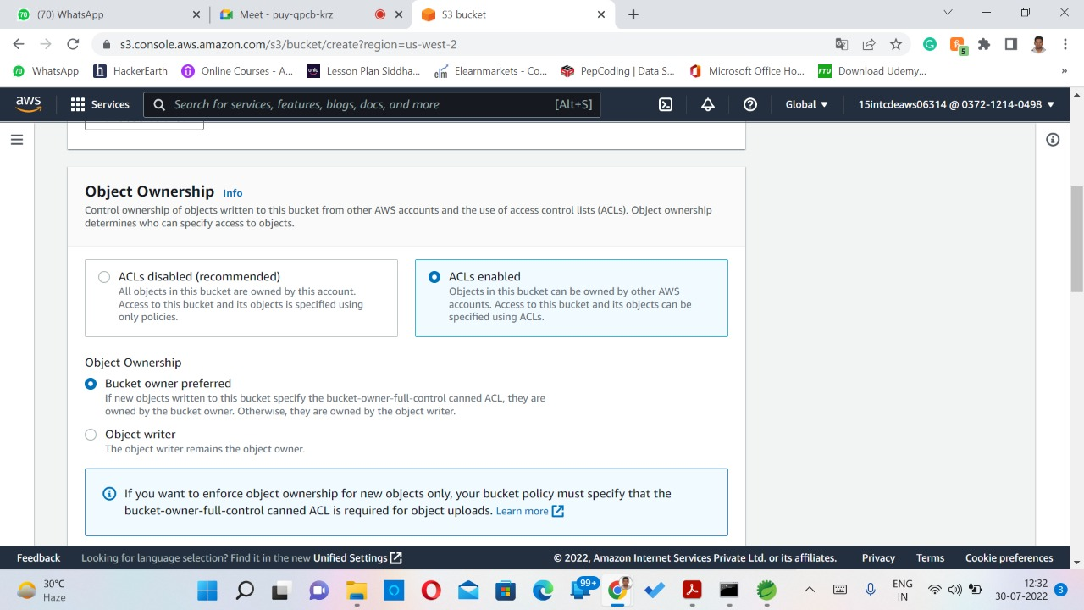
S3 Bucket Creation:

Slide 30
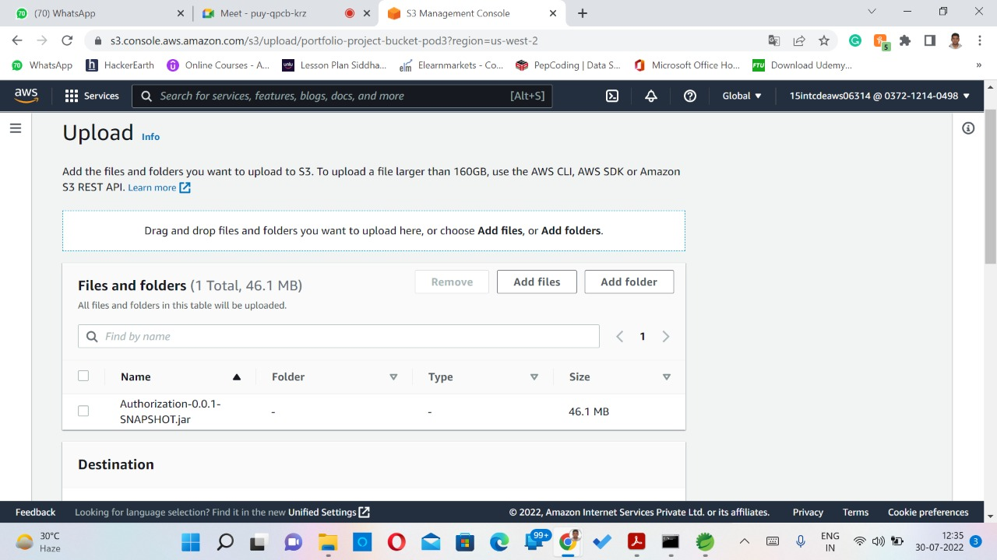
Upload jar File into S3 Bucket:

Slide 31
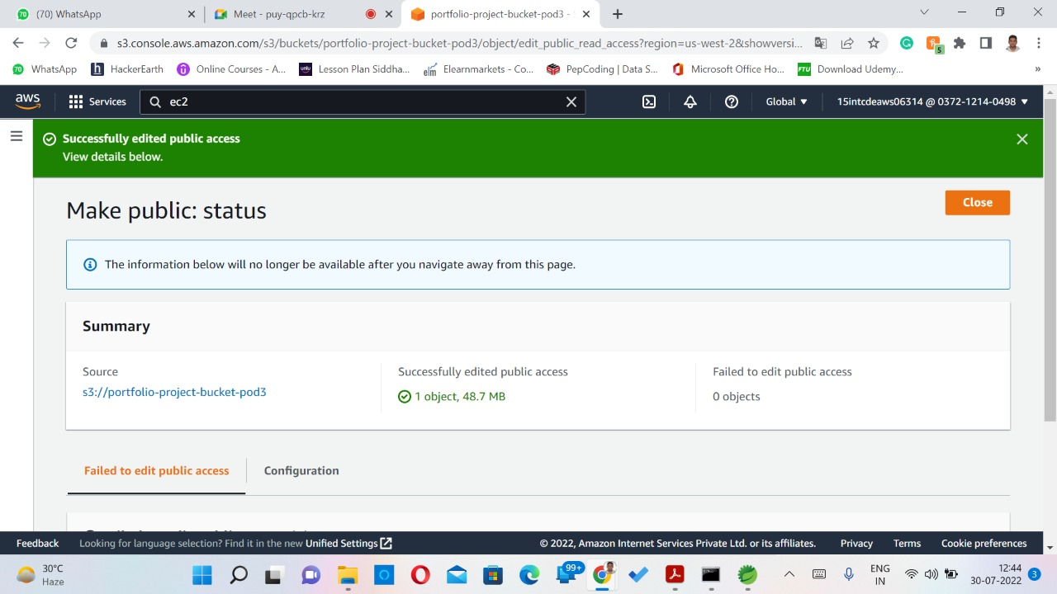
Make public access to each jar File:

Slide 32
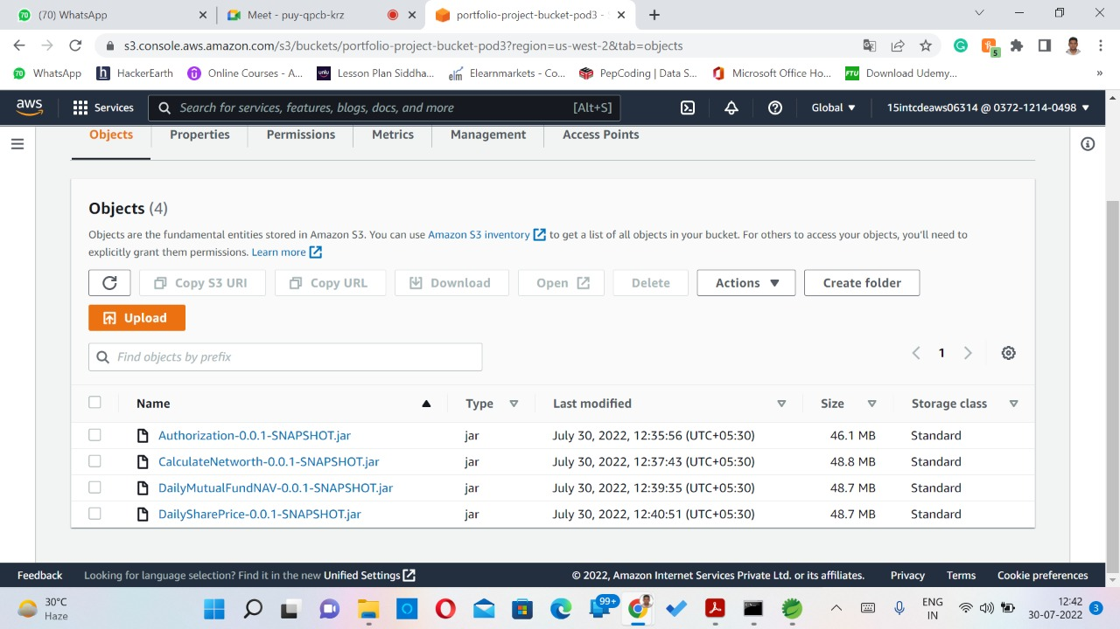
S3 Bucket -Objects:

Slide 33
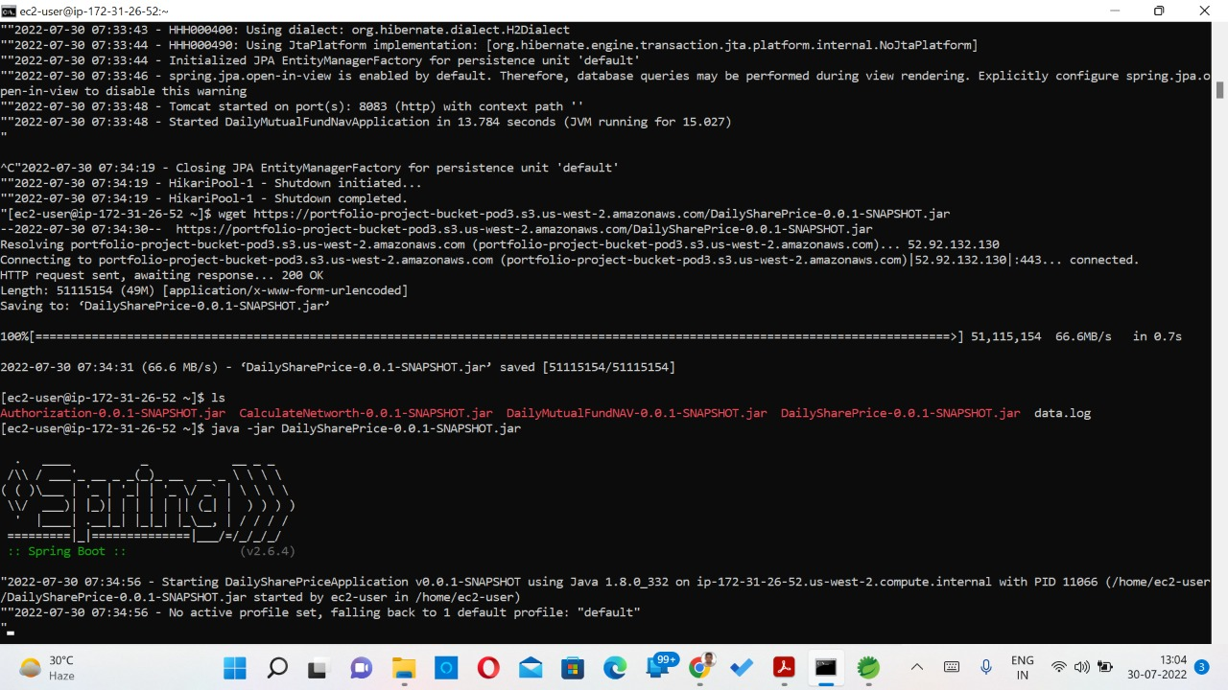
Connect Objects into S3 to EC2:

Slide 34
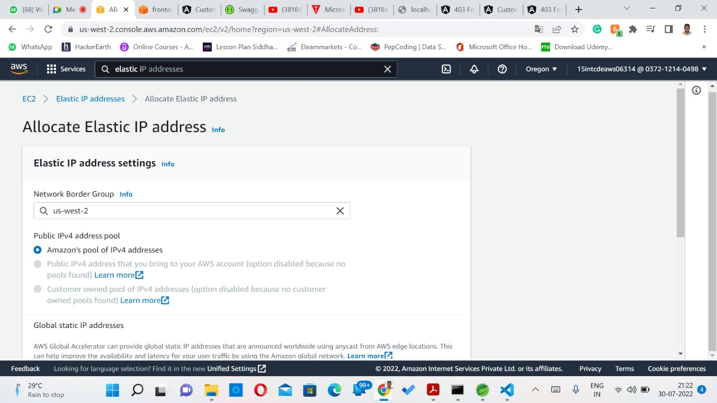
Elastic IP Address:

Slide 35
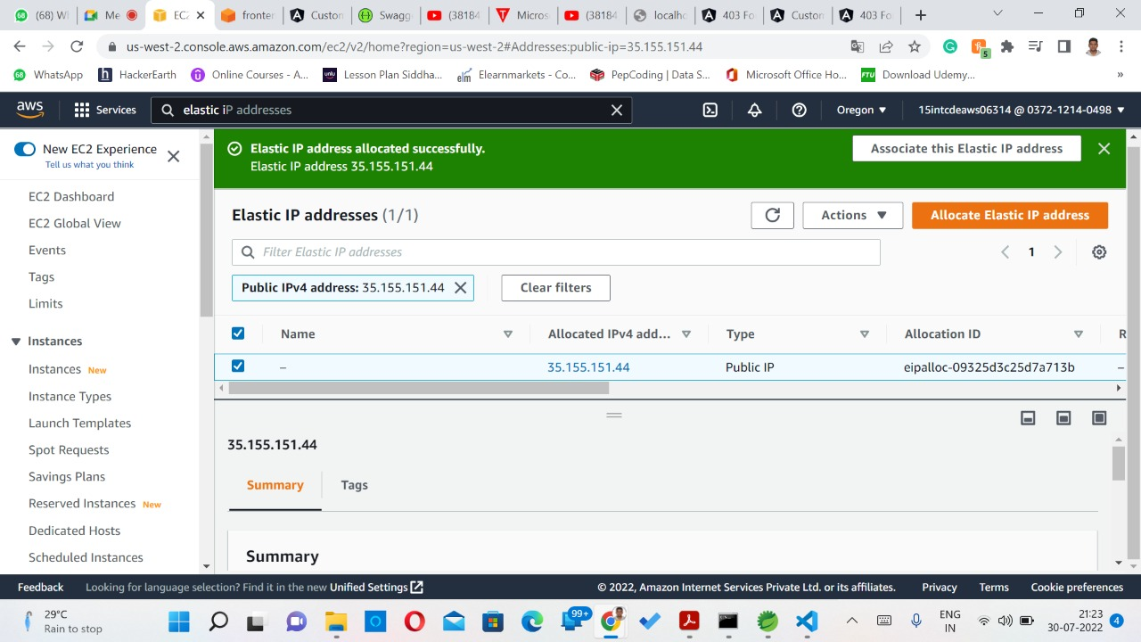
Elastic IP Address:

Slide 36
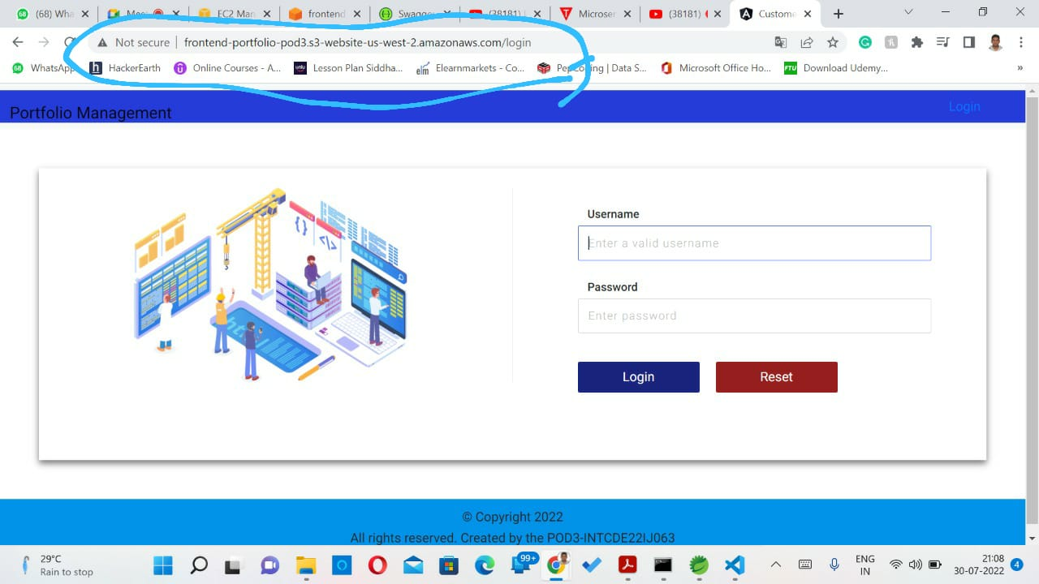
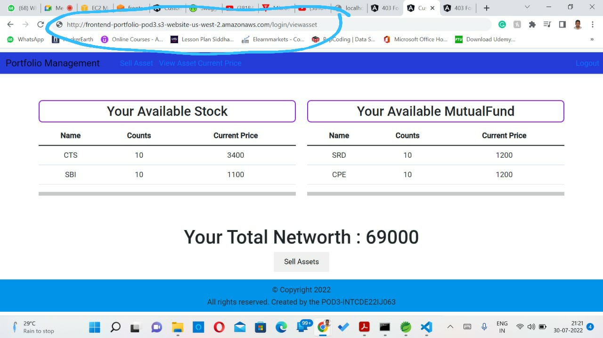
AWS Code Deploy:

Slide 37
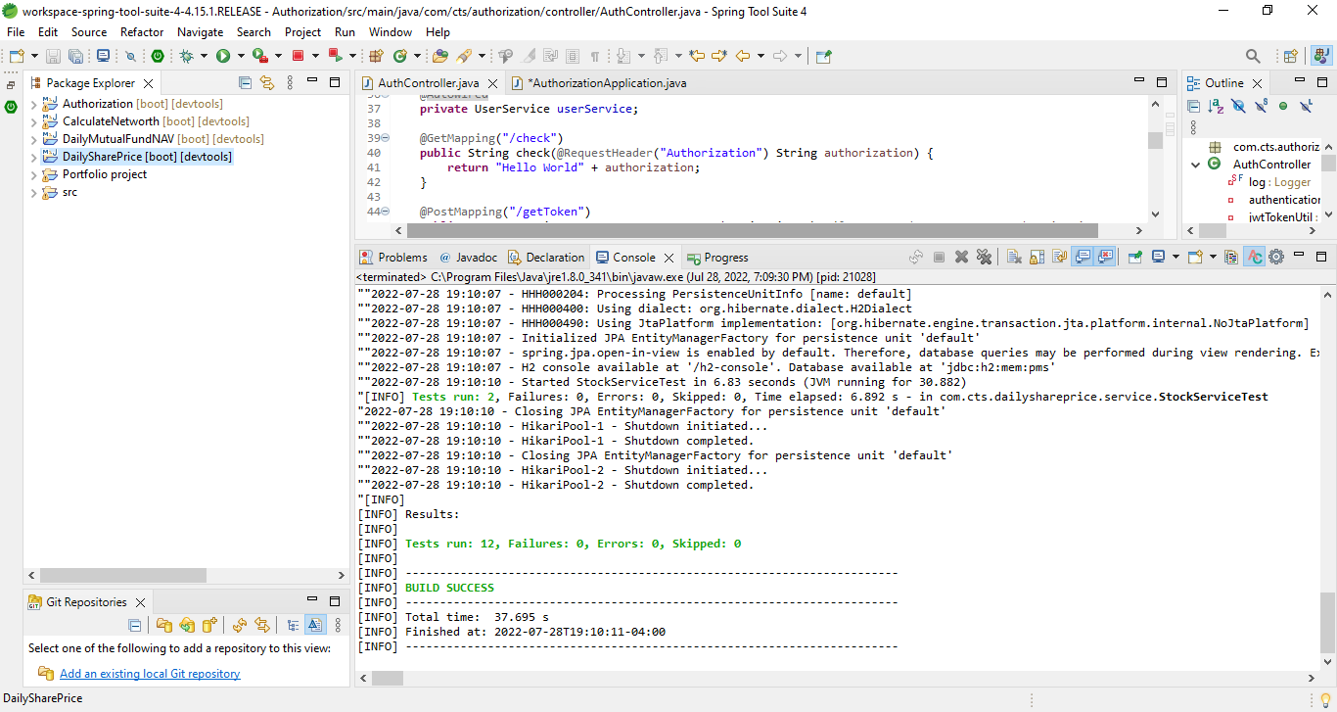
Unit testing:

Slide 38
Thank You ...!

