Slide 1
Sentiment Analysis on Amazon Fine Food Reviews
Goutham Thota
Jaya Surya Thota
Tejaswi Chintapalli

Slide 2
Introduction
A wide range of consumer reviews for various food products can be found in the Amazon Fine Food Reviews dataset, which is accessible on Kaggle.
Customer reviews have grown increasingly important as the number of people shopping online has increased.
This project aims to explore the dataset and gain insights into customer sentiment, trends, and patterns in the food industry.
Our goals include using machine learning models to predict or categorize reviews based on their sentiment or other characteristics, as well as doing EDA and sentiment analysis.
The findings of our investigation can assist entities to understand the preferences and viewpoints of their customers by giving them useful information.

Slide 3
Overview
Dataset
1
Exploratory Data Analysis
Data Transformation
2
Data Splitting
3
Model Building & Model Selection
4
Performance Evaluation
5
SAT5165

Slide 4
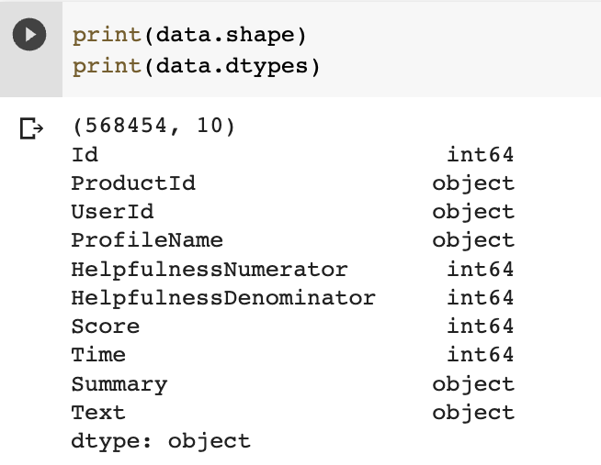
Data set
568454 rows, 10 columns
Dropped unnecessary columns
Text and Score are the columns
used
Text is independent variable
Score is the dependent variable

Slide 5
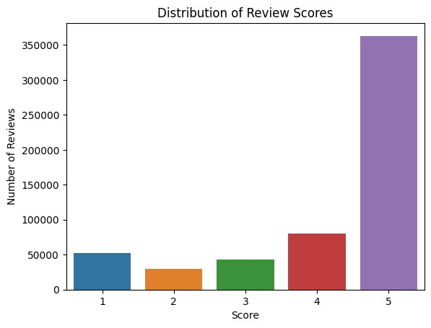
Target Variable
Name: Score
No of classes: 5
Name of classes: 1, 2, 3, 4, 5

Slide 6
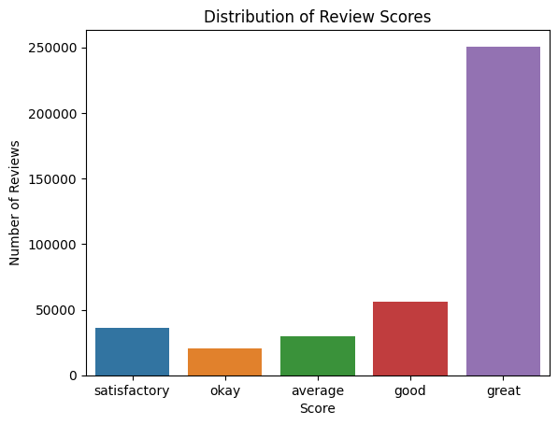
Target Category
Name: score
No of classes: 5
Name of classes: satisfactory, okay, average, good, great

Slide 7
5 classes
The data with 5 classes did not work because
Preprocessing takes a lot of time
3 data splits, train, validation and test
Hyper parameter tuning
Time complexity is too high

Slide 8
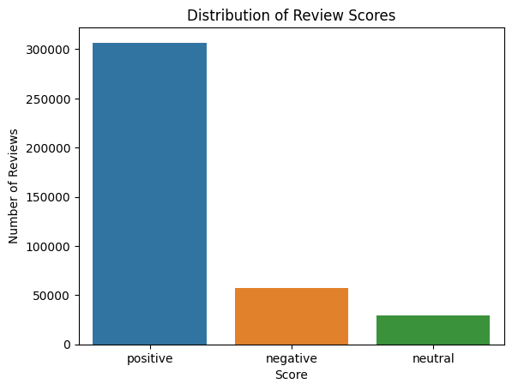
Target Category
Name: score
No of classes: 3
Name of classes: positive, neutral,
negative

Slide 9
3 classes
The data with 3 classes did not work because
3 data splits, train, validation and test
Hyper parameter tuning
logistic regression and Naive Bias ran successfully
Decision trees, Random Forest, and neural networks did not run

Slide 10

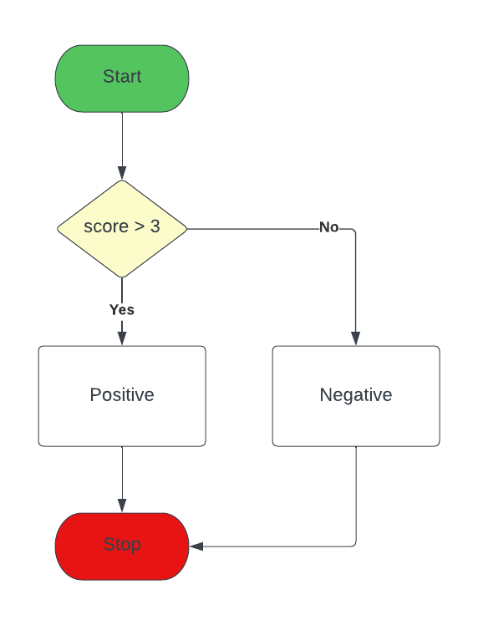
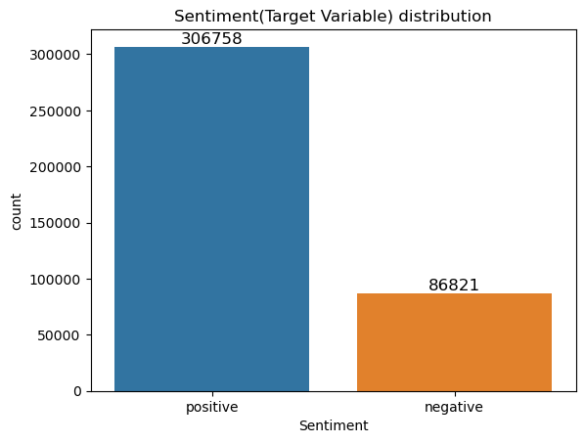
Data Preprocessing
Converting Score into Sentiment

Slide 11
Data Preprocessing
Drop duplicate
393579 rows, 2 columns
Convert the text into lower case
Removed numbers, special characters, stop words
Lemmatization

Slide 12
TF-IDF Vectorizer
TF-IDF stands for Term frequency-inverse document frequency
The term frequency is the number of times a word appears in a text
The inverse document frequency is a measure of how much information a word provides across the collection of texts.
Convert data into numeric values
Gives the rank of word in the text

Slide 13
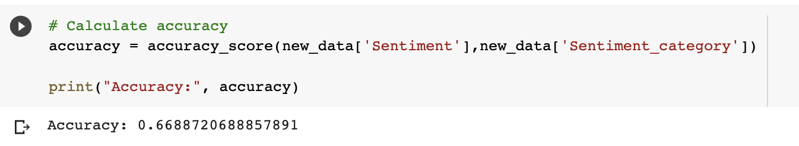
Model Building
Pre-trained model:
Sentiment Intensity Analyser from Vader
Accuracy: 66%

Slide 14
Classification models
The project tested the following different models, to identify the best model for Sentiment Analysis.
Decision Tree
Random forests
Multinomial Naive Bayes
Logistic Regression
SAT5165

Slide 15
Data Splitting
70% training
15% validation
15% testing
Stratified random sampling

Slide 16
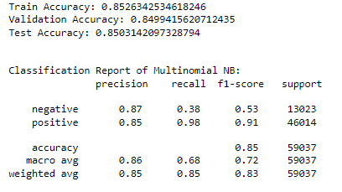
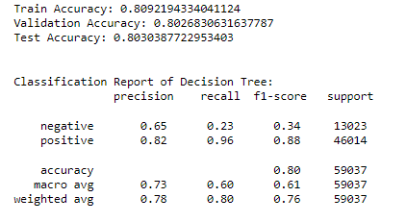
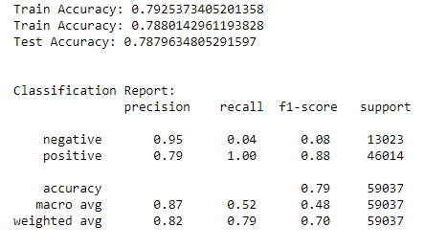
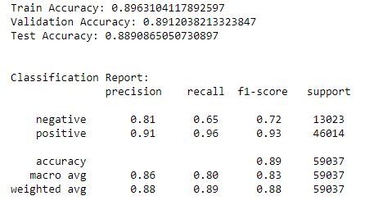
Results - Classification Reports
Multinomial Naive Bayes
Decision Tree
Logistic Regression
Random Forest

Slide 17
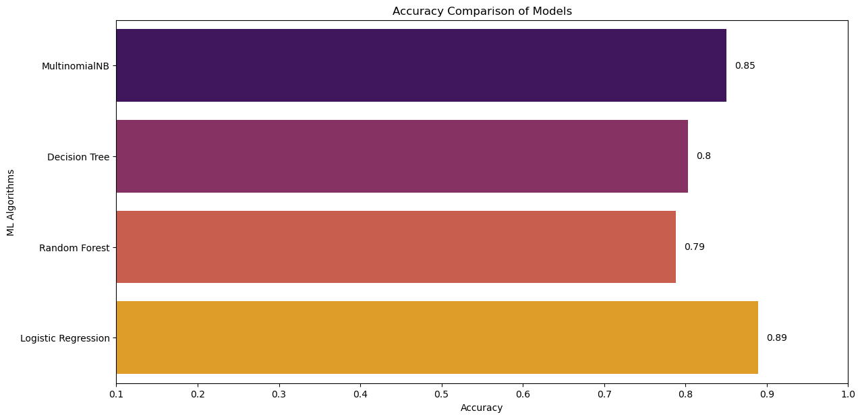
Results - Accuracy Plot

Slide 18
References
https://www.kaggle.com/code/varadahirwadkar/starter-amazon-fine-food-reviews-503caf78-5
https://en.wikipedia.org/wiki/Tf%E2%80%93idf
https://www.analyticsvidhya.com/blog/2021/06/vader-for-sentiment-analysis/

