Slide 1


IMPLEMENTATION OF 4-BIT VEDIC MULTIPLIER USING N-P BASED ECRL ADIABATIC LOGIC
GAYATRI VIDYA PARISHAD COLLEGE OF ENGINEERING (A) Madhurawada,
Visakhapatnam 530048
Presented by
PONNAMANDA TEJASWI(18131A04G3)
PILLALA LIKHITHA(18131A04F9)
REPAKA HARSHITH(18131A04H1)
KORAKULA SANTOSH KUMAR(17131A04C0)
UNDER THE ESTEEMED GUIDANCE OF
Sri. Sagara Pandu
Assistant Professor,
ECE Department

Slide 2
CONTENTS
Abstract
Objectives
Introduction
Adiabatic Logic-ECRL
Proposed N-P based ECRL Adiabatic logic
Multiplier
Vedic Multiplier
Software Used
Implementation of 4X4 Vedic Multiplier using ECRL logic
Implementation of Logic circuits using N-P based ECRL Logic
Performance Evaluation
Conclusion and Future scope
References

Slide 3
ABSTRACT
In current scenario, Low power VLSI design methodology is playing an important role because the low power devices require lesser heat sinks hence lesser area which is a cost-effective process.
This method of implementing low power circuits has some considerable tradeoff with “delay” parameter. By keeping this in mind, we have designed a 4X4 Vedic multiplier using N-P based ECRL Adiabatic Logic with an aim of reducing its power dissipation .
As power dissipation and delay are two opposing parameters we have reduced the power dissipation to 28.30 % when compared with existing 4X4 Vedic Multiplier based ECRL at the expense of delay.

Slide 4
OBJECTIVES
The objective of the project is to implement the 4-BIT Vedic multiplier using N-P Based ECRL Adiabatic Logic For low power dissipation.
To simulate and synthesize Vedic multiplier using CADENCE Virtuoso 90nm CMOS Technology.
To compare Existing Vedic multiplier with proposed Vedic Multiplier in terms of Power.

Slide 5
INTRODUCTION
During the past decades CMOS was responsible for creating low power equipment. Though CMOS technology provides circuits with very low static power dissipation, during the switching operation currents are generated, due to the discharge of load capacitances, which cause power dissipation increasing with the clock frequency. Power dissipation in CMOS can be reduced by decreasing the terminal capacitance value and by reducing the voltage supply. This results in low performance of device.
The Adiabatic technique prevents such losses. Hence Adiabatic logic is proposed for low power consumption in later researches. Efficient charge recovery logic (ECRL) is one of the standard logic styles investigated from Adiabatic logic. It is observed that ECRL has a voltage drop problem and increase in delay. Therefore, N-P based ECRL logic is proposed to overcome the disadvantages of ECRL Adiabatic logic.

Slide 6
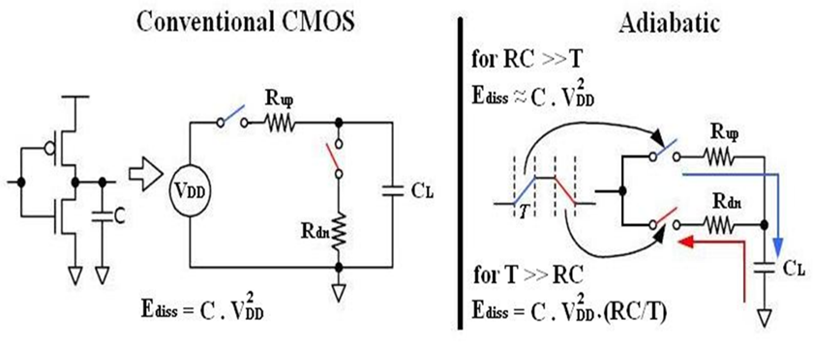
Principle of CMOS and Adiabatic logic circuits
Fig.1. Principle of CMOS and Adiabatic Logic Circuits

Slide 7
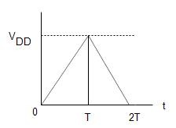
Mathematical expressions for power reduction in Adiabatic logic circuits
Energy dissipation in CMOS circuits: T=2RC
➔E_{diss}=(1/2)*CV_{dd}²…..(1) Energy dissipation in Adiabatic circuits: T>2RC
➔ here ramp voltage Time period is 2T ➔ E_{diss}=(RC/2T) *CV_{dd}²
➔ E_{diss}=(RC/4RC)*CV_{dd}²➔ E_{diss}=(1/4)*CV_{dd}^{2.}...........(2)
Fig.2.Triangular Supply of One Time Period .
Hence Total time period of one triangular Supply=T_{on}+ T_{off}+ T_{rise}+ T_{fall}
As power dissipation P_{diss}=Ediss/T ➔P_{diss}=C.V_{dd}². f
Therefore, by eq(1) & (2) we can say
P_{diss} in Adiabatic <P_{diss} in CMOS

Slide 8
ECRL-Efficient Charge Recovery Logic
Efficient Charge Recovery Logic (ECRL) uses cross-coupled PMOS transistors.
It has the structure similar to Cascode Voltage Switch Logic (CVSL) with differential signaling. It consists of two cross-coupled transistors M1 and M2 and two NMOS transistors .
AC power supply PWRC is used for ECRL gates, so as to recover and reuse the supplied energy. Both out and outbar are generated so that the power clock generator can always drive a constant load capacitance independent of the input signal .
That is, to say, ECRL always pumps charge on the output with a full swing. However, as the voltage on the supply clock approaches.

Slide 9
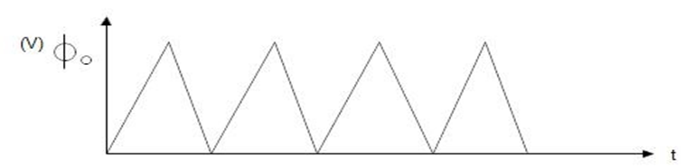
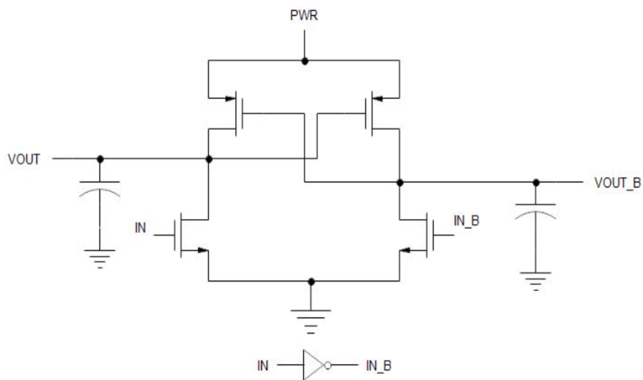
Energy reuse in Adiabatic ECRL
ECRL saves energy by returning delieverd energy back to the supply.
The AC power supply is needed to efficiently restore the charge. Therefore we use Triangular supply here.
In ECRL inverter When Input is “1” and during rising edge of triangular supply NMOS will be turned ON .Since NMOS ON capacitor charges to 50% of supply power . Now capacitor will discharges for falling edge of triangular supply hence PMOS will turn ON.
During discharging process the ECRL logic saves some part of the energy for every cycle and reuses it.
Fig.3.PWRC supply
Fig.4.ECRL inverter

Slide 10
Disadvantages of ECRL Adiabatic logic
1.The delay will get increased if the rise time and fall time of the power supply is increased.
2. The ECRL logic reduces the power dissipation at the expense of delay.
3. It has voltage drop problem.
4. The gate count increases for every logic circuit that is implemented using this technique
So, to overcome all these demerits of ECRL logic to some extent, the transmission gate logic has been proposed.

Slide 11
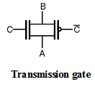
Proposed N-P Based ECRL Adiabatic Logic
Transmission Gate Logic :
The Transmission gate Logic is used to solve the voltage drop problem of the Pass Transistor Logic.
This technique uses the complementary properties of NMOS and PMOS transistors. i.e. NMOS devices passes a strong '0' but a weak '1' while PMOS transistors pass a strong '1' but a weak '0’.
The transmission gate combines the best of the two devices by placing an NMOS transistor in parallel with a PMOS transistor as shown in Figure below
Fig.5.Transmission gate symbol

Slide 12
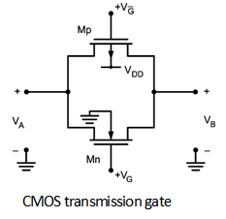
BASIC STRUCTURE OF TRANSMISSION GATE
The basic structure of transmission gate is shown in Figure below which consists of NMOS and PMOS transistors. Here, VG is applied to NMOS, and (VDD- VG) applied to the PMOS.
The transmission gate work voltage-controlled switch. When VG is high, NMOS and PMOS are conducting hence switch is closed. Therefore, conduction path between left and right sides exist.
When VG is low, then the MOSFETs are in cutoff and switch is open. Therefore, there is no direct relationship between VA and VB.
Fig.6.CMOS TG

Slide 13
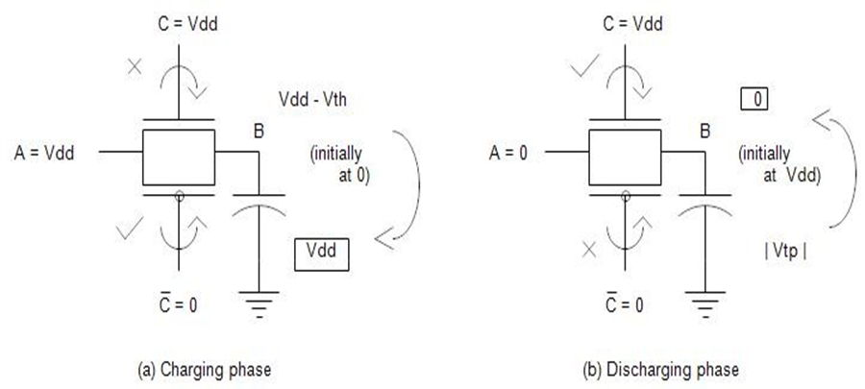
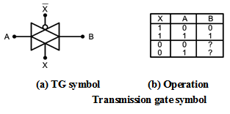
Transmission gate Operation:
Fig.8.Truth table of TG
Fig.7. Principle of Transmission gate

Slide 14
ADVANTAGES OF TRANSMISSION GATE
Complex gates can be implemented using minimum number of transistors, which also reduces parasitic.
The combination of both an PMOS and NMOS in Transmission Gate arrangement avoids the problem of reduced noise margin, increase switching resistance and increased static power dissipation (caused by increased Threshold Voltage), but requires that the control and its complement be available.

Slide 15
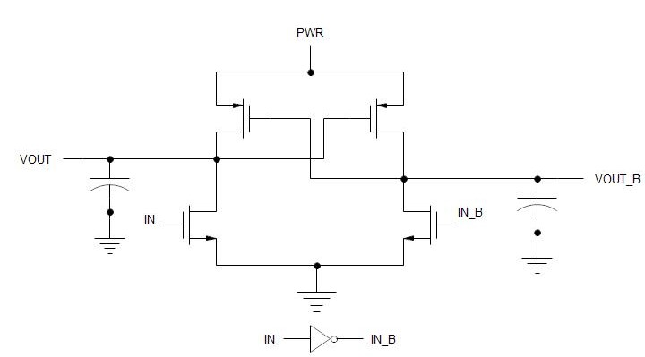
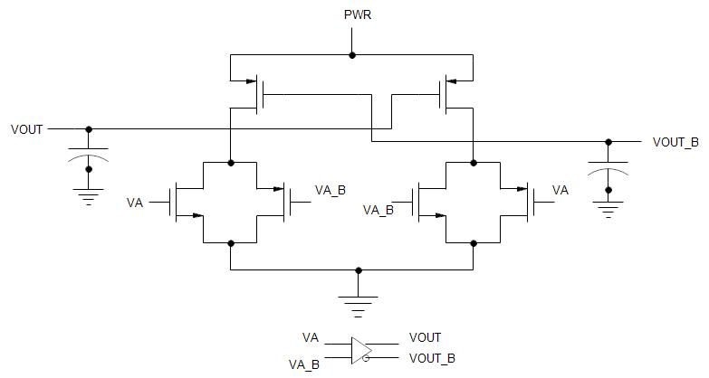
ECRL inverter Vs N-P Based ECRL inverter
Fig.9.ECRL Inverter
Fig.10. N-P Based ECRL Inverter

Slide 16
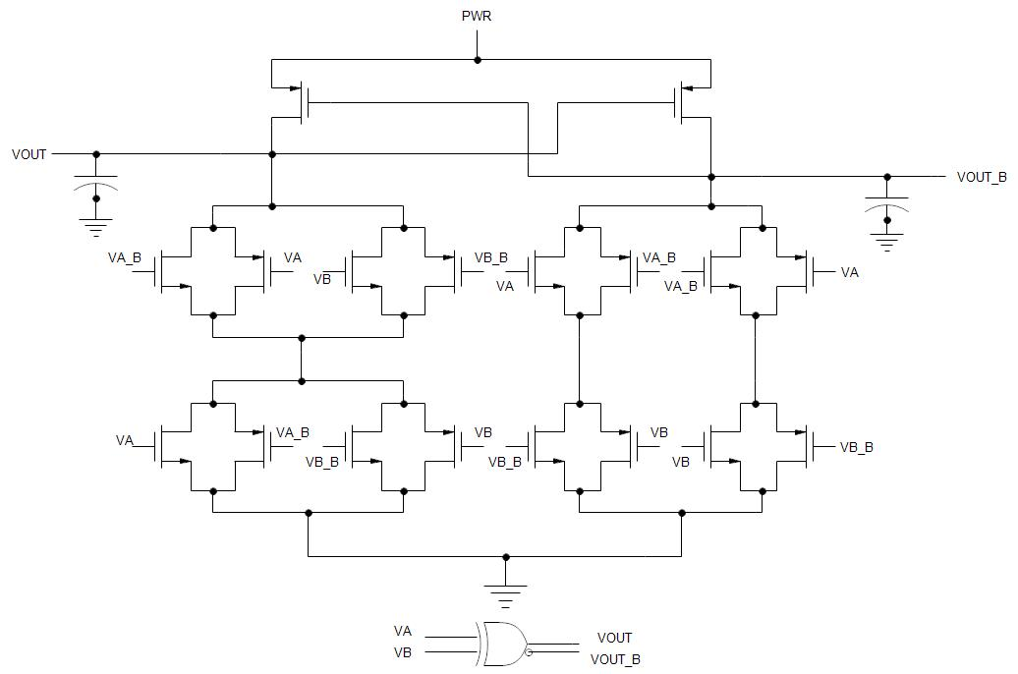
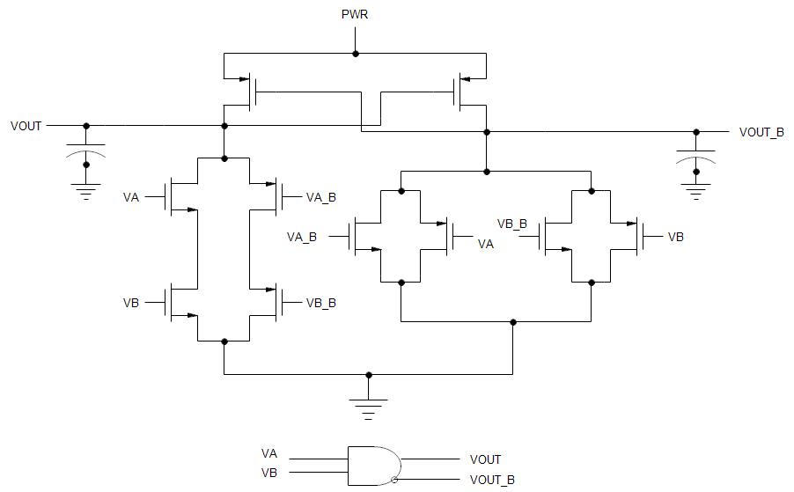
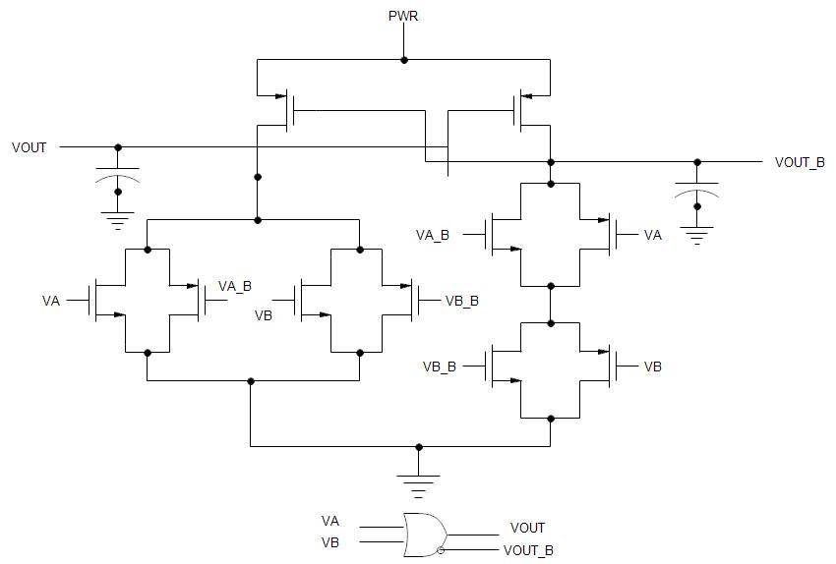
Implementation of basic gates using N-P Based ECRL Adiabatic logic
Fig.11.N-P Based ECRL OR-NOR GATE
Fig.12.N-P Based ECRL AND-NAND
Fig.13.N-P Based ECRLXOR-XNOR gate

Slide 17
MULTIPLIER
Multipliers plays an important role in many computation systems
Multipliers in VLSI require more hardware resources and more processing time and are used in Digital Processing Systems.
There are many researches in multiplier that result in reducing the power and thereby, causing delay. Generation of partial products in multipliers may result in large power consumption

Slide 18
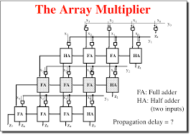
ARRAY MULTIPLIER
GENERAL N-bit ARRAY MULTIPLIER
FULL ADDERS:N^2
HALF ADDERS:2N
AND GATES:4N^2+2N
OR GATES :N^2
Fig.14. Block Diagram of Array Multiplier

Slide 19
VEDIC MULTIPLIER
The Vedic Multiplier is one of the fastest multiplier.
The structure of Vedic Multiplier is Vertical & Crosswise.
Since the partial products and their sum are calculated in Parallel, it generates all partial products and their sum in one step.
Here since the generation of partial products and their sum are calculated in parallel (that is together), the multiplier is independent of clock frequency of the processor.

Slide 20
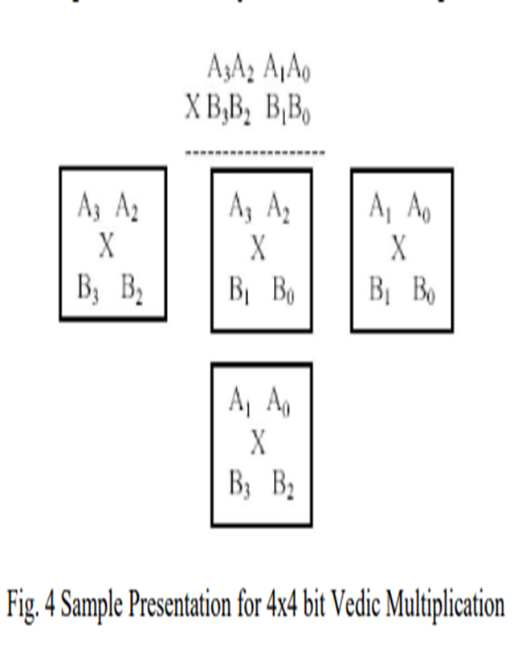
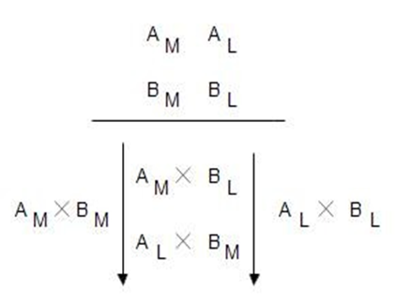
VEDIC MULTIPLICATION
Fig.15. General representation for Vedic multiplication
Fig.16. 4X4 vedic multiplication

Slide 21
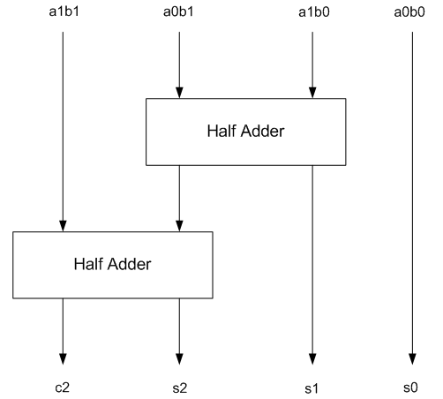
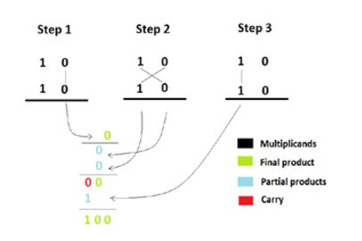
2x2 VEDIC MULTIPLIER
Fig.17. 2x2 Vedic Multiplier block diagram
Fig.18. Example of 2x2 Vedic Multiplier

Slide 22
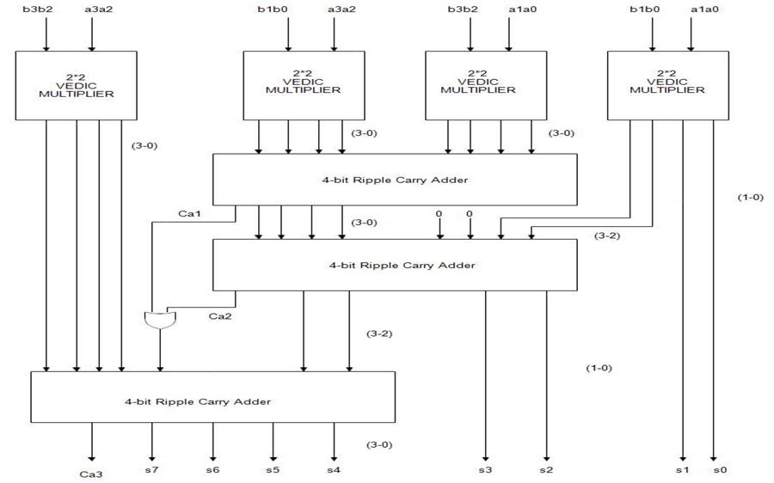
4X4 VEDIC MULTIPLIER
Fig.19. BLOCK DIAGRAM OF 4X4 VEDIC MULTIPLIER

Slide 23
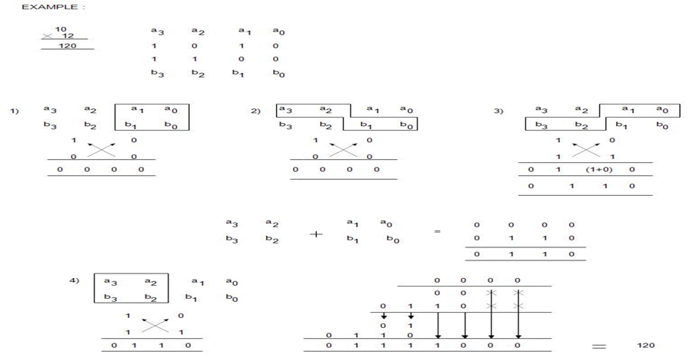
4x4 vedic multiplier
Fig.20. Example for 4x4 Vedic multiplication

Slide 24
SOFTWARE USED
Software used for Simulation & Synthesis :
CADENCE VIRTUOSO 90nm CMOS Technology
The Cadence Virtuoso System Design Platform links two world class Cadence technologies—custom IC design and package/PCB design/analysis—creating a holistic methodology that automates and streamlines the design and verification flow for multi-die heterogeneous systems. Leveraging the Virtuoso Schematic Editor and the Virtuoso Analog Design Environment, it provides a single platform for IC-and package/system-level design capture, analysis, and verification. In addition, the Virtuoso System Design Platform provides an automated bidirectional interface with the Cadence Sip-level implementation environment and Clarity 3D solver

Slide 25
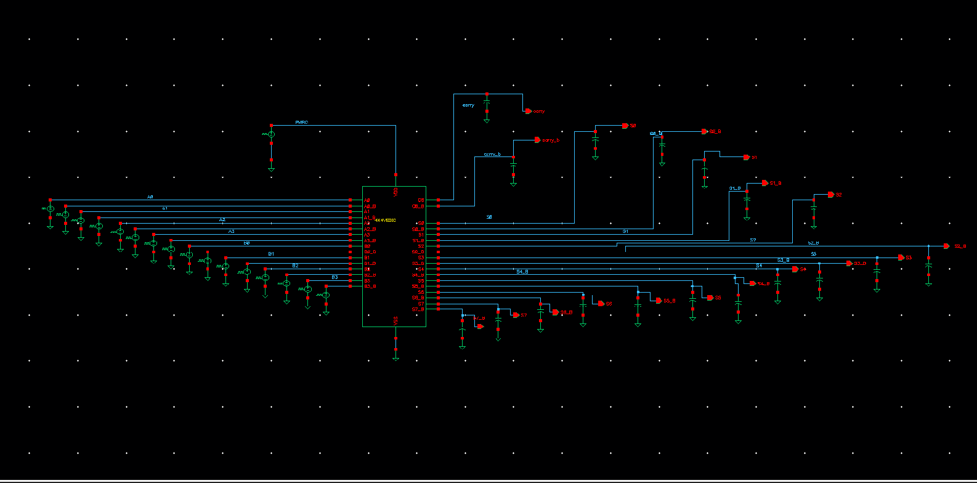
Fig.21. ECRL 4X4 VEDIC MULTIPLIER
IMPLEMENTATION OF 4X4 VEDIC MULTIPLIER BY EXISTING ECRL USING CADENCE

Slide 26
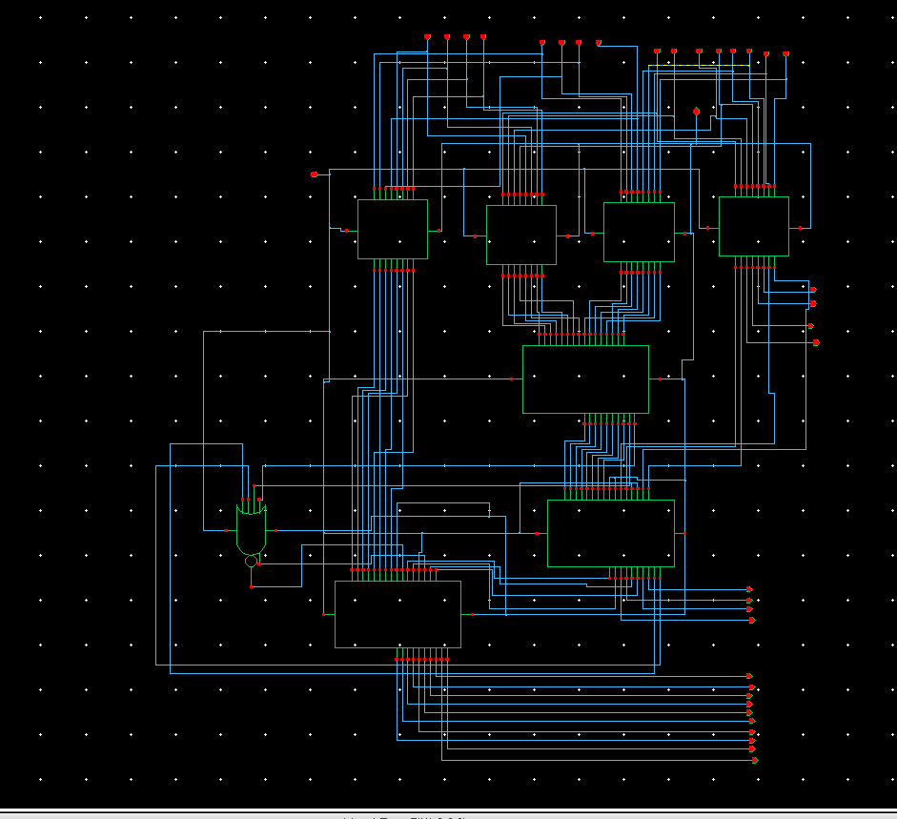
SCHEMATIC OF 4X4 VEDIC MULTIPLIER USING ECRL
Fig.22 Schematic of ECRL 4X4 VEDIC MULTIPLIER

Slide 27
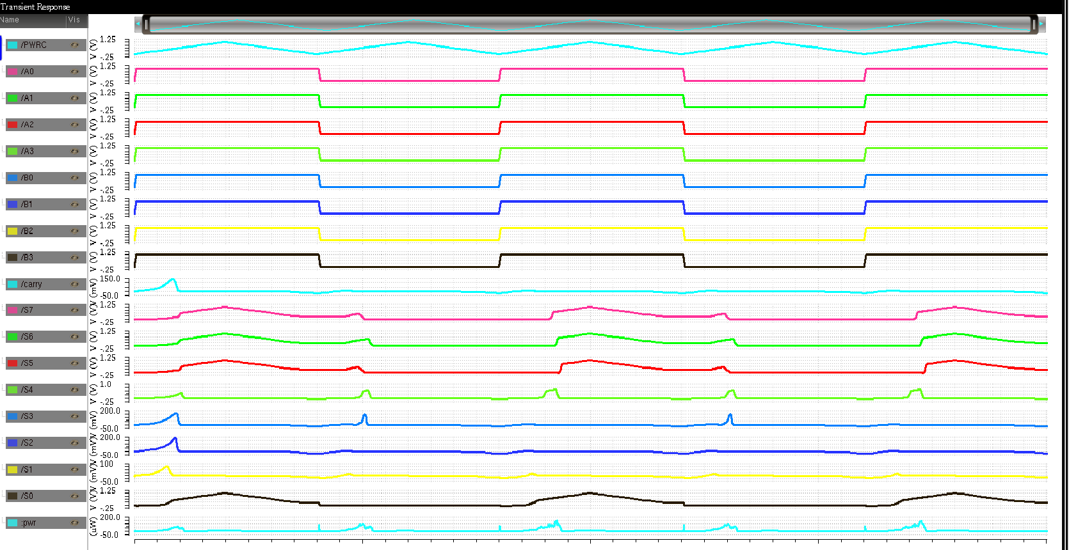
SIMULATION RESULTS OF 4X4 VEDIC MULTIPLIER Using ECRL
Fig.23.simulation results of ECRL-4X4 VEDIC MULTIPLIER

Slide 28
IMPLEMENTATION OF LOGIC CIRCUITS BY N-P BASED ECRL ADIBATIC LOGIC USING CADENCE

Slide 29
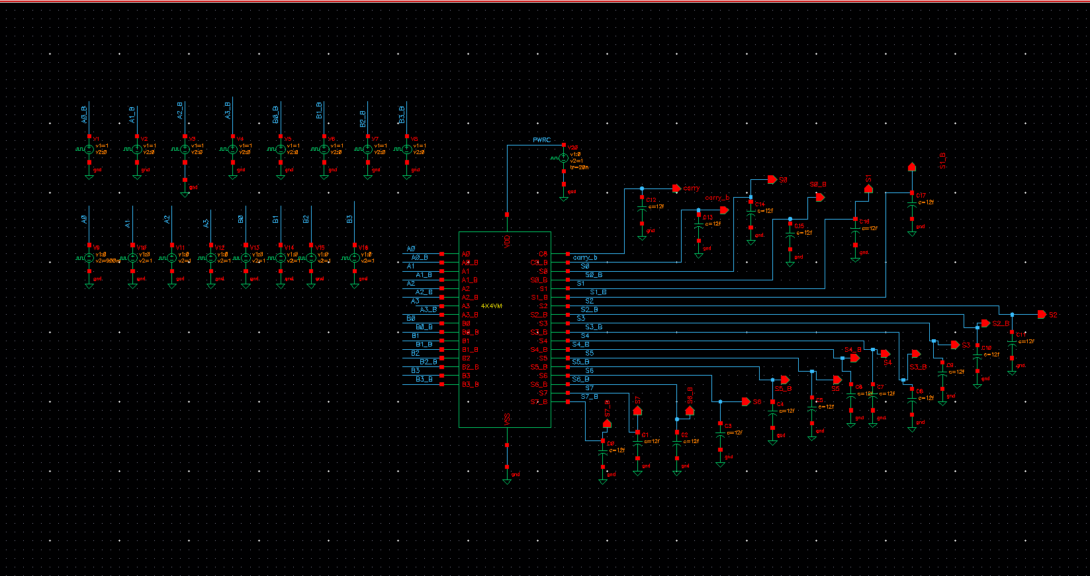
N-P Based ECRL 4X4 VEDIC MULTIPLIER
Fig.24. N-P Based ECRL 4X4 VEDIC MULTIPLIER

Slide 30
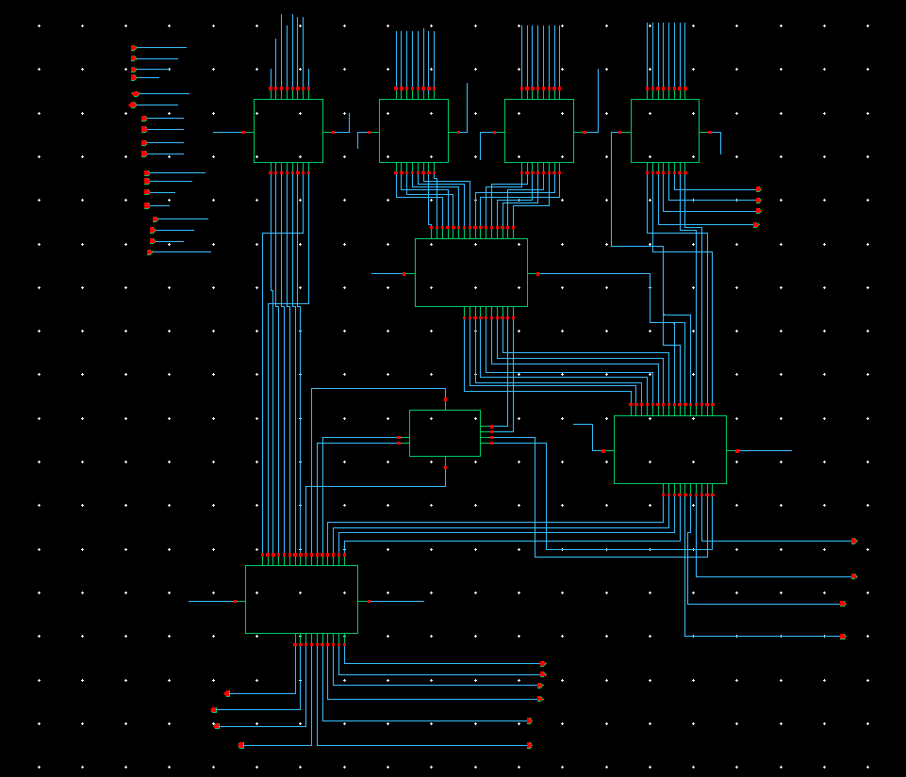
Schematic of N-P Based ECRL4X4 VEDIC MULTIPLIER
Fig.25. Schematic of ECRL 4X4 VEDIC MULTIPLIER

Slide 31
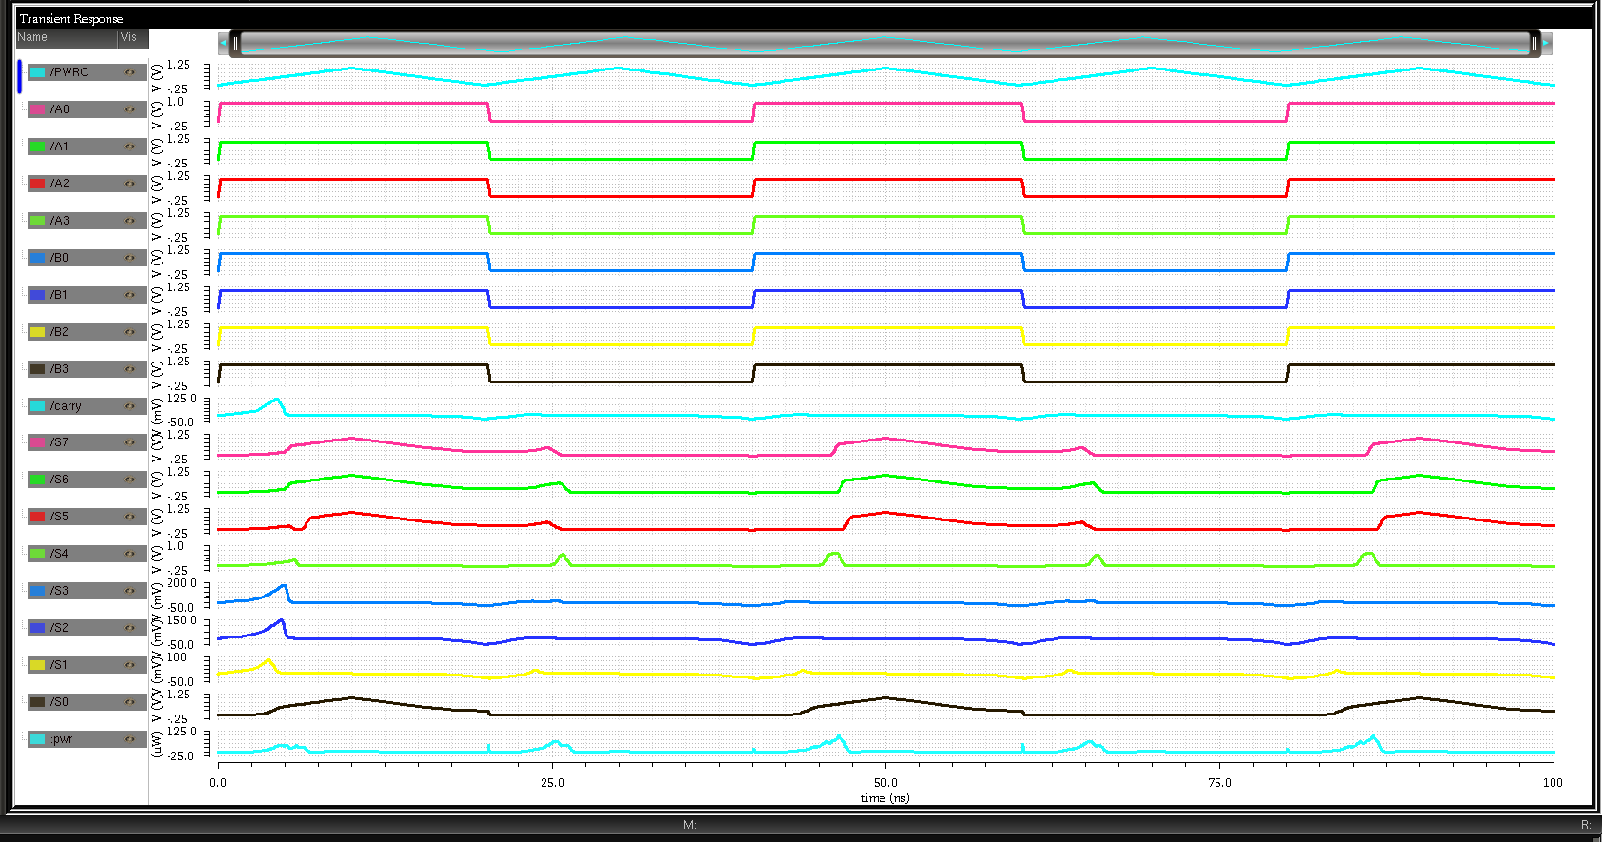
Simulation results of N-P Based ECRL 4X4 VEDIC MULTIPLIER
Fig.26.simulation results of N-P Based ECRL-4X4 VEDIC MULTIPLIER

Slide 32
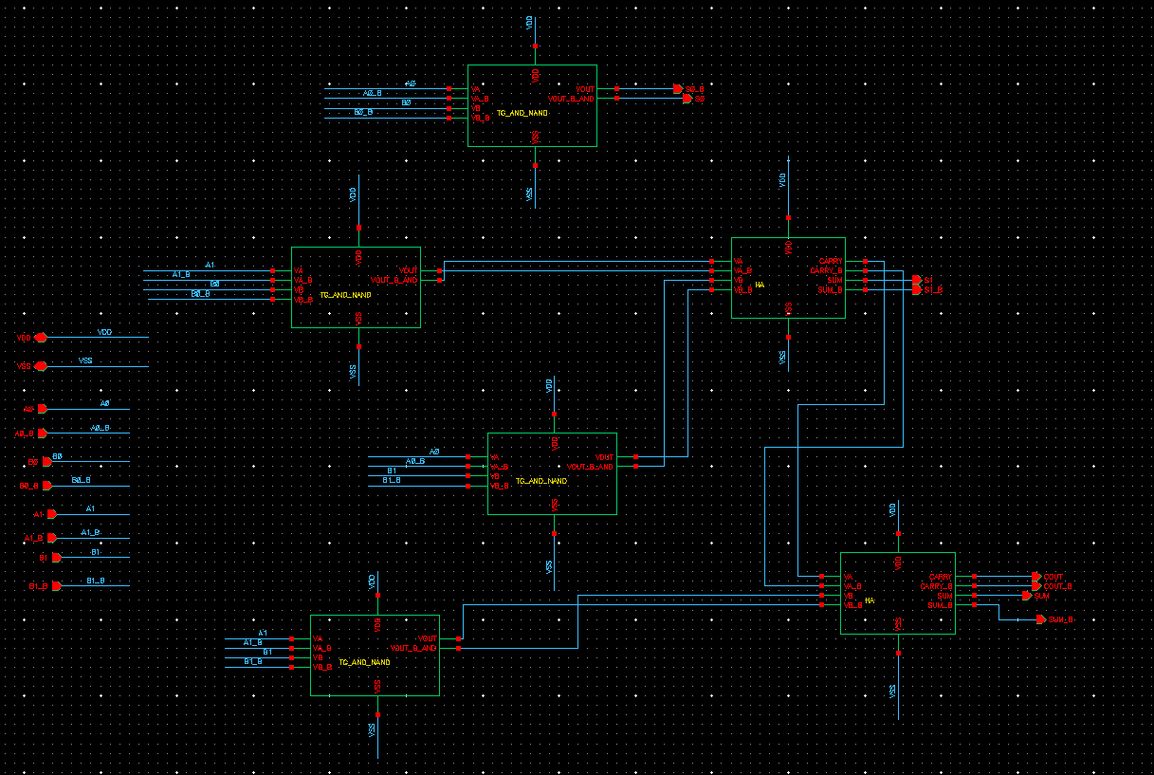
Schematic of N-P Based ECRL 2x2 VEDIC MULTIPLIER
Fig.27.Schematic of N-P Based ECRL 2X2 VEDIC MULTIPLIER

Slide 33
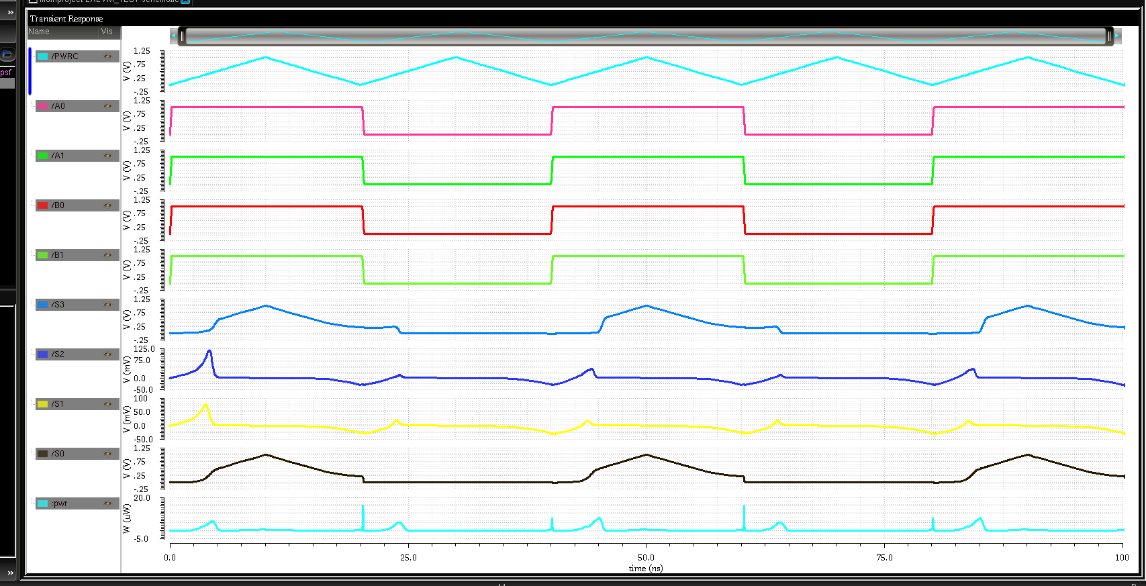
Simulation results of N-P Based ECRL 2X2 VEDIC MULTIPLIER
Fig.28.simulation results of N-P Based ECRL 2X2 VEDIC MULTIPLIER

Slide 34
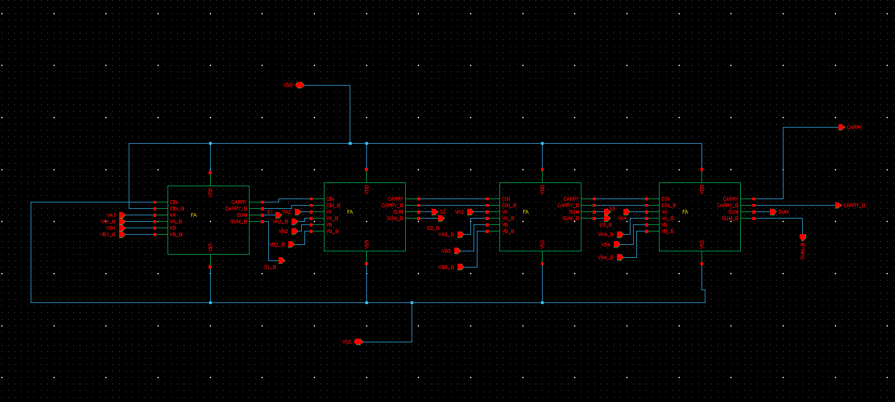
Schematic of N-P Based ECRL Ripple Carry Adder
Fig.29. Schematic of N-P Based ECRL Ripple Carry Adder

Slide 35
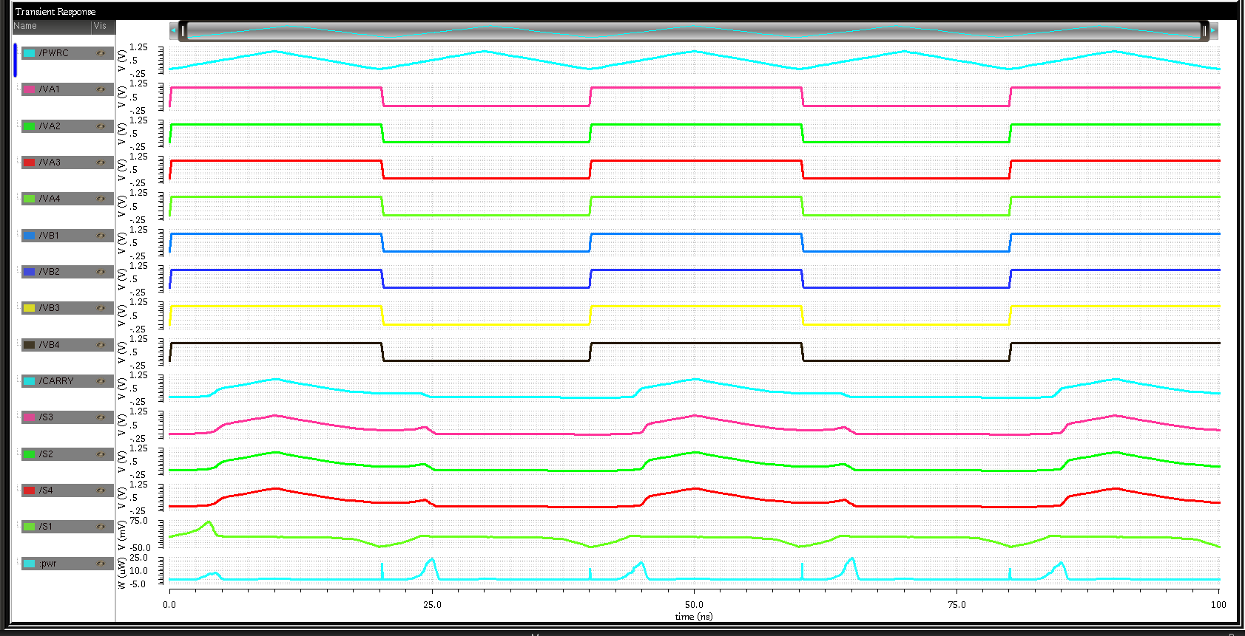
Simulation results of N-P Based ECRL Ripple Carry Adder
Fig.30.simulation results of N-P Based ECRL Ripple Carry Adder

Slide 36
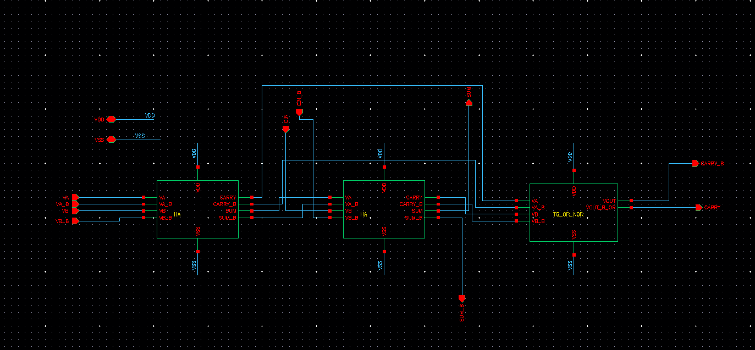
Schematic of N-P Based ECRL Full Adder
Fig.31.Schematic of N-P Based ECRL Full Adder

Slide 37
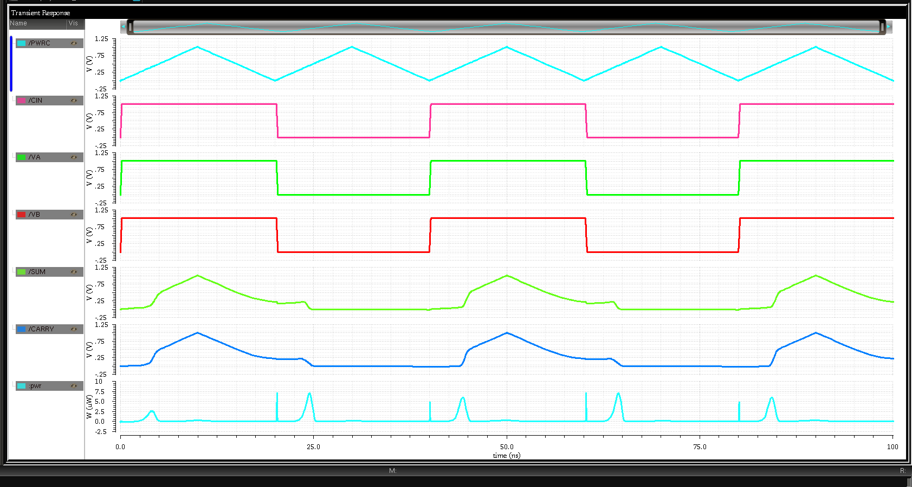
Simulation results of N-P Based ECRL Full Adder
Fig.32.Simulation result of N-P Based ECRL Full Adder

Slide 38
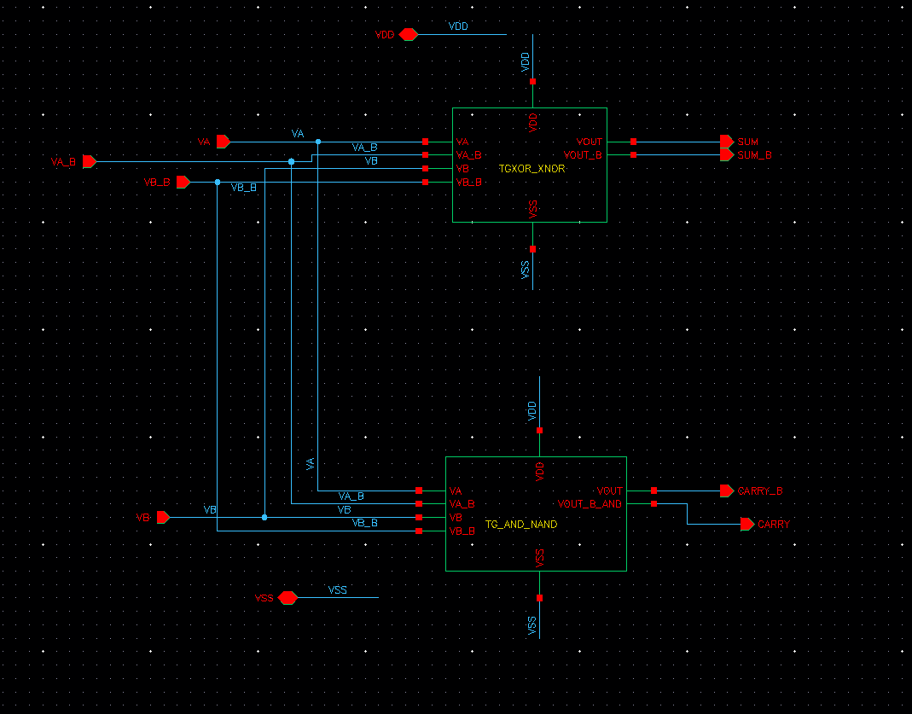
Schematic of N-P Based ECRL Half Adder
Fig.33.Schematic of N-P Based ECRL Half Adder

Slide 39
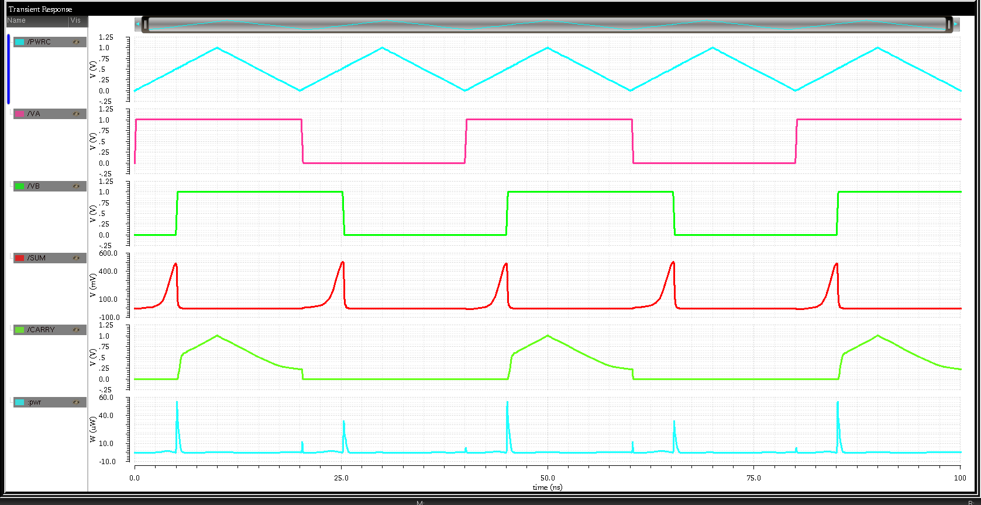
Simulation results of N-P Based ECRL Half Adder
Fig.34.Simulation result of N-P Based ECRL Half Adder

Slide 40
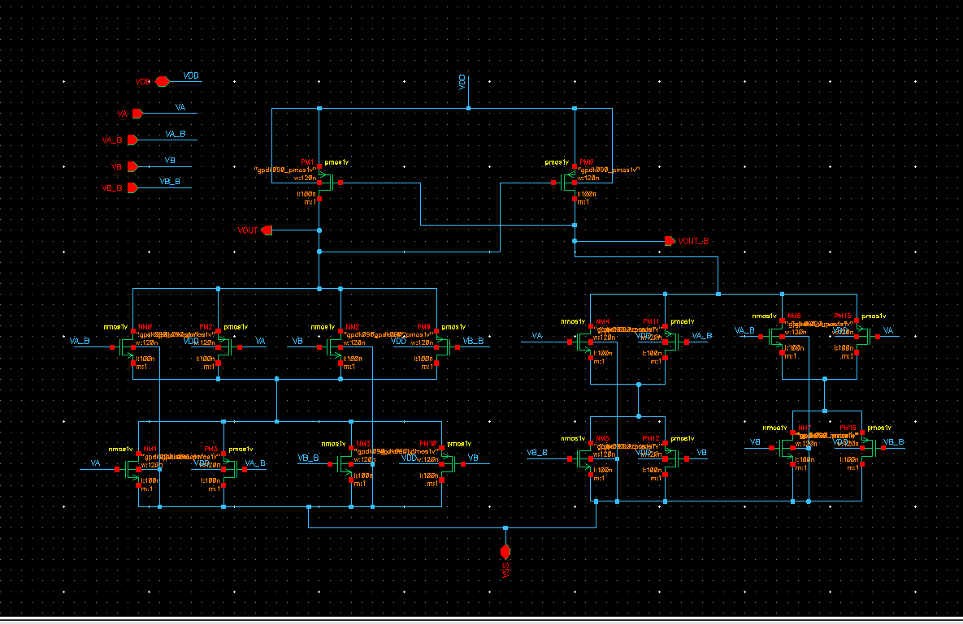
Schematic of N-P Based ECRL XOR-XNOR GATE
Fig.35.Schematic ofN-P Based ECRLXOR-XNOR gate

Slide 41
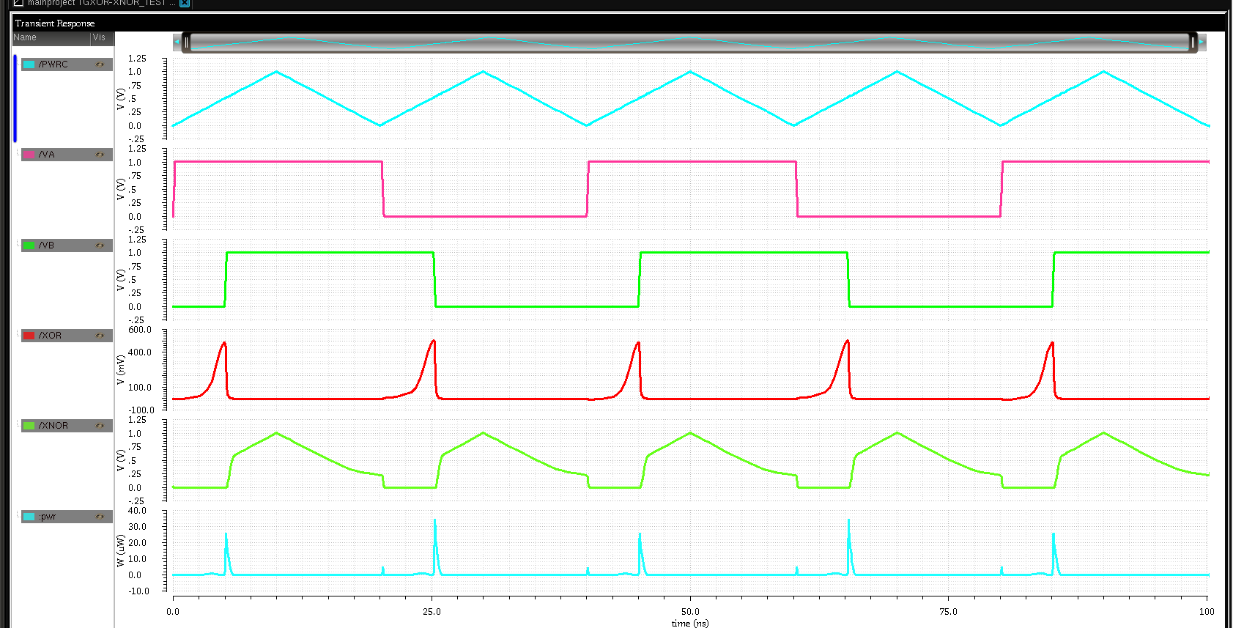
Simulation Results of N-P Based ECRL XOR-XNOR GATE
Fig.36.Simulation result of N-P Based ECRLXOR-XNOR gate

Slide 42
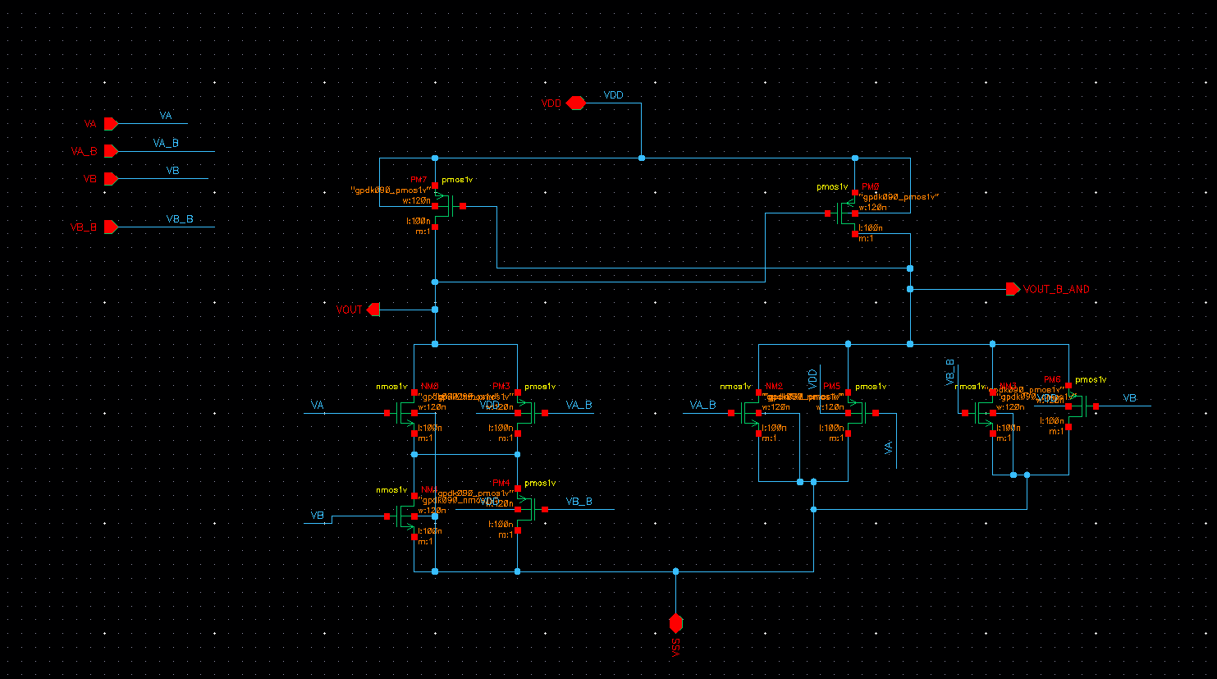
Schematic of N-P Based ECRL AND-NAND GATE
Fig.37.Schematic N-P Based ECRL AND-NAND gate

Slide 43
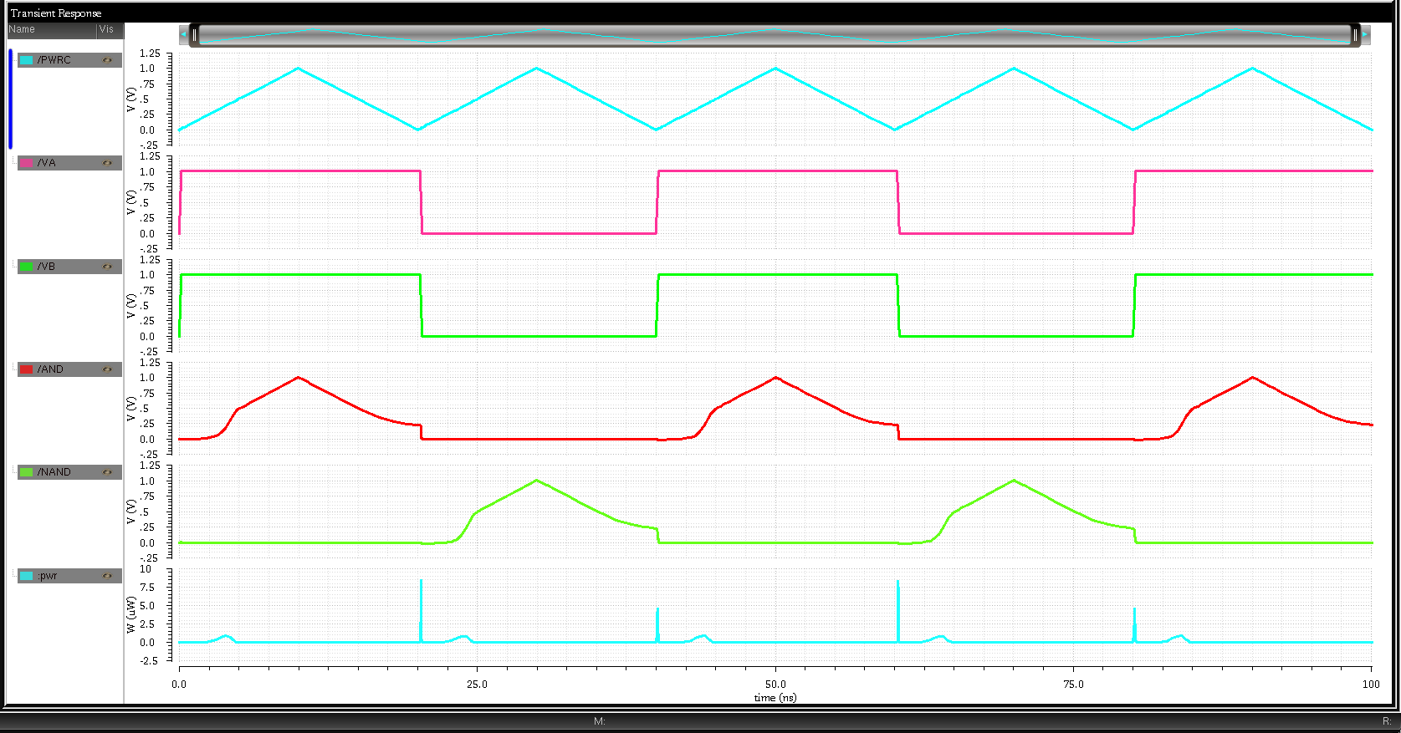
Simulation results of N-P Based ECRL AND-NAND GATE
Fig.38.Simulation result of N-P Based ECRL AND-NAND gate

Slide 44
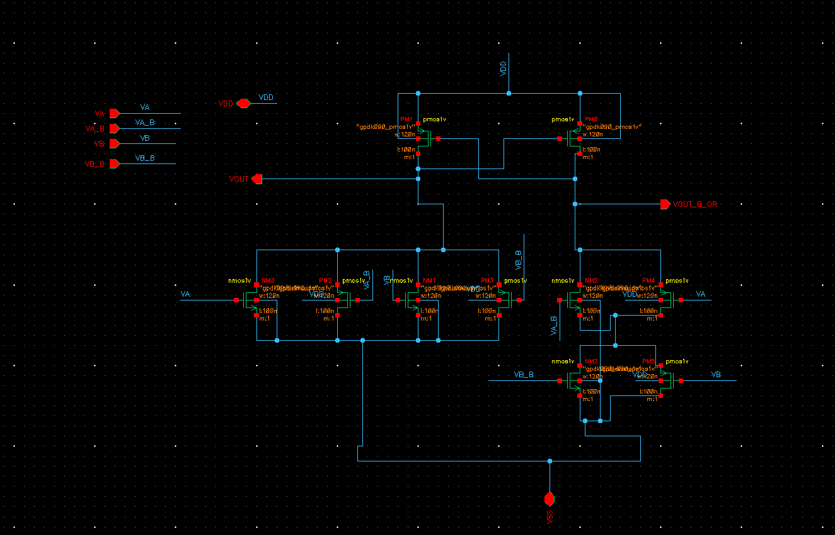
Schematic of N-P Based ECRL OR-NOR GATE
Fig.39.Schematic of N-P Based ECRL OR-NOR gate

Slide 45
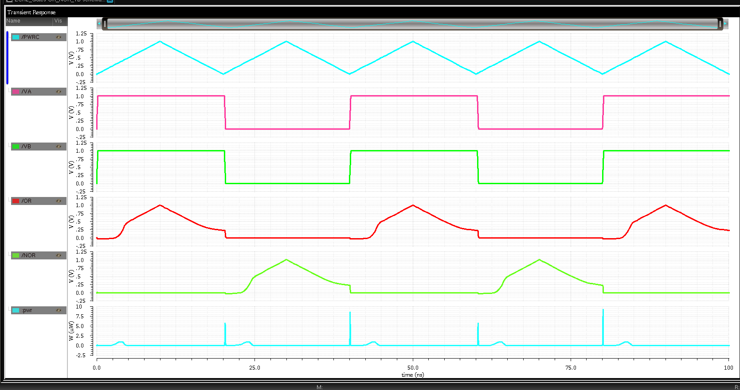
Simulation Results of N-P Based ECRL OR-NOR GATE
Fig.40.Simulation result of N-P Based ECRL OR-NOR gate

Slide 46
PERFORMANCE EVALUATION
CALCULATIONS OF POWER DISSIPATION
CALCULATIONS OF PROPAGATION DELAY

Slide 47
1.Power dissipation table of basic gates
Circuit | Existing ECRL Logic Power Dissipation(uw) |  |  |  | Proposed N-P Based ECRL logic Power Dissipation(uw)
 | VDD | TRI | VDD (12fF) | TRI (12fF) | VDD | TRI | VDD (12fF) | TRI (12fF)
1.INVERTER | 0.462 | 0.0123 | 1.475 | 0.097 | 0.497 ➔7.57%i | 0.011 ➔10.57%d | 1.489 ➔0.94%i | 0.091 ➔6.18%d
2.OR-NOR | 41.02 | 0.0058 | 41.535 | 0.055 | 41.03 ➔0.02%i | 0.006 ➔35.94%d | 41.55 ➔0.036%i | 0.047 ➔14.46%d
3.AND-NAND | 0.270 | 0.0102 | 0.8219 | 0.056 | 0.289 ➔7.03%i | 0.0075 ➔35.80%d | 0.818 ➔0.47%d | 0.0496 ➔11.428%d
4.XOR- XNOR | 0.289 | 0.06135 | 33.56 | 0.2301 | 32.544 ➔0.55%i | 0.0789 ➔29.34%i | 33.70 ➔0.41%i | 0.247 ➔7.34%i

Slide 48
2.Power Dissipation table of adders
Circuit | Existing ECRL Logic Power Dissipation(uw) |  |  |  | Proposed N-P Based ECRL Logic Power Dissipation(uw)
 | VDD | TRI | VDD (12fF) | TRI (12fF) | VDD | TRI | VDD (12Ff) | TRI (12fF)
HALF ADDER | 32.63 | 0.0925 | 30.44 | 0.36 | 32.87 ➔0.73%i | 0.114 ➔23.24%i | 34.57 ➔13.56%i | 0.38 ➔6.11%i
FULL ADDER | 32.812 | 0.0595 | 33.97 | 0.2359 | 33.12 ➔0.93%i | 0.061 ➔2.43%i | 34.23 ➔0.77%i | 0.2142 ➔9.19%d
RCA | 33.585 | 0.538 | 38.27 | 0.787 | 37.01 ➔3.22%i | 0.304 ➔43.49%d | 39.31 ➔2.71%i | 0.787 ➔0%

Slide 49
3.Power dissipation table of multipliers
Circuit | Existing ECRL Logic Power Dissipation(uw) |  |  |  | Proposed N-P ECRL Logic Power Dissipation(uw)
 | VDD | TRI | VDD (12fF) | TRI (12fF) | VDD | TRI | VDD (12fF) | TRI (12fF)
2X2VM | 2.171 | 0.1318 | 3.257 | 0.315 | 2.871 ➔13.81%d | 0.121 ➔8.19%d | 3.948 ➔21.21%i | 5.490 ➔5.39%d
4X4VM | 34.77 | 4.49 | 38.27 | 5.49 | 4.984 ➔85.66%d | 2.861 ➔36.28%d | 4.984 ➔86.97%d | 3.936 ➔28.30%d

Slide 50
4.Delay Comparison table of basic gates
Basic Gate | Existing ECRL Logic Delay(ns) |  |  |  | Proposed N-P Based ECRL Logic Delay(ns)
 | VDD | TRI | VDD (12fF) | TRI (12fF) | VDD | TRI | VDD (12fF) | TRI (12fF)
1.INVERTER | 0.056 | 4.709 | 0.177 | 4.805 | 0.0612 | 4.710 | 0.176 | 4.808
2.OR | 0.029 | 4.909 | 0.127 | 5.006 | 0.0348 | 0.005 | 0.128 | 5.007
3.NOR | 0.111 | 4.713 | 0.288 | 4.812 | 0.118 | 4.716 | 0.273 | 4.816
4.AND | 0.117 | 4.913 | 0.287 | 5.010 | 0.112 | 4.916 | 0.271 | 5.015
5.NAND | 0.030 | 4.709 | 0.127 | 4.806 | 0.035 | 4.710 | 0.128 | 4.808
6.XOR | 0.111 | 4.742 | 0.281 | 4.891 | 0.108 | 4.722 | 0.267 | 4.859
7.XNOR | 0.077 | 15.13 | 5.152 | 5.561 | 5.124 | 5.239 | 5.282 | 5.606

Slide 51
5.Delay Comparison table of Adders
Circuit | Existing ECRL Logic Delay(ns) |  |  |  | Proposed N-P Based ECRL Logic Delay(ns)
 | VDD | TRI | VDD (12fF) | TRI (12Ff) | VDD | TRI | VDD (12fF) | TRI (12fF)
1.HA | 5.088 | 5.13 | 5.267 | 5.525 | 5.099 | 5.161 | 5.262 | 5.545
2.FA | 0.095 | 4.913 | 0.022 | 5.022 | 0.001 | 4.941 | 0.003 | 5.092
3.RCA | 0.001 | 4.909 | 0.002 | 5.04 | 0.001 | 4.909 | 0.002 | 5.011

Slide 52
4.Delay Comparison table of multipliers
Circuit | Existing ECRL Logic Delay(ns) |  |  |  | Proposed N-P Based ECRL Logic Delay(ns)
 | VDD | TRI | VDD (12fF) | TRI (12fF) | VDD | TRI | VDD (12fF) | TRI (12fF)
1.2X2VM | 0.003 | 0.004 | 0.004 | 5.056 | 0.003 | 4.934 | 0.005 | 5.079
2.4X4VM | 0.008 | 4.949 | 0.009 | 5.084 | 1.079 | 6.202 | 1.245 | 6.616

Slide 53
CONCLUSION AND FUTURE SCOPE
In this project, we have compared all the proposed basic gates, Adders and Multipliers with existing ECRL circuits. Hence the proposed N-P based ECRL adiabatic logic 4X4 Vedic Multiplier has 28.30% lesser power consumption when compared with existing ECRL 4X4 Vedic multiplier. Therefore, our proposed multiplier is faster, power efficient and requires small area than the existing ECRL and conventional CMOS multipliers. .
By utilizing FinFET Technology, the power dissipation of the Vedic multiplier might be reduced better than that of the N-P based ECRL Adiabatic logic in near future. The Vedic multiplier is used in the implementation of faster real-time harder image processing, parallel FIR architecture, an asynchronous digital signal processor core, and image compression.

Slide 54
REFERENCES
1)V. Kunchigi, L. Kulkarni and S. Kulkarni, "High speed and area efficient vedic multiplier," 2017 International Conference on Devices, Circuits and Systems (ICDCS), 2017, pp. 360-364, doi: 10.1109/ICDCSyst.2012.6188747.
2)S. K.C., S. M., G. B.C., L. D.M., Navya and P. N.V., "Performance Analysis of Parallel Prefix Adder for Datapath Vlsi Design," 2018 Second International Conference on Inventive Communication and Computational Technologies (ICICCT), 2018, pp. 1552-1555, doi: 10.1109/ICICCT.2018.8473087.
3)Beaumont-Smith, Andrew & Lim, Cheng chew. (2018). Parallel prefix adder design. 218-225. 10.1109/ARITH.2001.930122.
4)A. Kant and S. Sharma, "Applications of vedic multiplier designs - A review," 2019 4th International Conference on Reliability, Infocom Technologies and Optimization (ICRITO) (Trends and Future Directions), 2019, pp. 1-6, doi: 10.1109/ICRITO.2015.7359309.

Slide 55
THANK YOU

