Slide 1
Mobile First Demo
Customer Communication Management – Design mockups

Slide 2


Notes:
MM - The copyright on this screen is wrong. It should be 2018. done
MM – Buttons look too small on the screen. done
MM – This screen uses photorealistic imagery which clashes with the rest of the course design. Changed to illustrative approach

Slide 3
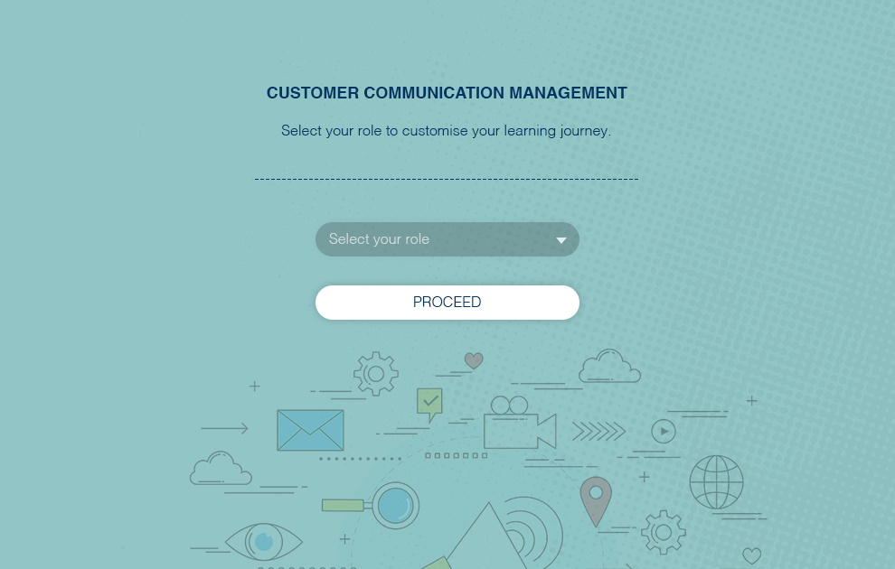
Notes:
MM - The copyright on this screen is wrong. It should be 2018. done
MM – Buttons look too small on the screen. done
MM – This screen uses photorealistic imagery which clashes with the rest of the course design. Changed to illustrative approach

Slide 4
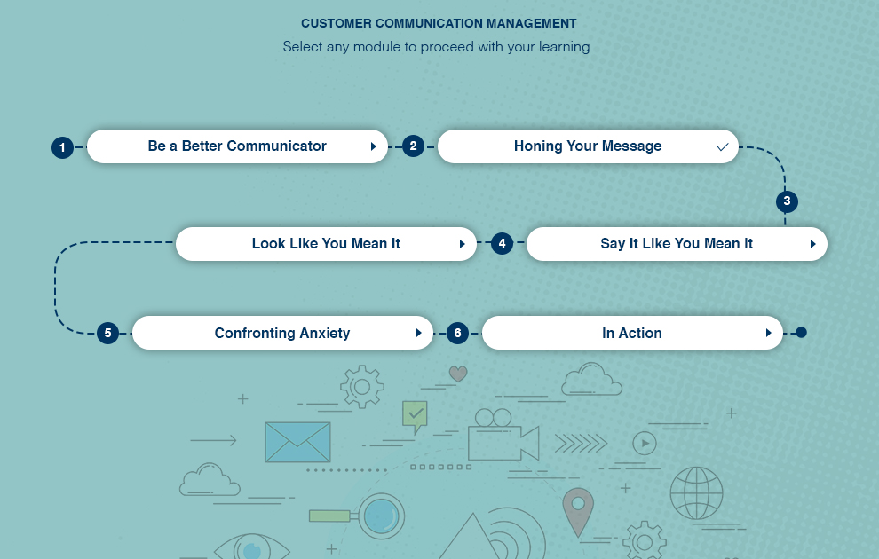
Notes:
MM - The copyright on this screen is wrong. It should be 2018. done
MM – Buttons look too small on the screen. done
MM – This screen uses photorealistic imagery which clashes with the rest of the course design. Changed to illustrative approach

Slide 5
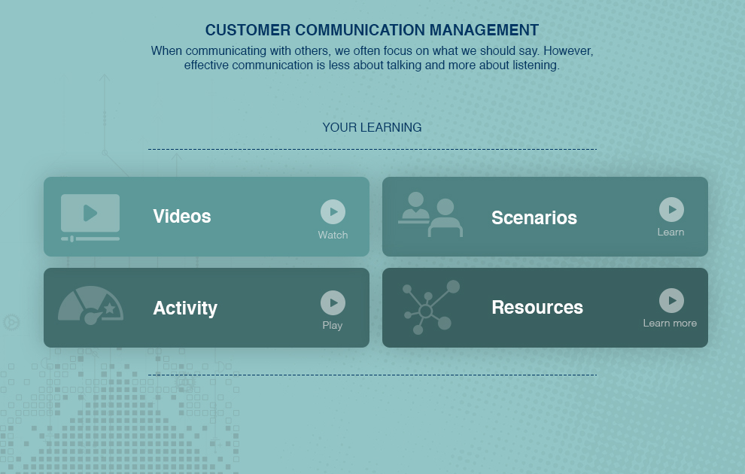
Notes:
MM - The copyright on this screen is wrong. It should be 2018. done
MM – Buttons look too small on the screen. done
MM – This screen uses photorealistic imagery which clashes with the rest of the course design. Changed to illustrative approach

Slide 6
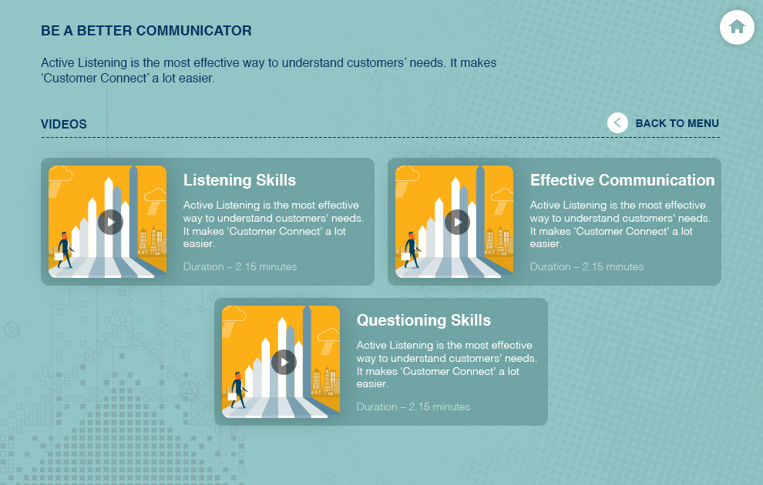
Notes:
MM - The copyright on this screen is wrong. It should be 2018. done
MM – Buttons look too small on the screen. done
MM – This screen uses photorealistic imagery which clashes with the rest of the course design. Changed to illustrative approach

Slide 7
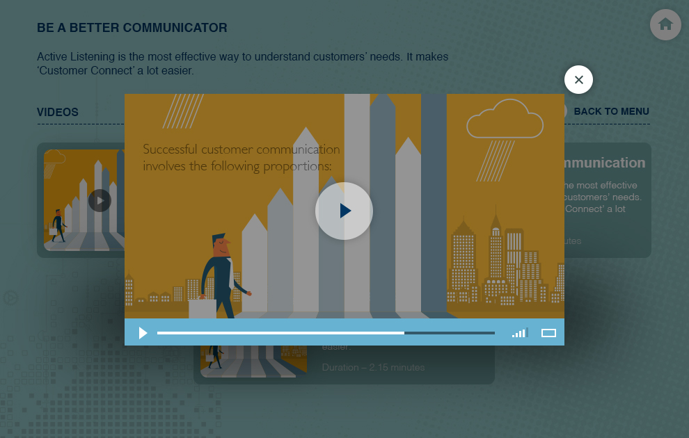
Notes:
MM - The copyright on this screen is wrong. It should be 2018. done
MM – Buttons look too small on the screen. done
MM – This screen uses photorealistic imagery which clashes with the rest of the course design. Changed to illustrative approach

Slide 8
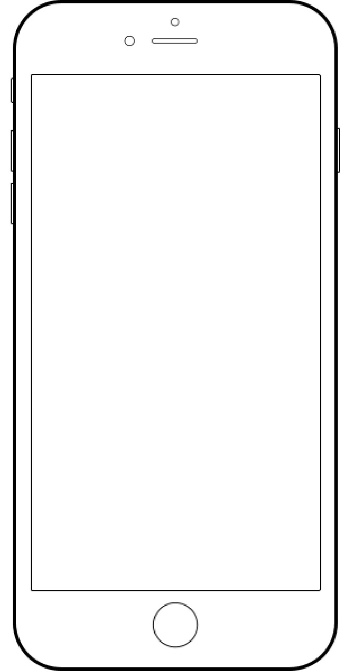

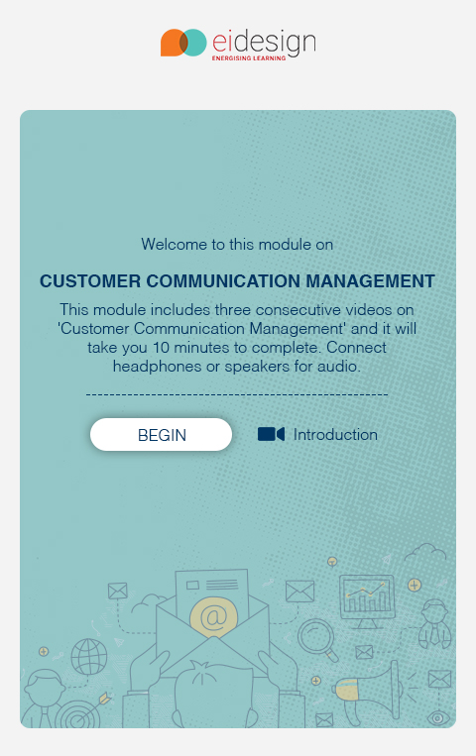
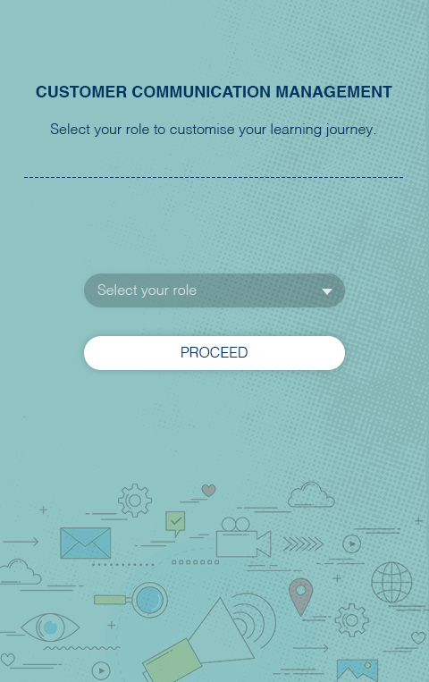
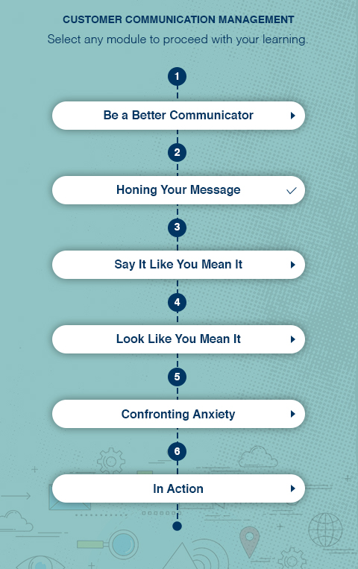
Notes:
MM – Again, the copyright year is wrong. done
MM – I really don’t like the approach to the coach here. Firstly, it conflicts with the photorealistic approach in the background. Secondly, his clothing is too casual. I would just remove him from this screen. Changed the character
MM – Text is a bit small. Also, can we make the buttons bigger? done
MM – This screen uses photorealistic imagery which clashes with the rest of the course design. I think we need to rethink the approach here. Done changed to illustrative approach

Slide 9
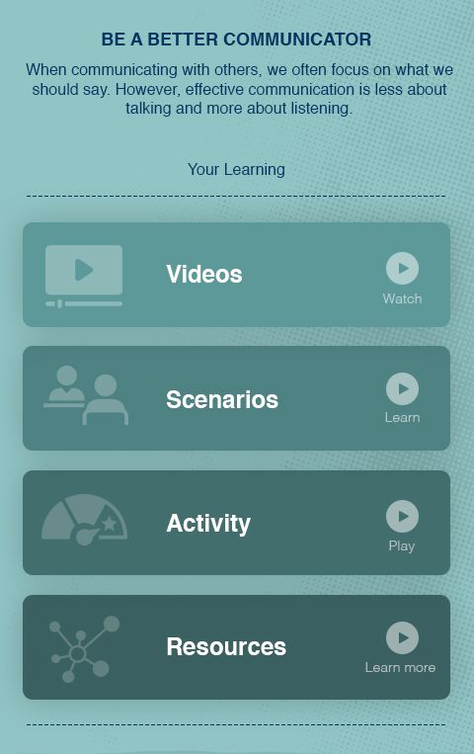
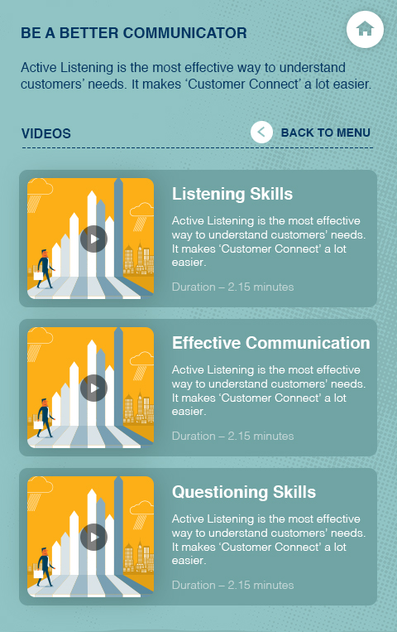
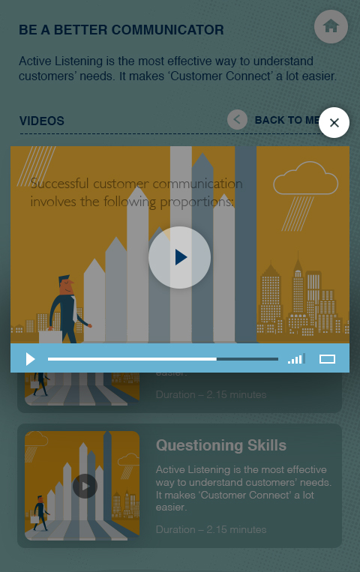
Notes:
MM – Again, the copyright year is wrong. done
MM – I really don’t like the approach to the coach here. Firstly, it conflicts with the photorealistic approach in the background. Secondly, his clothing is too casual. I would just remove him from this screen. Changed the character
MM – Text is a bit small. Also, can we make the buttons bigger? done
MM – This screen uses photorealistic imagery which clashes with the rest of the course design. I think we need to rethink the approach here. Done changed to illustrative approach

