Slide 1
Citizen AI – Intelligent Citizen Engagement Platform
Internship at SmartBridge
Team ID: LTVIP2025TMID31767
Team Leader: Shaik Safiya Jasmine
Team Members: Shaik Imran Basha, Chintalapudi Tejaswini, Shaik Abdul
Mentor: J Prasanth Kumar

Slide 2
Introduction
Intelligent, citizen-focused engagement platform
Bridges gap between citizens and municipal governance
Offers transparent issue reporting and live tracking
Centralized dashboard for authorities

Slide 3
Purpose
Empower citizens and streamline feedback
Goals:
- Transparent civic operations
- Trust and satisfaction
- Automation of workflows
- Efficient grievance redressal

Slide 4
Problem Statement
Manual, delayed, or opaque complaint systems
Frustration due to lack of response
No centralized or organized mechanism
Diminished public trust

Slide 5
Empathy Map
Says: 'Nobody responds'
Thinks: 'Is anyone seeing it?'
Does: Posts or ignores
Feels: Frustrated, hopeless

Slide 6
Brainstorming Outcomes
AI-powered complaint summarization
Mobile-friendly dynamic surveys
Conversational assistant
Personalized dashboards

Slide 7
Customer Journey Map
Awareness → Access → Query
Assistance → Feedback → Engagement
Insight → Trust

Slide 8
Functional Requirements
Secure login
AI-generated civic summaries
Conversational AI with voice and text

Slide 9
Non-Functional Requirements
Responsive UI
Real-time performance
Scalable backend
Privacy-compliant

Slide 10
Technology Stack
Frontend: React.js, TailwindCSS
Backend: Flask, FastAPI
Database: PostgreSQL, Firebase
AI: GPT-4, Whisper, HuggingFace

Slide 11
Solution Architecture
Frontend: React.js
Backend: Node.js / Express
Database: MongoDB / Firebase
Hosting: Vercel

Slide 12
Project Planning & Timeline
Weeks 1–2: Empathy map
Weeks 3–4: UI, flow
Weeks 5–6: API, DB
Week 7: Usability testing
Week 8: Hosting
Week 9: Feedback & Review

Slide 13
Functional Testing Summary
Service display, form submission ✅
Field validation, confirmation ✅
Dashboard login ✅
Phone number validation ⚠️

Slide 14
Performance Testing Summary
Fast submission ⚡
Mobile responsive 📱
Data feedback loop 🔁
Security checks partial 🔒

Slide 15
Results (User Dashboard)
Housing, Transportation Services
Clear availability indicators
Visual access buttons

Slide 16
Advantages
Faster resolution ⏱️
24/7 availability 🕒
Data-driven insights 📊
Multilingual, cost-efficient 🗣️
Real-time tracking 📈

Slide 17
Disadvantages
Needs internet 🌐
Data privacy challenges 🔐
High development cost 💸
Maintenance required 🔄
Possible AI bias ⚖️

Slide 18
Future Scope
Smart City integration (IoT)
Voice assistants (Alexa, Google)
Predictive analytics
Citizen rating & gamification
Blockchain & offline support
Real-time analytics dashboard

Slide 19
Links & Demo
Source Code: https://github.com/Tejaswini-1803/Citizen-AI.git
Demo Video: Screen Recording 2025-06-26
Website: citizen-aig7.vercel.app

Slide 20
Conclusion
Bridges citizen-government gap
Transparent, intuitive, scalable platform
Ready for real-world implementation

Slide 21
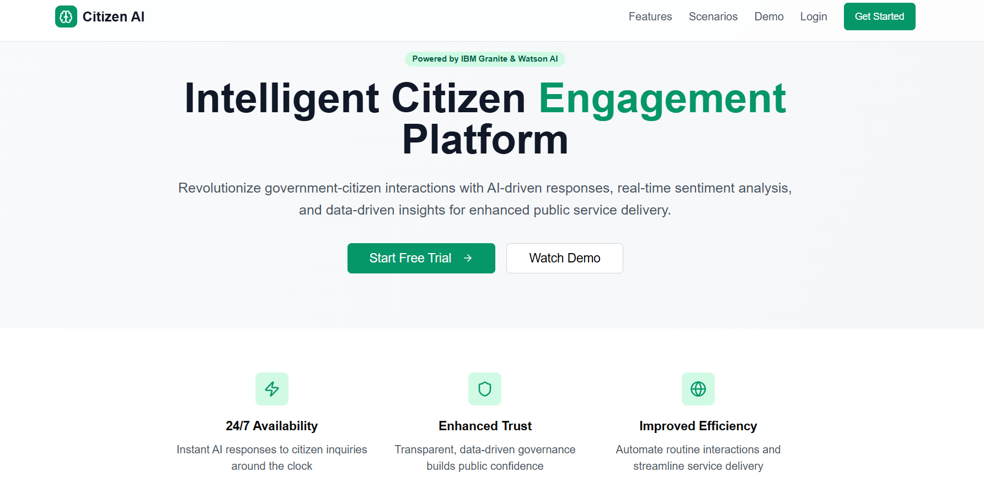
Homepage UI

Slide 22
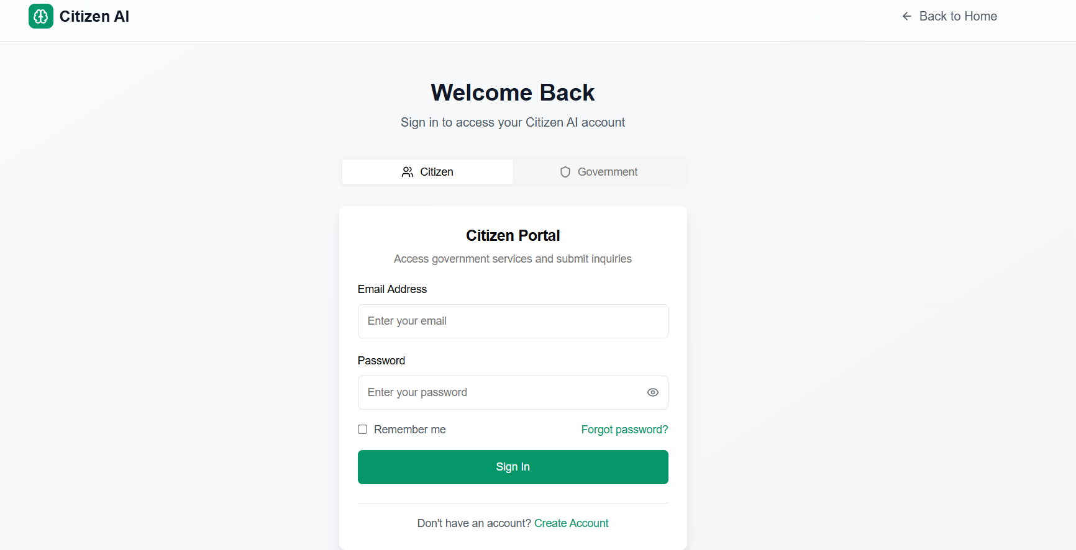
Login Screen

Slide 23
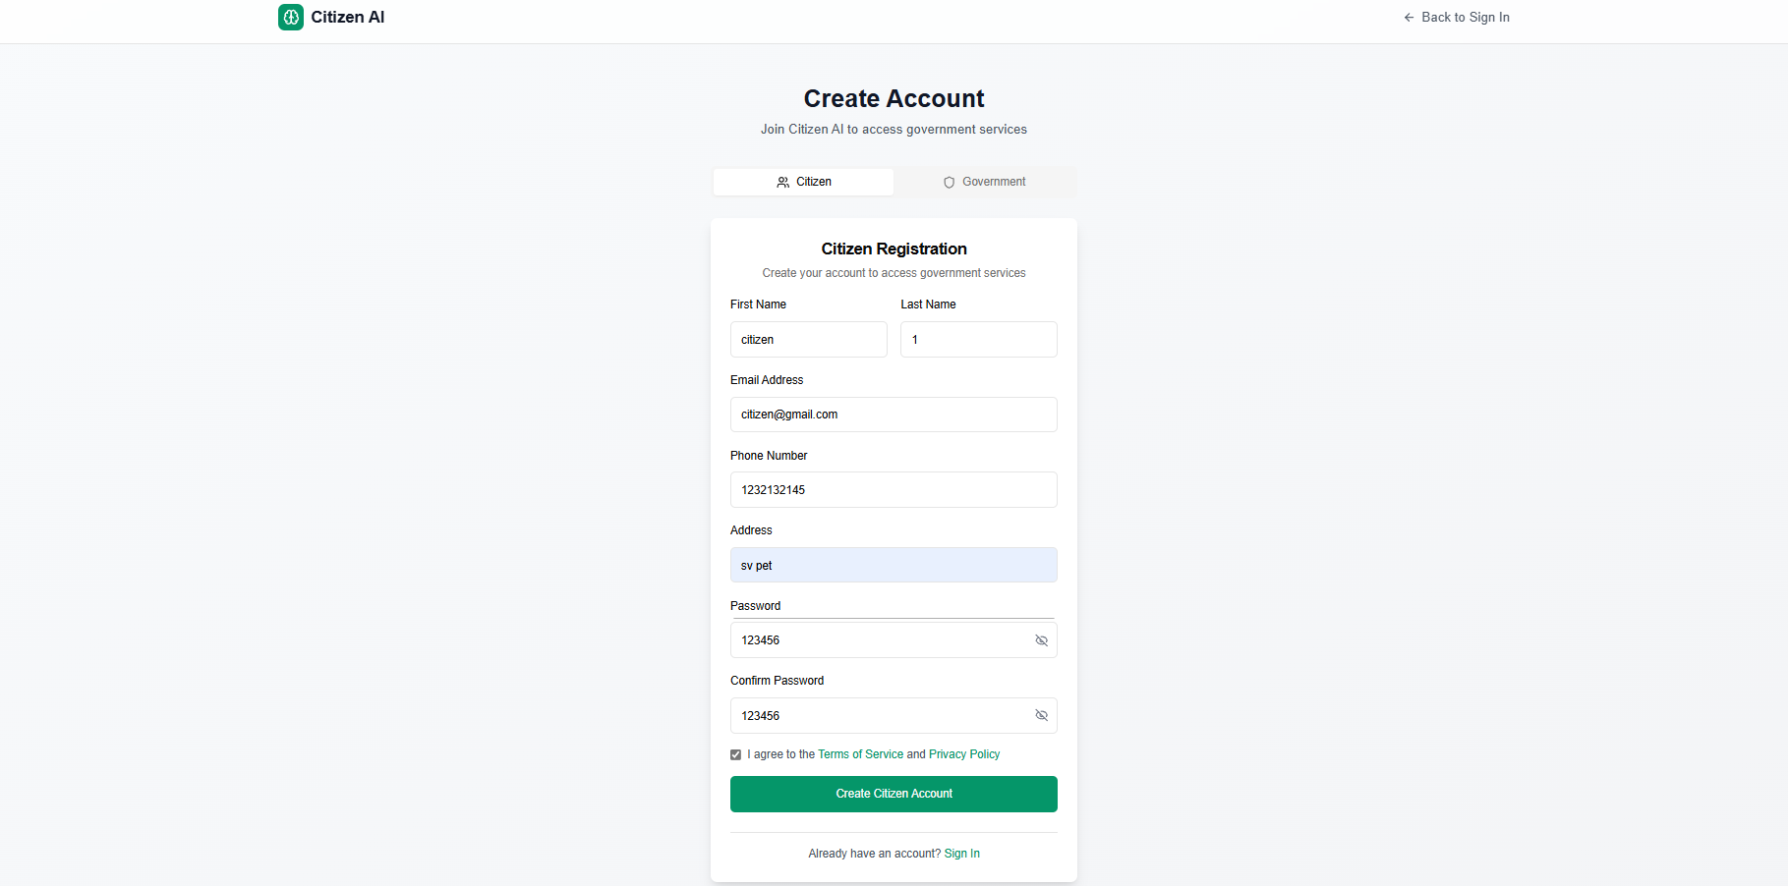
Create Account Form

Slide 24
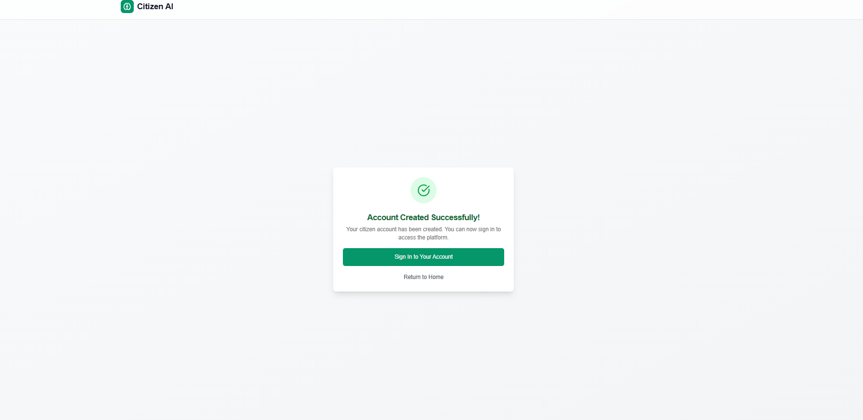
Account Created Confirmation

Slide 25
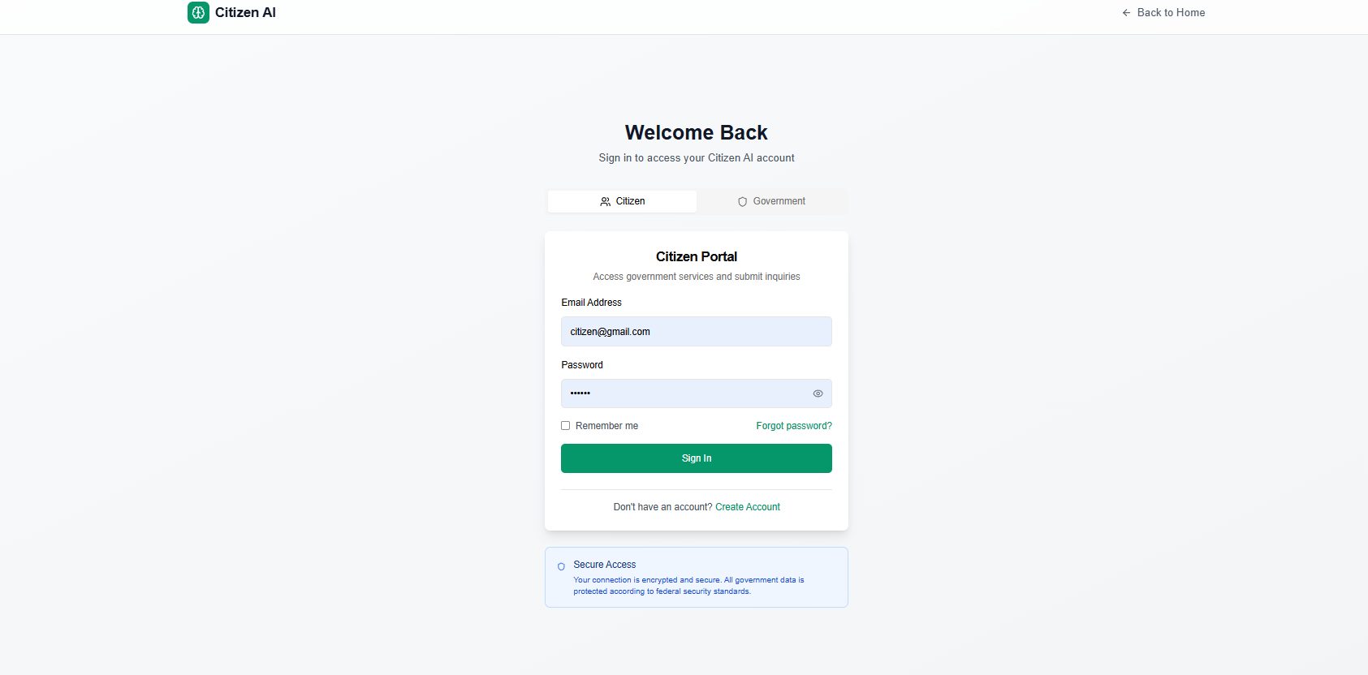
Secure Login Screen

