Slide 1
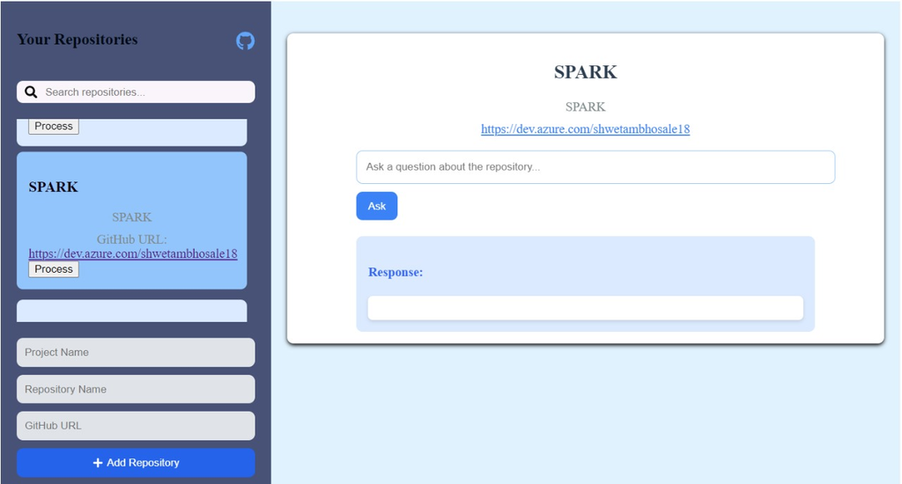
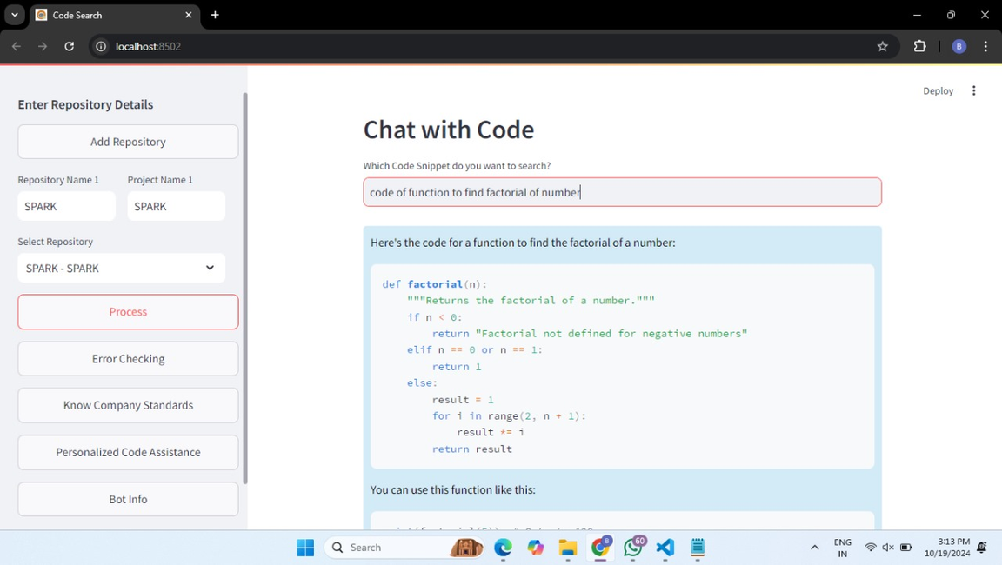




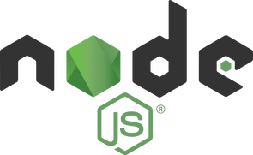



Team 40: Code Search Utility
Problem Statement: Develop a chatbot utility to help new developers retrieve code snippets by querying in natural language and fetching relevant code implementations from Azure DevOps repositories.
Using REACT
Using STREAMLIT
TECHNOLOGY STACK
STREAMLIT, Langchain, FAISS (for vector stores),
Azure DevOps (API access), Google Generative AI (embeddings) Integration: FASTAPI React (UI/UX), MongoDB Cluster, Node, Express
STREAMLIT
Azure DevOps
Langchain
FASTAPI
Express

Slide 2
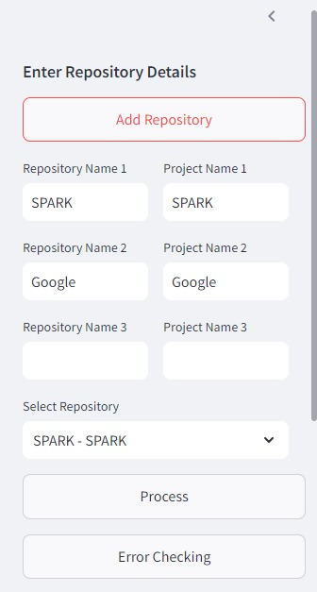
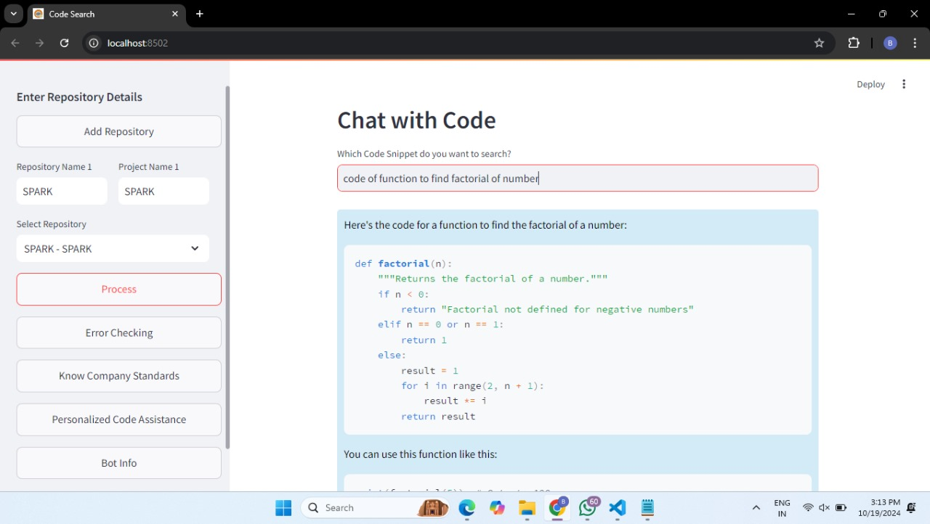
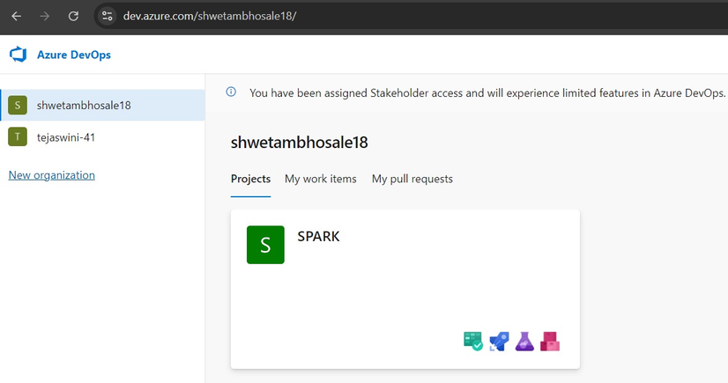
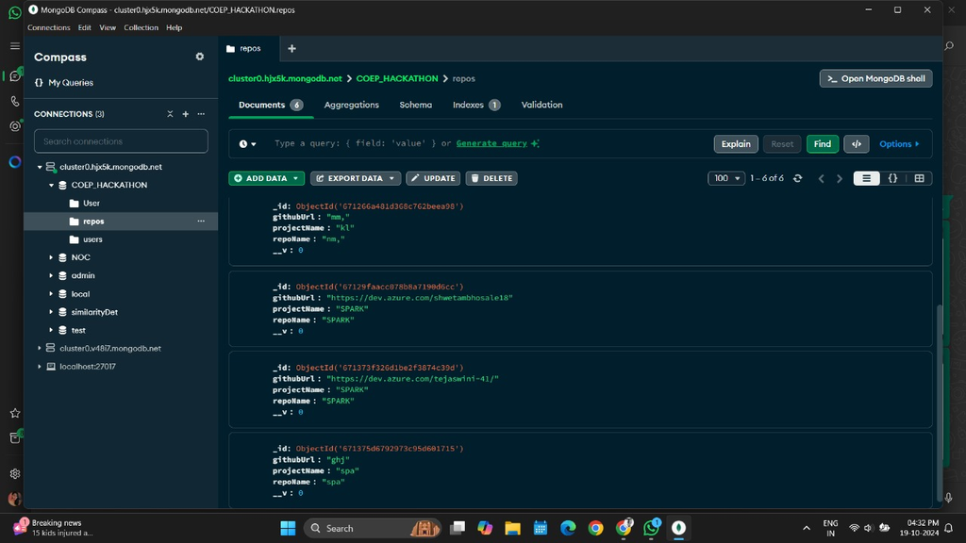
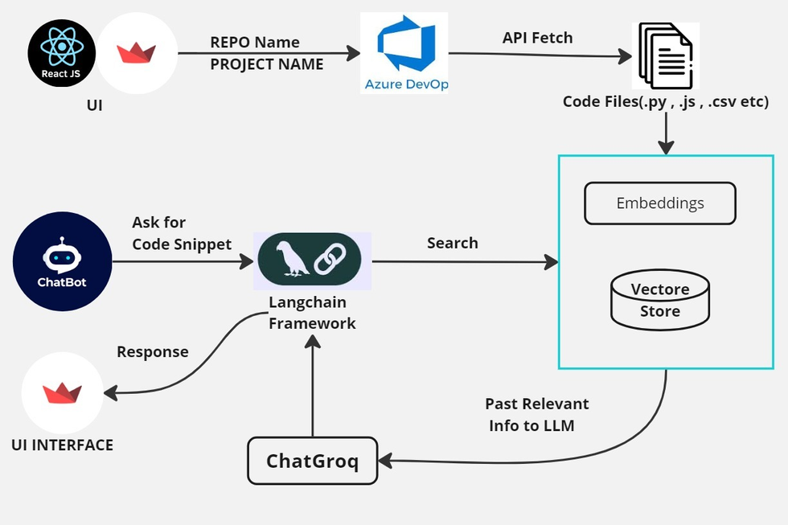
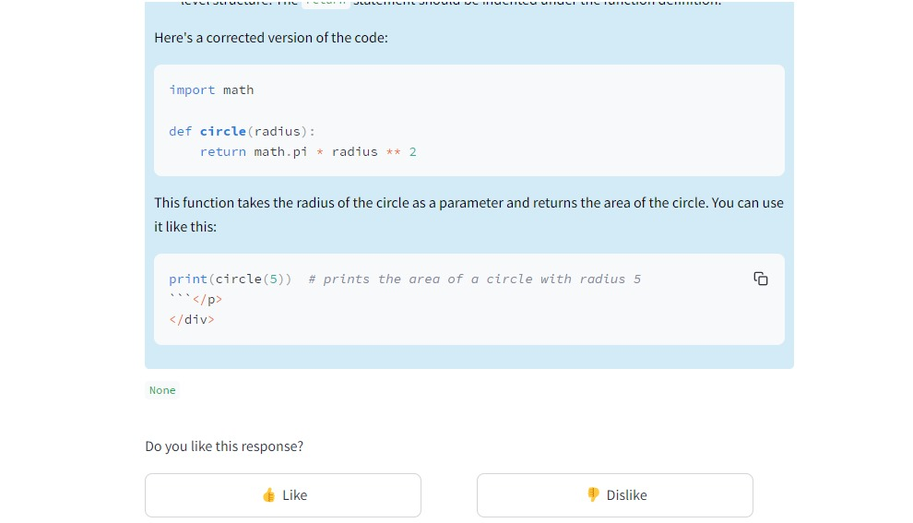
Features
Azure DevOps
MongoDB
WORKFLOW

Slide 3
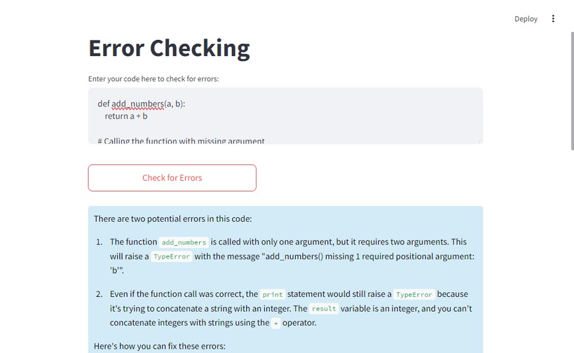
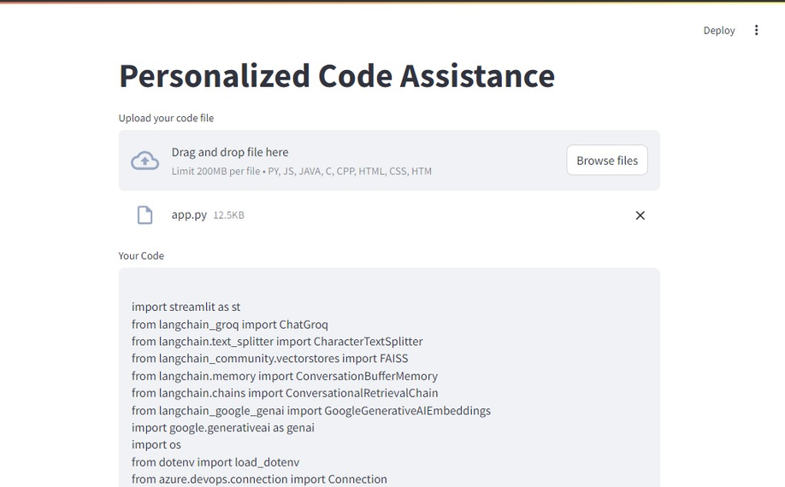
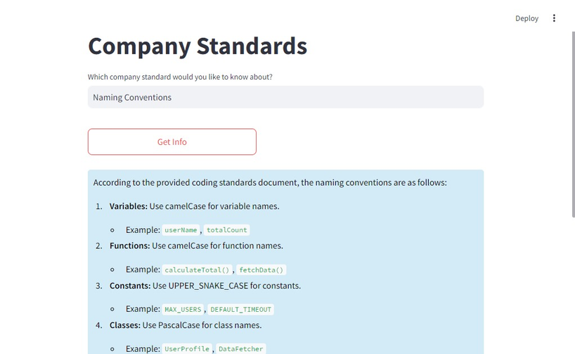
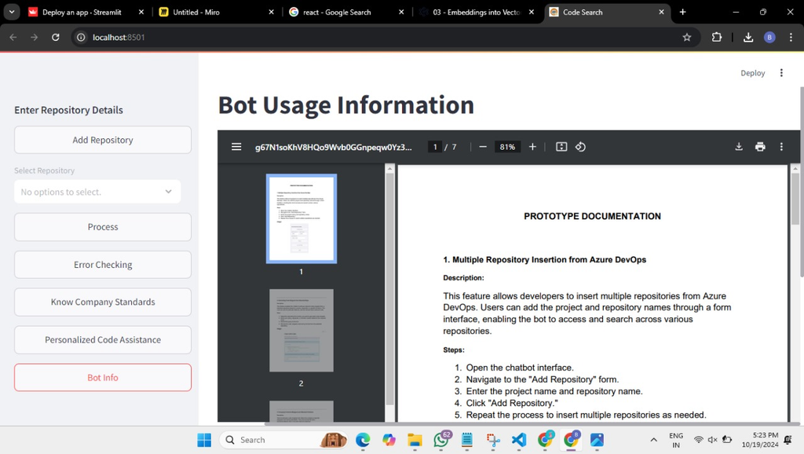
UNIQUENESS
Real-Time Data Fetching: Connect and interact with Azure DevOps to access different source code repositories.
Code Optimization and Error Checking: Find and fix errors in your code and get suggestions for improving it.
Code Summaries: Quickly summarize your code to understand what it does without reading every line.
Personalized Code Help: Upload a PDF of your own code, and the bot will suggest parts that fit with your existing code or summarize it for you.
Understanding Company Standards: Learn about your company's coding standards, with the bot ready to answer any questions you have.
Documentation on and Guides: Guide on how the chatbot works, from start to finish, so you know what it can do.

