Slide 1
FarmChain X AI Driven Agricultural Traceability Network
Where Every Harvest Speaks Its Journey

Slide 2
Problem Statement :
Farmers across the world work hard every single day but still earn very little money because middlemen stand between them and consumers, controlling all prices, market information and payments without ever sharing it fairly. Most farmers live in remote areas with no internet access, no smartphone knowledge and no platform in their own language, making it completely impossible for them to find and connect with consumers directly. Even if both the farmer and consumer are willing to do business directly, there is no affordable logistics system, no common platform and no trust mechanism to protect either party across long distances. This forces farmers to keep depending on middlemen who underpay them while consumers keep overpaying, creating a broken and unfair global food system that benefits nobody except the middlemen standing in between

Slide 3
System Architecture Overview
FARMER SIDE
API GATEWAY
CONSUMER SIDE
📱 Mobile App
🗣️ Voice Input
📸 Camera
📍 GPS Tagging
AI/ML
LAYER
BLOCKCHAIN
LAYER
📱 Mobile/Web
🔍 Search
🛒 Order
📦 Track
APPLICATION SERVICES
DATABASE & STORAGE

Slide 4
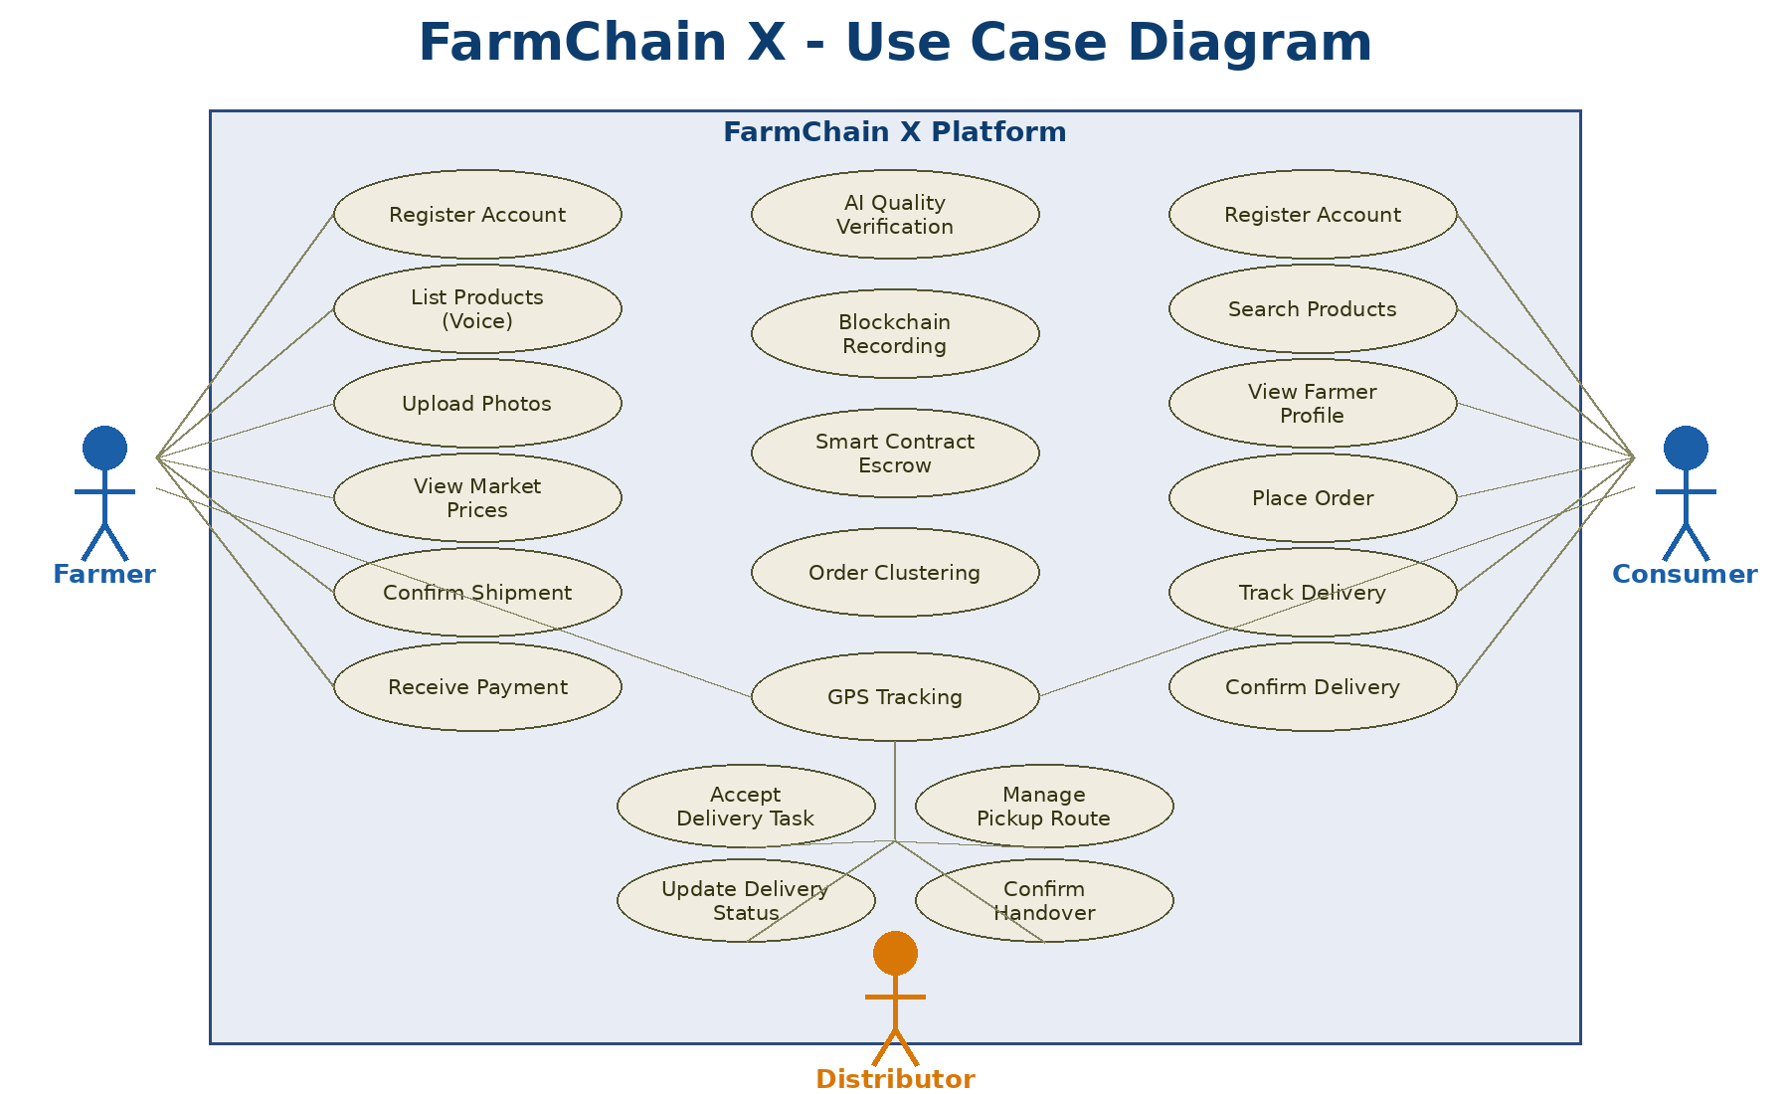

Slide 5
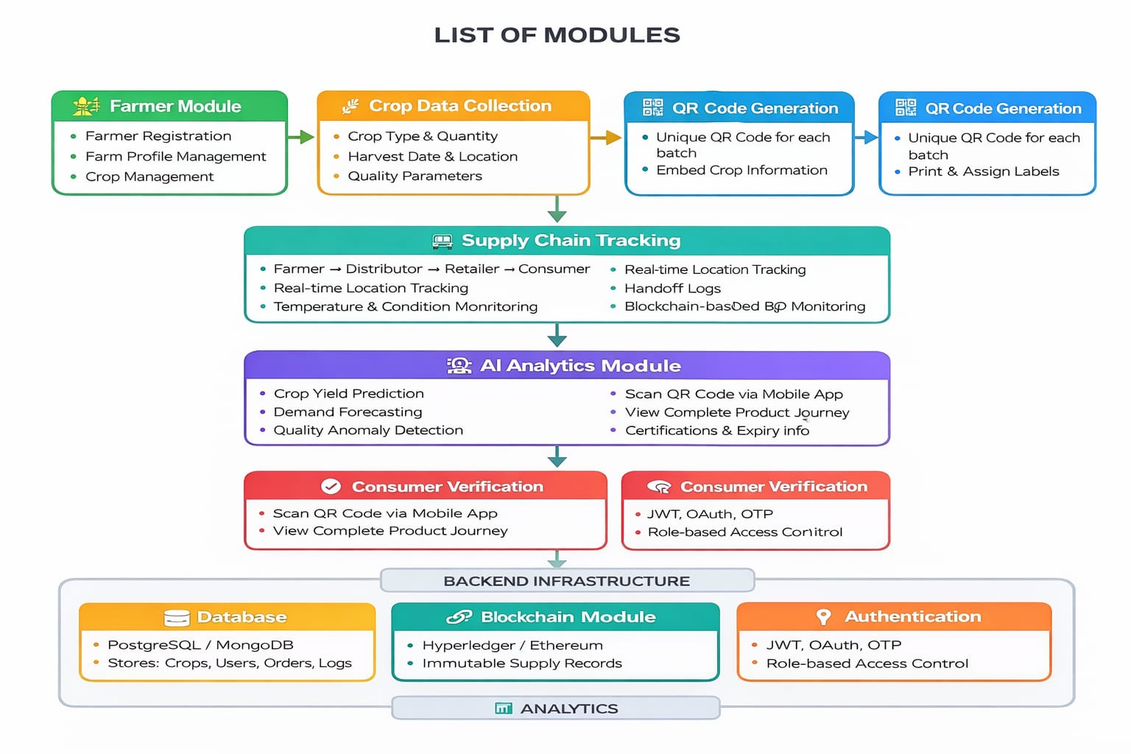

Slide 6
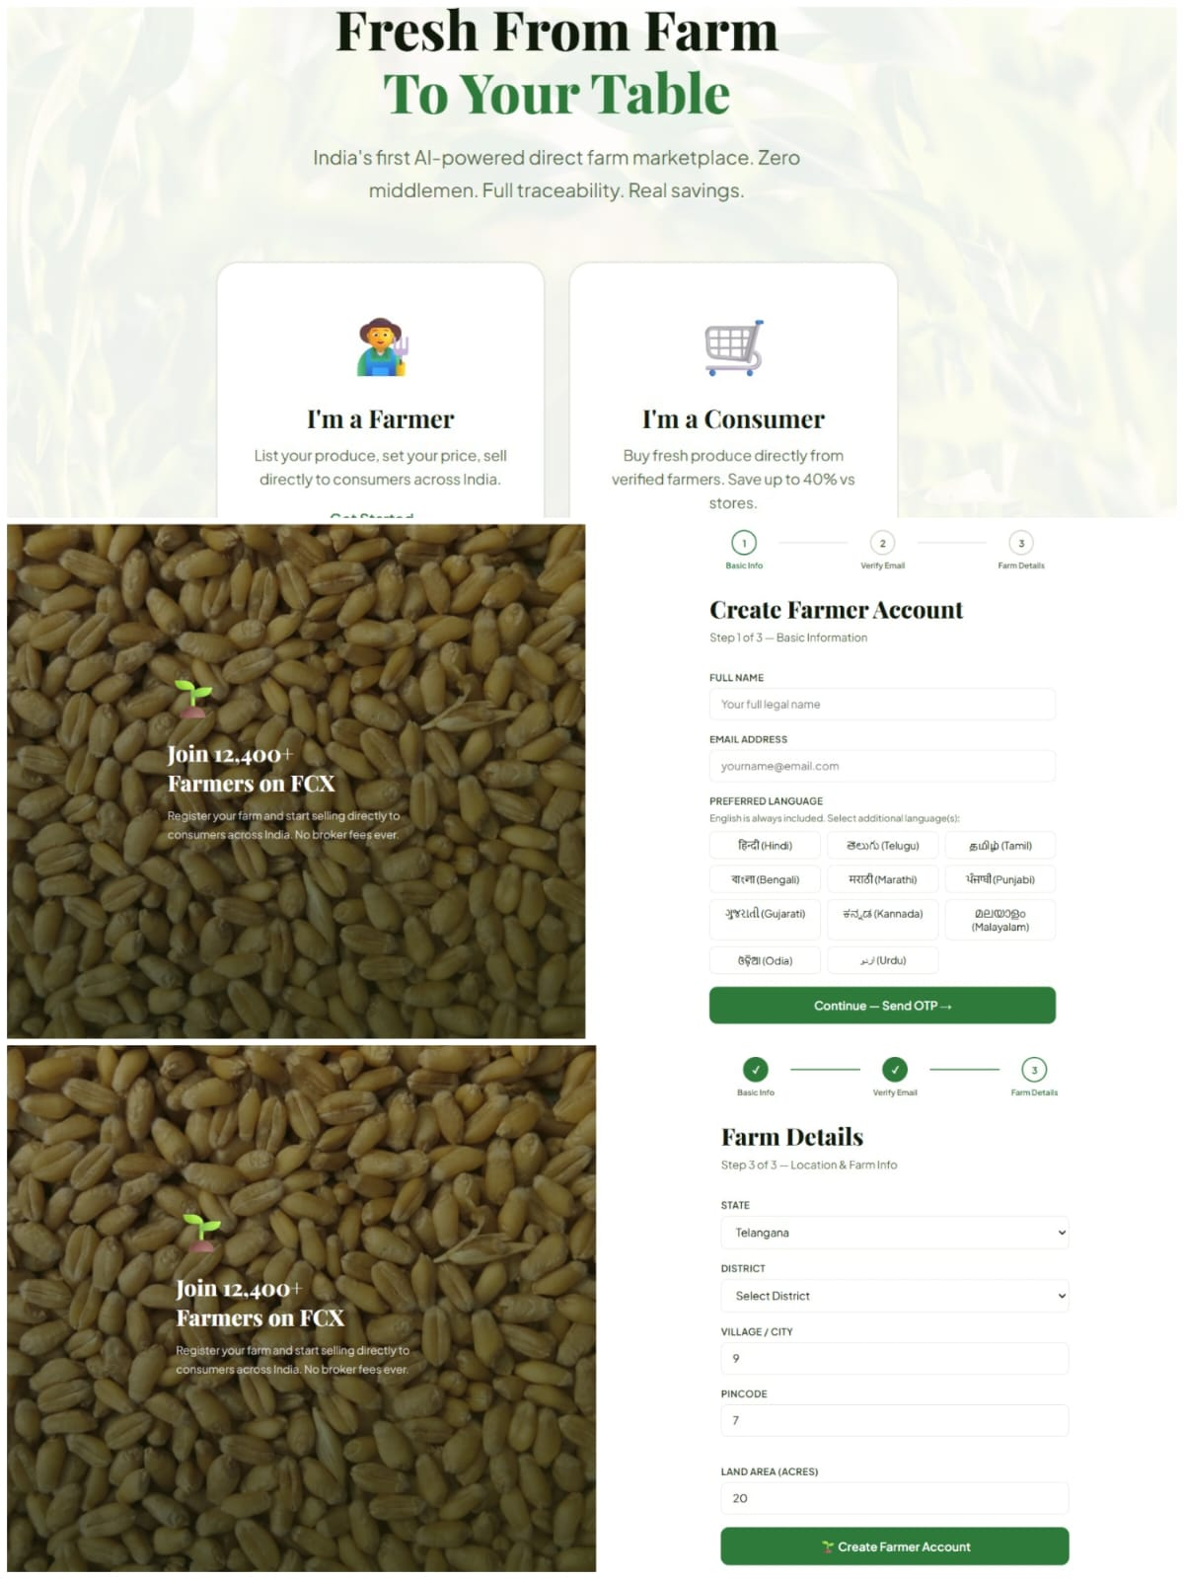

Slide 7
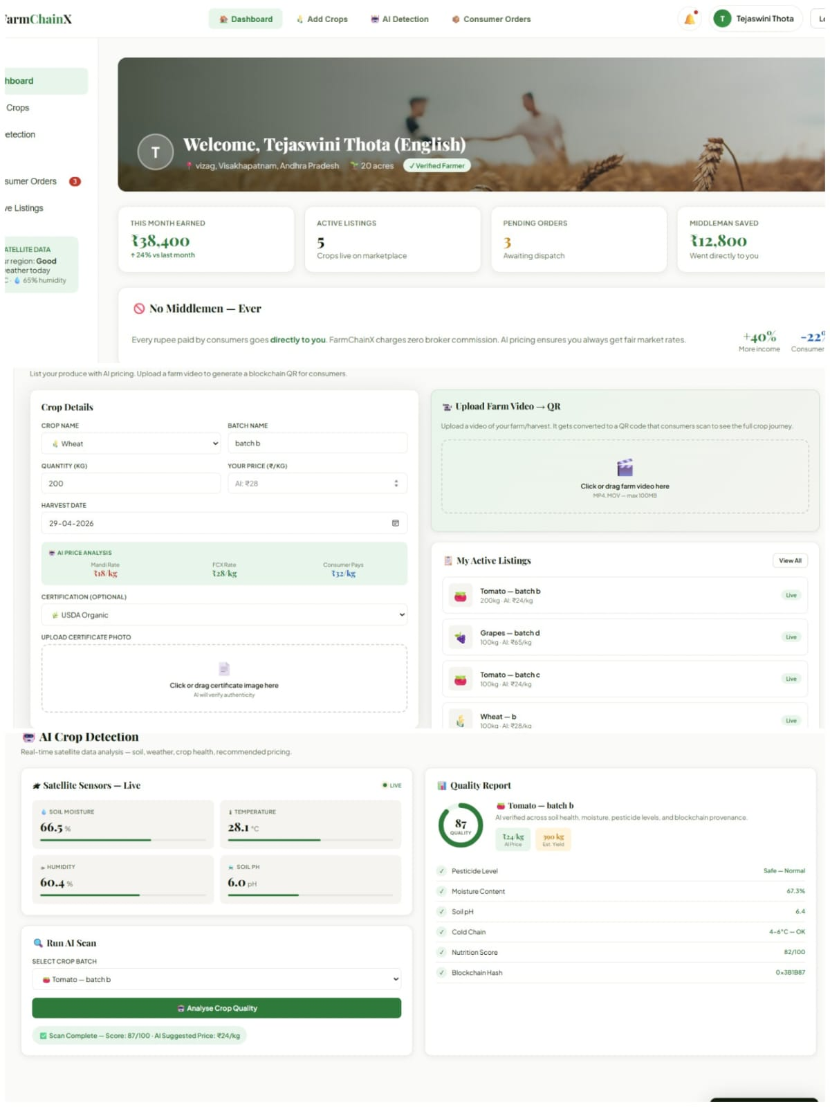

Slide 8
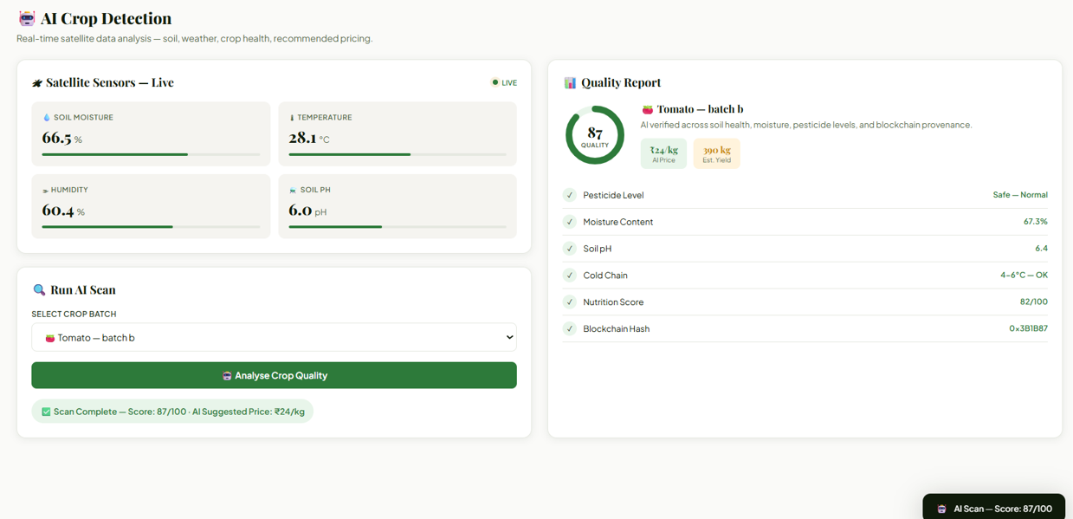

Slide 9
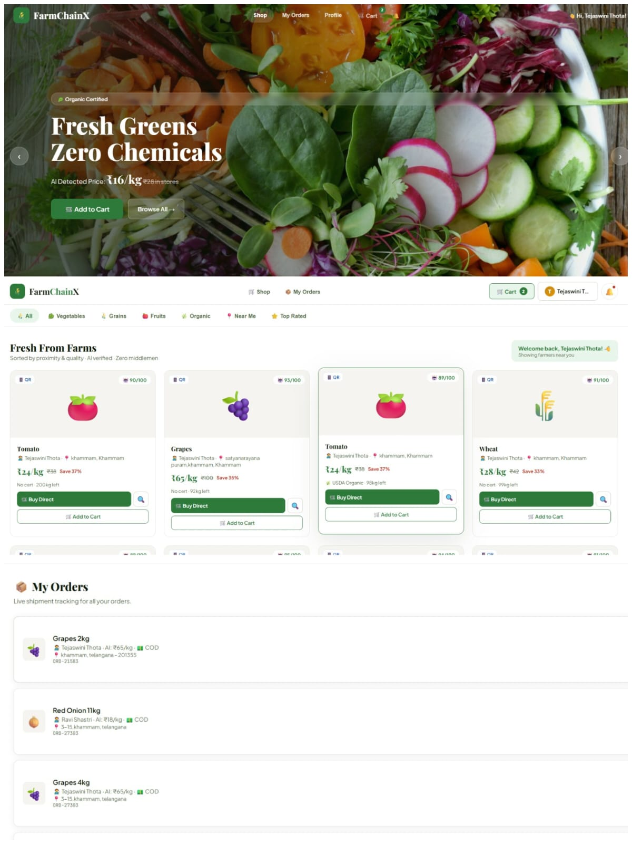

Slide 10
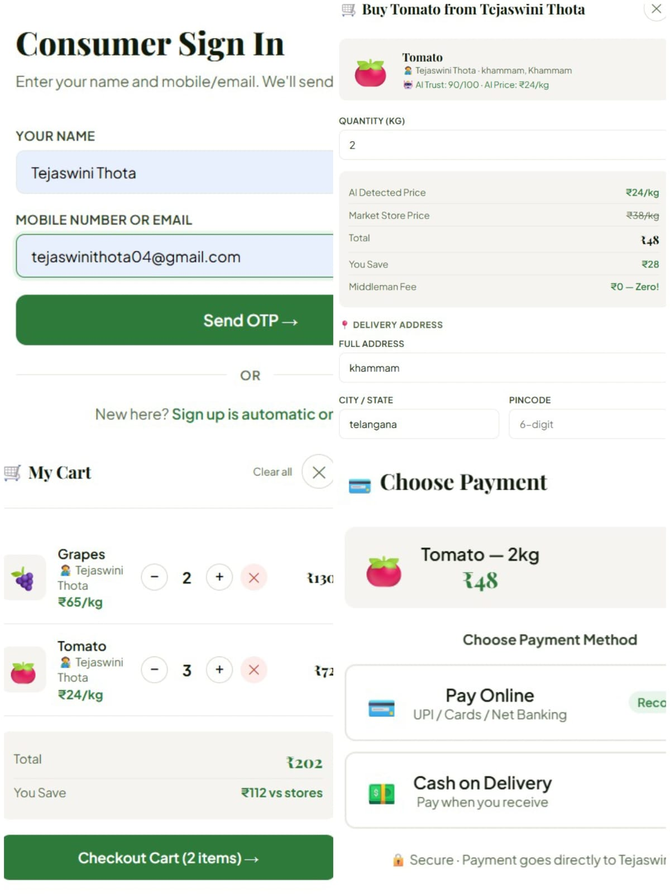

Slide 11
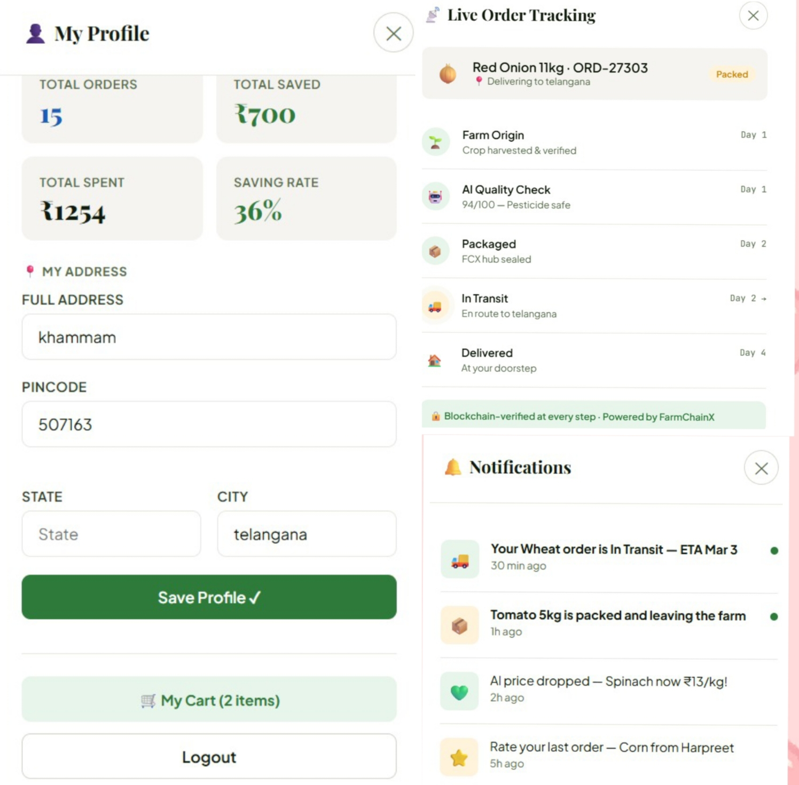

Slide 12
Thank you!

