Slide 1

Sentiment Classification Using NLP and Deep Neural Networks : An Analysis of Movie Reviews
Group – 16
Sulakshana Thirunagari
Tejaswini Gadde
Samyukth Challa
Professor –
Jesus A. Gonzalez

Slide 2
Introduction
Overview of Dataset
Dataset Preprocessing
Model Description
Performance Comparison
Strengths of the project
Areas of Improvement
Conclusion
Future Work
Agenda

Slide 3

Introduction
Sentiment analysis deciphers text emotions: positive, negative, neutral.
Applications: product reviews, social media analysis, customer feedback.
Deep learning models used: RNN, LSTM, CNN.
Dataset: IMDB, 25,000 training and testing samples.

Slide 4
IMDB dataset: 50,000 labeled reviews (positive/negative).
Data split: 25,000 training, 25,000 testing.
Sentiment balance: Equal proportion of positive and negative reviews.
No neutral ratings: Polarity ≥ 7 (positive), ≤ 4 (negative).
Overview of the Dataset

Slide 5
Loading the Data
Removing HTML Tags
Removing Diacritics
Expanding Contractions
Removing Numbers
Correcting Typos
Removing Punctuation
Lemmatization
Removing Double Spaces
Stopword Removal
Data Preprocessing

Slide 6
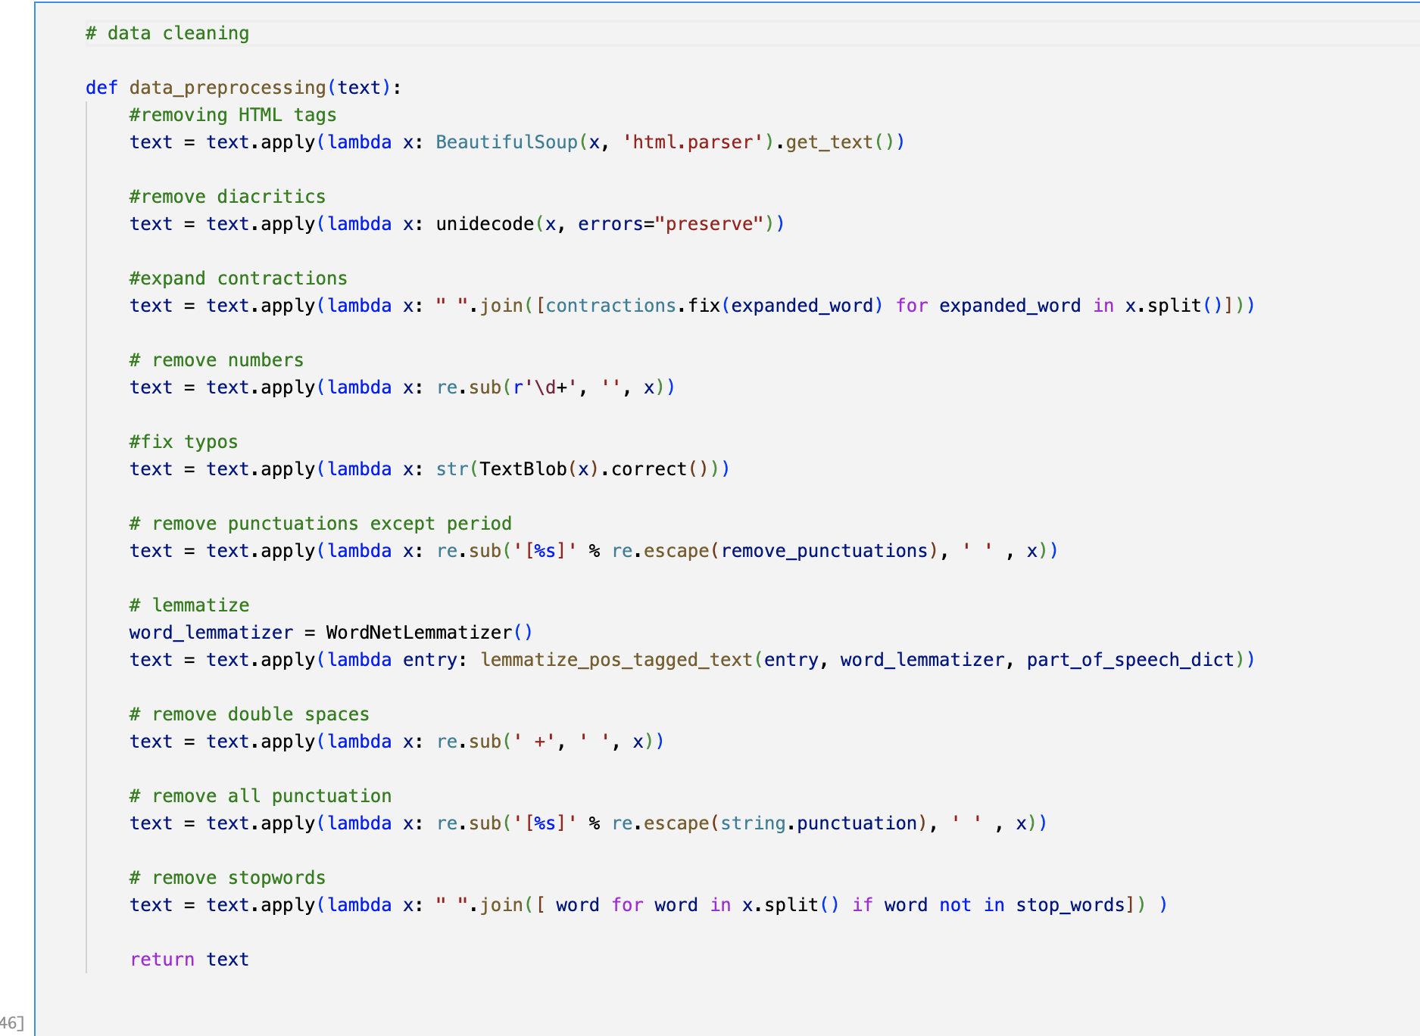

Slide 7




RNN: Sequential learning with GRU layers.
LSTM: Captures long-term dependencies in text.
CNN: Focuses on local feature extraction for sentiment classification.
Model Description

Slide 8
LAYERS
Embedding Layer: Converts words into dense vectors.
Activation Functions: ReLU for hidden layers, Sigmoid for output.
Regularization: Dropout and Batch Normalization to prevent overfitting.
Optimizer: Adam with varying learning rates.
Callbacks: EarlyStopping and ReduceLROnPlateau to optimize training.

Slide 9
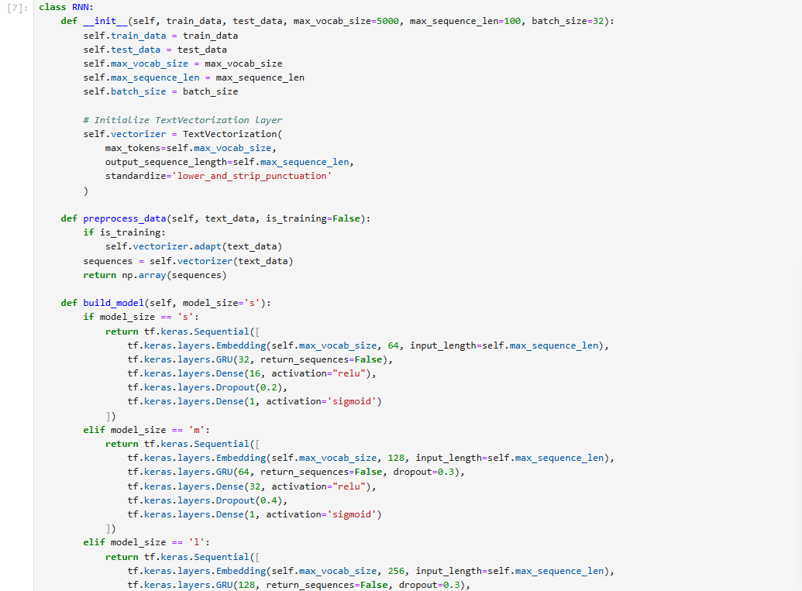
Improved RNN
Embedding Layer: max_vocab_size=5000,
GRU Layer: 32 units with dropout
Dense Layers: 16 units (ReLU) and output layer (Sigmoid).
Best performance at num_words = 5000 with highest accuracy of 0.8358.
Higher vocabulary sizes with fewer epochs slightly decreased accuracy.

Slide 10
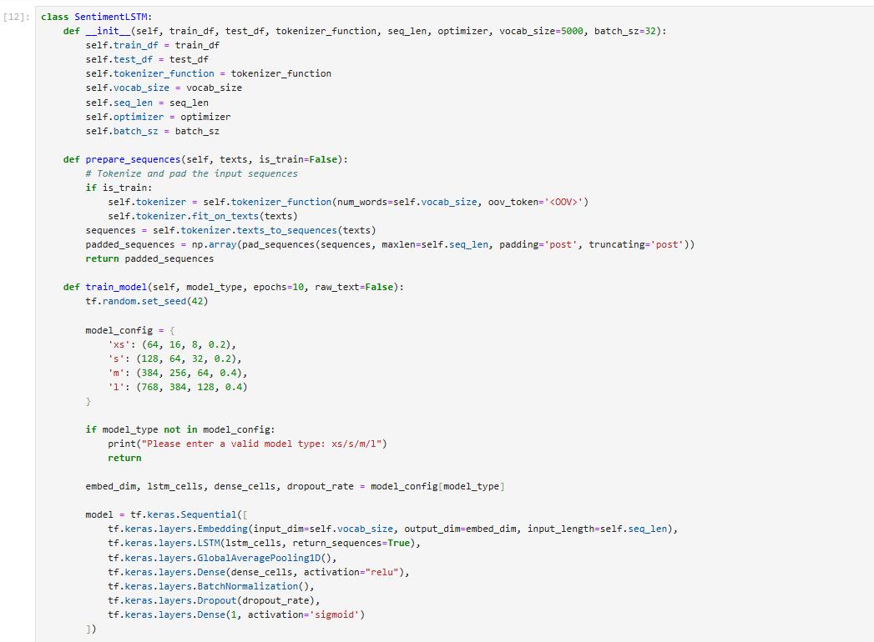
LSTM
.
Embedding Layer: Variable num_words.
LSTM Layer: Configurable size (s, m, l) with dropout.
Dense Layers: ReLU activation and Sigmoid output.
Best accuracy at num_words = 2500, model_size = 'm' with 0.8408.
Balanced precision and recall for both classes in optimal configurations.

Slide 11
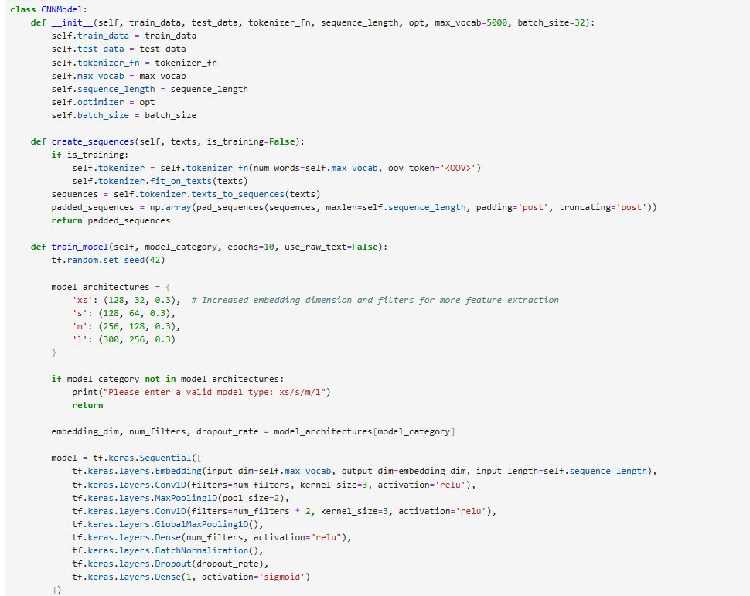
CNN
Embedding Layer: Variable num_words.
Convolutional Layers: Two Conv1D layers with varying filters.
Pooling Layers: MaxPooling1D and GlobalMaxPooling1D for dimensionality reduction.
Dense Layers: ReLU activation, BatchNormalization, Dropout, and Sigmoid output.

Slide 12
Model Training
Data Preprocessing (Tokenization, Padding)
Initialize the model with different parameters
Model Training with Early Stopping to prevent overfitting
training will be stopped when there is no accuracy improvements for the epochs
Evaluation on Validation Set
Perform multiple experiments with hyper parameters

Slide 13
Hyperparameters
Hyperparameter | Selected Values
Vocabulary Size | 500, 750, 1000, 2500, 5000, 7500, 10000, 20000
Sequence Length | 100 or 150
Learning Rate | 0.003
Batch Size | 256 or 512
Epochs | 10 or 100
Model Size | xs, s, m, l

Slide 14
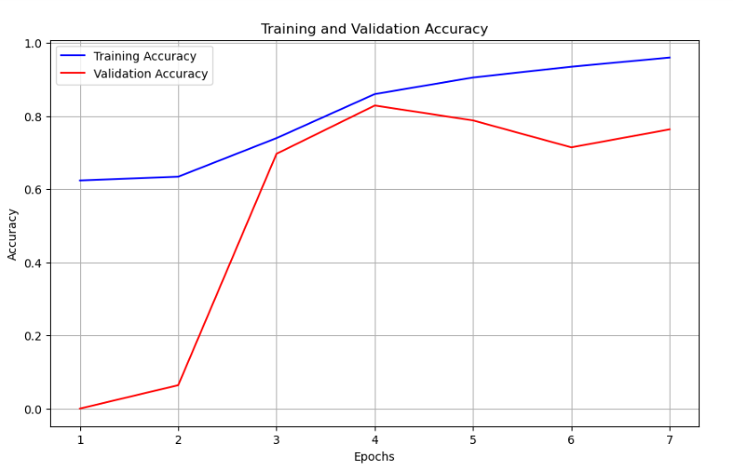
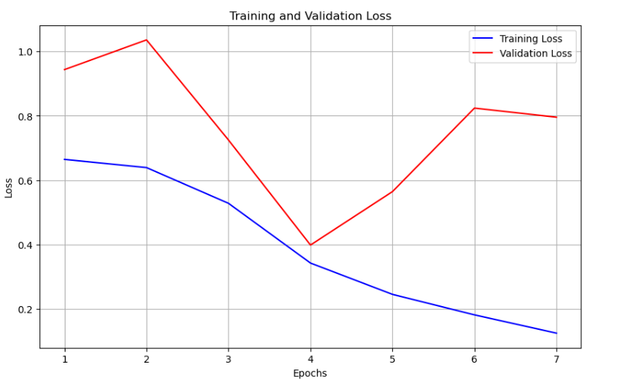
RNN Model performance
Hyperparameters | Model Accuracy | Precision (0) | Recall (0) | F1-score (0) | Precision (1) | Recall (1) | F1-score (1)
num_words=500, size='s' | 0.8023 | 0.84 | 0.75 | 0.79 | 0.77 | 0.85 | 0.81
num_words=750, size='s’ | 0.7859 | 0.76 | 0.85 | 0.80 | 0.83 | 0.73 | 0.77
num_words=1000, size='s' | 0.8206 | 0.86 | 0.76 | 0.81 | 0.79 | 0.88 | 0.83
num_words=2500, size='m' | 0.8331 | 0.85 | 0.81 | 0.83 | 0.82 | 0.85 | 0.84
num_words=5000, size='m' | 0.8337 | 0.83 | 0.84 | 0.84 | 0.84 | 0.83 | 0.83
num_words=5000, size='m' | 0.8358 | 0.83 | 0.84 | 0.84 | 0.84 | 0.83 | 0.84
num_words=7500, size='m' | 0.7944 | 0.85 | 0.71 | 0.78 | 0.75 | 0.88 | 0.81
num_words=7500, size='m' | 0.7826 | 0.86 | 0.68 | 0.76 | 0.73 | 0.89 | 0.80
num_words=10000, size='l’ | 0.8146 | 0.80 | 0.84 | 0.82 | 0.83 | 0.79 | 0.81
num_words=10000, size='l’ | 0.7764 | 0.85 | 0.67 | 0.75 | 0.73 | 0.88 | 0.80
num_words=20000, size='l' | 0.7977 | 0.86 | 0.71 | 0.78 | 0.75 | 0.89 | 0.81
num_words=20000, size='l’ | 0.7763 | 0.71 | 0.94 | 0.81 | 0.91 | 0.62 | 0.73
Best Accuracy: 0.83748 with num_words = 5000, epochs = 100.
The optimal RNN configuration for this sentiment analysis task is num_words = 5000, epochs = 100, yielding 0.8358 accuracy.

Slide 15
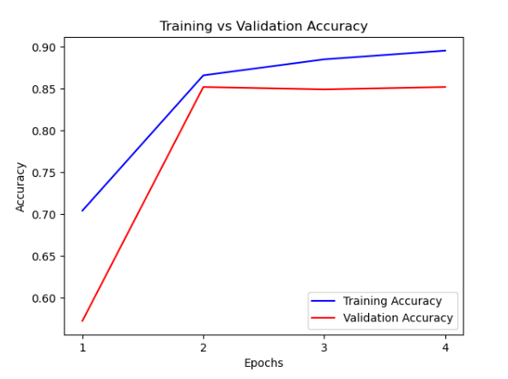
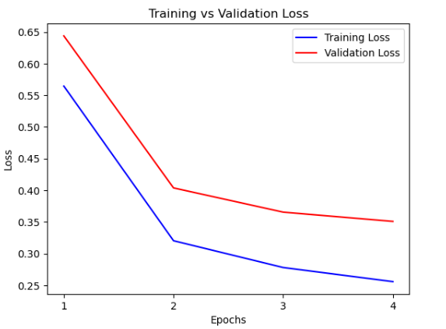
Results
LSTM Model Performance
Configuration | Accuracy | Precision (0) | Recall (0) | F1-score (0) | Precision (1) | Recall (1) | F1-score (1)
num_words = 500, model_size = 's' | 0.82396 | 0.88 | 0.75 | 0.81 | 0.78 | 0.90 | 0.84
num_words = 750, model_size = 's' | 0.8366 | 0.86 | 0.81 | 0.83 | 0.82 | 0.87 | 0.84
num_words = 1000, model_size = 's' | 0.83092 | 0.90 | 0.74 | 0.81 | 0.78 | 0.92 | 0.84
num_words = 2500, model_size = 'm' | 0.8408 | 0.90 | 0.76 | 0.83 | 0.80 | 0.92 | 0.85
num_words = 5000, model_size = 'm' | 0.83904 | 0.88 | 0.78 | 0.83 | 0.81 | 0.89 | 0.85
num_words = 7500, model_size = 'm' | 0.82076 | 0.78 | 0.90 | 0.83 | 0.88 | 0.75 | 0.81
num_words = 7500, model_size = 'm' | 0.78972 | 0.82 | 0.74 | 0.78 | 0.76 | 0.84 | 0.80
num_words = 10000, model_size = 'l' | 0.83104 | 0.82 | 0.84 | 0.83 | 0.84 | 0.82 | 0.83
num_words = 10000, model_size = 'l' | 0.79572 | 0.92 | 0.65 | 0.76 | 0.73 | 0.94 | 0.82
num_words = 20000, model_size = 'l' | 0.81876 | 0.76 | 0.92 | 0.84 | 0.90 | 0.71 | 0.80
num_words = 20000, model_size = 'l' | 0.80964 | 0.77 | 0.89 | 0.82 | 0.87 | 0.73 | 0.79
The highest accuracy achieved was 0.8408 with the configuration num_words = 2500 and model_size = 'm'

Slide 16
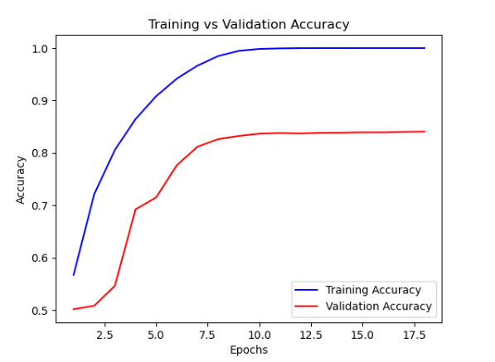
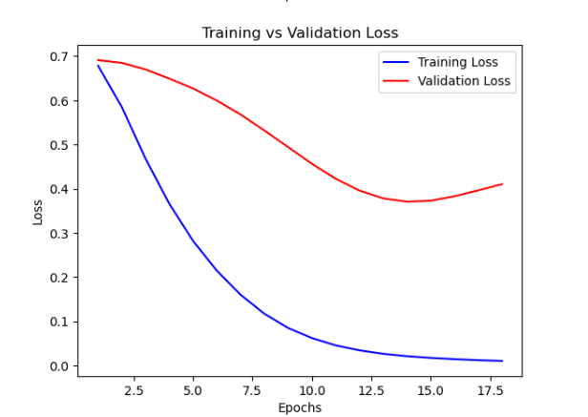
CNN Model Performance
Configuration | Accuracy | Precision (0) | Recall (0) | F1-score (0) | Precision (1) | Recall (1) | F1-score (1)
num_words=500, model_size='s' | 0.81068 | 0.83 | 0.78 | 0.81 | 0.79 | 0.84 | 0.82
num_words=750, model_size='s' | 0.8162 | 0.82 | 0.80 | 0.81 | 0.81 | 0.83 | 0.82
num_words=1000, model_size='s' | 0.82484 | 0.82 | 0.83 | 0.83 | 0.83 | 0.82 | 0.82
num_words=2500, model_size='m' | 0.83728 | 0.84 | 0.83 | 0.84 | 0.83 | 0.85 | 0.84
num_words=5000, model_size='m' | 0.83296 | 0.86 | 0.79 | 0.83 | 0.81 | 0.88 | 0.84
num_words=7500, model_size='m' | 0.8196 | 0.83 | 0.81 | 0.82 | 0.81 | 0.83 | 0.82
num_words=7500, model_size='m' | 0.76276 | 0.77 | 0.75 | 0.76 | 0.76 | 0.77 | 0.76
num_words=10000, model_size='l' | 0.83644 | 0.84 | 0.83 | 0.84 | 0.83 | 0.84 | 0.84
num_words=10000, model_size='l' | 0.80656 | 0.80 | 0.82 | 0.81 | 0.82 | 0.79 | 0.80
num_words=20000, model_size='l' | 0.83136 | 0.83 | 0.83 | 0.83 | 0.83 | 0.83 | 0.83
num_words=20000, model_size='l' | 0.80452 | 0.80 | 0.82 | 0.81 | 0.81 | 0.79 | 0.80
The highest accuracy achieved was 0.8378 with the configuration num_words = 2500 and model_size = 'm'

Slide 17
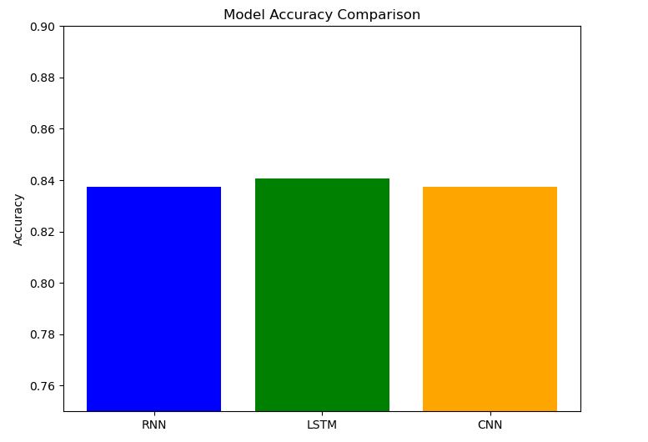
LSTM: Highest accuracy - 84.08% .
CNN: High speed, accuracy - 83.72% .
RNN: Balanced performance with slight limitations on long sequences.
Performance Comparison
Figure 2: Visualization for Accuracy Comparison

Slide 18
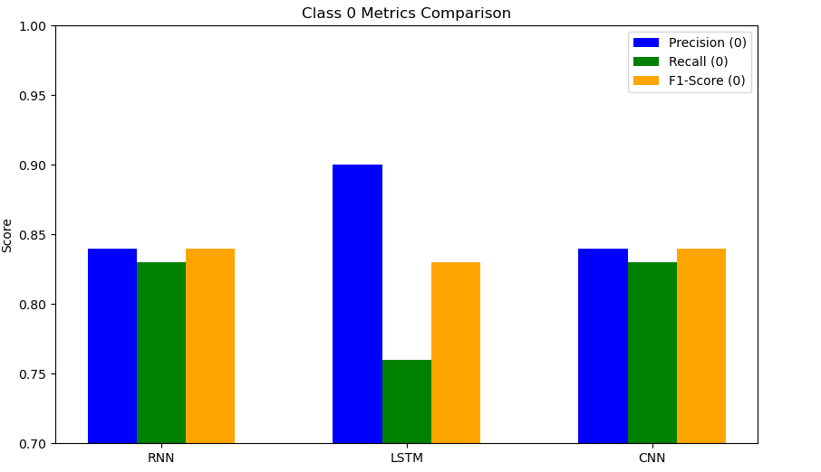
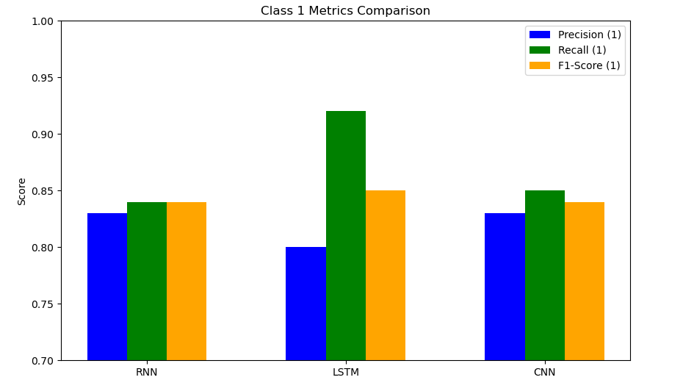
Comparision Metrics
Figure: Precision, recall and F1-score Visualization for negative class
Figure: Precision, recall and F1-score Visualization for positive class

Slide 19
Strengths of the Project
Compared RNN, LSTM, and CNN with detailed metrics.
LSTM achieved highest accuracy and balanced performance.
Effective preprocessing ensured reliable input.
Fine-tuned hyperparameters for better scalability.
Visualizations enhanced interpretability.
Results are reproducible using the IMDb dataset.

Slide 20
Successfully applied RNN, LSTM, and CNN for sentiment analysis.
LSTM outperformed other models with the highest accuracy.
Preprocessing and fine-tuning improved model performance.
Provides a solid foundation for advancing sentiment analysis research.
Conclusion

Slide 21
Implement advanced models like BERT or GPT for better contextual understanding.
Further fine-tuning hyperparameters for each model.
Combining multiple models to leverage their strengths.
Building a web or mobile application to utilize the trained models in real-time.
Error Analysis— Investigating misclassified instances to understand model limitations.
Future Work

Slide 22
REFERENCES
Shilpa. P. C, Rissa Shereen, Susmi Jacob, Vinod P, "Sentiment Analysis Using Deep Learning," Third International Conference on Intelligent Communication Technologies and Virtual Mobile Networks (ICICV 2021).
Nehal Mohamed Ali, Marwa Mostafa Abd El Hamid, Aliaa Youssif, "Sentiment Analysis For Movies Reviews Dataset Using Deep Learning Models," International Journal of Data Mining & Knowledge Management Process (IJDKP).
Saeed Mian Qaisar. "Sentiment Analysis of IMBd Movie Reviews Using Long Short-Term Memory", 2020 2nd International Conference on Computer and Information Sciences (ICCIS).

Slide 23
THANK YOU

