Slide 1
Climate Change Visualization Project
Project 1
By,
XXXXXXXXXX
XXXXXXXXXX
XXXXXXXXXX

Slide 2
Title
Climate Change Patterns: Visualizing Global Temperature and Emissions Correlations

Slide 3
Introduction
Domain: Climate Science and Environmental Analysis
This project explores the relationship between global temperature anomalies and greenhouse gas emissions
Focuses on visualizing temporal and geographical patterns in climate data
Aims to present complex climate relationships through intuitive visualizations

Slide 4
Research Questions
How have global temperature anomalies changed over time (1880-present)?
Which countries are the largest contributors to greenhouse gas emissions?
What is the statistical correlation between CO₂ emissions and temperature changes?
Can we identify critical periods where emissions and temperature show significant relationship changes?

Slide 5
Research Questions
How have global temperature anomalies changed over time (1880-present)?
Which countries are the largest contributors to greenhouse gas emissions?
What is the statistical correlation between CO₂ emissions and temperature changes?
Can we identify critical periods where emissions and temperature show significant relationship changes?

Slide 6
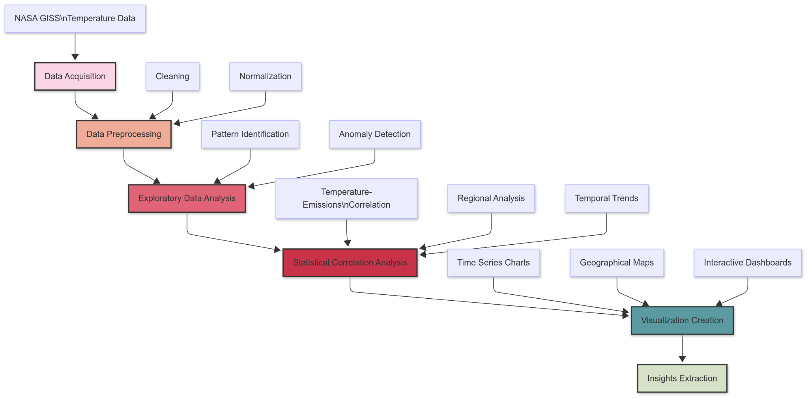
Methodology - Workflow

Slide 7
Data Abstraction
NASA GISS Surface Temperature Analysis:
Type: Structured time-series data
Key attributes: Date, Location (lat/long), Temperature anomaly
Size: Monthly measurements from 1880-present (~1700 time points)
Our World in Data CO₂ Emissions:
Type: Structured time-series data
Key attributes: Year, Country, Total emissions, Per capita emissions, Sector breakdown
Size: Annual measurements from 1750-present for 200+ countries

Slide 8
Data Source
NASA GISS Surface Temperature Analysis (GISTEMP v4)
Source: https://data.giss.nasa.gov/gistemp/
Highly respected climate dataset used in IPCC reports
Our World in Data CO₂ Emissions Dataset
Source: https://github.com/owid/co2-data
Comprehensive emissions data compiled from multiple sources

Slide 9
Data Transformation
Standardized measurement units across temperature records
Aggregated monthly data to create seasonal and annual averages
Created regional groupings for geographic analysis
Filled missing values in temperature records using interpolation
Calculated moving averages to smooth short-term variability
Generated temperature anomaly calculations relative to baseline periods

Slide 10
Task Abstraction - Target
Long-term global temperature trends (1880-present)
Acceleration patterns in temperature change
Seasonal temperature variation patterns
Regional differences in warming rates
Identification of climate anomalies and extreme events
Statistical significance of observed temperature changes

Slide 11
Task Abstraction - Actions
Time-series analysis of temperature anomalies
Seasonal decomposition of temperature patterns
Geographic aggregation and regional comparison
Moving average calculations to identify trends
Variance analysis to identify changing temperature volatility
Statistical significance testing of warming patterns

Slide 12
Technical Implementation
Python for data cleaning and analysis
Pandas for data manipulation
NumPy for numerical operations
SciPy for statistical analysis
Matplotlib for preliminary visualizations
Power BI for visualization creation
Connected to preprocessed temperature dataset
Created interactive temperature dashboards
Designed custom visualizations for temporal and spatial patterns

Slide 13
EDA - Visualizations

Slide 14
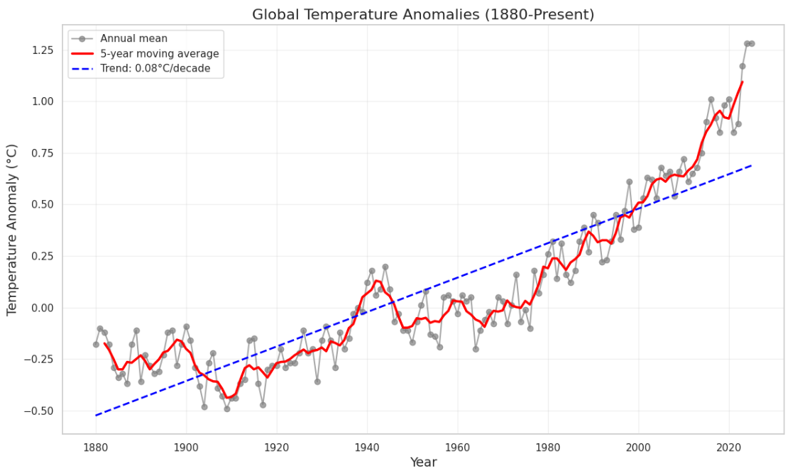
This graph shows global temperature anomalies from 1880-present with annual values (gray dots/line), 5-year moving average (red line), and the long-term warming trend of 0.08°C per decade (blue dashed line).
The data reveals a clear progression from cooler temperatures (negative anomalies) before 1940 to accelerating warming after 1980, with recent temperatures exceeding 1.0°C above the baseline period.

Slide 15
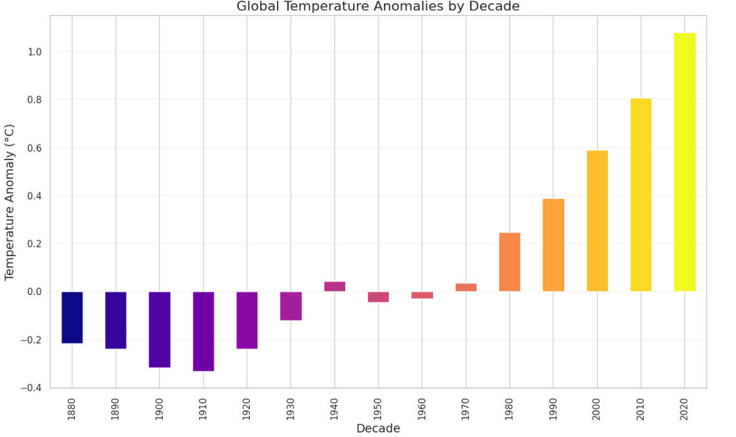
This bar chart displays average global temperature anomalies by decade, using color gradient from purple (cooler) to yellow (warmer) to emphasize the warming trend.
The visualization shows a clear progression from negative anomalies in early decades (1880s-1920s) to increasingly positive anomalies in recent decades, with the 2020s exceeding 1.0°C above baseline—more than double the warming observed in the 1990s.

Slide 16
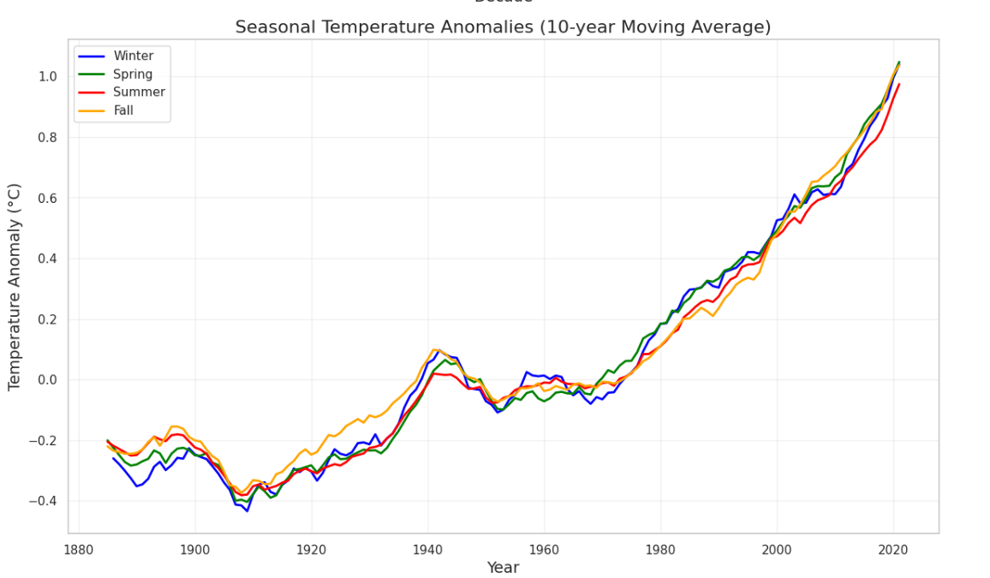
This multi-line chart displays 10-year moving averages of temperature anomalies for all four seasons (Winter, Spring, Summer, Fall), showing they've followed similar warming trajectories since 1880.
All seasons exhibit parallel warming patterns with a notable mid-century plateau around 1940-1970, followed by consistent acceleration after 1980, reaching approximately 1.0°C above baseline by 2020—indicating climate change is affecting all seasons similarly.

Slide 17
Power BI Dashboard

Slide 18
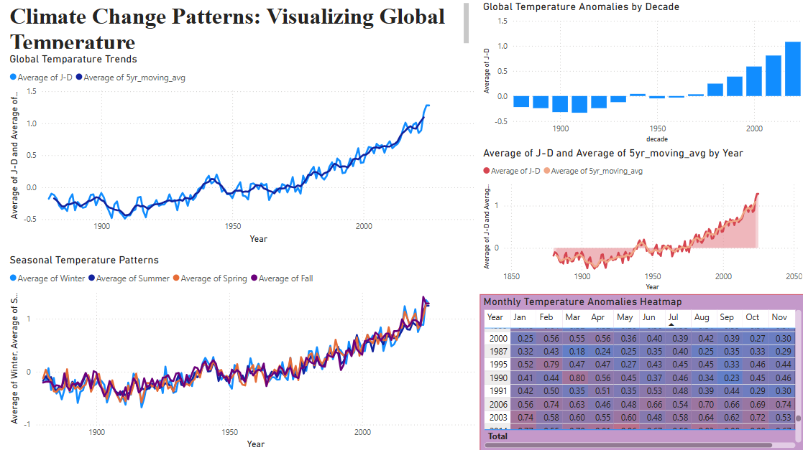

Slide 19
Explanation (Power BI dashboard)
This dashboard visualizes NASA GISS temperature data showing clear global warming patterns from 1880-present.
The top-left chart shows annual (blue) and 5-year moving average (orange) temperatures, revealing dramatic acceleration after 1980.
The top-right chart displays decadal temperatures, progressing from negative anomalies pre-1950 to exceeding 1.0°C in recent decades.
The bottom visualizations break down trends by season (showing all seasons warming simultaneously) and display monthly anomalies through a color-coded heatmap.

Slide 20
Story telling Stage-1
Initial exploration revealed significant data quality variations across regions
Temperature measurements more reliable in recent decades
Identified key periods of acceleration in warming trends
Discovered important regional variations requiring further investigation
Found interesting patterns in seasonal temperature changes

Slide 21
Story telling Stage-2
Moving averages reveal clearer long-term trends beyond natural variability
Statistical analysis confirms significance of warming patterns
Regional analysis shows geographic disparity in warming rates
Temporal analysis identifies acceleration points in temperature increase
Extreme value analysis shows changing distribution of temperature events

Slide 22
Work Management
Implementation Status:
Completed temperature data acquisition and preprocessing
Finished exploratory temperature data analysis
Created 5 core temperature visualizations in Power BI
Conducted statistical analysis using Python
Prepared the Presentation on initial findings and methodology

Slide 23
Individual Contribution
Team Member 1:
Led data acquisition and preprocessing workflow
Developed Python code for statistical analysis
Created data transformation pipeline
Performed temporal trend analysis
Team Member 2:
Led visualization design and implementation
Created interactive dashboards in Power BI
Designed color schemes and visual encodings
Implemented seasonal and decadal visualizations
Team Member 3:
Designed the Heat Map in Power Bi dashboard
Prepared Storytelling and analytical narrative
Created presentation structure and content
Prepared future recommendations for Project 2

Slide 24
Next Steps for Project 2
Integrate CO₂ emissions dataset from Our World in Data
Analyze correlation between temperature changes and emissions
Create interactive D3.js visualizations for web deployment
Implement sector-based emissions analysis
Develop country-level comparison of emissions and temperature patterns
Create comprehensive interactive web experience with narrative components

Slide 25
Thank you

