Slide 1
Tejaswini M
Text to Image
3/21/2024 Annual Review

Slide 2
IMAGE TO TEXT
Visual content serves as a potent communication tool, capable of captivating audiences within seconds. Research indicates that people process visual information 60,000 times faster than text, highlighting the innate power of images to grab attention and convey messages effectively. Whether it's photographs, infographics, or videos, visual elements play a crucial role in engaging and retaining audience interest.
3/21/2024 Annual Review

Slide 3


AGENDA
Problem Statement
Project Overview
End Users
Solution
Modelling
Result
Conclusion
3/21/2024 Annual Review

Slide 4

PROBLEM STATEMENT
Traditional text-based methods struggle to engage audiences amidst the information overload, leading to difficulties in conveying intricate concepts and ensuring comprehension. This communication gap impedes message effectiveness and desired outcomes.
3/21/2024 Annual Review

Slide 5
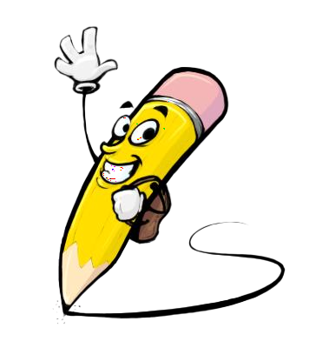
PROJECT OVERVIEW
In an increasingly visual-oriented digital landscape, the ability to effectively transform textual content into compelling visual representations is paramount. My project, Text-to-Image, aims to address this need by developing an innovative model that seamlessly converts text into captivating imagery. By bridging the gap between text and visual communication, the project seeks to enhance engagement, comprehension, and the overall impact of communication efforts across various domains.
3/21/2024 Annual Review

Slide 6

WHO ARE THE END USERS?
Content creators, including bloggers, vloggers, and social media influencers, can benefit from the model to generate visually captivating content for their online platforms, enhancing audience engagement.
3/21/2024 Annual Review

Slide 7

THE WOW IN YOUR SOLUTION
Generator
The Generator generates the image from the text given as input each time the user refresh it generates new image
3/21/2024 Annual Review

Slide 8
MODELLING
First preprocess the textual data and load it into the system. Next, utilize a Stable Diffusion Pipeline, a powerful tool for generating images from text, to transform the textual descriptions into images. Then fine-tune the pipeline using a pre-trained model to ensure high-quality image generation.Libraries such as PyTorch, Transformers, tqdm, and OpenCV are used.
3/21/2024 Annual Review

Slide 9
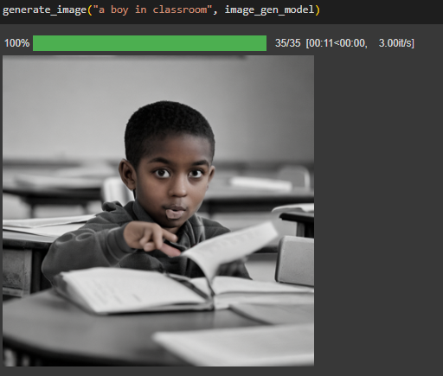
RESULTS
https://colab.research.google.com/drive/1u4-JYljnKH-o9Z_X09qpTprXpopsWpWd?usp=sharing
3/21/2024 Annual Review

Slide 10

Conclusion
My project aims to demonstrate the feasibility and effectiveness of using deep learning for text-to-image generation. By leveraging advanced deep learning techniques and state-of-the-art models, we strive to push the boundaries of text-to-image synthesis and pave the way for exciting applications in fields such as content generation, design, and multimedia.
3/21/2024 Annual Review

