Slide 1
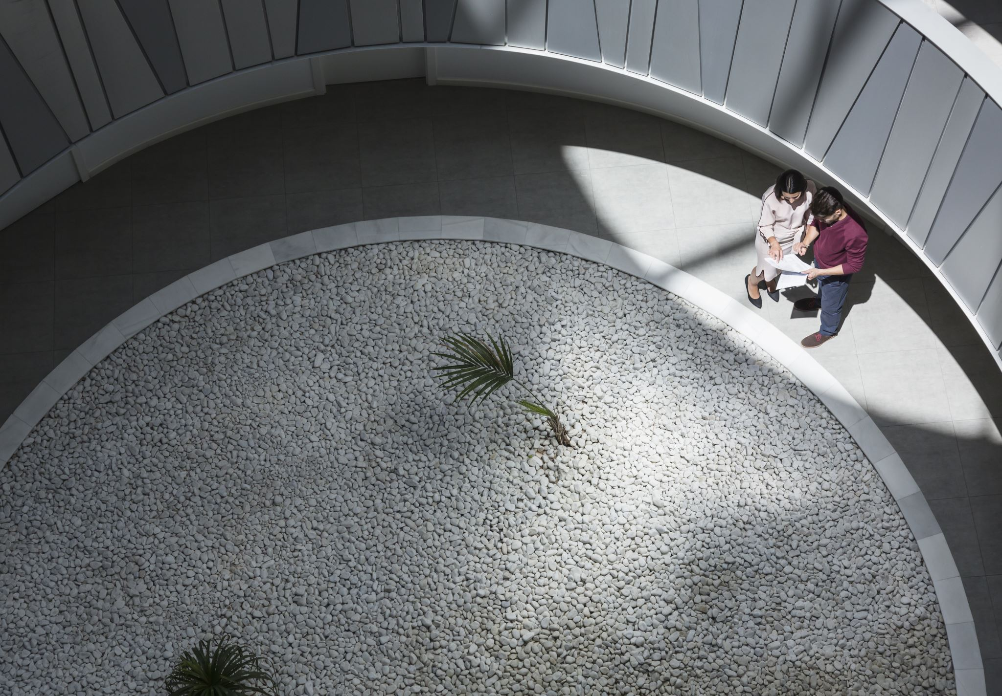
HealthAI – Intelligent Healthcare Assistant using IBM Granite
Internship Project by Bangaru Tejaswini
NRI Institute of Technology
SmartInternz with IBM

Slide 2

Problem Statement
• Patients delay checkups due to minor doubts
• Rural areas lack quick health guidance
• No easy AI-based assistant for everyday health Q&A

Slide 3
Objectives
• Build a chatbot that assists patients with common health questions
• Predict possible conditions based on user symptoms
• Generate treatment suggestions using AI
• Make it accessible using a simple web app (Streamlit)

Slide 4

Technologies Used
• ✨ IBM Granite 13B Chat Model (Hugging Face)
• 🚀 Python
• 🌐 Streamlit
•✨ Pyngrok (for public hosting)
•💬 Hugging Face API
• Google Colab

Slide 5

System Architecture
User inputs
Streamlit UI
Model Prompt
IBM Granite API
Response

Slide 6

Key Features
💬 Ask Health Questions
🔍 Predict Health Conditions
📄 Generate Treatment Plans
✨ Easy interface + real-time AI replies

Slide 7
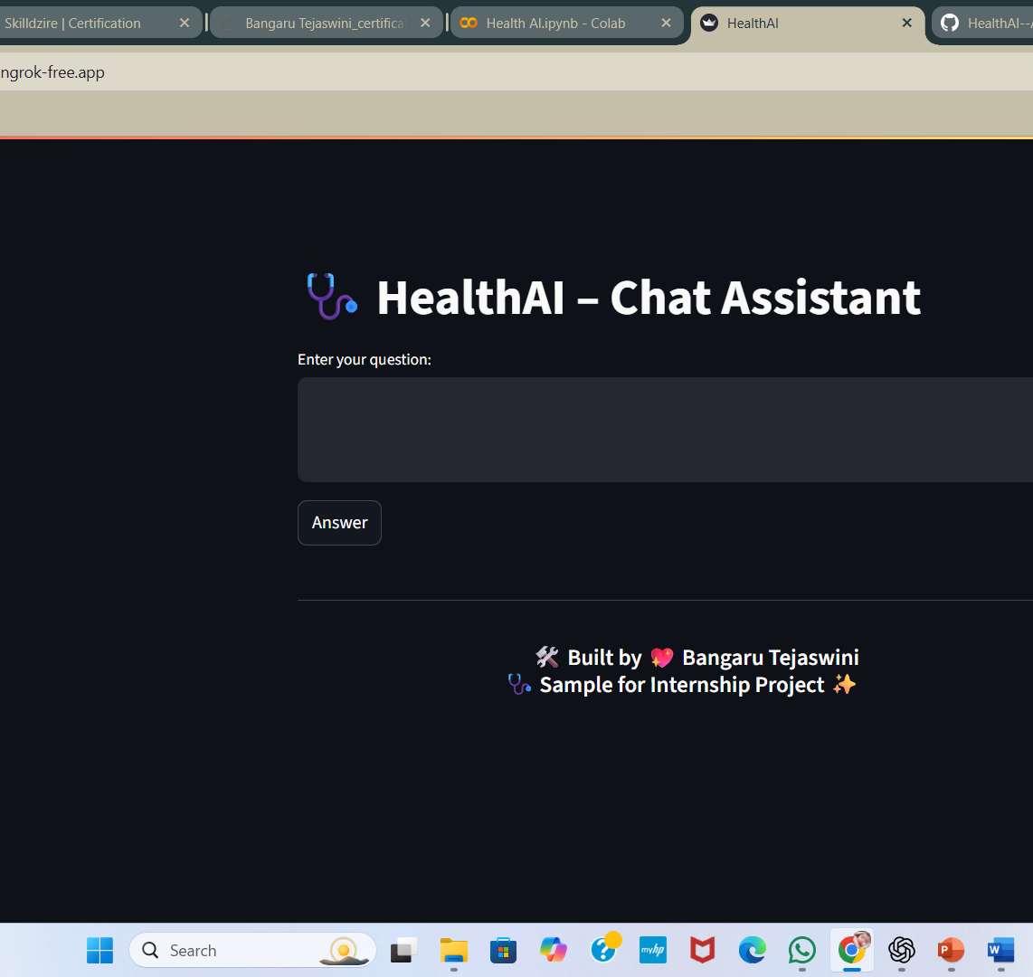
UI Preview – Ask Question
Patients enter any health-related query
AI gives friendly, evidence-based answers

Slide 8
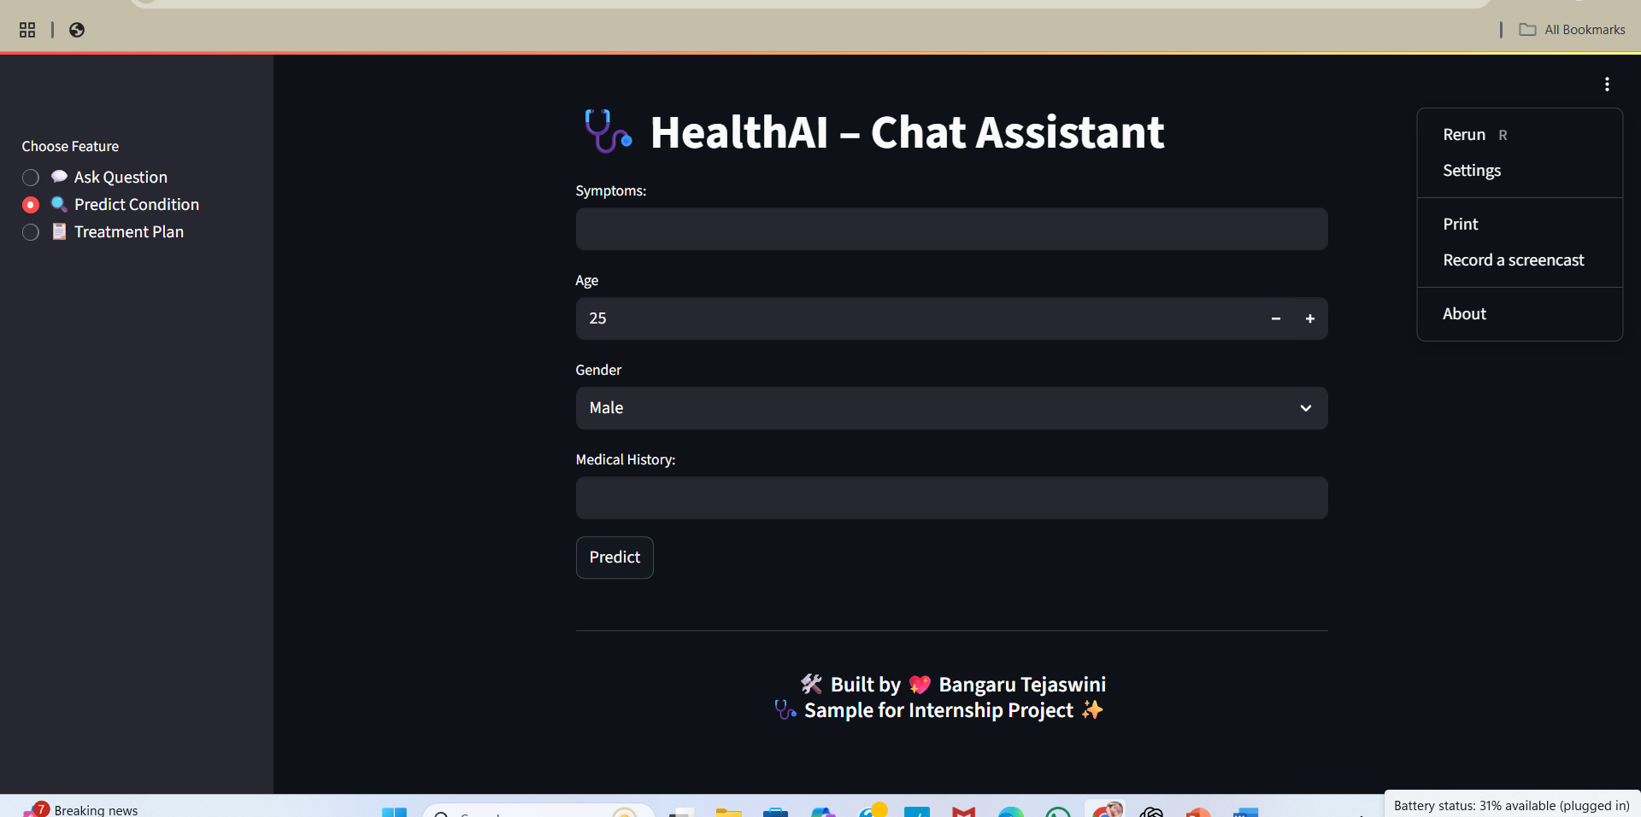
UI Preview – Predict Condition
User enters symptoms, age, gender, history
AI responds with top 3 possible conditions

Slide 9
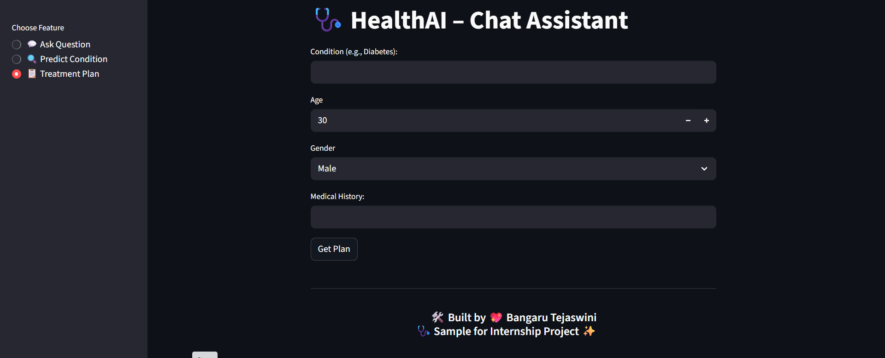
UI Preview – Treatment Plan
User provides known condition & personal details
AI returns a plan: meds, diet, lifestyle, testing

Slide 10
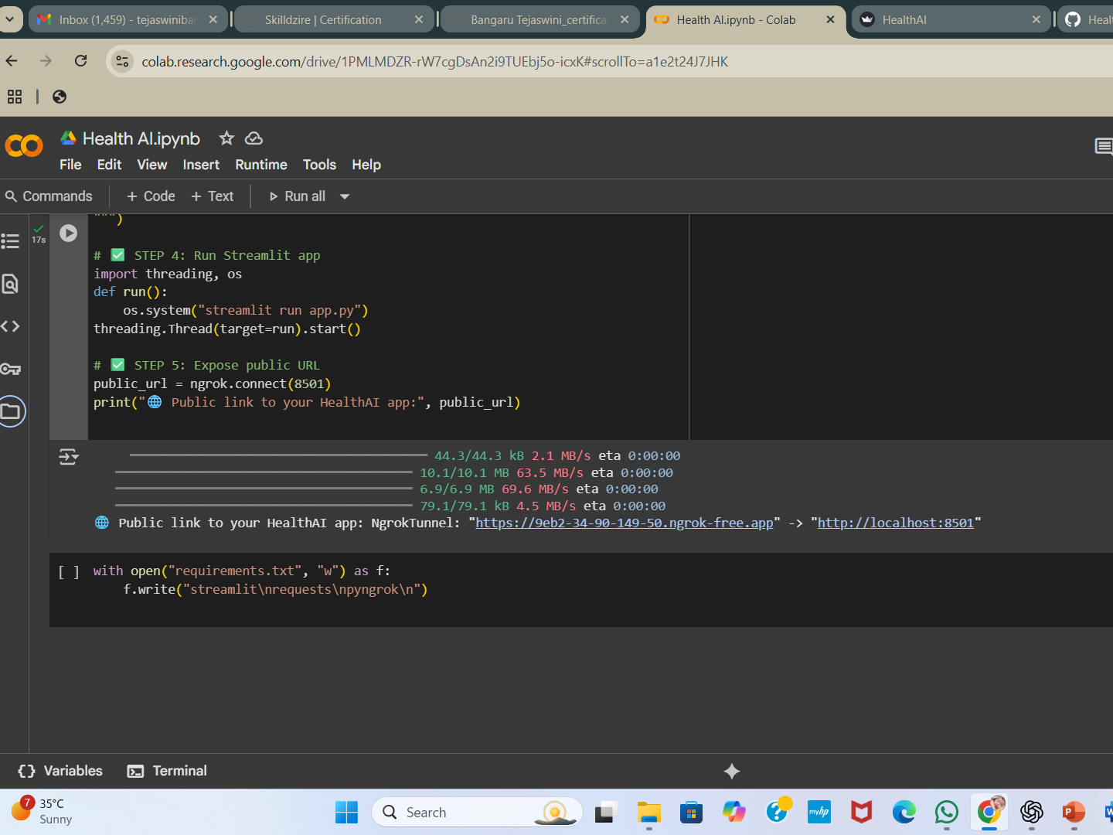
Live Demo – Colab + Public URL

Slide 11

Sample Output (Text)
• Condition: Diabetes
AI Suggestion:
• Take Metformin 500mg once daily
• Eat high-fiber foods
• Walk 30 mins daily
• Check HbA1c every 3 months

Slide 12
Benefits
• 24x7 Health Assistant
• No technical knowledge needed
• Faster health decision support
• Easy access from mobile/laptop
• Useful for rural and urban users

Slide 13
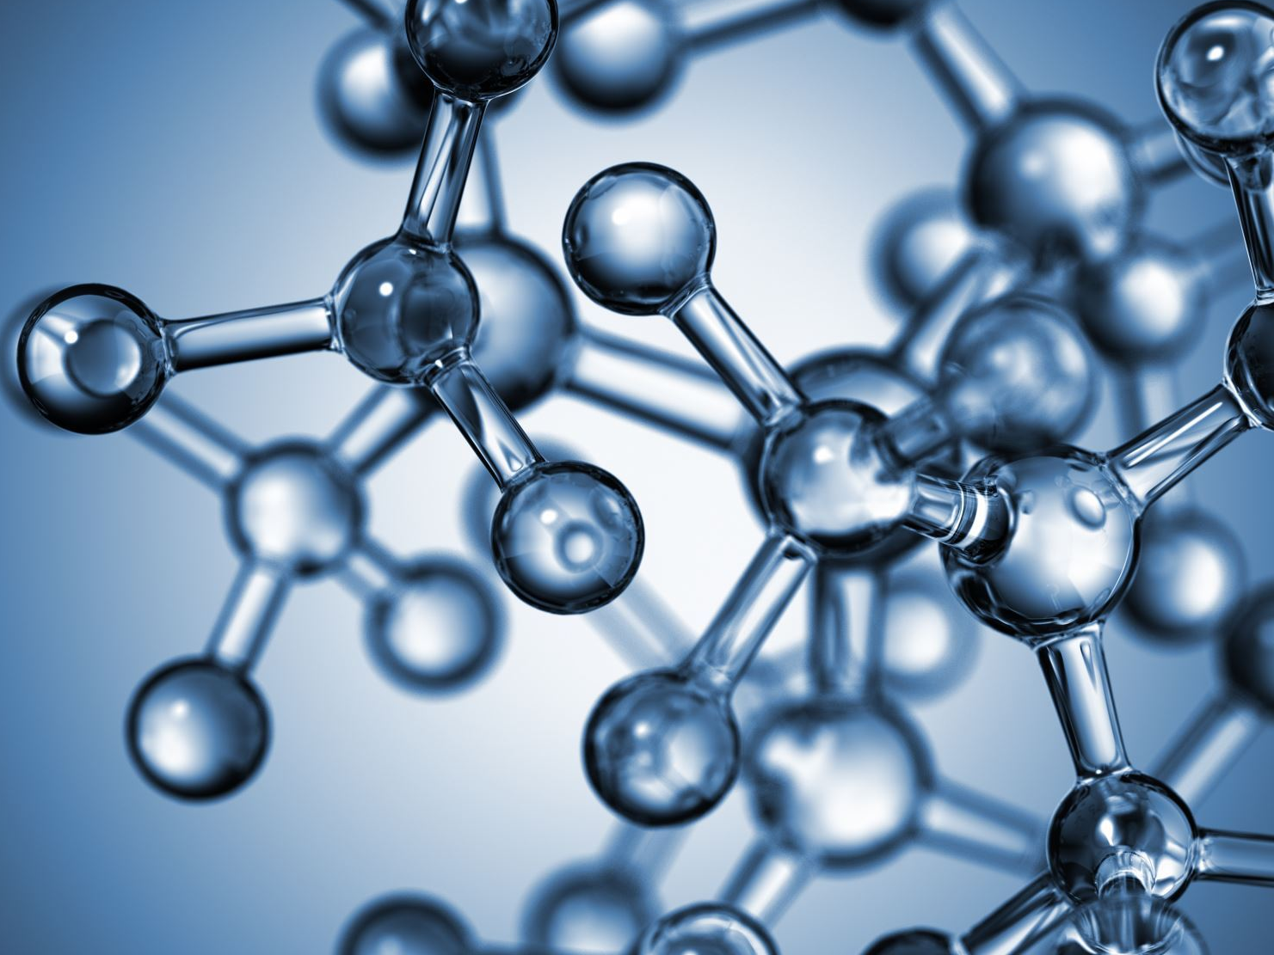
Challenges Faced
• Limited tokens in Hugging Face API
• Streamlit hosting requires ngrok
• Needed to ensure ethical + responsible replies

Slide 14

Future Enhancements
• Add voice input/output
• Save patient history securely
• Add multi-language support (e.g., Telugu)
• Integrate with hospital systems

Slide 15
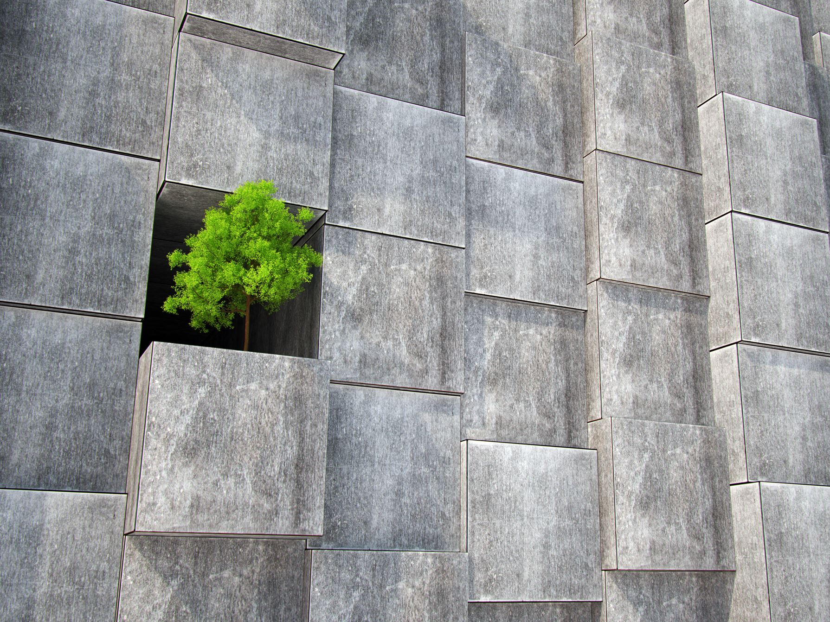
Thank You
Thank you for giving me this opportunity to present!
Project by Bangaru Tejaswini
HealthAI – Powered by IBM Granite

