Slide 1
IoT-Based Implementation Using AWS IoT Core
KARPURAM TEJASWINI – 2210030434
Guide Name : Ms. P. Sree Lakshmi

Slide 2
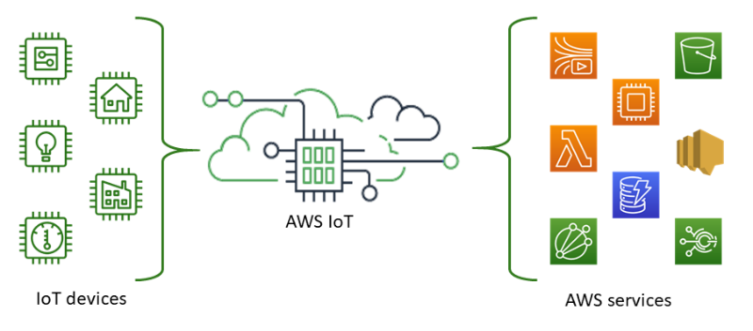
Introduction
The project focuses on implementing a smart home automation system using AWS IoT Core. It enables remote monitoring and control of home appliances through cloud-based services and IoT devices.

Slide 3
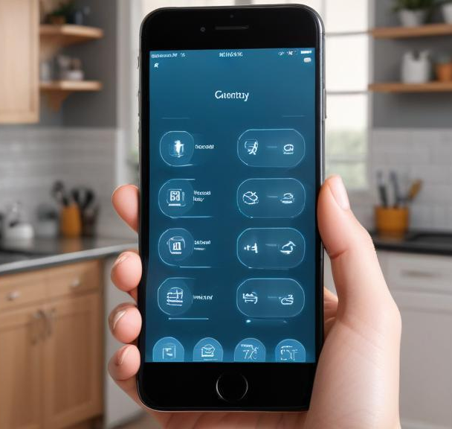
AWS Services Used and Justification
AWS IoT Core is used for secure device connectivity and message routing. DynamoDB stores device data, while AWS Lambda automates processing. AWS IAM ensures security, and AWS SNS provides real-time alerts.

Slide 4
Project Purpose and Expected Outcome:
The project aims to create an efficient and secure smart home system that allows users to control appliances remotely while ensuring real-time monitoring and automation.

Slide 5
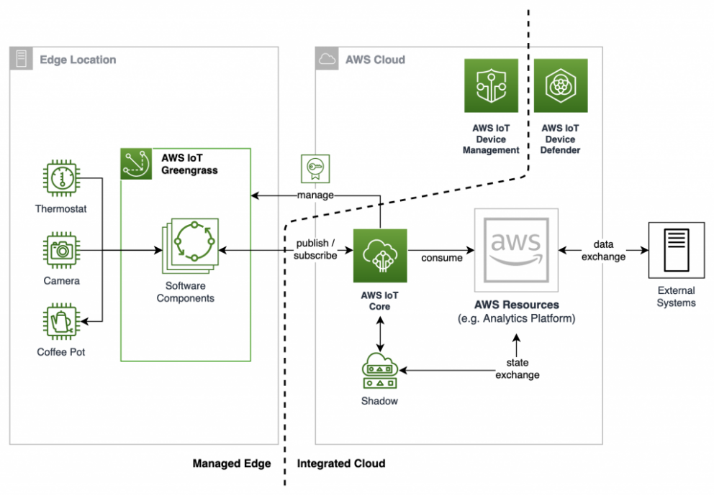
Architecture and workflow of the system
IoT devices connect to AWS IoT Core via MQTT for real-time data transmission. AWS IoT Rules Engine routes messages to DynamoDB for storage and triggers AWS Lambda for automation. The frontend application retrieves data and controls devices via API Gateway.

Slide 6
AWS Services Interaction
IoT devices publish messages to AWS IoT Core. The IoT Rules Engine processes messages and forwards them to Lambda, DynamoDB, or SNS. API Gateway and AWS Lambda allow users to send commands to IoT devices.
Justification for AWS Service Selection
AWS IoT Core ensures secure device communication. DynamoDB provides scalable data storage. AWS Lambda automates actions, reducing server maintenance. IAM and security policies protect access.

Slide 7
Implementation Steps
AWS Infrastructure Setup
Register IoT devices in AWS IoT Core.
Create MQTT topics for communication.
Define IoT policies to manage device permissions.
Configure IoT Rules Engine to route messages to AWS services.
Security Policies, IAM Roles, and Access Controls
Assign unique security certificates to IoT devices for authentication.
Create IAM roles to grant specific permissions for AWS resource access.
Implement Multi-Factor Authentication (MFA) for added security.
Enforce fine-grained access control to protect user data.

Slide 8
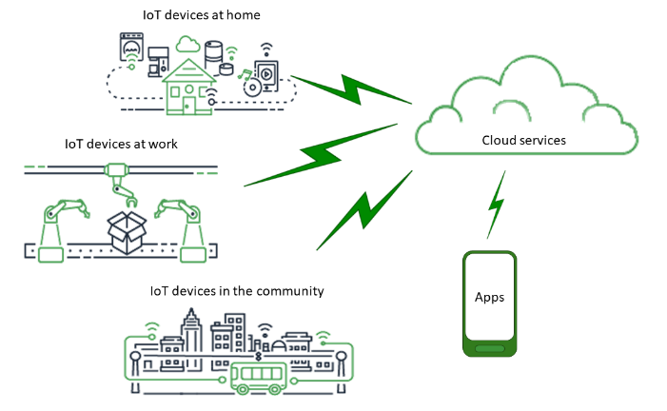
Automation and CI/CD Pipeline
Set up AWS CodePipeline to automate deployment of Lambda functions.
Configure AWS Step Functions for workflow management.
Schedule device actions based on user preferences.
Ensure continuous integration and delivery (CI/CD) to improve system efficiency.

Slide 9
THANK YOU

