Slide 1
Analysis and Visualization of Baltimore 911 Dataset
By
Tejaswini Jaladurgam

Slide 2
Dataset Overview
This dataset contains 292761 crime records in Baltimore with 16 features.
The data includes columns like CrimeDate, CrimeTime, Location, Description, and others.
This project explores trends, distributions, and crime patterns to to generate practical insights.

Slide 3
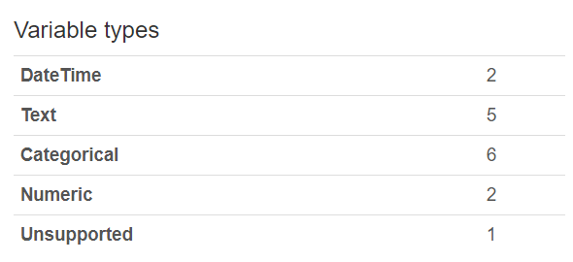
Types of Attributes

Slide 4
A.Numeric attributes are : 1. Longitude
2. Latitude
B.Categorical Attributes are :
Description
Inside/Outside
Weapon
District
vri_name
Total Incidents
C.Discrete Attributes are:
CrimeCode
Location
Post
Neighborhood
Premise
D.Temporal Attributes are :
CrimeDate
CrimeTime

Slide 5
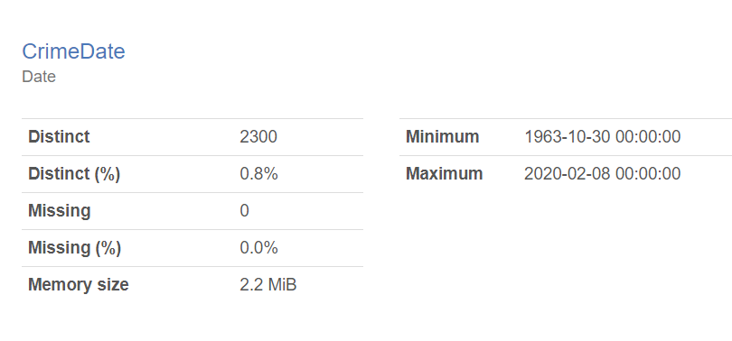
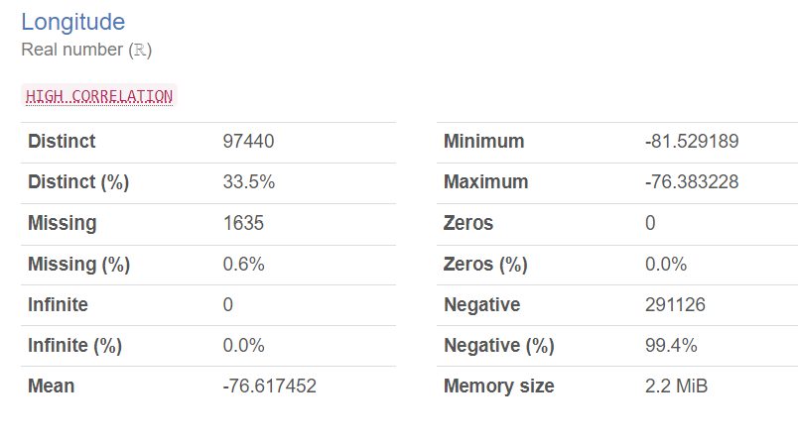
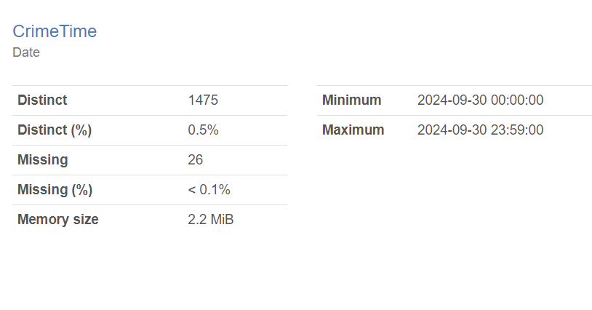
The minimum,maximum of the Attributes

Slide 6
Top 3 Discrete Values with distinct value count
1.Location
Distinct Value Count = 27064
Distinct Value Count(%) = 9.3%
2.Crime Date
Distinct Value Count = 2300
Distinct Value Count(%) = 0.8%
3.Crime Time
Distinct Value Count = 1475
Distinct Value Count(%) = 0.5%

Slide 7
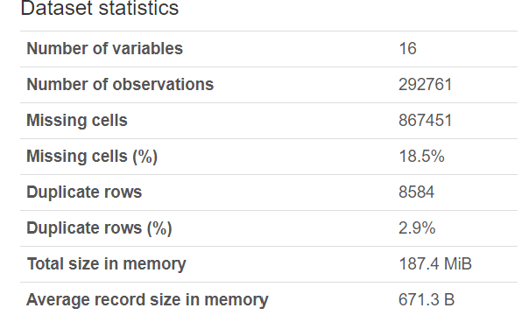
Missing Values Observations
There is 18.5% of rows with missing values
Ensuring data completeness is critical for accurate insights

Slide 8
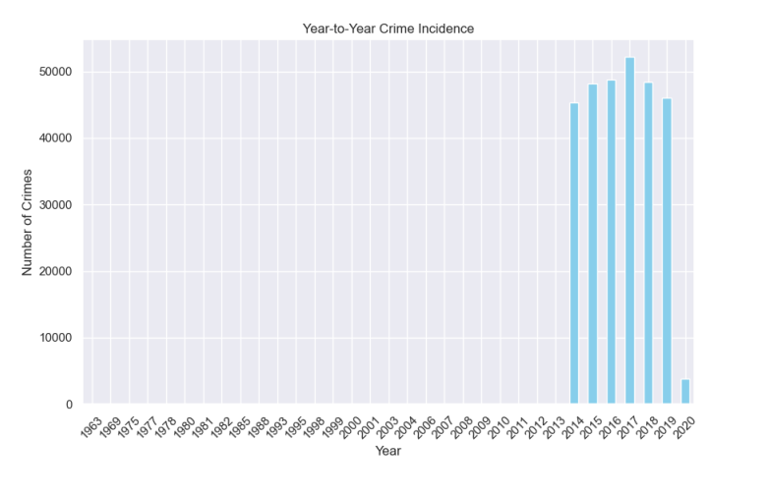
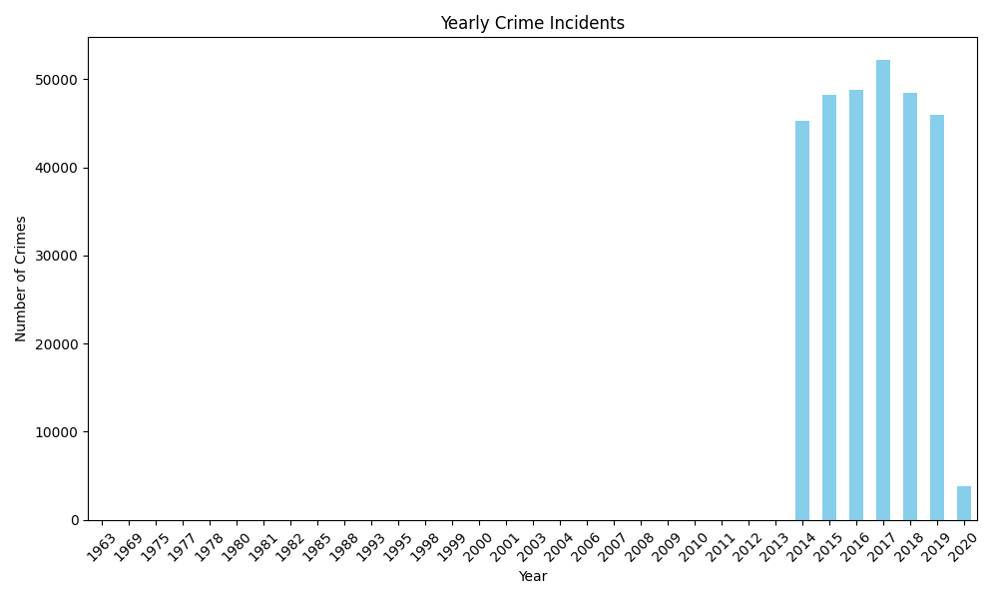
Yearly Crime Incidents
Figure: Yearly Crime Incidents

Slide 9
Yearly Trends Observations
We observe fluctuations in the number of crimes over the years.
A significant rise in crime is noted in specific years, suggesting that factors like changes in the economy or policies may have had an impact.

Slide 10
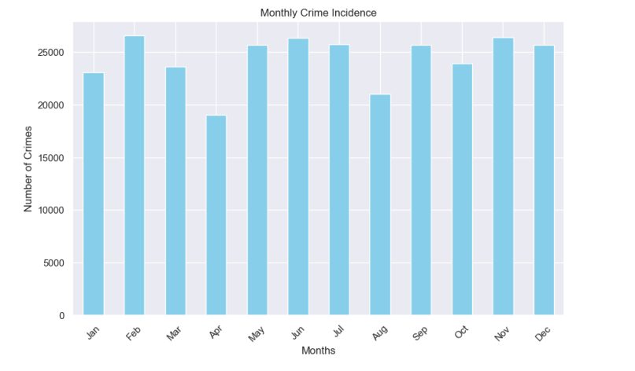
Monthly Crime Incidents
Figure: Monthly Crime Incidents

Slide 11
Monthly Trends Observations
Crime incidents tend to rise during the summer months (June-August).
This might correlate with outdoor activities, school vacations, or increased gatherings.

Slide 12
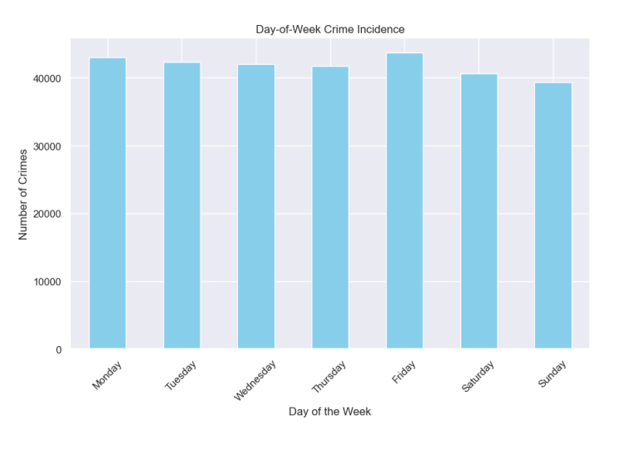
Crime Incidents by Day of the Week
Figure: Day of the Week Crime Trends

Slide 13
Day of the Week Observations
Crimes often increase as the weekend approaches, with Fridays and Saturdays seeing the highest number of incidents reported.
This pattern suggests that weekends may bring more social activity and gatherings, potentially leading to a higher risk of crimes.

Slide 14
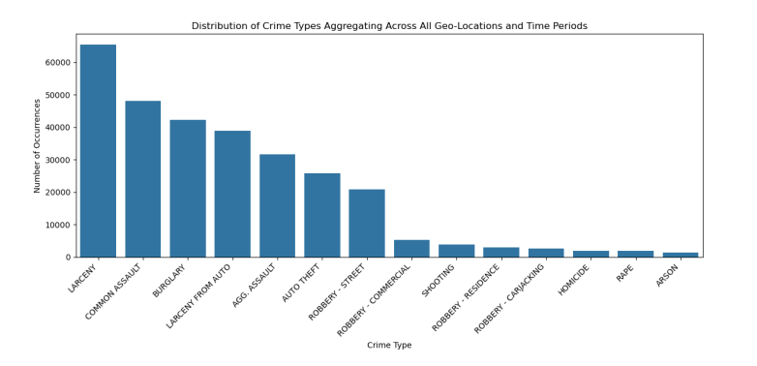
Crime Type Distribution
Figure: Distribution of Crime Types

Slide 15
Crime Type Analysis
The most common crimes are burglary, larceny, and robbery.
These types of crimes are frequently reported across the dataset, accounting for a large portion of criminal activity in Baltimore.

Slide 16
Crime Type Insights
The most common crime types reported in Baltimore include:
Burglary, larceny, and robbery dominate the statistics.
Variability in crime types is observed seasonally and temporally.
Specific types are associated with certain times of day and locations.

Slide 17
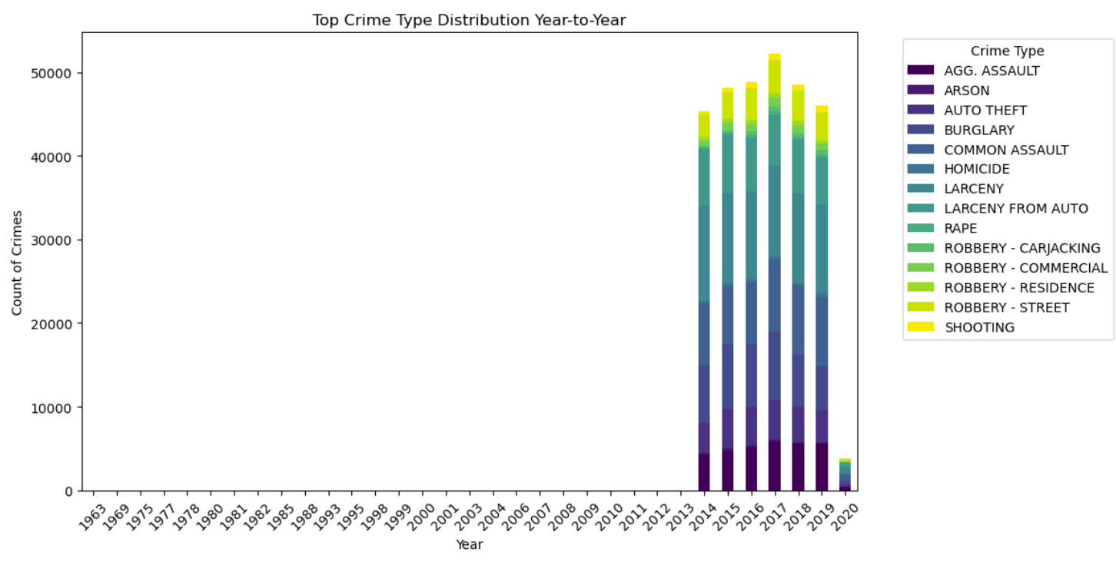
Changes in Crime Types Over Times
Figure: Crime Type Variability Over Years

Slide 18
Year-to-Year Insights
The year-to-year distribution of crime types reveals significant fluctuations in overall crime rates, indicating periods of increased criminal activity.
• Certain crime types show varying trends across different years, influenced by socio-economic factors, public policy changes, or community engagement initiatives.
• Understanding these yearly variations helps law enforcement agencies assess the effectiveness of strategies and adapt resource allocation accordingly.
Recommendation: Focus on proactive strategies during years with notable increases in crime rates, particularly for specific crime types that show persistent growth.

Slide 19
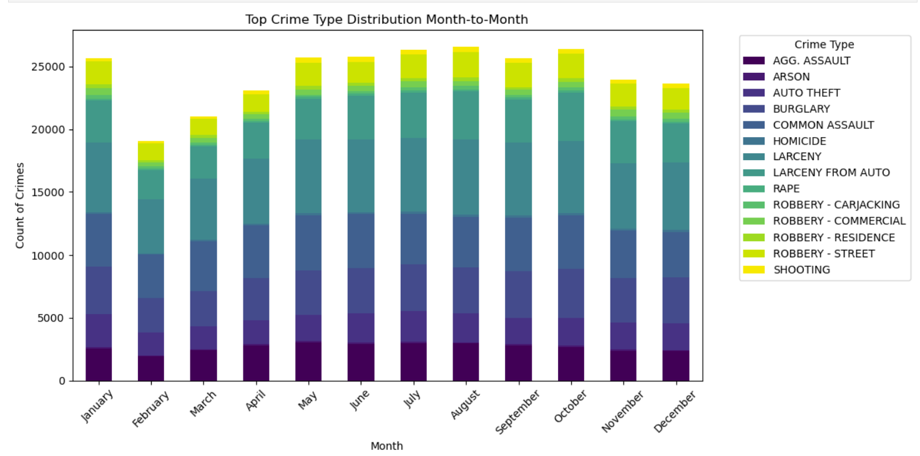
Month-to-Month Crime Type Distribution
Figure: Month-to-Month Crime Type Distribution

Slide 20
Month-to-Month Insights
The month-to-month distribution of crime types shows variations in crime frequency across different months.
• Certain crimes increase during specific months, correlating with seasonal activities.
• Understanding these patterns can guide resource allocation and crime prevention strategies.
Recommendation: Focus on crime types that peak in summer months.

Slide 21
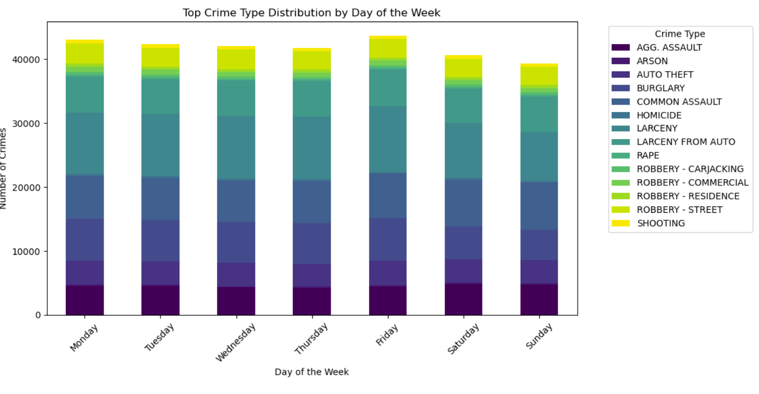
Day-to-Day Crime Type Distribution
Figure: Day-to-Day Crime Type Distribution

Slide 22
Day-to-Day Insights
The day-to-day distribution of crime types indicates variations in crime frequency throughout the week.
• Certain crime types are more common on weekends compared to weekdays
• Understanding these patterns aids in scheduling police patrols effectively.
Recommendation: Increase patrols during high-crime days, particularly Fridays and Saturdays.

Slide 23
Temporal Analysis Dashboard
The following graph shows the temporal trends of crime incidents across various months and years.

Slide 24
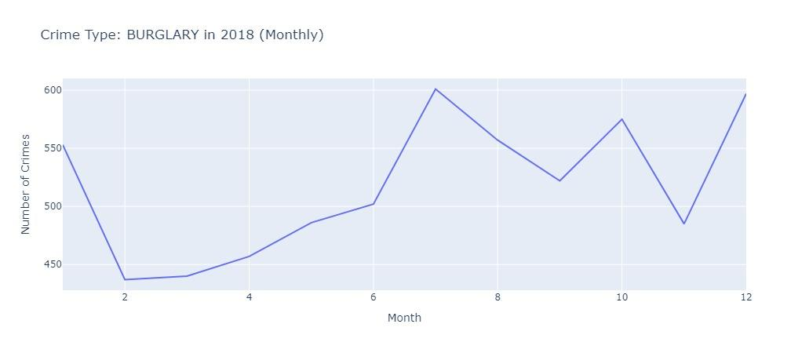
Temporal Trends Graph
Figure: Temporal Trends Graph

Slide 25
Spatial Analysis Dashboard
The following graph displays the spatial distribution of crime incidents across Baltimore.

Slide 26
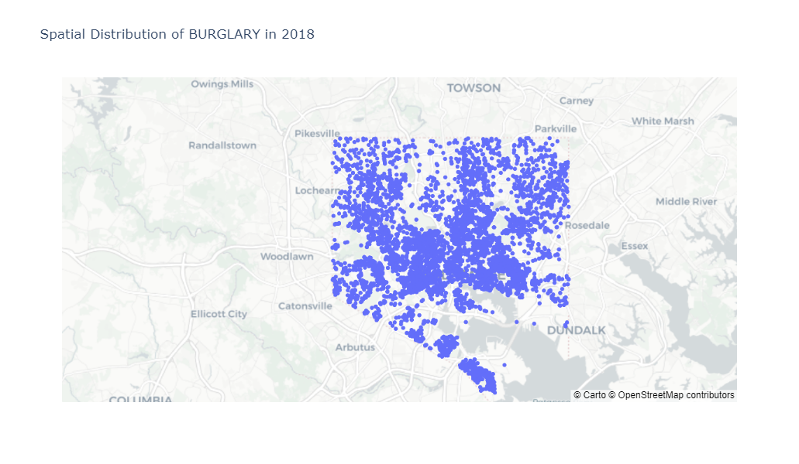
Spatial Distribution Graph
Figure: Spatial Distribution Graph

Slide 27
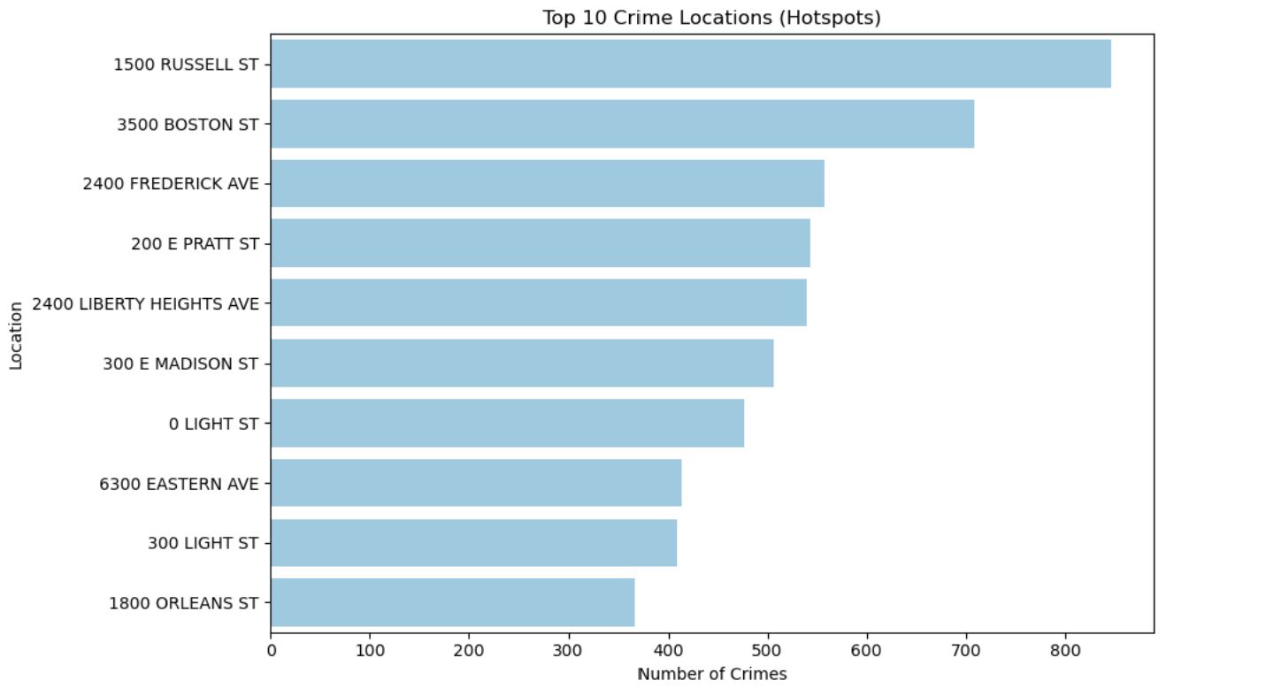
Top 10 Crime Locations
Figure: Crime Hotspots

Slide 28
Hotspot Analysis
Certain locations like 1500 Russell Street, 3500 Boston Street are identified as crime hotspots based on incident frequency.
Focusing resources on these areas can enhance public safety.
High crime areas may require additional community programs.
Understanding local factors can inform strategies.

Slide 29
Timing Insights for Hotspots
Analyzing peak crime times can help in resource allocation.
Crimes are more likely to occur during late-night hours.
Focusing patrols during these times can prevent incidents.
Data-driven strategies enhance police effectiveness.

Slide 30
Conclusions and Recommendations
Based on the analysis of the Baltimore 911 dataset, we can conclude the following:
Crime incidents are more frequent in the summer months and on weekends.
Targeted interventions are needed for burglary and larceny.
Utilizing data insights can guide resource deployment effectively.

