Slide 1
Introduction to MAVEN
By
Gunjan Patel &
Tejaswini Kalavakunta

Slide 2
What is MAVEN?
Maven, in essence, is a software project management and build automation tool primarily used for Java projects.
It helps developers manage all aspects of their project's lifecycle, from building and testing to packaging and deployment.

Slide 3
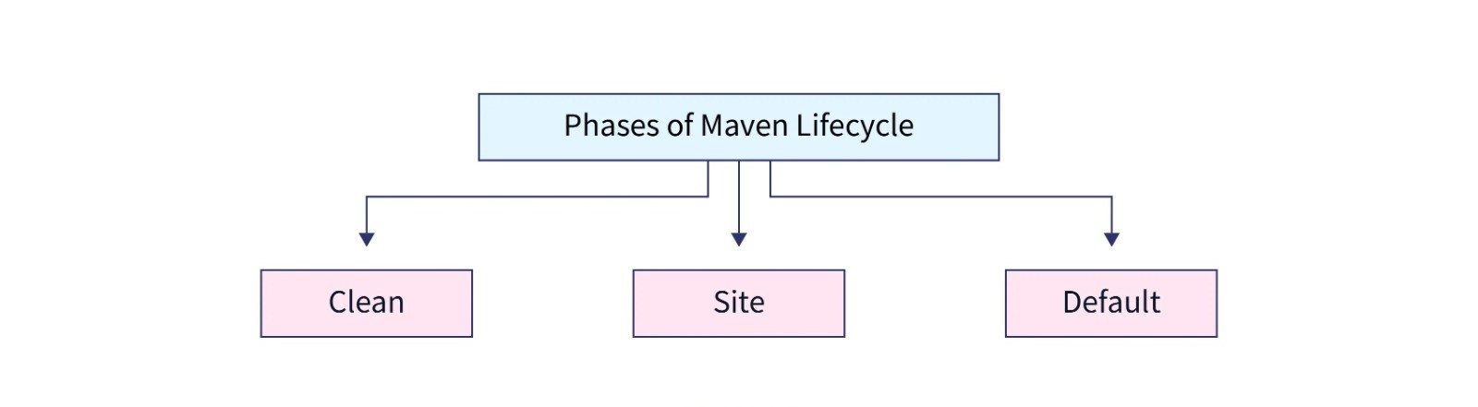
MAVEN Lifecycle

Slide 4
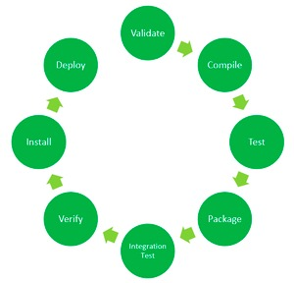
Phases of Default Lifecycle

Slide 5
Goals
clean: Cleans up the project from previous builds.
compile: Compiles source code into class files.
test: Runs unit tests.
package: Packages compiled classes into JAR or WAR files.
install: Installs the package into a local repository.
deploy: Deploys the package to a remote repository.
Goals are executed as mvn clean install executes both the clean and install goals consecutively

Slide 6
Advantages
Standardized Build
Effortless Dependency Management
Multi-Module Projects
Boosting Productivity
Quality and Control

Slide 7
Usage
Maven automates the entire software project build lifecycle, from compilation to packaging.
Integrates testing frameworks into the build process for unit testing and reporting.
Integrated with many IDEs for seamless development workflow.

Slide 8
Thank You

