Slide 1
Employee Data Analysis using Excel
TEJASWINI.S
STUDENT NAME:
REGISTER NO:
DEPARTMENT:
COLLEGE
312209156
B.COM
: ANNA ADARSH COLLEGE FOR WOMEN
NMID:2690668ADE6E10CB6CE4120791F1E29A

Slide 2
PROJECT TITLE
USING PIVOT TABLES FOR EMPLOYEE TURNOVER ANALYSIS

Slide 3


AGENDA
Problem Statement
Project Overview
End Users
Our Solution and Proposition
Dataset Description
Modelling Approach
Results and Discussion
Conclusion
3/21/2024 Annual Review

Slide 4

PROBLEM STATEMENT
I am creating this PowerPoint presentation using pivot tables for employee turnover analysis to clearly and concisely present key data insights. Pivot tables allow us to summarize complex data, identify trends, and support data-driven decision-making. This approach makes the information more accessible to stakeholders and helps in developing effective retention strategies. Overall, it enhances understanding and facilitates informed discussions on employee turnover.

Slide 5

PROJECT OVERVIEW
This presentation provides an analysis of employee turnover using pivot tables to identify key trends and insights. By examining turnover rates across different departments, tenure lengths, and reasons for leaving, we aim to understand the underlying factors contributing to employee departures. The findings will help us develop targeted strategies to improve employee retention, reduce costs associated with turnover, and enhance overall organizational performance. This data-driven approach will support informed decision-making and foster a more stable and engaged workforce.
.

Slide 6

WHO ARE THE END USERS?
HUMAN RESOURCES (HR)
SENIOR MANAGEMENT AND EXECUTIVES
DEPARTMENT HEADS AND MANAGER
FINANCE AND OPERATIONS TEAMS
EMPLOYEES
6. PERFORMANCE ANALYSTS
Each of these groups can use the insights from the presentation to improve their respective areas and contribute to reducing turnover.

Slide 7

OUR SOLUTION AND ITS VALUE PROPOSITION
Our solution is a comprehensive analysis of employee turnover using pivot tables to transform raw data into meaningful insights. This approach allows us to understand patterns and causes of employee departures and develop strategies to mitigate turnover.
Our solution is a comprehensive analysis of employee turnover using pivot tables to transform raw data into meaningful insights. This approach allows us to understand patterns and causes of employee departures and develop strategies to mitigate turnover.
VALUE PROPOSITION
1. Enhanced Decision-Making
2. Cost Reduction
3.Improved Employee Satisfaction
4.Optimized Workforce Planning
5.Data-Driven Insights
6. Compliance and Reporting

Slide 8
Dataset Description
The dataset used for this analysis is sourced from Kaggle and includes detailed information on employee turnover. Here is a description of the key components of the dataset:
1.Employee ID
2.Department
3.Job Role
4.Date of Hire
5. Date of Exit
6.Tenure
7.Reason for Leaving
8.Performance Rating
9.Salary
10.Gender

Slide 9

THE "WOW" IN OUR SOLUTION
The “Wow” in our solution lies in its ability to turn complex employee turnover data into clear, actionable insights through advanced pivot table analysis. This approach reveals hidden trends and patterns, offering a deep understanding of turnover causes and impacts across departments and roles. By visualizing data dynamically, we empower stakeholders to make informed decisions that address both immediate and future turnover challenges. The solution’s predictive capabilities enable proactive interventions, enhancing retention strategies and optimizing workforce planning. This not only reduces recruitment and training costs but also boosts employee satisfaction and organizational stability, ultimately driving long-term business success. The comprehensive, data-driven insights provided transform how we approach turnover, offering strategic value that aligns with our organizational goals.
3/21/2024 Annual Review
9

Slide 10
MODELLING
1.Data Import and Preparation:
✓Import Data: Load the employee turnover dataset into Excel or a similar tool.
✓Clean Data: Ensure data integrity by correcting errors, filling missing values, and removing duplicates.
2.Pivot Table Creation:
✓Insert Pivot Table: Select the data range and insert a pivot table to begin the analysis.
✓Configure Pivot Table: Drag and drop fields into rows, columns, and values to organize data for analysis.
3.Analyze Turnover Rates:
✓Rows and Columns Setup: Place dimensions such as Department and Job Role in the rows section to break down turnover by these categories.
✓Turnover Metrics: Add turnover counts or rates to the values section to calculate the number of employees leaving and turnover percentages.
4.Evaluate Tenure Data:
✓Average Tenure Calculation: Use the pivot table to calculate average tenure for employees who left, which helps in understanding how long employees stay before leaving.
✓Tenure Distribution: Group tenure data into ranges (e.g., 0-1 years, 1-3 years) to analyze tenure distribution among departing employees.
10

Slide 11
MODELLING
5.Examine Reasons for Leaving:
✓Reason Analysis: Drag the “Reason for Leaving” field into the rows or columns section to see how different reasons contribute to turnover rates.
✓Visual Representation: Use pivot charts to visualize the distribution of reasons for leaving, such as pie charts or bar graphs.
6.Temporal Analysis:
✓Time-Based Analysis: Add date fields (e.g., Date of Exit) to the columns section to analyze turnover trends over time (monthly, quarterly, or yearly).
✓Trend Identification: Identify patterns in turnover rates across different time periods to detect seasonal or cyclical trends.
7.Department and Role Analysis:
✓Department Analysis: Place “Department” in the rows section to compare turnover rates across various departments.
✓Role Analysis: Examine turnover rates by job role to identify if certain roles experience higher turnover.

Slide 12
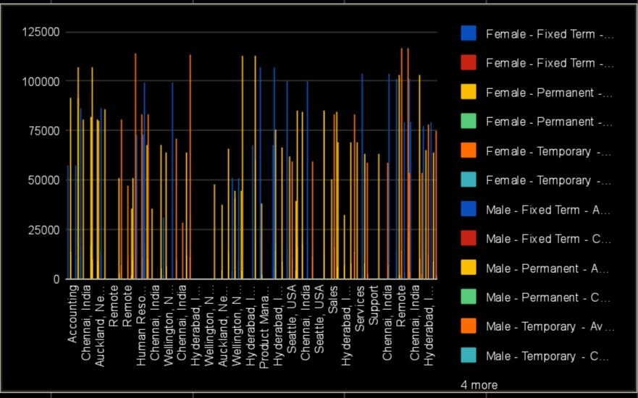
RESULTS
12

Slide 13
conclusion
Using pivot tables for employee turnover analysis offers a powerful way to transform raw data into actionable insights. It allows for a detailed examination of turnover trends across various dimensions like department, role, and tenure, helping identify patterns and root causes. By visualizing data dynamically, pivot tables make complex information more accessible, facilitating informed decision-making. The ability to drill down into specifics enables targeted interventions to reduce turnover. This method supports strategic planning by highlighting areas that need attention and potential improvements. Ultimately, it helps organizations enhance employee retention, reduce associated costs, and maintain a more stable, engaged workforce.

