Slide 1

SMART GAS LEAKAGE DETECTOR BOT

Slide 2
Introduction
Goals &amp; Objectives
Components
Scope &amp; Limitation
System Operation
Conclusion
Outline Of Presentation

Slide 3
Introduction
A gas detector is a device that detects the presence of gases in an area, often as part of a safety system. A gas detector can sound an alarm to operators in the area where the leak is occurring, giving them the opportunity to leave. This type of device is important because there are many gases that can be harmful to organic life, such as humans or animals.
Gas detectors can be used todetect combustible, flammable and toxic gases, and oxygen depletion. This type of device is used widely in industry and can be found in locations, such as on oil rigs, to monitor manufacturing processes and emerging technologies such as photovoltaic. They may be used in firefighting.

Slide 4
Goals & Objectives
The objective of this project is to detect any leakage if LGP- based
Cars, small-scale factories or in home appliances also. While LGP is
an essential need of every household, its leakage could lead to a
disaster. Here I have developed an Arduinio based LGP gas leakage
Detector. If gas leakage occurs, this system detects it and makes an
alert.

Slide 5
Scope and Limitation
This project is designed only for detecting gas leakage in every place.
To improve, we can be used this device as a wireless Gas Leakage
detector in home security, in special factories, and other.

Slide 6
Components
Arduino ( Uno )
16*2 Lcd Display
USB cable
Mq2 Gas sensor
2 LED’S
Buzzer
1K Resister-1
100R Resistor-3
4.7K Resistor -1
Male to male jumper wires
Connecting wires
Battery clip
9V Battery
Bread board

Slide 7
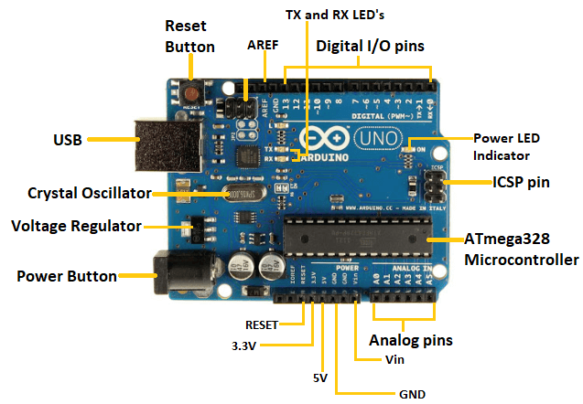
ARDUINO UNO
The Arduino Uno is an open-source microcontroller board based on the Microchip ATmega328P microcontroller and developed by Arduino.cc and initially released in 2010. The board is equipped with sets of digital and analog input/output (I/O) pins that may be interfaced to various expansion boards (shields) and other circuits.

Slide 8
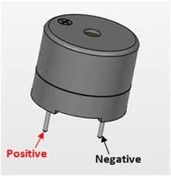
BUZZER
A buzzer is understood as a device that creates an audible tone under the influence of an applied external voltage. This output may either be in the form of a buzzing or a beeping sound.

Slide 9
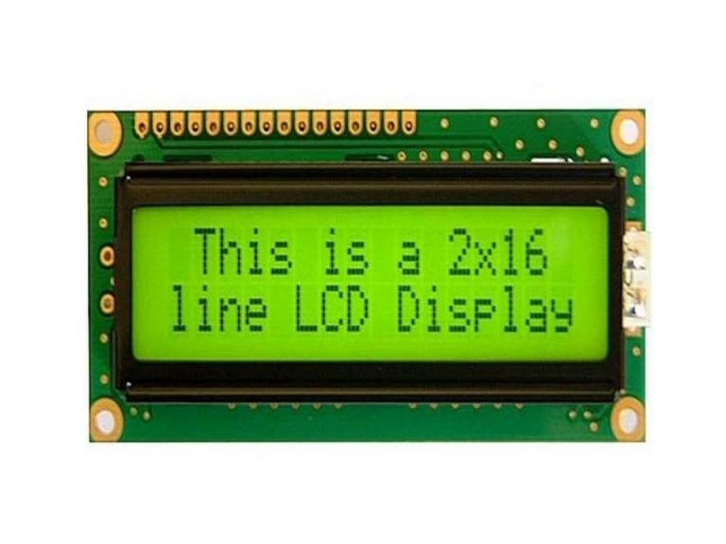
16*2 LCD DISPLAY
LCD stands for liquid crystal display it mostly used in different electronic projects and devices to display different values.
LCD uses liquid crystals for the production of visible image. 16 x 2 liquid crystal display is a basic LCD module used in DIy electronic projects and circuits.

Slide 10
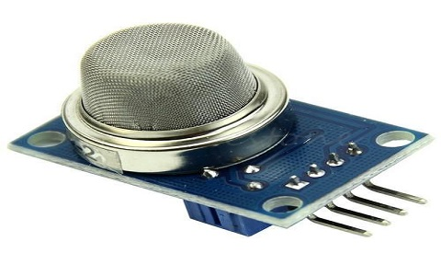
SENSOR
MQ2 gas sensor is an electronic sensor used for sensing the concentration of gases in the air such as LPG, propane, methane, hydrogen, alcohol, smoke and carbon monoxide.
MQ2 gas sensor is also known as chemiresistor. It contains a sensing material whose resistance changes when it comes in contact with the gas. This change in the value of resistance is used for the detection of gas.

Slide 11
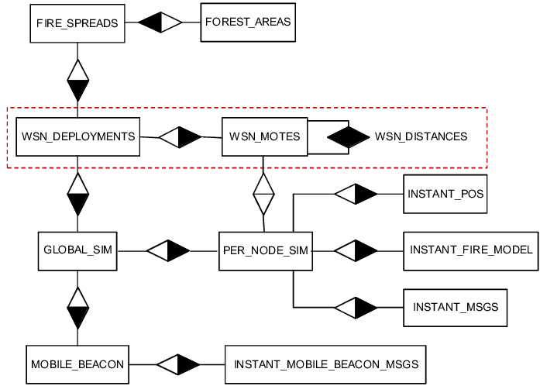
Entity Relationship Diagram

Slide 12
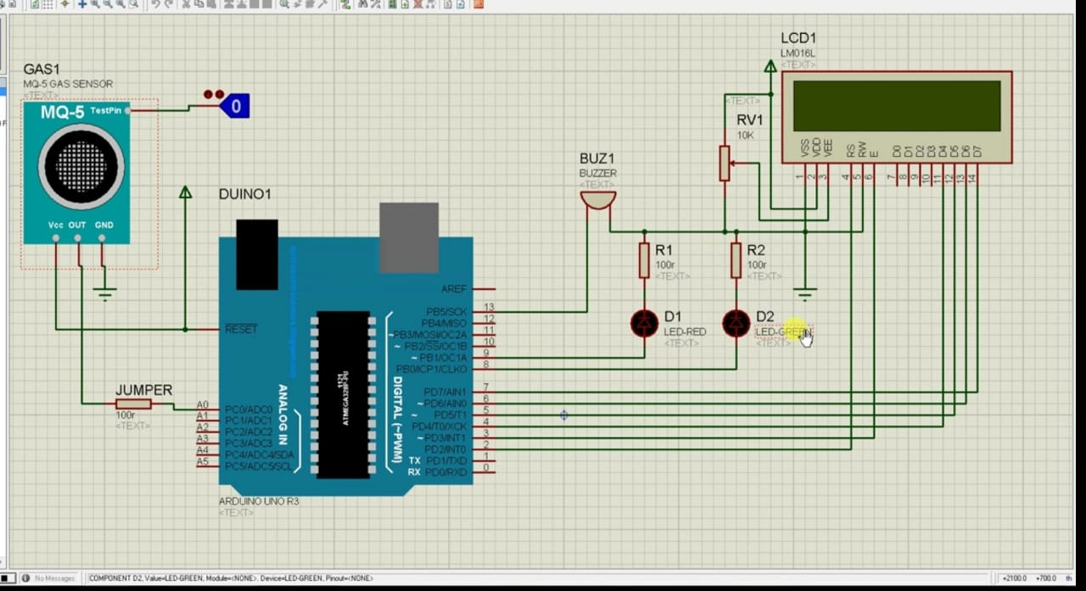
System Operation

Slide 13
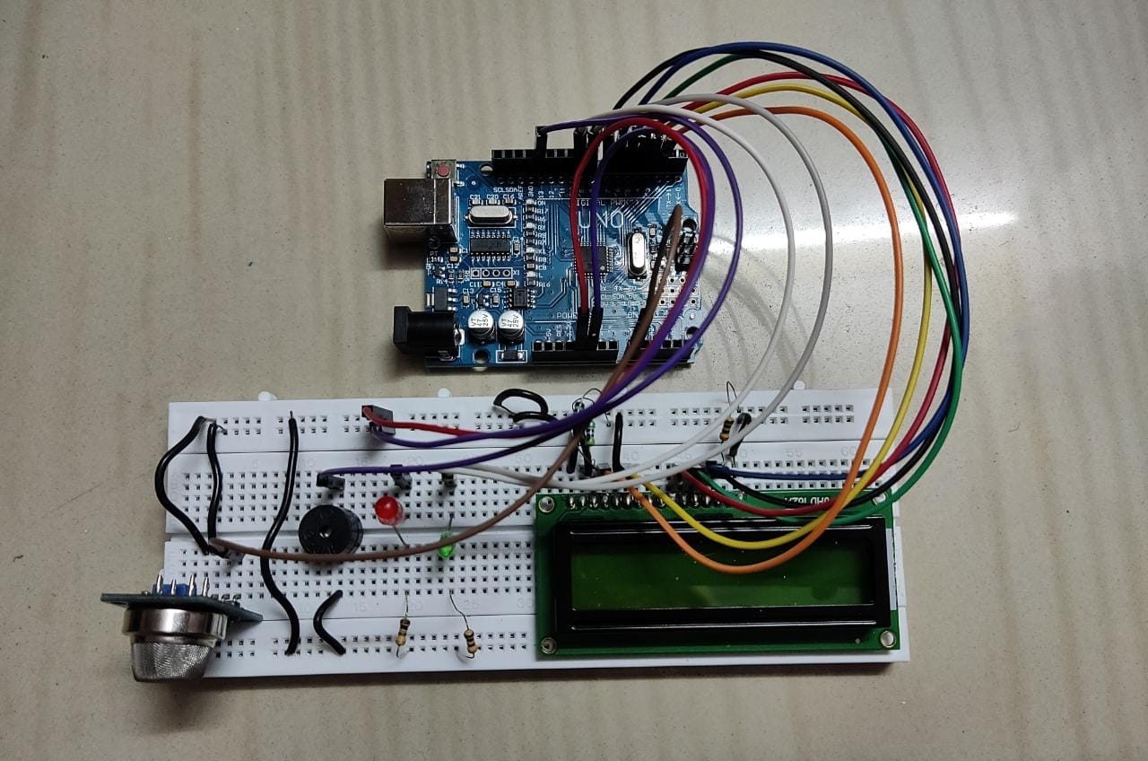

Slide 14
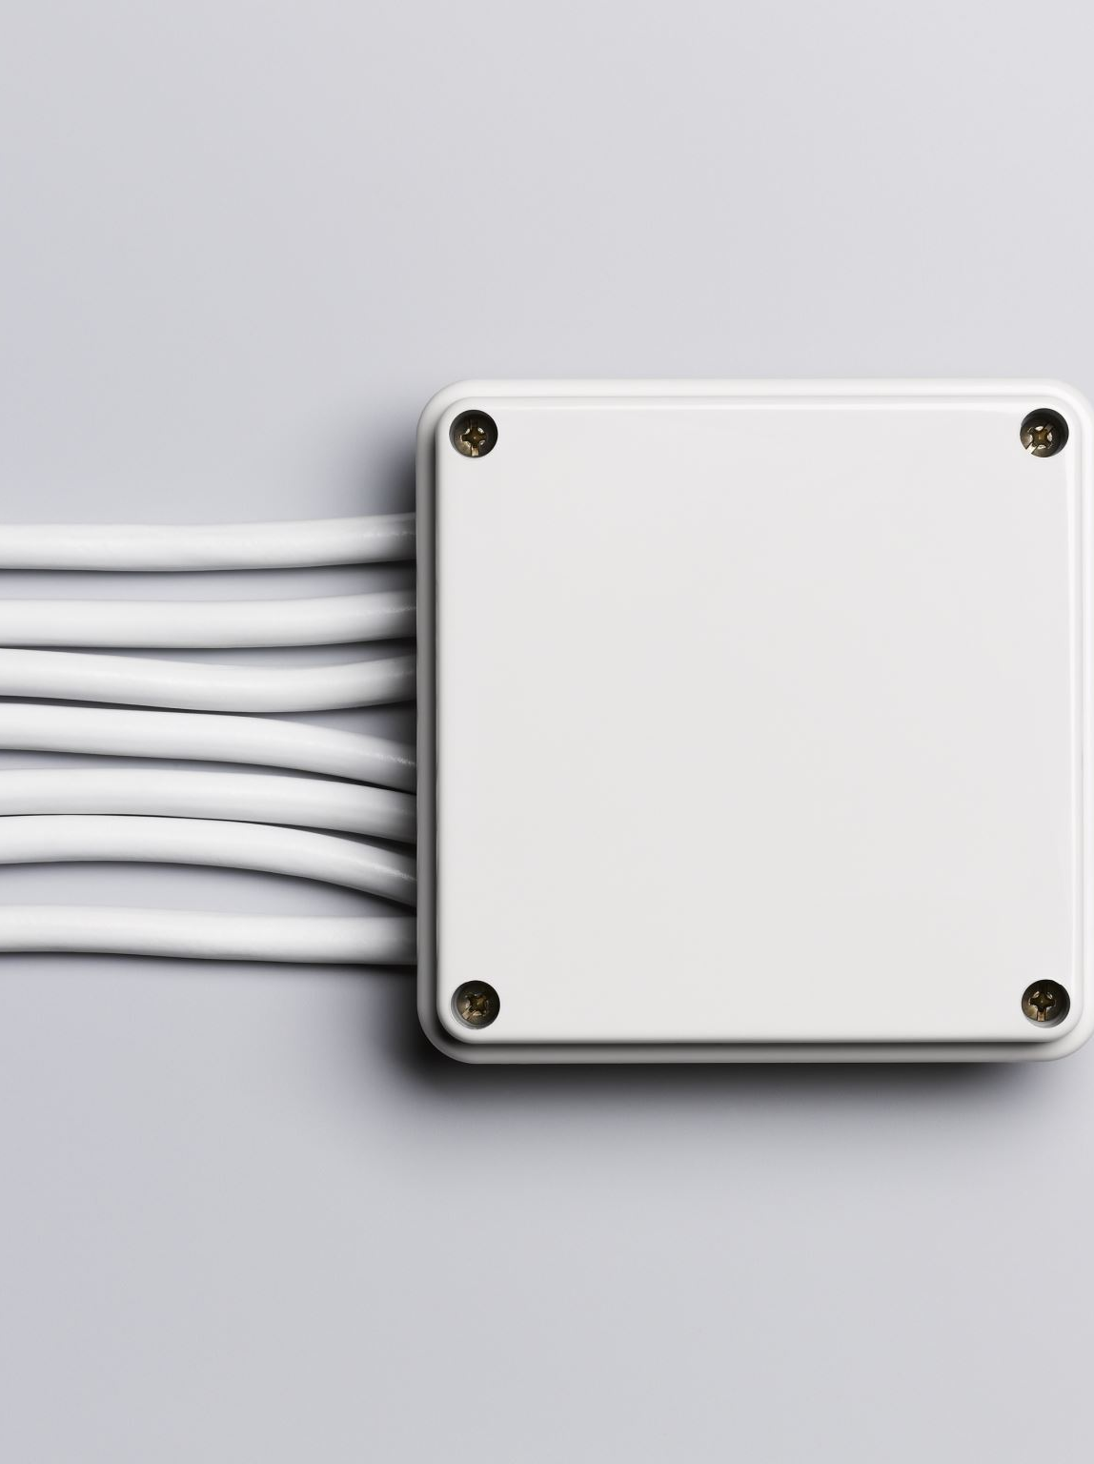
This system monitors the gas, smoke
by sensor 1, sensor 2, sensor 3. If any gas is detected the signal of sensors goes low and activate the Arduino UNO. Which
send signals to the LCD (“GAS DETECTED AT ZONE), where sensor 1 is for zone 1, sensor 2 for zone 2 and sensor 3 for
zone 3 respectively, Buzzer and GSM to alert the people about danger and if no gas is detected then LCD displays “NO
GAS DETECTED” in its 16x2 display

Slide 15
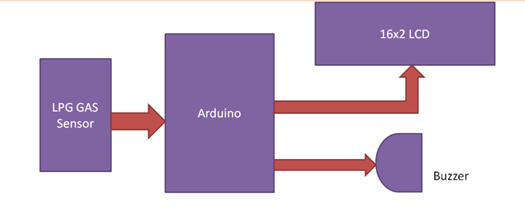

Slide 16
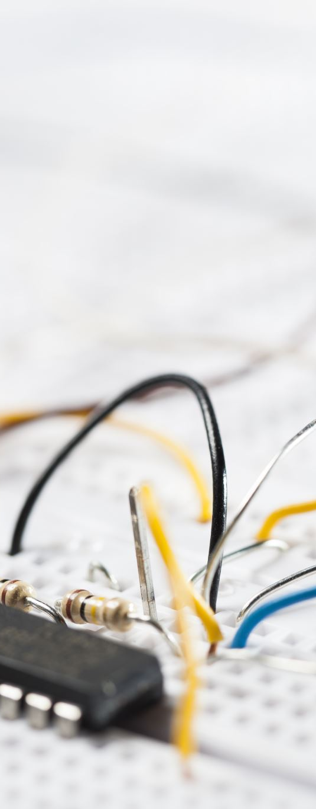
Conclusion
After this project performance, can conclude that detection of the LPG gas leakage is incredible in the project system.
Applicable usefully in the industrial and domestic purpose. In danger situations we are able to save the life by using this
system. An alert is indicated by the GSM module. A sensor node senses gas like CO2, oxygen, propane. The estimated
range of transmission and consumption of power is obtained. The simple procedures and Arduino UNO Micro controller
area used to build the sensor

Slide 17

THANK YOU

