Slide 1
Release Orchestrator
Enterprise Deployment Control Plane
packager → docker build (per package) → Confluence → Jira RM ticket → Harness → ECS (EC2)
5 services · Next.js agent UI · GitHub Actions · Harness CD · AWS ECS / EC2
Release Orchestrator
1 / 8

Slide 2
The Release Problem
Manual, error-prone releases
No single source of truth
Building, documenting, ticketing and deploying 5 services by hand is slow and inconsistent.
Change summaries, RM tickets and deploy state live in separate tools with no link between them.
Slow, risky deployments
No safe dry-run
Hand-rolled ECS deploys lack repeatability, rollback and an auditable trail.
Teams can't rehearse the full release flow without touching production systems.
Release Orchestrator
2 / 8

Slide 3
One Pipeline, End to End
A single orchestrator drives every stage and an agent UI makes it observable.
1
2
3
4
5
Packager
→
Docker Build
→
Confluence
→
Jira RM Ticket
→
Harness → ECS
Detect which of the 5
packages changed
One image per
package, pushed to ECR
Auto change-summary
page
Release Management
ticket, linked to page
Rolling deploy to
EC2 cluster
Any stage failure aborts the run and surfaces in the UI and CI — no partial releases.
Release Orchestrator
3 / 8

Slide 4
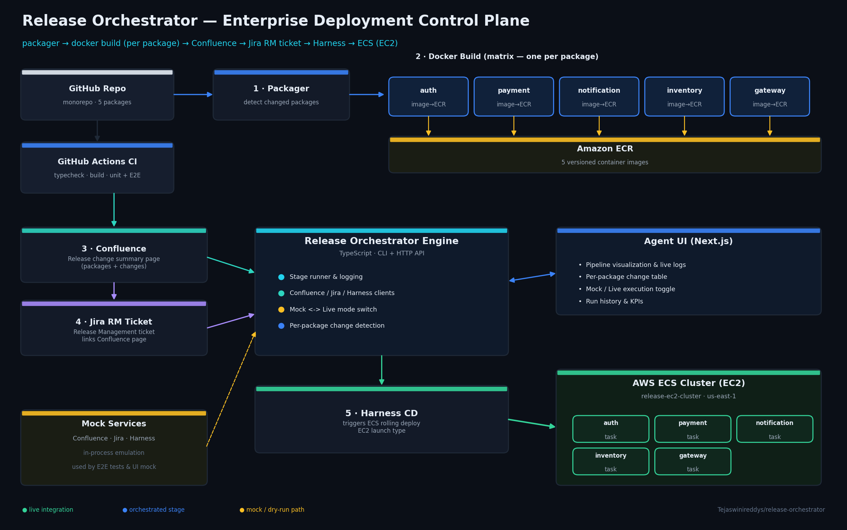
System Architecture
Release Orchestrator
4 / 8

Slide 5
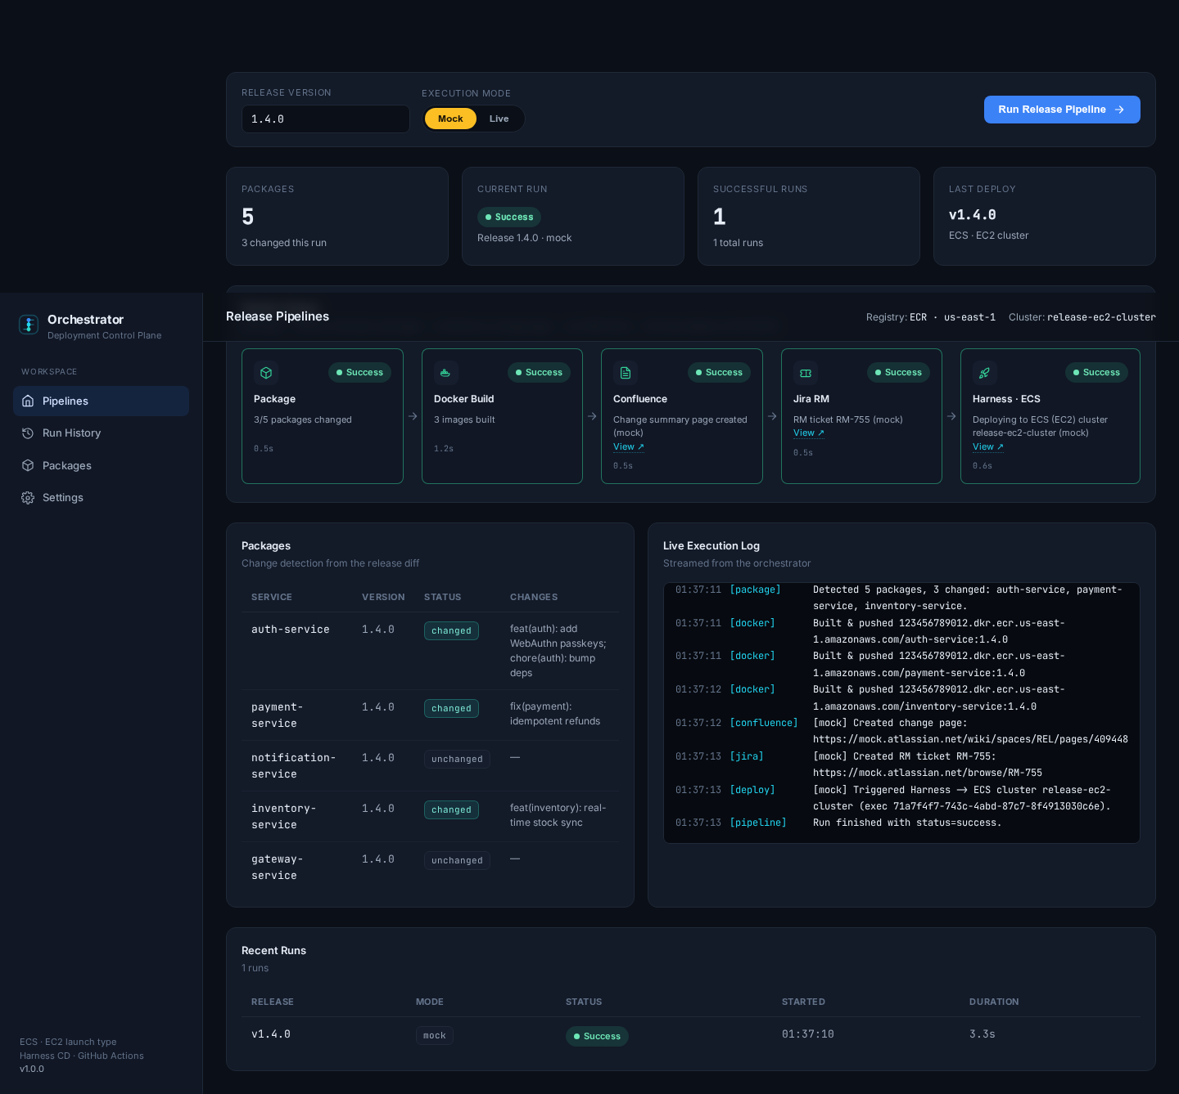
The Agent UI
Next.js dashboard · live pipeline visualization
Mock / Live toggle
Dry-run the full flow or fire real APIs
Per-stage status & timing
Package → Docker → Confluence → Jira → Deploy
Streaming execution log
Every step traced in real time
Change-aware packages
See which services changed and why
Run history & KPIs
Success rate, last deploy, totals
Release Orchestrator
5 / 8

Slide 6
CI/CD & Quality
GitHub Actions
Testing
Mock vs. Live
ci.yml — typecheck, build, unit + E2E, UI build (must stay green)
build-packages.yml — matrix Docker build, one image per package
release-deploy.yml — Confluence + Jira + Harness on tagged release
Unit tests — packager, docker matrix, Confluence/Jira rendering
End-to-end test — full pipeline against in-process mocks
Injected git diff & docker executor — deterministic, no daemon
Mock — emulated Confluence/Jira/Harness, zero secrets
Live — same code path, real REST APIs via env secrets
Switchable from the UI toggle or RUN_MODE env var
Release Orchestrator
6 / 8

Slide 7
Deployment Target
Harness CD performs an ECS rolling deploy on the EC2 launch type, with automatic rollback.
ORCHESTRATION
LAUNCH TYPE
CLUSTER
AWS ECS
EC2
release-ec2-cluster
REGISTRY
STRATEGY
SERVICES
Amazon ECR · us-east-1
Rolling + auto rollback
5 task definitions
Release Orchestrator
7 / 8

Slide 8
What This Delivers
Repeatable
Every release runs the identical, tested pipeline.
Traceable
Confluence page + Jira RM ticket auto-linked to each deploy.
Observable
The agent UI shows live status, logs and history.
Safe
Mock mode rehearses the entire flow with zero production risk.
github.com/Tejaswinireddys/release-orchestrator
Release Orchestrator
8 / 8

