Slide 1

Facial image analysis for glasses detection
Under the supervision of
Dr. Rupesh Mishra
(Associate Professor, Department of CSE-AIML)
presented for
Capstone Project Review
Team Number : 143
Team Members:
D. Bala Varshitha (2103A52012)
B.Harini Sri (2103A52006)
B.Anvitha (2103A52007)
M.Vyshnavi (2103A52023)
P.Tejaswi (2103A52029)

Slide 2
Introduction
Biometrics, user customisation, and security all make extensive use of facial image analysis. The goal of this project is to use face photos to determine whether a person is wearing glasses.
Glasses detection, which is used in augmented reality, virtual try-on, and personalized experiences, is essential for increasing the accuracy of face identification .This technology uses image processing and machine learning approaches to recognize glasses accurately from a variety of angles and face types.
The goal of this project is to develop a solution that can accurately detect glasses using sophisticated image processing methods and machine learning models.
In order to contribute to the larger field of facial image analysis, we investigate the integration of deep learning techniques to recognize glasses on faces through this research.
The initiative aims to support real-world applications and stronger facial recognition algorithms.

Slide 3
Problem Identification
In applications such as biometric authentication, online tests, or secure access systems, glasses may make it more difficult to recognize face features and confirm identities. These systems may be less successful due to reflections or obstacles from glasses, which could result in inaccurate identification or an inability to record facial characteristics. As of right now, there isn't a commonly used automated solution that can recognize glasses and modify the system or user instructions appropriately.

Slide 4
LITERATURE REVIEW
Year | Model used | Parameters | Merits | Demerits
2019[1] | Haar-like Features CNN AlexNet Transfer Learning | Features: 3099 Haar-like features. Image Variants: 2500 per class. | Portability High Detection Rate | Data Management Costly Implementation.
2015[2] | CNNs RNNs / LSTMs Object Detection (e.g., YOLO, SSD. | Input Resolution. Data Volume. Detection Accuracy: | Real-Time Scalable Auto Tagging | Privacy Complexity Environment
2017[3] | RootSIFT SVM Machine Learning | Handles low-res images. High data flow. | Performs well on standard datasets | May lag behind deep learning in complex scenarios.
2018[4] | RootSIFT SVM | Features: RootSIFT, deep learning. Datasets: CEW, ZJU, LFWA, CelebA | Accuracy Efficiency Best on LFWA | Deep Learning Limitations Complexity. Computational cost.
2015[5] | Robust LBP SVM | Features: Robust Local Binary Pattern (LBP). Performance. | High Accuracy Robust Efficient: | Resolution Sensitivity. LBP Limitations.

Slide 5
.
Year | Models used | Parameters | Merits | Demerits
2018[6] | Capsule Networks LeNet AlexNet, ResNet | Dijkstra’s Algorithm Viola-Jones Classifier | Fast, accurate eyeglasses detection. Improved boundary accuracy. | Inaccurate segmentation affects measurements. No robustness.
2021[7] | Capsule Networks LeNet AlexNet, ResNet | Accuracy Precision F-score | Best accuracy. Spacial handling. Simple and fast. | Computationally intensive complex. Risk of overfitting.
2011[8] | CNN VGG-FaceNet | Sparse representation. NIR face database. Performance metrics. | Better features. Superior performance. | Complex. Scalability. Misalignment.
2024[9] | CNN MobileNet architecture. | MobileNet architecture. Transfer learning. | Efficient. Accurate detection. Tailored design. | Limited scope. Overfitting. Complexity.
2015[10] | CNN CTV inpainting. | Accuracy metrics. Feature extraction. | Robust. Accurate. | Complexity. Data dependency.

Slide 6
objective
Creating a strong deep convolutional neural network (CNN) model to identify the presence of glasses in facial photos is the main goal of this project. To determine whether a person is wearing glasses, the model will examine facial attributes, guaranteeing accuracy over a range of facial structures, lighting scenarios, and image characteristics.
Principal Goals:
Correct Categorization: Create a CNN model that achieves high precision and recall by correctly differentiating faces with and without spectacles.
Real-Time Detection: Make the model as fast and effective as possible for real-time applications such as user authentication and monitoring.
Robustness Across Variations: Guarantee steady performance in spite of changes in illumination, facial features, picture angles, and eyeglass styles.
Scalability: Create a model that is simple to incorporate into a range of platforms and systems, including web apps.
User-Friendly Implementation: Provide a solution that is simple enough to deploy and operate without requiring deep learning knowledge.

Slide 7
Proposed plan
Collect a variety of facial picture datasets, including ones with and without spectacles, for data collection and preprocessing. To increase the robustness of the model, preprocess photos by resizing, normalizing, and augmenting them.
Model Development: Create a deep CNN architecture that is best suited for jobs involving image categorization. To avoid overfitting, use strategies like batch normalization and dropout.
Training & Optimization: Use the preprocessed dataset to train the model. To increase accuracy, apply strategies like hyperparameter tuning and data augmentation.
Evaluation & Testing: To gauge performance, test the model on a different validation set. Improve the model's robustness and real-time detection under varied circumstances.
Deployment: Create an intuitive user interface that is simple to integrate on embedded, mobile, and web platforms. Assure compatibility and scalability for a range of applications.

Slide 8
Existing PLAN vs Proposed plan
Existing method:Frequently depend on crude machine learning models or conventional image processing.Sensitivity to changes in lighting, angles, and face features limits accuracy.Real-time performance issues make them less appropriate for dynamic applications.Require a lot of feature engineering, which might be less scalable and time-consuming.
Proposed method: The suggested approach automatically extracts features from unprocessed photos by using a deep CNN model for end-to-end learning.By identifying strong patterns in a variety of datasets, it improves generalization and attains greater accuracy.Real-time detection optimization, quick processing, and suitability for dynamic settings.Scalable and simple to incorporate into various platforms, with little need for human intervention.

Slide 9
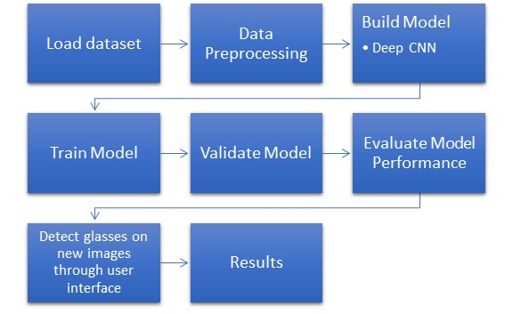
ARCHITECTURE

Slide 10
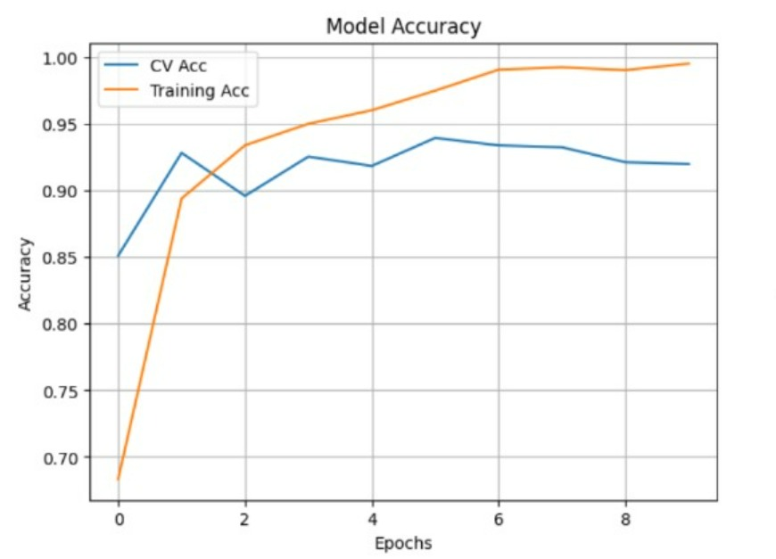
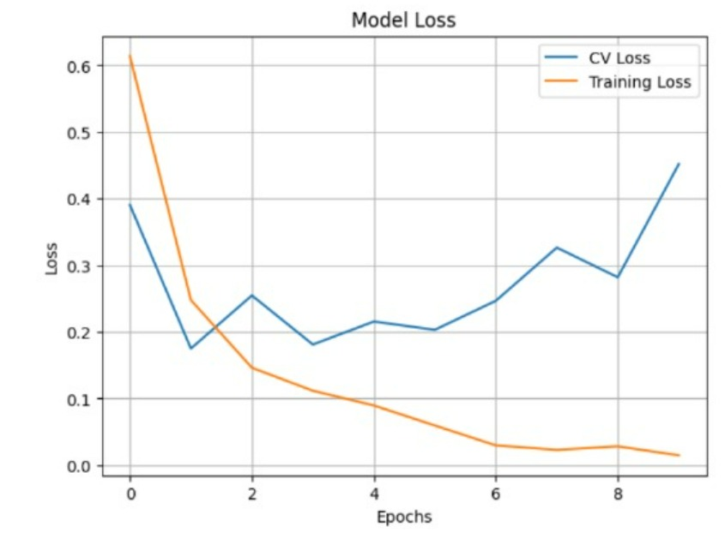
RESULTS

Slide 11

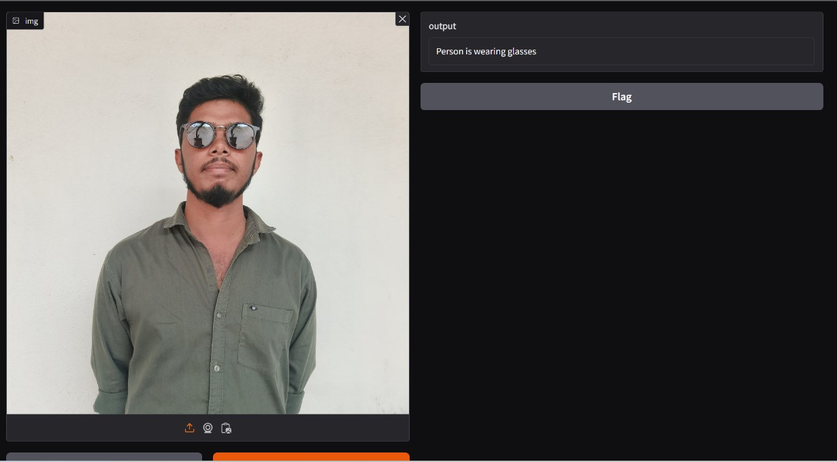
.

Slide 12
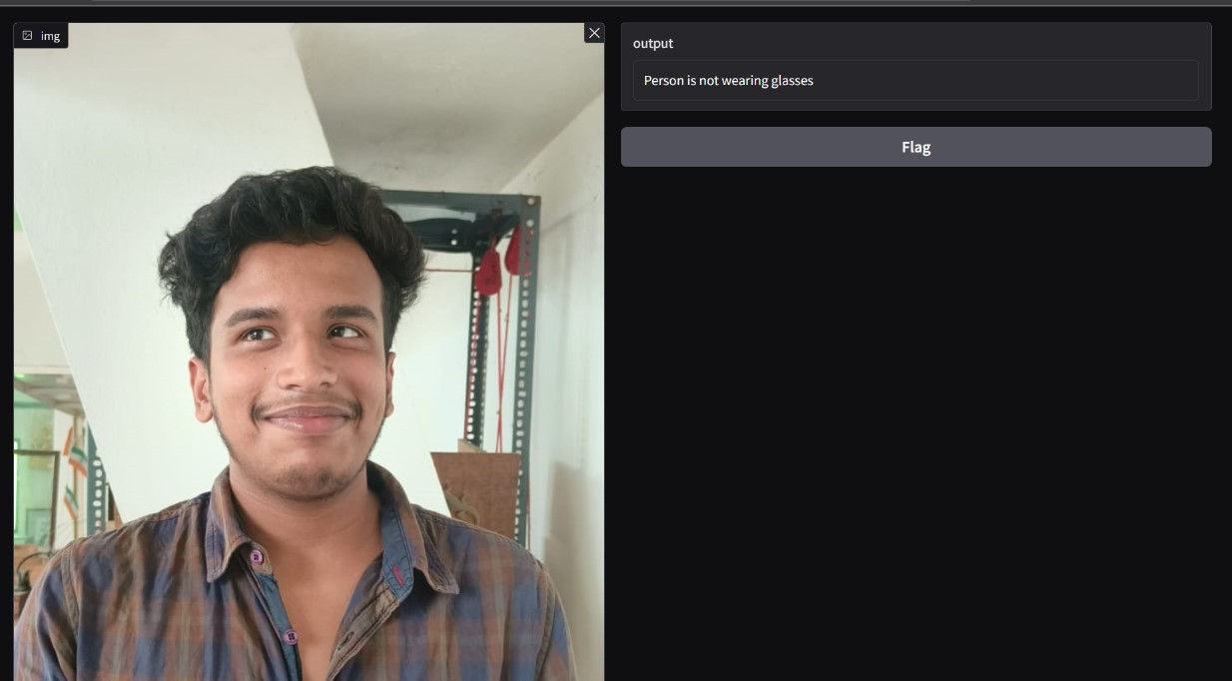

.

Slide 13
Future SCOPE
Combining Facial Recognition Software:Improve the resilience and adaptability of security systems by using glass detection to recognize and handle situations when glasses may compromise the accuracy of facial recognition.
Tailored Suggestions in Online Sales Utilize :the model in e-commerce platforms to improve user experience by suggesting eyewear styles based on recognized facial features and pre-existing eyewear trends.
Applications in Healthcare:Help keep an eye on patients in medical institutions to ensure they are wearing protective eyewear or following their prescriptions for medical glasses.
Improvements to Augmented Reality (AR):Use the model in AR systems to more precisely adjust virtual overlays or filters, resulting in improved virtual try-on experiences for entertainment or eyewear items.

Slide 14
CONCLUSION
This project successfully employs a deep convolutional neural network (CNN) for facial image analysis, enabling accurate detection of glasses in images. The model effectively classifies images from the dataset, demonstrating strong performance and reliability. The integration of advanced techniques enhances detection accuracy, making it suitable for applications in e-commerce and assistive technologies. Future work may explore further dataset diversification and model optimization to improve robustness and adaptability in various environments.

Slide 15
REFERENCES
[1] Suleman Khan, M. Hammad Javed, Ehtasham Ahmed, Syed AA Shah, Syed Umaid Ali, “Facial Recognition using Convolutional Neural Networks and Implementation on Smart Glasses”, 2019 International Conference on Information Science and Communication Technology (ICISCT).
[2] Alberto Fernandez, Ruben Casado, Ruben Usamentiaga, “A Real-Time Big Data Architecture for Glasses Detection Using Computer Vision Techniques” , 2015 3rd International Conference on Future Internet of Things and Cloud.
[3] Abdulaziz Alorf, A. Lynn Abbott, “In defense of low-level structural features and SVMs for facial attribute classification”, 2017 IEEE International Joint Conference on Biometrics (IJCB).
[4] Pawel Drozdowski, Florian Struck, Christian Rathgeb, Christoph Busch, “Detection of Glasses in Near-Infrared Ocular Images”, 2018 International Conference on Biometrics (ICB).
[5] Alberto Fernandez, Rodrigo Garcia, Ruben Usamentiaga & Ruben Casado, “Glasses detection on real images based on robust alignment”, 2015.
[6] Paul Urthaler, DI Dr. Horst Bischof, DI Dr. Martin Urschler, “Glasses detection and segmentation from face portrait images ”, 2018.
[7] Metin Bilgin, Korhan Mutludogan, “Detecting Transparency of Glasses with Capsule Networks Based on Deep Learning”, 2021 6th International Conference on Computer Science and Engineering (UBMK).
[8] Dong Yi, Stan Z. Li, “Learning sparse feature for eyeglasses problem in face recognition”, 2011 IEEE International Conference on Automatic Face & Gesture Recognition (FG).
[9] Kajal Lochab; Lakshin Pathak, “Glasses Detection from Human Face Images”, 2024.
[10] Antoni Liang; Chathurdara Sri Nadith Pathirage; Chenyu Wang; Wanquan Liu; Ling Li; Jinming Duan, “Face Recognition Despite Wearing Glasses”, 2015 International Conference on Digital Image Computing: Techniques and Applications (DICTA).

Slide 16
THANK YOU
.

