Slide 1
MINI PROJECT ON QR-BOD
PROJECT MENTOR-MR. PANKAJ KAPOOR
MADE BY- ARPITA SINGH(161500126)
- TEJBIR SINGH(161500584)

Slide 2
CONTENT
INTRODUCTION
DATA FLOW DIAGRAM
PROTOTYPE
SCOPE
REFERENCES

Slide 3
INTRODUCTION
Our project is very useful in all the digitally driven devices, just by one-
click we can get the information about anything or person we want to, it not
only just gives the thing name but can also give the geo coordinates, other
information. We should be able to watch the movies, match, anything just
by one scan from our mobile phones.

Slide 4
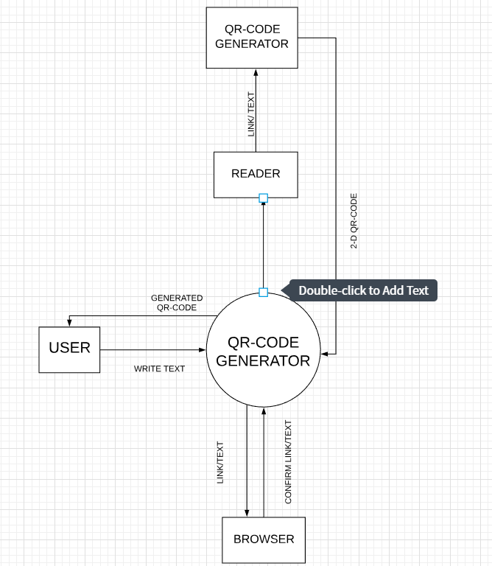
DATA FLOW DIAGRAM

Slide 5
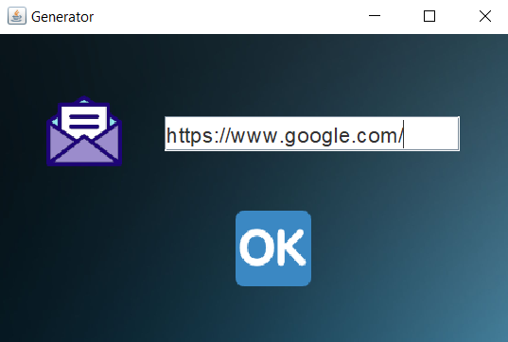
PROTOTYPE
INPUT FORMAT

Slide 6
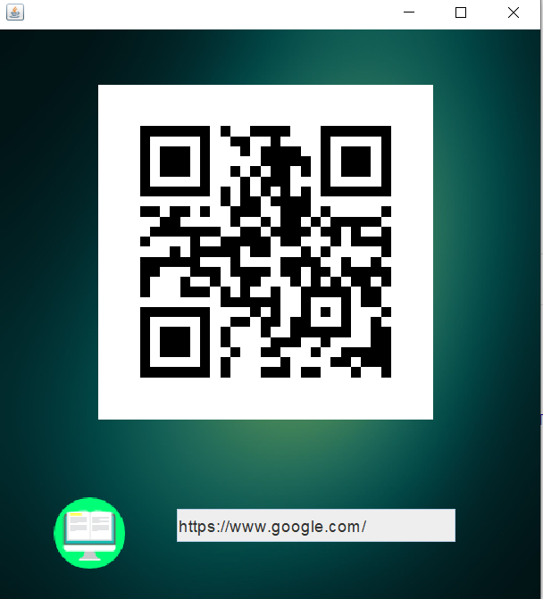
PROTOTYPE(Cont..)
OUTPUT FORMAT

Slide 7
SCOPE
QR Codes on bus stops, train stations and subway stations: A quick scan
would give you real time information on when the next bus, train or subway
arrive.
E-learning. Have your QR code generate an email that starts an autoresponder,
sending daily emails filled with lessons and related information.

Slide 8
REFEREENCES
https://blog.hubspot.com/blog/tabid/6307/bid/29449/how-to-create-a-qr-code-in-4-quick-steps.aspx
https://www.github.com
https://www.wikipedia.com
https://ieeexplore.ieee.org/document/8120658/
https://crunchify.com/java-simple-qr-code-generator-example/
https://www.pdfdrive.com/java-the-complete-reference-7th-edition-e3625514.html

Slide 9

THANK YOU

