Slide 1
Adaptive Sudoku Solver
Adaptive strategy selection and switching for Sudoku as a CSP
Foundations of Artificial Intelligence
Name: Tejendra Chapai
Register Number: 240701558
Department: CSE
College: Rajalakshmi Engineering College
Notes:
Introduce the project: an AI-based solver that chooses and switches between three established strategies. Fill in your details on this slide.

Slide 2
Problem Statement
Sudoku as a CSP
Each of the 81 cells is a variable with domain 1–9. Constraints forbid repeated digits in any row, column or 3×3 box.
Puzzles differ
Puzzles vary in empty cells, forced moves and the number of candidates per cell, so their computational difficulty differs.
Fixed strategies
Constraint propagation, MRV + backtracking and Min-Conflicts behave differently; one fixed technique may not suit every puzzle.
Need for adaptation
Selecting a strategy from measurable puzzle features, and switching when progress stalls, motivates an adaptive solver.
Notes:
Sudoku is a CSP: 81 variables, domain 1-9, all-different constraints over rows, columns and 3x3 boxes. Puzzles differ in empty cells, forced moves and candidate spread, so one fixed strategy is not equally suitable for all of them.

Slide 3
Objectives
Model Sudoku as a CSP
Implement multiple AI solving techniques
1
2
Analyze puzzle characteristics
Develop adaptive strategy selection
3
4
Support strategy switching
Evaluate performance experimentally
5
6
Notes:
The scope is standard 9x9 Sudoku, combining existing AI techniques rather than inventing a new algorithm.

Slide 4
Research Gap
Existing approaches
Backtracking
Constraint Propagation
MRV
Min-Conflicts
Hybrid methods
Gap
Limited explicit adaptation based on measurable puzzle characteristics and real-time solving progress
Proposed
Adaptive strategy selection + strategy switching
Notes:
Prior work covers individual techniques and some hybrids (e.g. constraint programming with iterated local search). The gap, as framed in the report, is limited explicit adaptation from measurable puzzle features and solving progress. This is an opportunity to investigate, not a claim of a new algorithm.

Slide 5
Proposed System / Architecture
Sudoku Input
Puzzle Validation
Puzzle Analysis → Computational Profile
Adaptive Strategy Selection
Constraint Propagation
MRV + Backtracking
Min-Conflicts
one strategy at a time
switch / re-select and run again
Progress Monitoring
Strategy Switching
Solution Verification
Verified Solution
Notes:
Switching is a loop: after each strategy run the controller compares empty-cell counts; if the count dropped it re-analyzes and re-selects, otherwise it switches in the fixed order CP, MRV, Min-Conflicts, skipping tried strategies. Verification is is_valid() plus no empty cells.

Slide 6
AI Techniques
Constraint Propagation
Fills cells with exactly one candidate; repeats until no change (naked singles only)
MRV + Backtracking
Picks the empty cell with fewest candidates; recursive search with undo
Min-Conflicts
Local search: random fill, then repair the conflicted cell to minimize conflicts
Adaptive controller: profiles the puzzle, selects the strategy, monitors progress, switches if needed
Notes:
Constraint Propagation here means naked singles only. MRV picks the empty cell with fewest candidates and backtracks. Min-Conflicts is local search with random initial fill (seed 42). The adaptive controller decides which one runs.

Slide 7
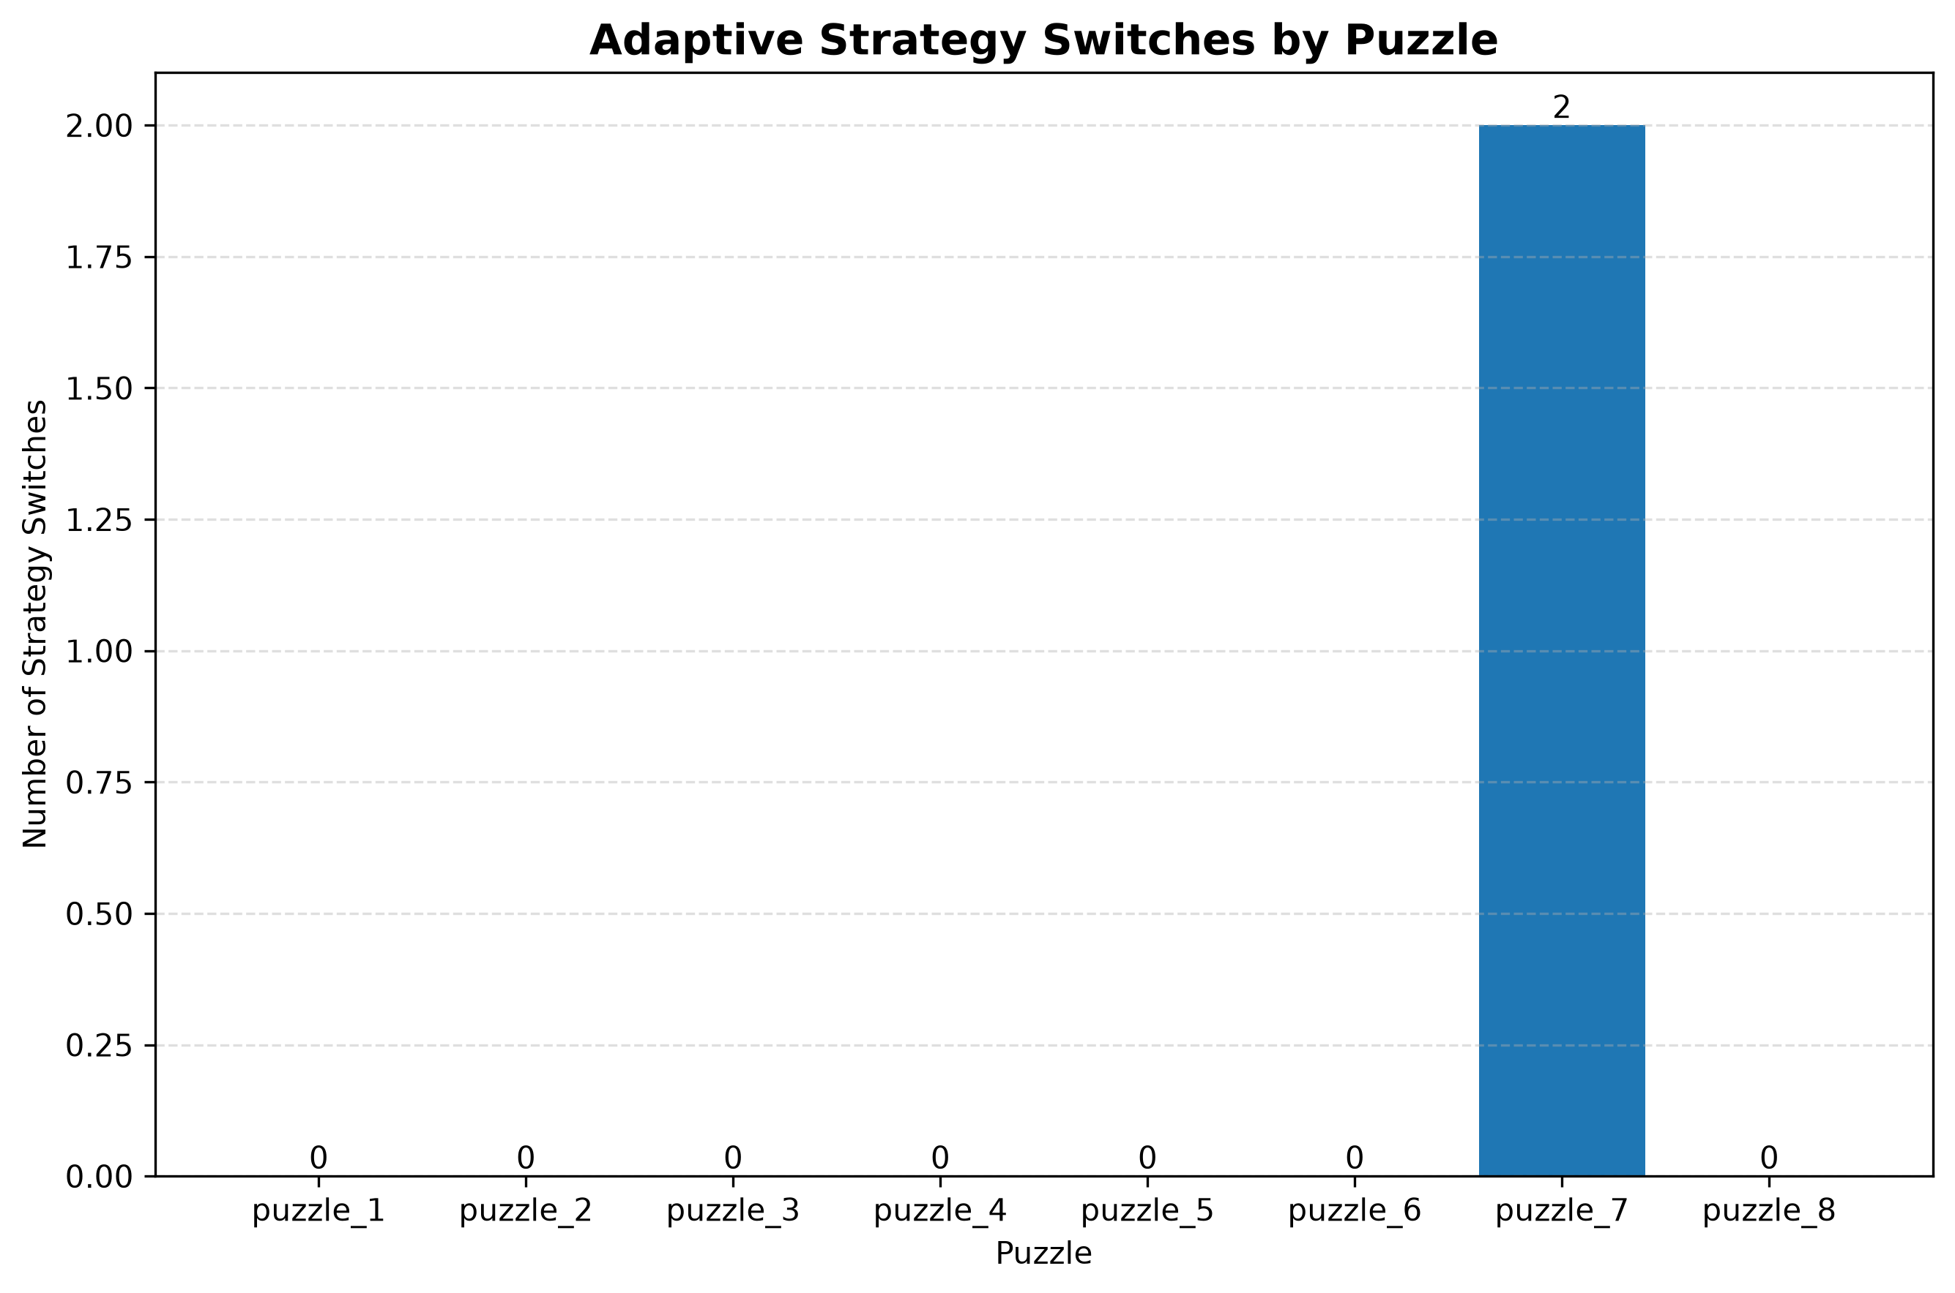
Adaptive Strategy Switching: P7
Min-Conflicts
no progress: switch 1
Constraint Propagation
no progress: switch 2
MRV + Backtracking
65
empty cells
2
strategy switches
Solved
verified
Switches per benchmark puzzle (repository graph). P7: 165 search nodes, 4,614 conflicts.
Notes:
P7 (65 empty cells, 0 forced moves, avg 5.57 candidates) starts with Min-Conflicts. The 100-step trial makes no progress, so the controller switches to CP, which finds no forced cell, then to MRV, which solves it. 165 nodes = 100 trial + 65 MRV. This slide shows the mechanism working; it is not a speed claim: MRV alone solves P7 in about 0.022 s.

Slide 8
Implementation: Key Modules
Module | Responsibility
validator.py | Structure, value and duplicate checks; final verification
candidates.py | Legal candidates per empty cell
constraint_propagation.py | Naked-single propagation
mrv_solver.py | MRV cell choice + recursive backtracking
min_conflicts.py | Local-search solver (seeded, restarts)
analyzer.py | Puzzle profile: empty cells, forced moves, candidates
strategy_switcher.py | Selection rule and switch order
adaptive_solver.py | Controller: run, monitor, switch
metrics.py | Time, nodes, backtracks, conflicts, switches
user_interface.py | Terminal 9×9 input and result display
Notes:
Modules live in src/. validator.py also performs final verification; src/verifier.py is an unused stub.

Slide 9
Experimental Setup
Benchmark
9×9 Sudoku, digital grid
Official benchmark: 8 puzzles
20 to 65 empty cells
Four solver configurations
Min-Conflicts budget: 1000 steps, 1 restart
Python 3.13.14
Metrics
Solving time
Search nodes
Backtracks
Conflicts
Strategy switches
Success rate
Notes:
The 8 puzzles are project-generated (seeded script, identical to the literal dataset): permuted base solution plus random cell removal. Do not call them a published standard. Min-Conflicts budget in the benchmark: 1000 steps, 1 restart, seed 42, so 0/8 means within this budget. Python 3.13.14 is from the report; confirm before presenting.

Slide 10
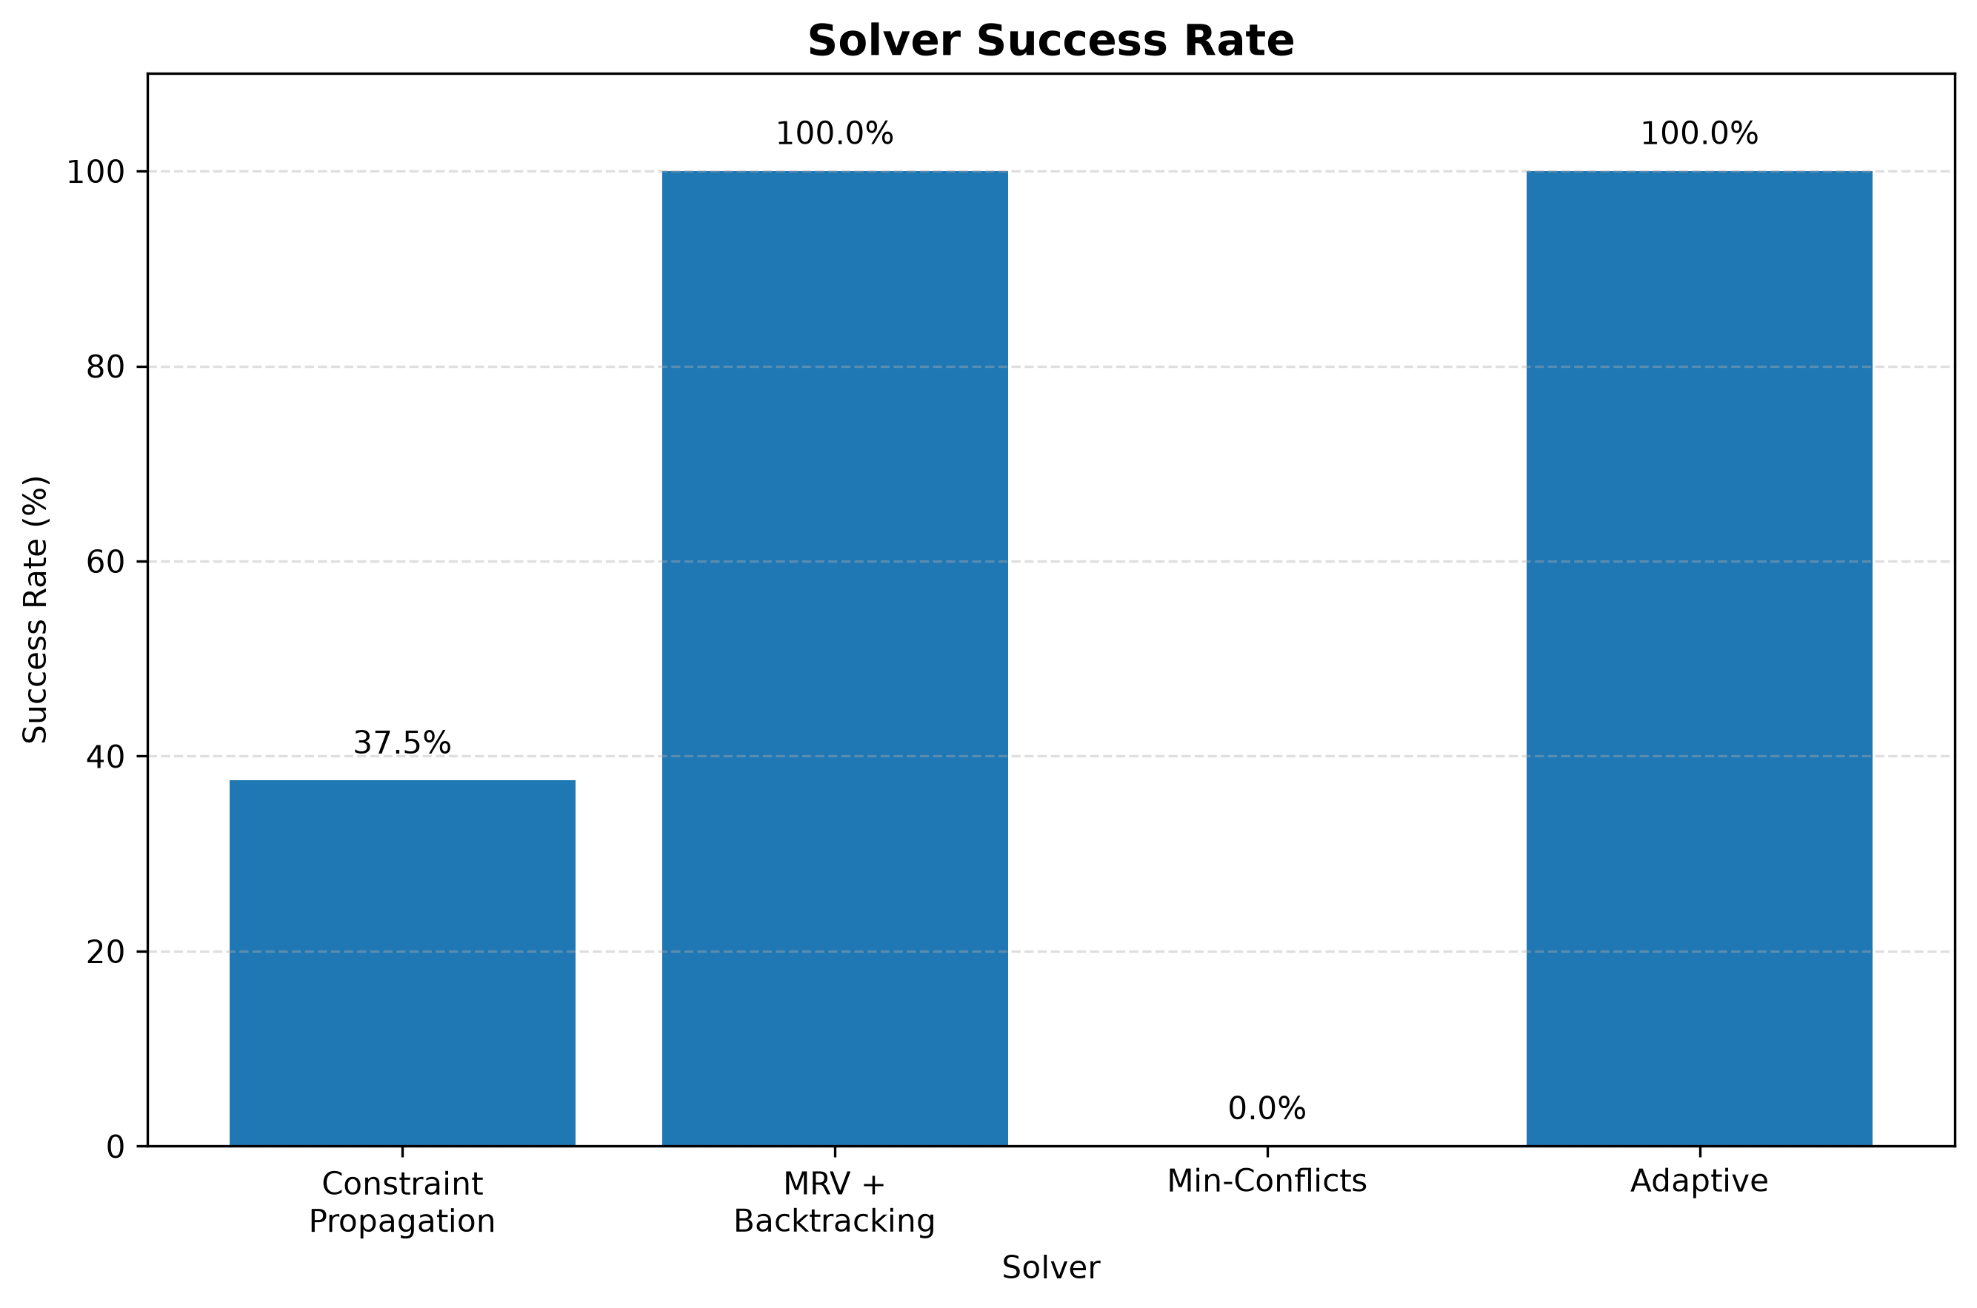
Results: Official 8-Puzzle Benchmark
Solver | Success | Avg time (s) | Avg nodes
Constraint Propagation | 37.5% | 0.001053 | 0.00
MRV + Backtracking | 100% | 0.017572 | 48.62
Min-Conflicts | 0% | 0.647065 | 1000.00
Adaptive | 100% | 0.027370 | 54.88
Adaptive matches MRV + Backtracking on success (8/8) but carries additional overhead; the results do not show it is faster.
Source: results/tables/solver_summary.csv (8 puzzles, one run each)
Notes:
Adaptive and MRV both solved 8/8. Adaptive has higher average time and nodes, reflecting overhead from analysis, selection, monitoring and switching (P7 alone is about half of adaptive total time). Timings are single-run and machine dependent. These are the finalized values from results/tables and the report.

Slide 11
Demonstration: Terminal Workflow
User enters 9×9 Sudoku
Validation
Puzzle analysis
Adaptive strategy
Switching if required
Solution
Performance metrics
P9: additional demonstration / testing puzzle
Not part of the official 8-puzzle benchmark; no benchmark results are reported for it.
Notes:
Option 1 in main.py: rows are entered as 9 space-separated digits (0 = empty). Option 2 runs the P7 demo live. P9 is an additional test puzzle stored outside the benchmark; it can only be tried by typing its grid into option 1. A live run showed Min-Conflicts, CP, MRV with 2 switches, but no P9 result is stored in the repository.

Slide 12
Conclusion & Future Work
Conclusion
Combines multiple AI techniques in one adaptive framework
Adaptive solved 8/8 benchmark puzzles; MRV + Backtracking also 8/8
Actual strategy switching demonstrated (P7)
Adaptive introduces computational overhead
Contribution: the framework, not a new Sudoku algorithm
Future work (not implemented)
Improved strategy selection
More solving algorithms
Machine-learning-based selection
Improved dynamic switching
Larger benchmark dataset
Sudoku variants
Graphical user interface
Notes:
The contribution is the adaptive framework, not a new Sudoku algorithm. Future work is not implemented. The GUI item goes beyond the report and the repository.

