Slide 1
RETAIL_DW
FINAL PROJECT PRESENTATION
INFO 7290 – DWBI
BY PROFESSOR RICHARD P. SHERMAN
Project BY:
Devyani bothra
Sameer suman
Rachana movva
Tejesh rathi

Slide 2
Agenda
Overview
Data Integration through Talend
Business Intelligence Tools – PowerBI, QlikSense, Tableau

Slide 3
overview
Retail company that sells variety of products to people and business across various sales channels
For Regions – North America, Europe, Asia
Customers based on products purchased – Online, Catalog (Oracle)
Products for categories like Audio, TV, Computers, etc
Final aim was to load facts for different channels – FactSales, FactInventory, FactSalesQuota, FactStrategyPlans

Slide 4
Steps taken
Load DW to all the 4 regions by the script provided
DimLoad
Error handling
Currency Conversion
FactLoad
Parallelization

Slide 5
Error handling takeaways
1. Do overall JVM config settings
2. Commit/block - # of rows, block has to be a multiple of commit
3. Parallelize the job itself - precedence correct, experiment with what happens at same time, split by SOR/database
4. Parallel executions on load
5. Avoid insert and update & do a lookup & if inner join then update if a "reject" insert row
6. Only query columns needed for load or lookup. Trim strings on inputs
7. Do not use Cache
8. No tUnite or Bulk Transforms.

Slide 6
Date and currency conversion
Null handling
row2.EndDate==null||row2.EndDate.toString().trim().length()==0?0 :1
Conversion of different datatypes
Currency conversion using FactExchangeRate
BigDecimal multiplication

Slide 7
Business intelligence tools
Inventory Analysis – Tableau
SalesQuota – Qliksense
Online Sales – PowerBI
Rejects – QlikSense
Sales - PowerBI
Strategy – PowerBI
SalesAnalysis – Qliksense

Slide 8
BI tools
Comparison | Tableau | PowerBI | Qliksense
Drill down | Robust Drill down data feature | Decent | Average
Visualization | Best | Average | Average
User friendly | Best | Average | Decent
Trends and Analytics | Average | Best | Decent
Customization | Average | Best | Average
Interactive Visuals | Average | Decent | Best
Migrate Jobs | Decent | Best | Average

Slide 9
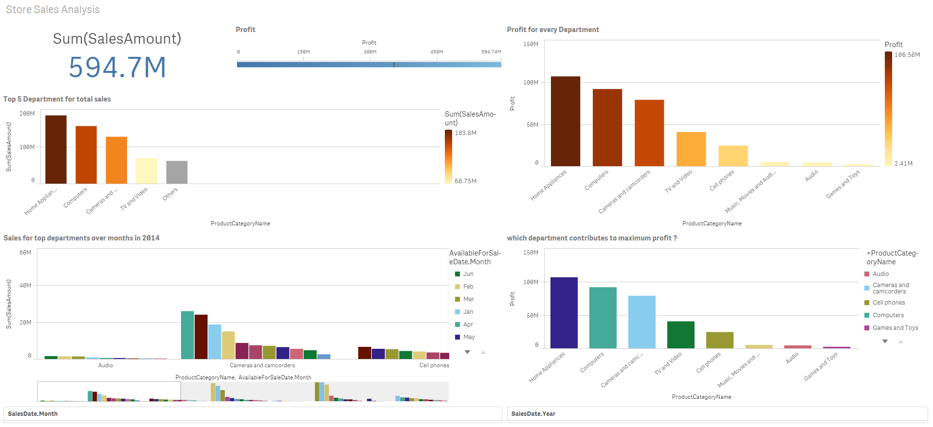
Qliksense – sales QUOTA analysis

Slide 10
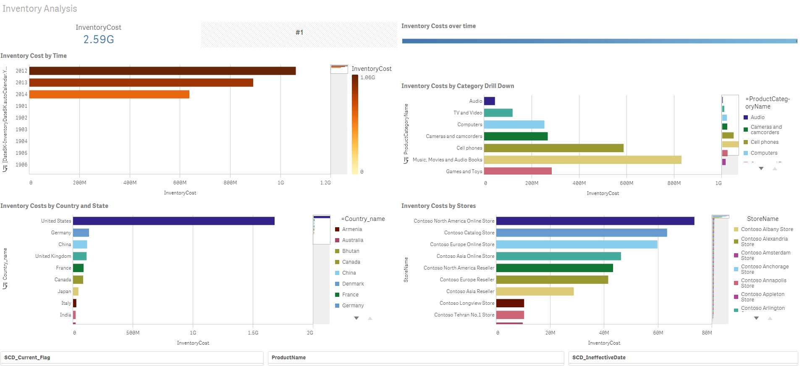
QLIKSENSE

Slide 11
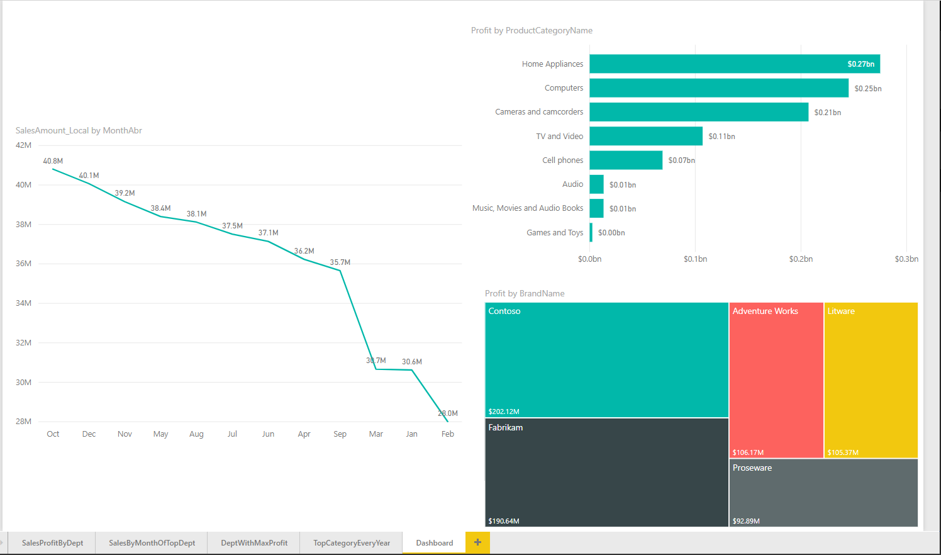
STRATEGY ANALYSIS - POWERBI

Slide 12
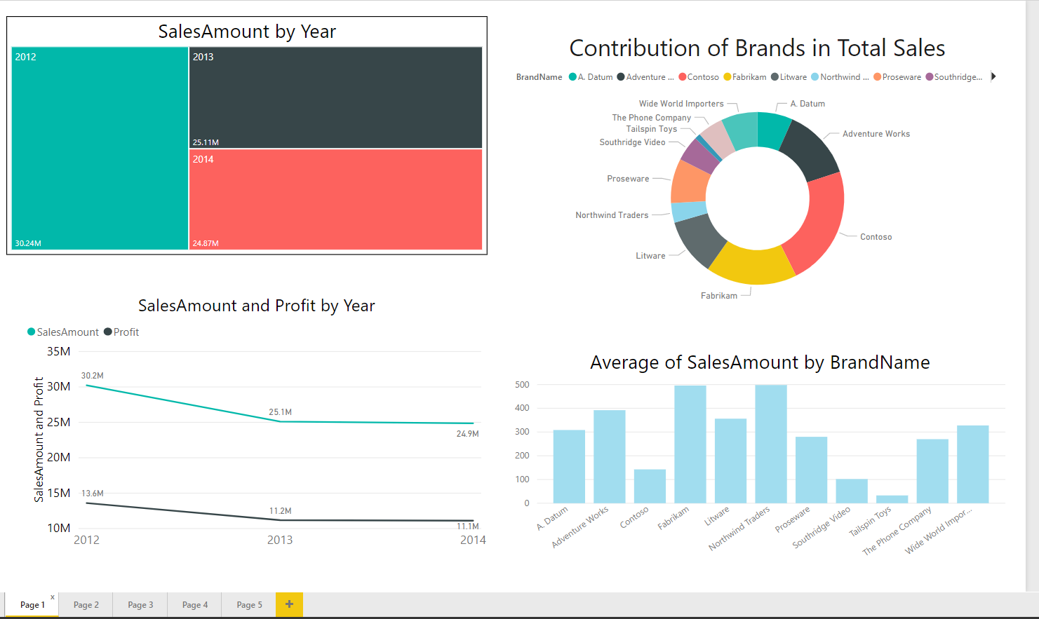
SALES

Slide 13
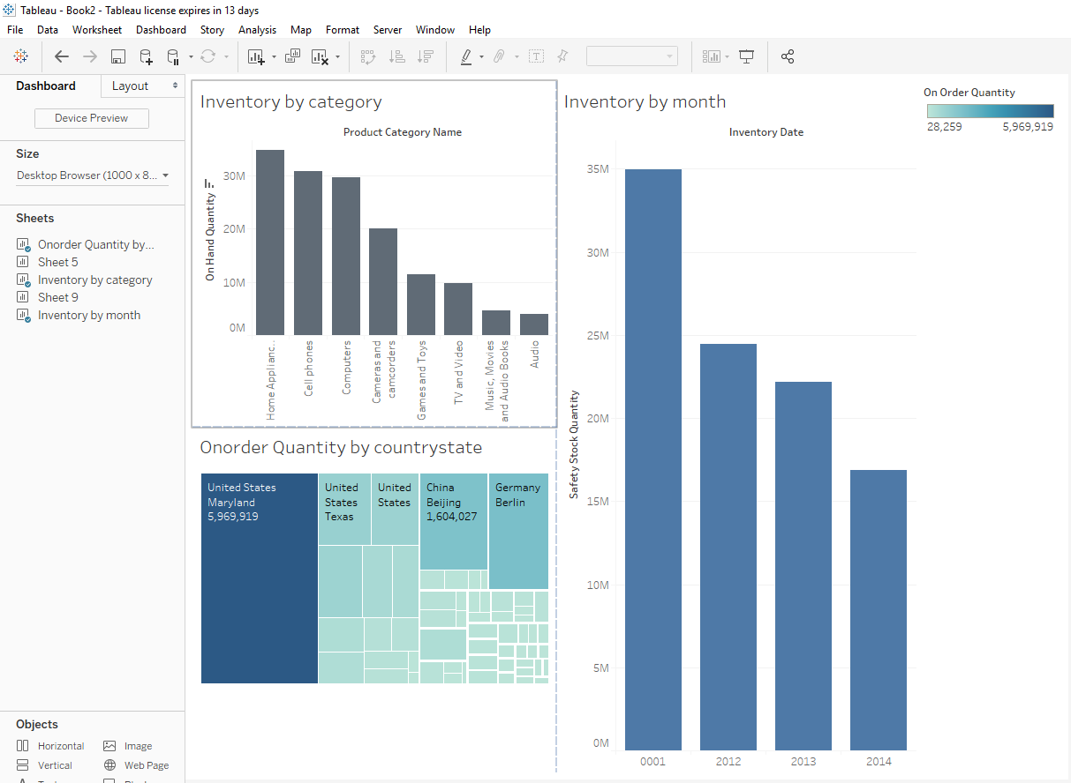
TABLEAU – INVENTORY ANALYSIS

Slide 14
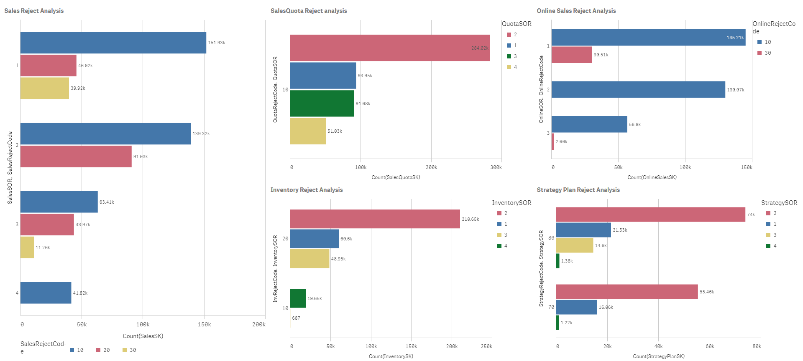
REJECT ANALYSIS - QLIKSENSE

Slide 15
Thank You ☺

