Slide 1

Implementation of 3D Object Detection
Models on Xilinx ZCU104 FPGA
Summer Colloquium Presentation • May – July 2026
Presented by: Tatikonda Tejesh
Roll No.: 2023BEE-035
Under the Guidance of: Prof. Manisha Pattanaik
Department of Electrical and Electronics Engineering
ABV – Indian Institute of Information Technology and Management, Gwalior
Academic Year 2025–2026
1/14

Slide 2
Problem Statement & Description
Autonomous driving demands real-time 3D perception from LiDAR under strict edge constraints
• LiDAR-based 3D object detection models (SECOND, Complex-YOLOv4) achieve high accuracy on GPUs
• GPU inference consumes 150–300 W — unsuitable for battery-powered edge platforms
• Non-deterministic GPU scheduling introduces latency jitter — unsafe for safety-critical braking
• LiDAR sensors operate at 10–20 Hz → need ≤100 ms inference per frame
The Gap
• No publicly available end-to-end deployment of SECOND or Complex-YOLOv4 on Xilinx FPGAs
• Xilinx-ZCU104-DPU instruction set does not natively support 3D sparse convolutions or Mish activation
• Need a heterogeneous CPU–DPU partitioning strategy validated on real hardware
2/13

Slide 3
Objectives
Architecture & Technique Exploration: Understand the ZCU104 board architecture, and the specific processes required to map neural networks to FPGA hardware.
Model Analysis & Validation: Systematically analyze model architectures (starting with Complex YOLOv4 and then SECOND model) for hardware mapping, followed by rigorous debugging, testing, and validation of hardware outputs to ensure deployment accuracy.
End-to-End Deployment: Implement the trained Complex YOLOv4 and SECOND models on the Zynq FPGA board(ZCU-104) using Xilinx pre-built DPU and comparing the performance.
Performance Benchmarking: Identify hardware bottlenecks to justify future custom accelerator designs.
3/13

Slide 4
Literature Review
3D Object Detection from LiDAR Point Clouds
• VoxelNet — First end-to-end deep learning for 3D detection; used dense 3D convolutions → slow
• SECOND — Introduced spatially sparse convolutions → dramatic speedup over VoxelNet
• Complex-YOLO — Projects point cloud to BEV image + YOLO; Euler region proposals for yaw
• PointPillars — Vertical pillars instead of voxels; fast 2D CNN backbone
FPGA-based Neural Network Acceleration
• Xilinx DPU (DPUCZDX8G) — Fixed ISA for Conv2D, BN, ReLU, pooling in INT8; no sparse 3D conv support
• INT8 Post-Training Quantization (PTQ) — ~4× model size reduction; 1–3% accuracy loss
• Quantization-Aware Training (QAT) — Simulates quantization during training; <1% accuracy loss
4/13

Slide 5
Hardware Platform: Xilinx ZCU104
Feature | Specification
SoC Device | Zynq UltraScale+ MPSoC XCZU7EV-2FFVC1156
Application Processors (PS) | Quad-core ARM Cortex-A53 (64-bit) @ 1.5 GHz
Real-Time Processors (PS) | Dual-core ARM Cortex-R5F @ 600 MHz
Graphics | Mali-400 MP2 GPU
Programmable Logic (PL Fabric) | 16 nm UltraScale+ FPGA Fabric
PL Numerical Capacity | System Logic Cells: ~504,000 LUTs (Look-Up Tables): 230,400 FFs (Flip-Flops): 460,800 DSP Slices: 1,728 (Crucial for Neural Net math) Block RAM (BRAM): 11.4 Mb (312 blocks) UltraRAM: 27 Mb (96 blocks)
Video Codec Unit (VCU) | Integrated H.264/H.265 Encode & Decode (up to 4K @ 60fps)
System Memory | 2 GB DDR4 (64-bit component memory for PS)
Connectivity | USB 3.0, Gigabit Ethernet, PCIe Gen2 x4 root port, SATA 3.1
Development Tools | Vivado Design Suite, Vitis Unified Software Platform, PetaLinux, Vitis AI
Typical Edge AI Uses | Deterministic FPGA Acceleration, Embedded Vision, ADAS (Advanced Driver Assistance Systems), Video Processing
5/13

Slide 6
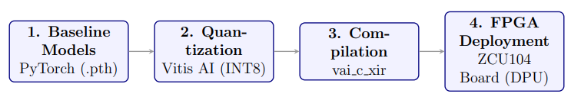
Methodology — Deployment Workflow
End-to-End FPGA Deployment Pipeline (Both Models)
Pre-trained Model Acquisition: Obtaining float32 PyTorch checkpoints pretrained on the KITTI dataset.
INT8 Quantization using the Vitis AI pytorch nndct quantizer inside a Docker container.
Compilation to a DPU-executable .xmodel using vai c xir.
Board Deployment and inference using the VART (Vitis AI Runtime) Python API on PetaLinux.
6/13

Slide 7
Methodology — Complex-YOLOv4
Architecture
• Input: 3-channel BEV image (608×608) — intensity, height, density from LiDAR
• Backbone: Darknet CNN (161 layers) → 3 YOLO detection heads (76×76, 38×38, 19×19)
• Output per anchor: 4 bbox + 2 yaw (complex numbers) + 1 objectness + 8 classes = 15 values
DPU–CPU Partitioning
• DPU: Entire Darknet backbone (Conv2D, BN, LeakyReLU, MaxPool, Route, Shortcut, Upsample)
• CPU: Final 3 × 1×1 convolutions, YOLO decode (sigmoid, grid offset, anchor scaling), NMS
Key Adaptation: Mish → LeakyReLU
• Mish not supported by DPU → replaced with LeakyReLU (α = 13/128 for exact INT8 fit)
• Retrained 30 epochs to recover accuracy
7/13

Slide 8
Methodology — SECOND
Architecture (Voxel-based Full 3D Detector)
• Voxelization + MeanVFE: raw point cloud → 3D voxel grid [1408×1600×40]
• 3D Sparse Backbone: sparse convolutions on occupied voxels (<5% of grid) → 8× downsample
• Height Compression: 3D → dense 2D BEV feature map [256×200×176]
• 2D Dense Backbone: 12 Conv2D layers + 2 ConvTranspose2D → [512×200×176]
• Detection Head: 3 parallel 1×1 convs (classification, box regression, direction)
DPU–CPU Partitioning (Heterogeneous)
• Host PC (Pre-computed): Voxelization, 3D Sparse Backbone, and Height Compression (bypassed on-board due to ARM CPU limitations).
• ZCU104 DPU: Dense 2D BEV backbone + detection head (>80% of total MACs).
• ZCU104 ARM CPU: File I/O and Post-processing (Anchor Decode, NMS).
Key Adaptation
• ONNX export of dense backbone only; compiled to SECOND_model.xmodel (5.82 MB)
8/13

Slide 9
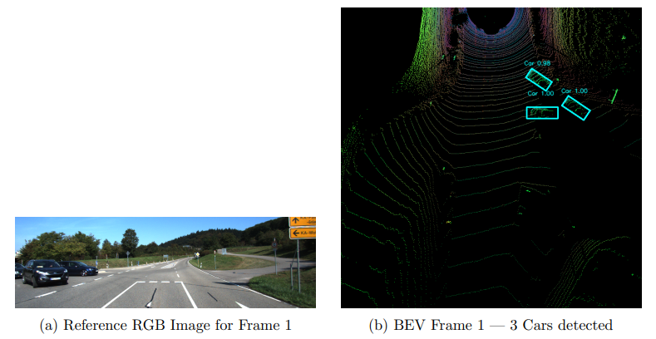
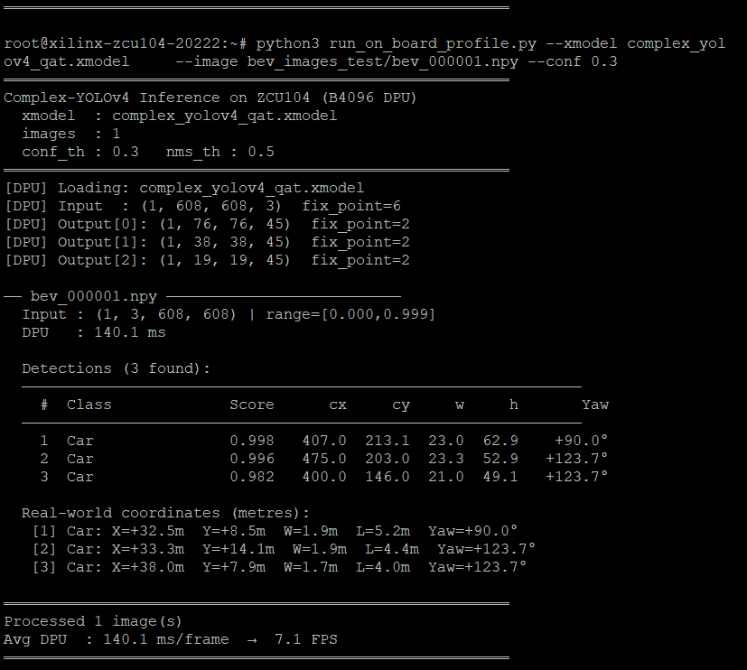
Results — Complex-YOLOv4 on ZCU104
DPU Inference Latency: 140.1 ms/frame
Throughput: 7.1 FPS
Power Consumption: ~15 W
xmodel Size: 67.3 MB
RAM Usage: 613 MB / 1985 MB (30.9%)
Input: [1, 608, 608, 3] INT8
Board’s Terminal(puTTY)
9/13

Slide 10
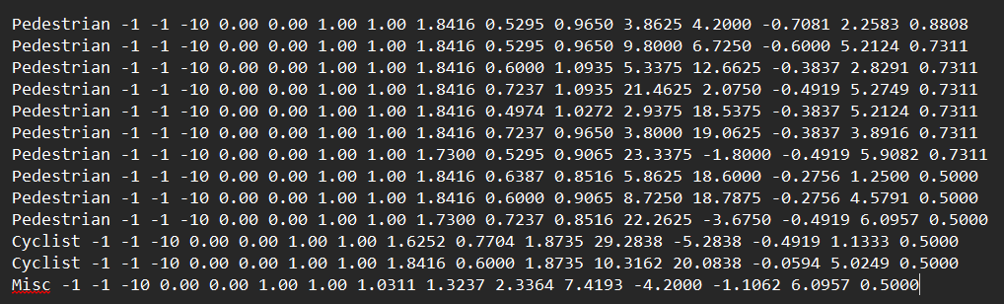

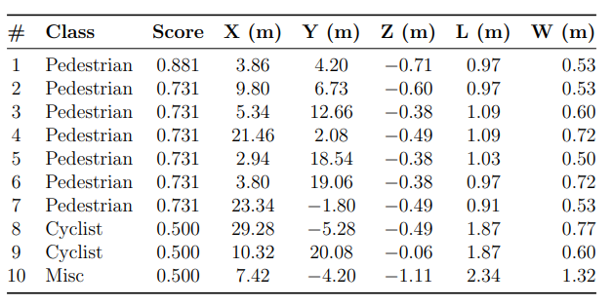
Results — SECOND on ZCU104
Board’s detections which are saved as .txt file
Inference Latency Profile
Pre-processing (CPU): 101.8 ms
DPU Execution: 543.4 ms
Post-processing (CPU): 475.2 ms
Total: 1120.4 ms (~0.89 FPS)
10/13

Slide 11
Future Work
Custom Accelerator for Complex-YOLOv4
  Design a dedicated Darknet inference engine optimized for its specific layer sequence, residual connections, and route/concatenation patterns.
Custom Accelerators for SECOND
  Dense Ops: Develop a Vitis HLS-based Conv2D engine (INT16) for dense operations and fused BatchNorm.
  Sparse Ops: Design a custom hardware engine for 3D sparse convolutions utilizing coordinate-based hash maps in on-chip memory to avoid CPU bottlenecks.
Quantization-Aware Training (QAT) & Mixed Precision
  Retrain models using QAT (simulated INT8 rounding) to recover accuracy lost for distant objects during Post-Training Quantization (PTQ).
  Explore mixed-precision inference (e.g., INT16 for first/last layers) to preserve small activation values.
11/13

Slide 12
References
[1] Y. Zhou & O. Tuzel, "VoxelNet: End-to-End Learning for Point Cloud Based 3D Object Detection," CVPR 2018
[2] Y. Yan, Y. Mao & B. Li, "SECOND: Sparsely Embedded Convolutional Detection," Sensors, 2018
[3] M. Simon et al., "Complex-YOLO: An Euler-Region-Proposal for Real-Time 3D Object Detection," ECCVW 2018
[4] A. Lang et al., "PointPillars: Fast Encoders for Object Detection from Point Clouds," CVPR 2019
[5] A. Bochkovskiy, C.-Y. Wang & H.-Y. Liao, "YOLOv4: Optimal Speed and Accuracy of Object Detection," 2020
[6] OpenPCDet Development Team, "OpenPCDet: Open-source Toolbox for 3D Object Detection," 2020
[7] A. Geiger, P. Lenz & R. Urtasun, "Are We Ready for Autonomous Driving? The KITTI Vision Benchmark Suite," 2012
[8] AMD/Xilinx, Vitis AI User Guide (UG1414), v3.5, 2023
[9] AMD/Xilinx, DPUCZDX8G for Zynq UltraScale+ MPSoCs Product Guide (PG338), 2023
[10] M. Nagel et al., "A White Paper on Neural Network Quantization," arXiv:2106.08295, 2021
12/13

Slide 13
THANK
YOU
1/14

