Slide 1
Attendance Management System
-R151050
-R151441
-R151541
-R151543
-R151642

Slide 2
Contents
Introduction
OverView
System Requirements
Analysis
Front End
Back End
Context Diagram
UML Diagrams
Project UI Designs
Conclusion

Slide 3
Introduction
AMS is a tool which is used for managing attendance and academic performance of the students.
Tracking student attendance .
This software can be managed by administrator or lecturers.
Is a CLIENT/SERVER system.
Can be accessed also via INTERNET.

Slide 4
Overview
Attendance Management System is based on web server, which can be implemented on any computer.
In This application, PHP and MySQL are used for back-end design and HTML, CSS and JavaScript are used as front-end tools.

Slide 5
Is this existed?
Yes , it’s existed.
Used in many companies for tracking employee attendance
Used in Universities/colleges for tracking student attendance

Slide 6
System Minimum Requirements
HARDWARE
  RAM – 1GB
  Harddisk - 100MB
  Processor – Any Processor
  SOFTWARE
  XAMPP – Hosting Purpose
  MySQLserver – For Database

Slide 7
FRONT END
To Develop Front End of this Project , We have used mainly three languages.
HTML
CSS – For Attractive Designs of UI
JavaScript
BACK END
For Back End of this project we have used two languages
PHP
MYSQLI

Slide 8
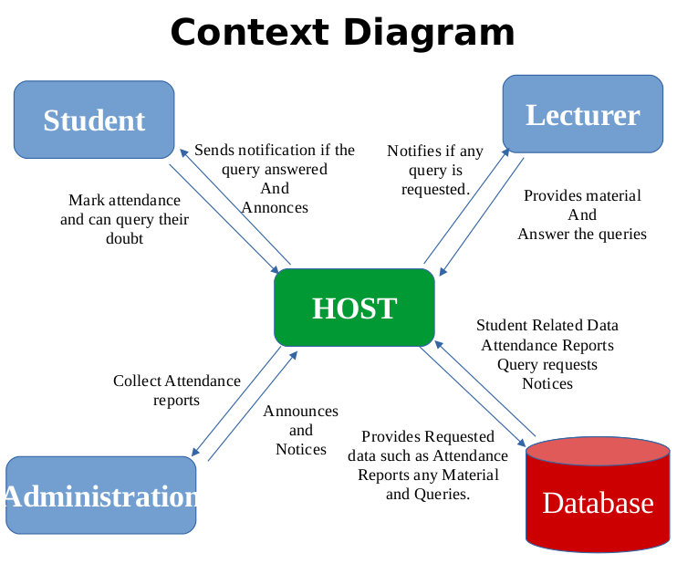
Context Diagram

Slide 9
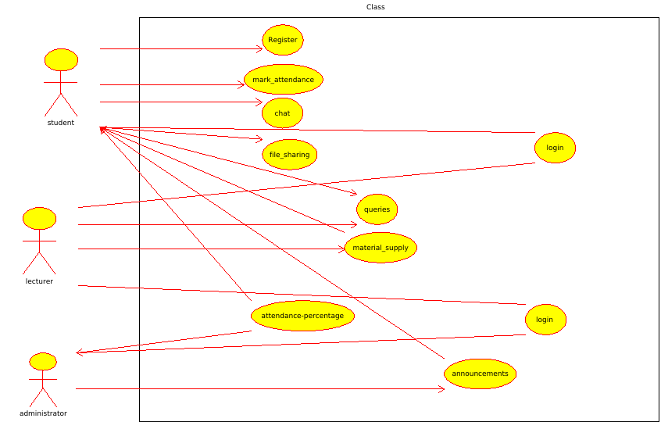
UML Diagrams
Use Case Diagram

Slide 10
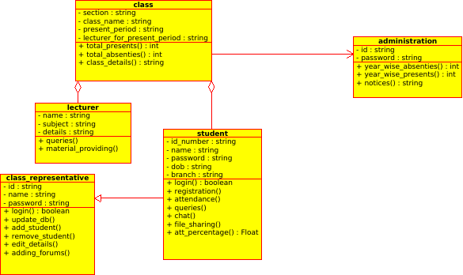
UML Diagrams
Class Diagram

Slide 11
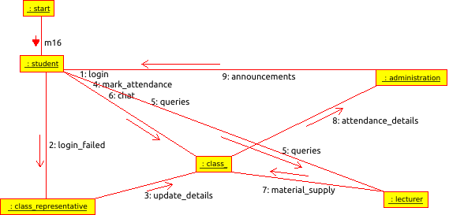
UML Diagrams
Colloaboration Diagram

Slide 12
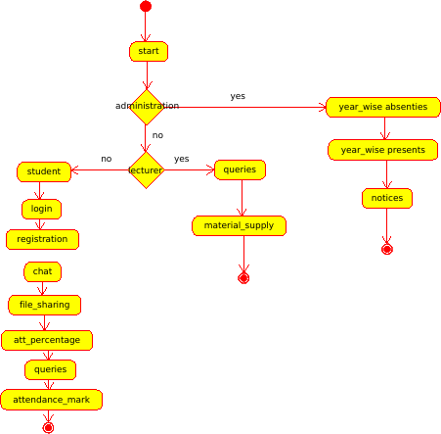
UML Diagrams
Activity Diagram

Slide 13
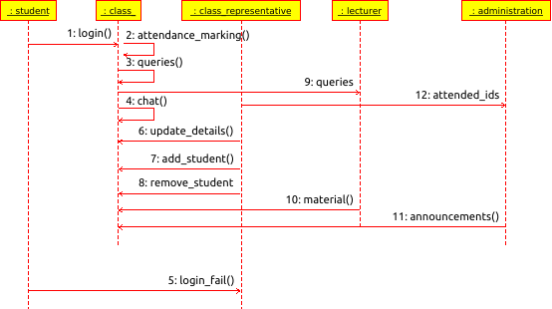
UML Diagrams
Sequence Diagram

Slide 14
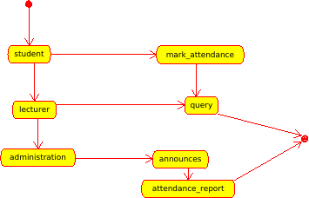
UML Diagrams
State Diagram

Slide 15
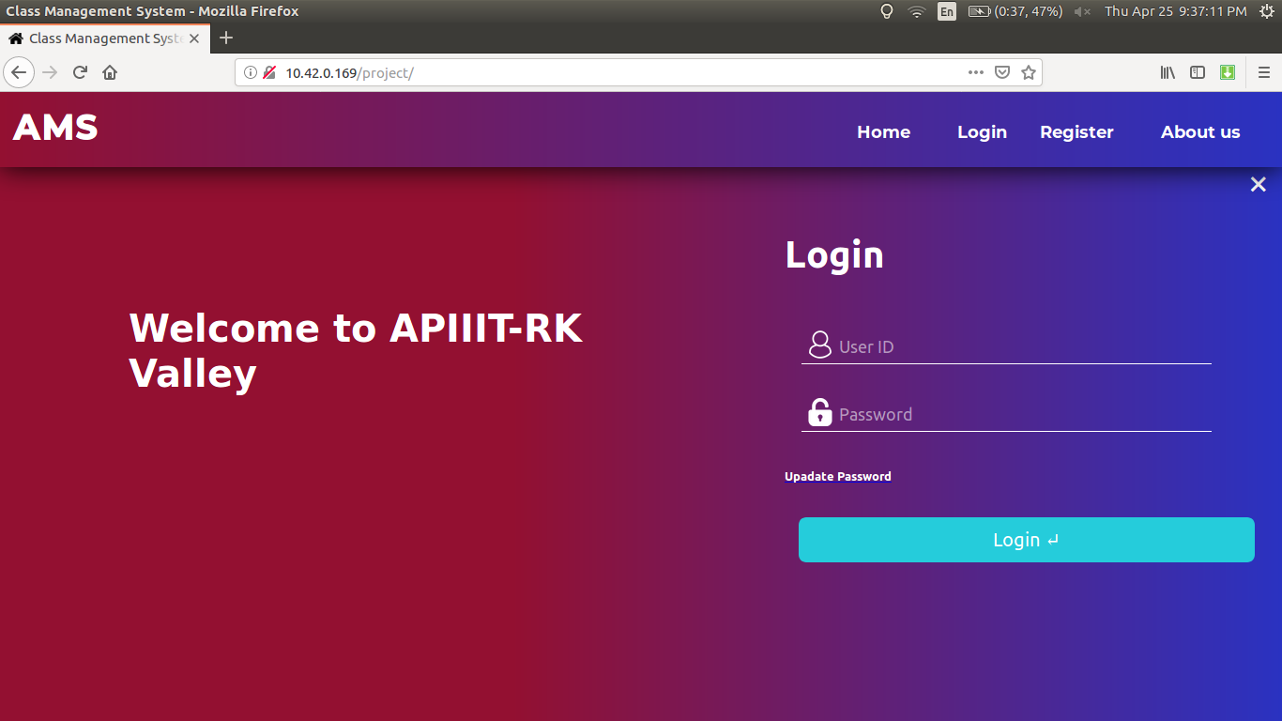
Project UI

Slide 16
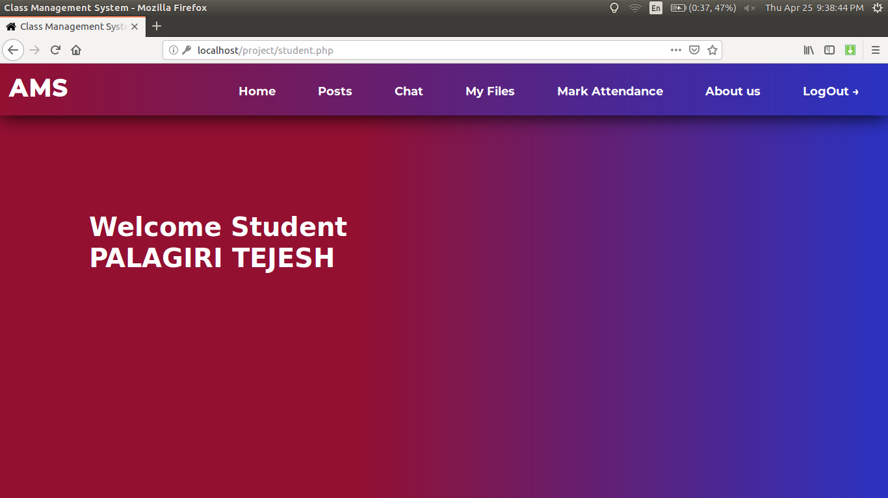
Student Home Page

Slide 17
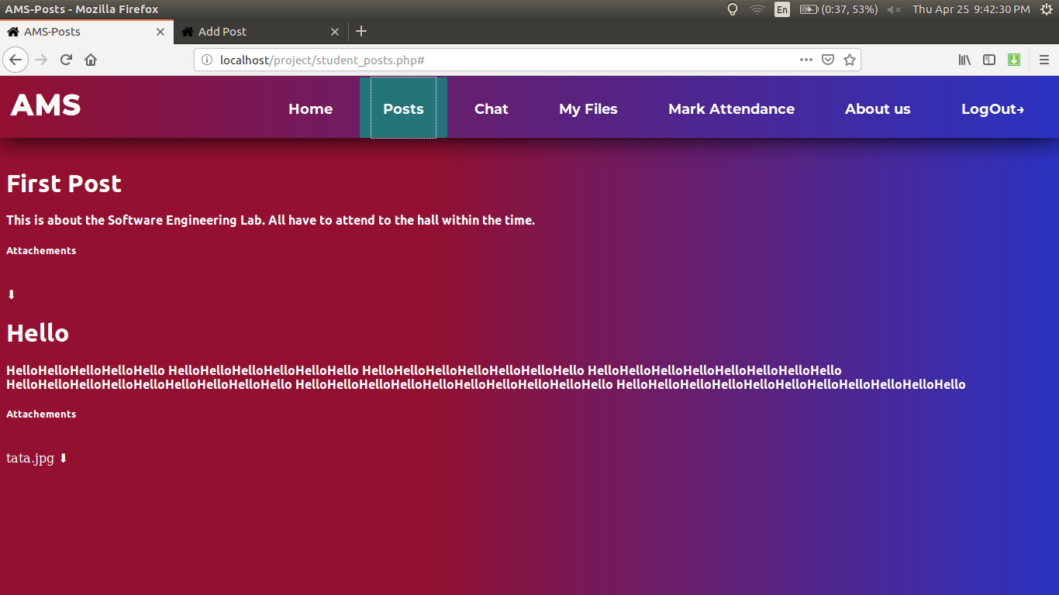
Student POSTS

Slide 18
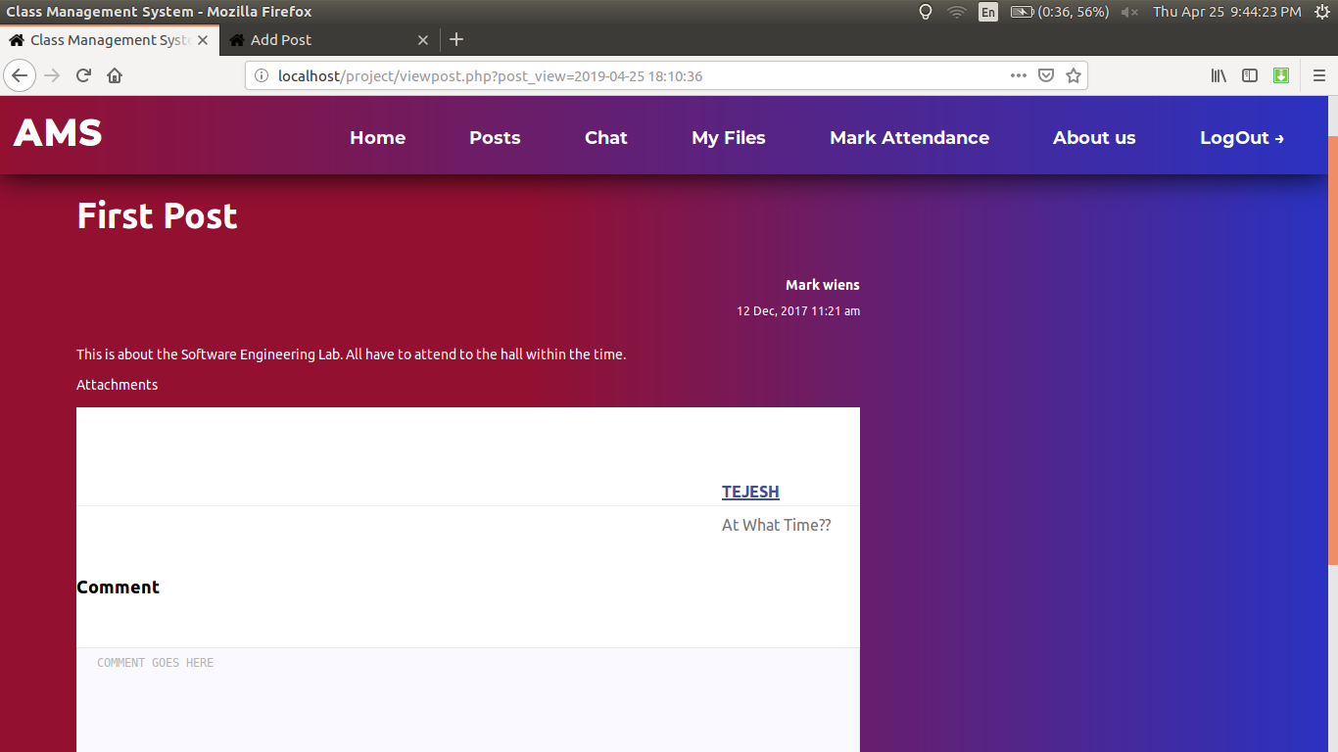
Full Post View with Comment Section

Slide 19
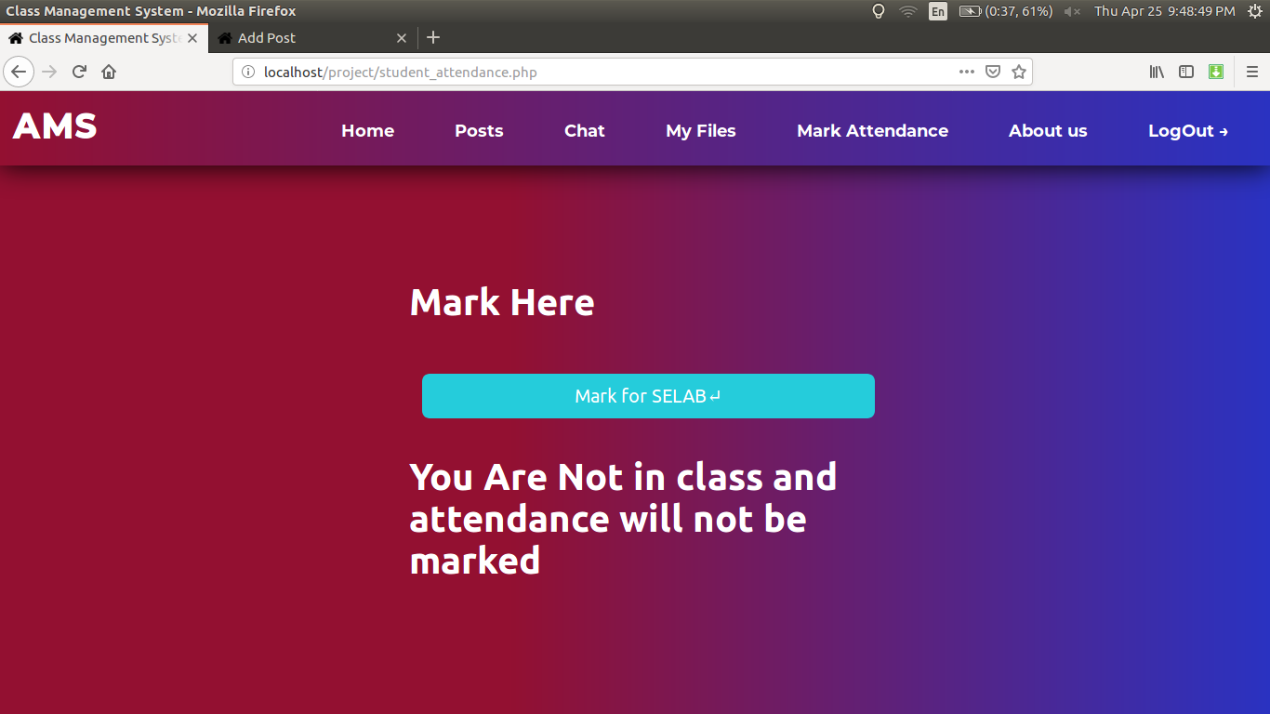
Attendance Marking

Slide 20
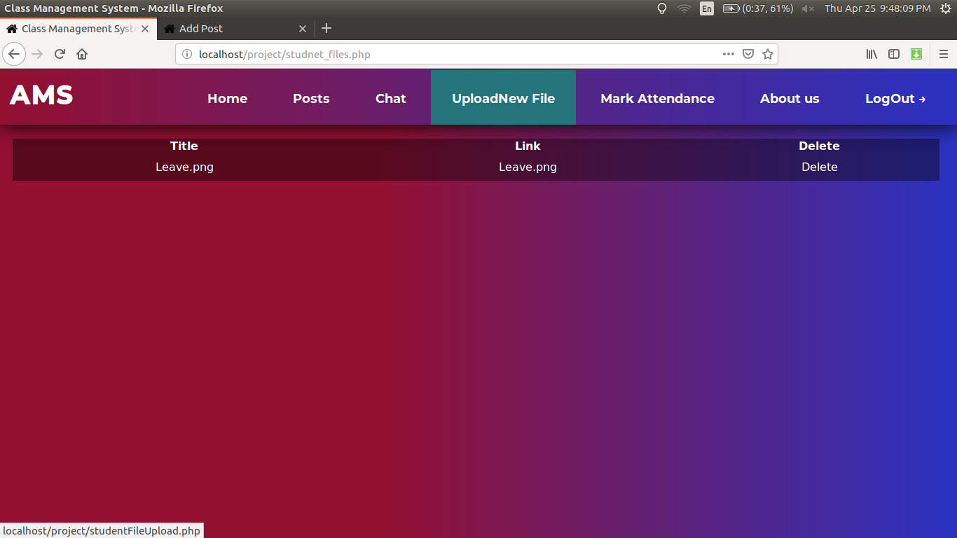
Student Cloud File Sharing

Slide 21
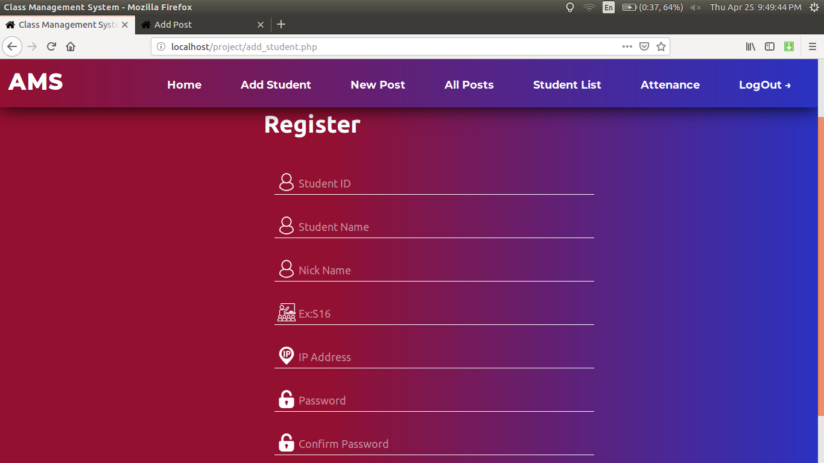
Admin Adding Student

Slide 22
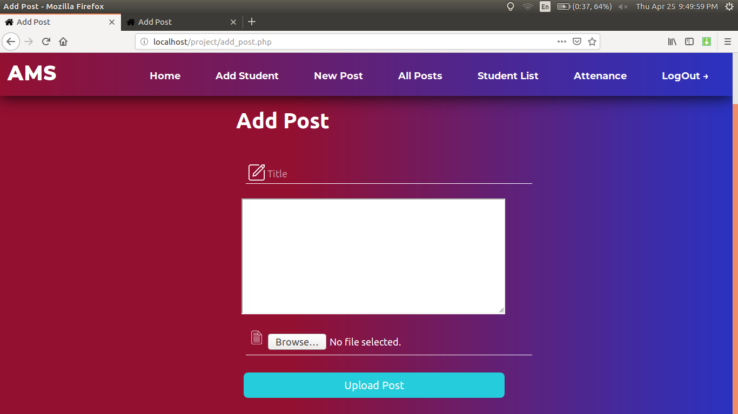
Admin Posting new Circular

Slide 23
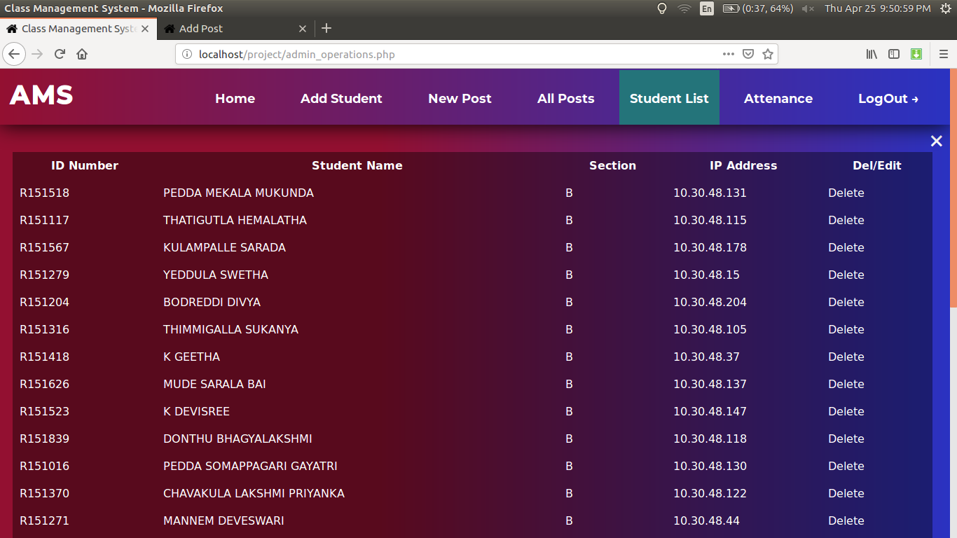
Admin Editing and Deleting Student

Slide 24
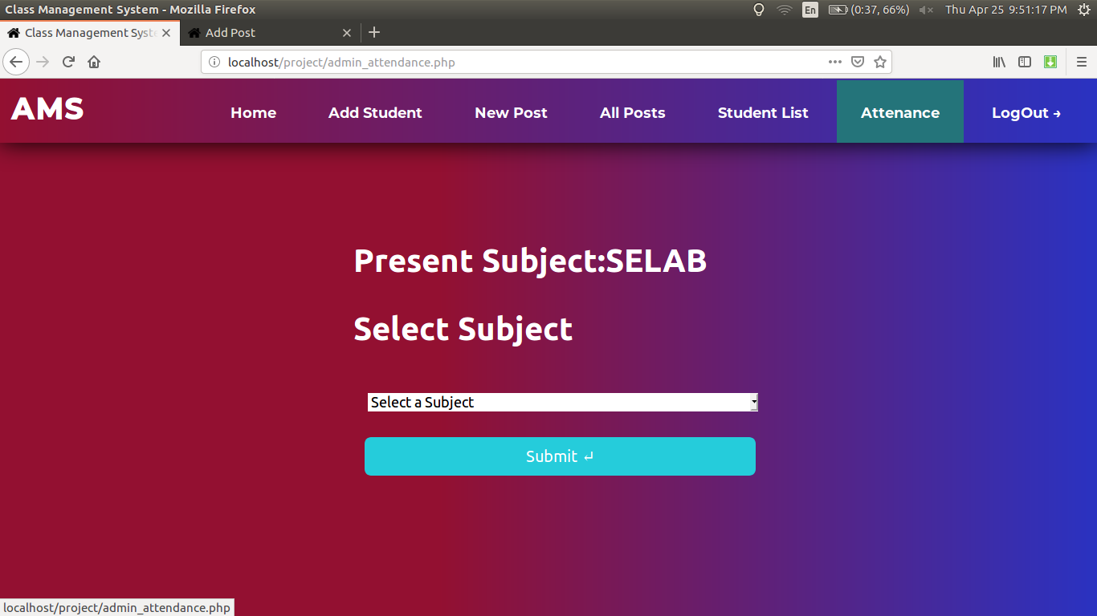
Admin Setting Current Period

Slide 25
Admin Setting Current Period

Slide 26
Conclusion
AMS is online tool for an University or Any other Institution and for Software Companies
We can get Attendance Reports of Students as our Criteria
We can Post Circulars to all the student
And available 24 X 7 online
Maintains Student Regularity and Student can asks any doubt to any User.

Slide 27
Thank You

Slide 28
References
HTML :https://www.w3schools.com/html/
PHP:https://www.w3schools.com/php/
SQL:https://www.w3schools.com/sql/
Moodle:https://moodle.org/
Reference code:https://www.kashipara.com/project/idea/html-css-template/student-attendance-management-system-project-in-html_1323.html
AMS Portal(RGUKT):http://10.50.50.6:8081/AMS/
Our Website:http://worldvise.ml/

