Slide 1
SWIGGY ANALYSING BANGALORE OUTLET CROP PRODUCTION ANALYSIS IN INDIA REPORT
UNID: CRIN2301354

Slide 2
INTRODUCTION:
In Swiggy Analysing Bangalore Outlet , after examining the data We can identify the most popular cuisines, dishes with high ratings etc.,
In Crop production analysis, after examining the dataset, We can identify the best crops to cultivated at the best season and also the states cultivating the crops.

Slide 3
DETAILS IN THE DATASET:
SWIGGY ANALYSING DATASET
Varieties Of Cuisines
Locations
Shop Names
Cost for two dishes
Rating for the particular dish.
CROP PRODUCTION ANALYSIS
State Name
District Name
Crop Year
Season
Crop
Area
Production

Slide 4
WEEK 1:
In Swiggy analysing project, on the first week I made my first sheet in project to get a basic details of the Dataset. In the first week I make my first chart to compare the rating and with costs of dishes.
In Crop production analysis project, same as the Swiggy analysis ,on the first week I tried to get a basic details from the dataset, After I tried with a lot of attributes I finalized with the Pie chart with the attribute Production.

Slide 5
WEEK 2:
In Week 2, I fully spent with my first project that is Swiggy Analysing project.
I made a lot of comparisons with all the attributes and finalize it with some 4 charts.
The comparison between Cuisine and Cost for Two and also with Rating using the line plot and scatter plot.
The Comparison between Shop name and Rating using Bar plot.
The Comparison between Location and Cost for Two dishes using Scatter plot.
And also I prepared a dashboard with these 4 sheets.

Slide 6
WEEK 3:
In the third week, I started my second project which is Crop production analysis.
I started this project with the attribute Production and I made my first Pie chart. With this we can get a lot of information about the Crop production in India.
I continued my work with the other attributes to get the detailed insights about the dataset.
And I finalized with the four charts, and created a dashboard for the sheets.

Slide 7
WEEK 4:
In the last week, I made my visualizations to look better. I edited the Axis, Tooltip, and Titles.
And the conclusion made for the projects with my own visualizations are:
In Swiggy analysis, The Highest rated dishes are affordable price. The Home foods, Ice Cream, Desserts are the highlest rated dishes in the dataset which are at affordable prices. Also the low rated dishes are same but it is not an Indian based Cuisine’s. Hence I concluded that the Indian cuisines are get highly attracted by people’s.

Slide 8
CONTINUED:
In Crop production analysis, The Kerala is highly cultivable state in India based on Whole Year.
The Coconut is highly cultivable crop in the whole year in which the Kerala is at the first position.
In the Autumn season, Bihar is cultivating Rice in a huge amount.
In the Kharif season, Uttar Pradesh is highly cultivating Sugarcane.
In the Rabi season, Uttar Pradesh is highly cultivating the Oil seeds, Potato, Wheat.
In the Summer season, West Bengal is highly cultivating the Rice.
In the Winter season,West Bengal is highly cultivating Potato and Rice.

Slide 9
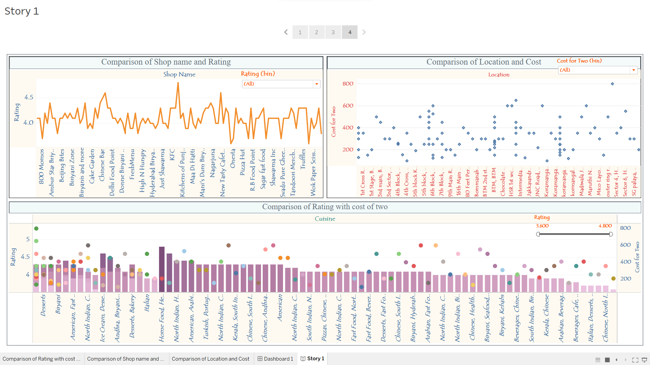
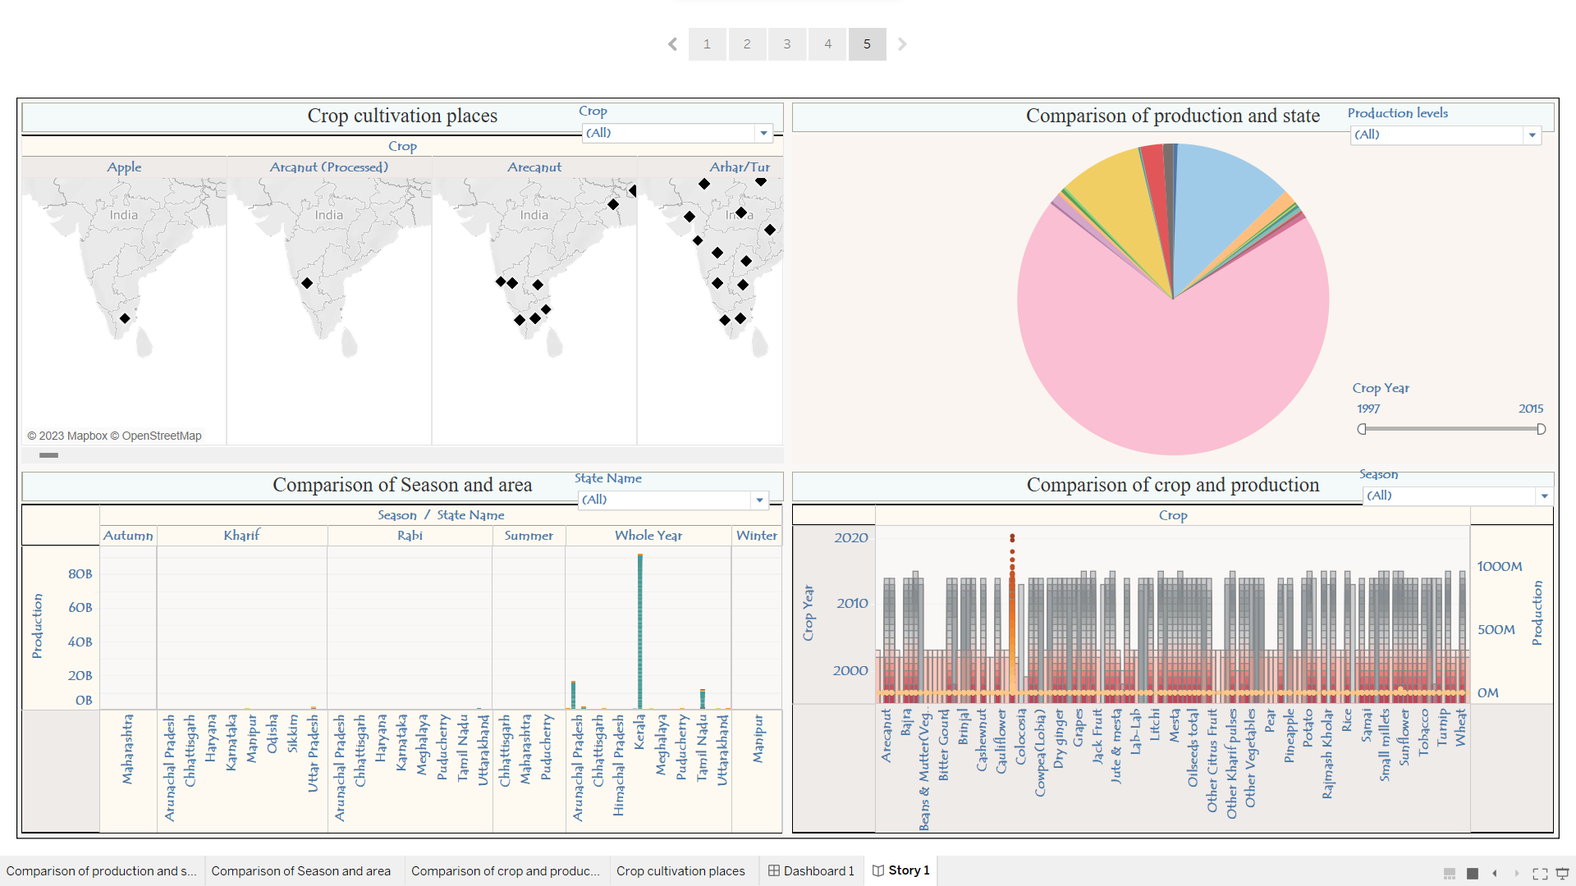
SCREENSHOTS OF THE PROJECT:

Slide 10
LINKS FOR MY PROJECTS:
PROJECT 7 CROP PRODUCTION ANALYSIS:
https://public.tableau.com/views/Cropproductionanalysis/Story1?:language=en-US&:display_count=n&:origin=viz_share_link
PROJECT 15 SWIGGY ANALYSING:
https://public.tableau.com/views/SwiggyAnalysisproject/Story1?:language=en-US&:display_count=n&:origin=viz_share_link

Slide 11
THANK YOU

