Slide 1
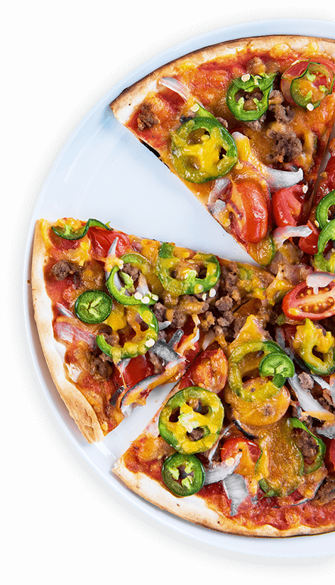
PIZZA
SALES ANALYSE BY
SQL -QUERY
Welcome to the Pizza Sales Analytics Project!
This portfolio showcases an in-depth analysis and insights derived from our pizza sales data, including revenue generation, customer preferences, and operational performance.

Slide 2

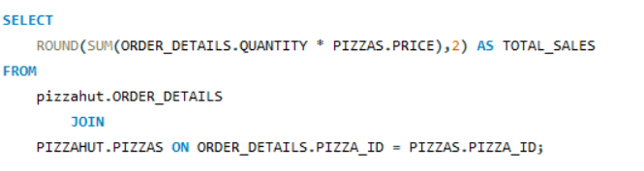

QUERY 1 : CALCULATED TOTAL REVENUE GENRATED BY PIZZA SALE .
Notes:
Image by pngfly.com

Slide 3
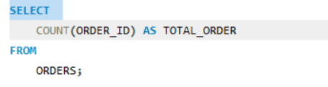

QUERY 2 : RETRIVEE THE TOTAL NUMBER ORDER PLACED .

Slide 4

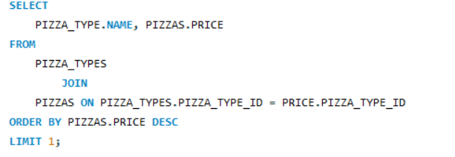

QUERY 3 :IDENTIFY THE HIGHEST PRICED PIZZA
PIZZA
SALES
Notes:
Image by pngfly.com

Slide 5
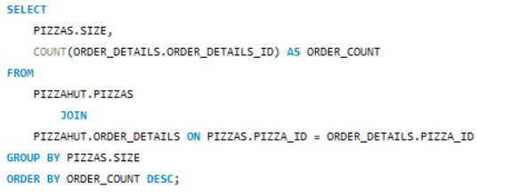
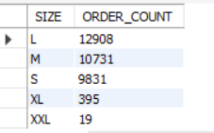
QUERY 4 :IDENTIFY MOST ORDER PIZZA SIZE ;
PIZZA
SALES
Notes:
Image by pngfly.com

Slide 6

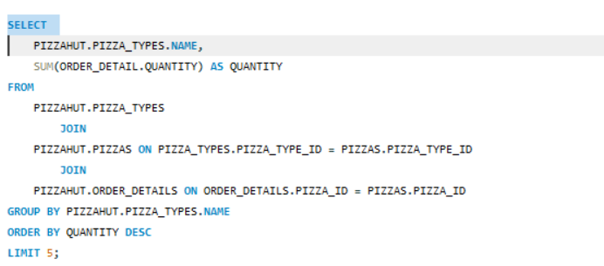
QUERY 5 : LIST THE TOP 5 MOST ORDERED PIZZA TYPE ALONG WITH THIER QUANTITIES
.
Notes:
Photo by Cel Lisboa on Unsplash

Slide 7
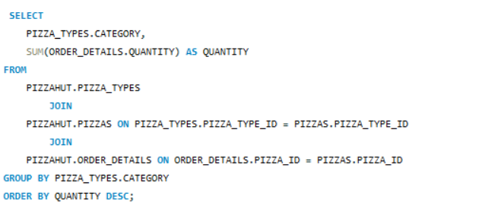
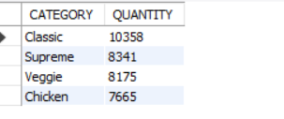
QUERY 6 :
JOIN THE NECESSARY TABLES TO FIND THE TOTAL QUANTITY OF EACH PIZZA CATEGORY ORDERED.
.
Notes:
Photo by Cel Lisboa on Unsplash

Slide 8
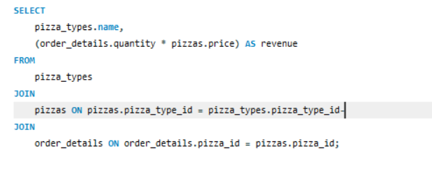
QUERY 7: determine the most 3 order pizza types based on the revenue
Notes:
Image by pngfly.com

Slide 9
THANK YOU

