Slide 1



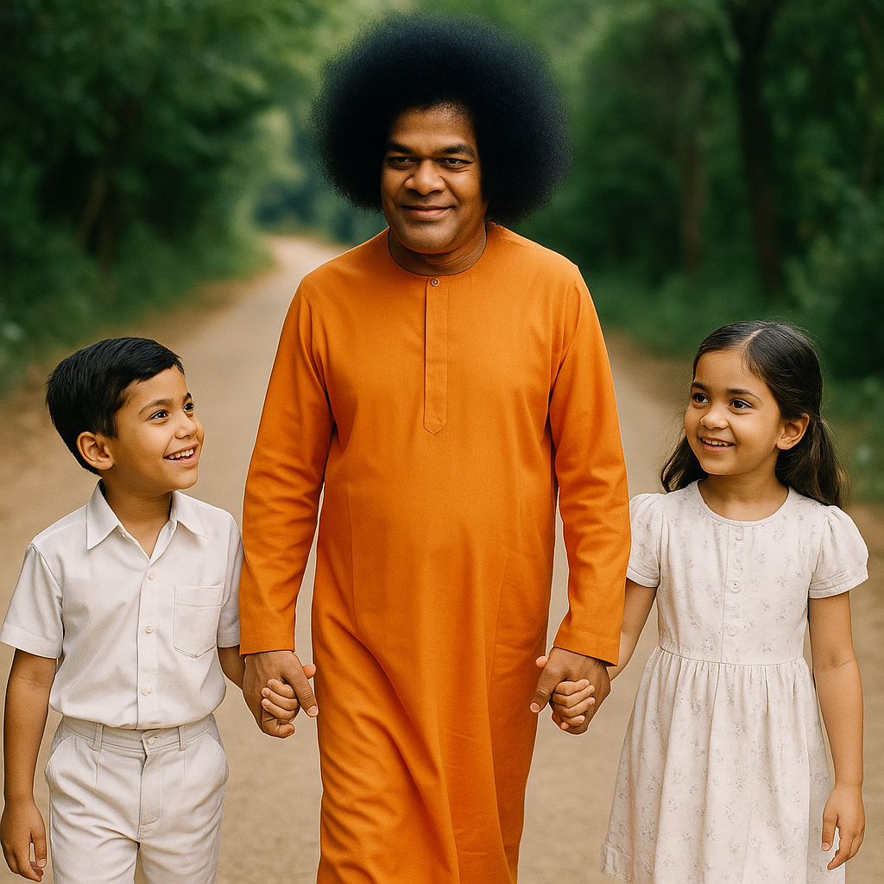
AUM SRI SAIRAM
SRI SATHYA SAI SEVA ORGANISATIONS (INDIA)
KANCHIPURAM SOUTH
DISTRICT LEVEL BALVIKAS TALENT SEARCH
(DLBTS - 2025)
LOVE ALL SERVE ALL
HELP EVER HURT NEVER

Slide 2
AUM SRI SAIRAM
SRI SATHYA SAI SEVA ORGANISATIONS (INDIA)
KANCHIPURAM SOUTH
DISTRICT LEVEL BALVIKAS TALENT SEARCH
(DLBTS - 2025)
GROUP 1 EVENTS
LOVE ALL SERVE ALL
HELP EVER HURT NEVER

Slide 3
AUM SRI SAIRAM
SRI SATHYA SAI SEVA ORGANISATIONS (INDIA)
KANCHIPURAM SOUTH
DISTRICT LEVEL BALVIKAS TALENT SEARCH
(DLBTS - 2025)
GROUP 1 ➔ BHAJANS
1st
2nd
3rd
LOVE ALL SERVE ALL
HELP EVER HURT NEVER

Slide 4
AUM SRI SAIRAM
SRI SATHYA SAI SEVA ORGANISATIONS (INDIA)
KANCHIPURAM SOUTH
DISTRICT LEVEL BALVIKAS TALENT SEARCH
(DLBTS - 2025)
GROUP 1 ➔ SLOKAS
1st
2nd
3rd
LOVE ALL SERVE ALL
HELP EVER HURT NEVER

Slide 5
AUM SRI SAIRAM
SRI SATHYA SAI SEVA ORGANISATIONS (INDIA)
KANCHIPURAM SOUTH
DISTRICT LEVEL BALVIKAS TALENT SEARCH
(DLBTS - 2025)
GROUP 1 ➔ VEDAM
1st
2nd
3rd
LOVE ALL SERVE ALL
HELP EVER HURT NEVER

Slide 6
AUM SRI SAIRAM
SRI SATHYA SAI SEVA ORGANISATIONS (INDIA)
KANCHIPURAM SOUTH
DISTRICT LEVEL BALVIKAS TALENT SEARCH
(DLBTS - 2025)
GROUP 1 ➔ TAMIZH CHANTS
1st
2nd
3rd
LOVE ALL SERVE ALL
HELP EVER HURT NEVER

Slide 7
AUM SRI SAIRAM
SRI SATHYA SAI SEVA ORGANISATIONS (INDIA)
KANCHIPURAM SOUTH
DISTRICT LEVEL BALVIKAS TALENT SEARCH
(DLBTS - 2025)
GROUP 1 ➔ STORY TELLING (ENGLISH)
1st
2nd
3rd
LOVE ALL SERVE ALL
HELP EVER HURT NEVER

Slide 8
AUM SRI SAIRAM
SRI SATHYA SAI SEVA ORGANISATIONS (INDIA)
KANCHIPURAM SOUTH
DISTRICT LEVEL BALVIKAS TALENT SEARCH
(DLBTS - 2025)
GROUP 1 ➔ STORY TELLING (TAMIL)
1st
2nd
3rd
LOVE ALL SERVE ALL
HELP EVER HURT NEVER

Slide 9
AUM SRI SAIRAM
SRI SATHYA SAI SEVA ORGANISATIONS (INDIA)
KANCHIPURAM SOUTH
DISTRICT LEVEL BALVIKAS TALENT SEARCH
(DLBTS - 2025)
GROUP 1 ➔ DRAWING
1st
2nd
3rd
LOVE ALL SERVE ALL
HELP EVER HURT NEVER

Slide 10
AUM SRI SAIRAM
SRI SATHYA SAI SEVA ORGANISATIONS (INDIA)
KANCHIPURAM SOUTH
DISTRICT LEVEL BALVIKAS TALENT SEARCH
(DLBTS - 2025)
GROUP 1 ➔ DEVOTIONAL SINGING (BOYS)
1st
2nd
3rd
LOVE ALL SERVE ALL
HELP EVER HURT NEVER

Slide 11
AUM SRI SAIRAM
SRI SATHYA SAI SEVA ORGANISATIONS (INDIA)
KANCHIPURAM SOUTH
DISTRICT LEVEL BALVIKAS TALENT SEARCH
(DLBTS - 2025)
GROUP 1 ➔ DEVOTIONAL SINGING (GIRLS)
1st
2nd
3rd
LOVE ALL SERVE ALL
HELP EVER HURT NEVER

Slide 12
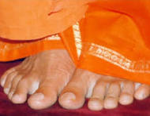
AUM SRI SAIRAM
SRI SATHYA SAI SEVA ORGANISATIONS (INDIA)
KANCHIPURAM SOUTH
DISTRICT LEVEL BALVIKAS TALENT SEARCH
(DLBTS - 2025)
JAI SAIRAM
LOVE ALL SERVE ALL
HELP EVER HURT NEVER

