Slide 1
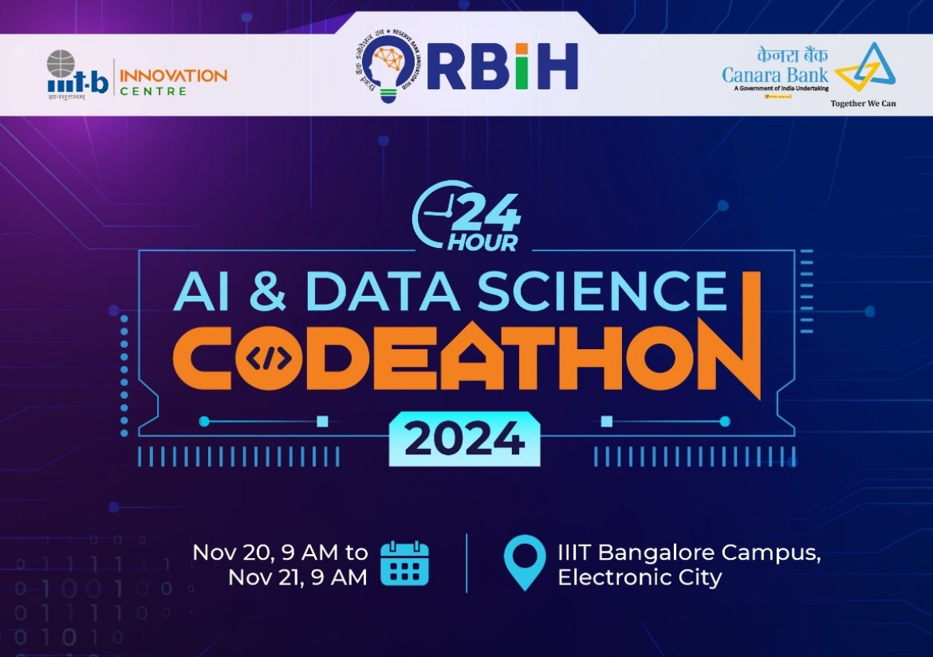

Slide 2

Team Members
Pratham Raj
Tashon
Tejashwar Reddy
Aniket(Sky Neon)

Slide 3
Who Is Our Customer?
Nano-Entrepreneurs , Nano-Business owners Incl. local vendors,shopkeepers ,farmers and cobblers.
People with small-scale business and people with disabilities.
People who are in desperate need of credit or loans for investing in their business and are not able to due to them being under-privileged.
Those people often lack the necessary documents and resort to illegal money lenders who charge high interest rates.
People with poor education and an anaemic source of income.

Slide 4
What Is The Problem?
Nano-entrepreneurs lack the access to a ribust and formal credit-based loan lending system and are often disapproved due to their lack of financial histories .
This exclusion restricts and hurdles their growth and financial stability .
The goal was to develop AI blended solutions that use AI’s data gathering, data manipulating and statistical abilites to assess creditworthiness and provide a easy and secure financial system for them to use at their disposal.

Slide 5
Our Solution
We addressed the challenge of limited documentation among nano-entrepreneurs by using reference datasets from multiple credit- loan banks and creating our own custom dataset.
This dataset is built by estimating missing information through data derived from surveys and census records and other public archives.By integrating this data we can construct a comprehensive profile for individuals who lack essential financial records.
Our AI-driven solution analyses these datasets using transaction patterns ,business performance inidicators - to predict creditworthiness

Slide 6
Future Potential And Development
1. Potential: AI-driven credit sytem can provide financial inclusions to millions of nano-entrepreneurs using alternative data.
2. Development: Integration of real-time data and continous learning will enhance accuracy adn adaptability.
3. Customer Ease: A simple mobile app for data management ,credit-tracking, and education will empower users.
4. Improvments: Focus on data privay , AI fairness and expanding data sources for more accurate assessmetns.

Slide 7

Thank You

