Slide 1

-Made by tejeswar
-Made by Kasi Yadav
Notes:
MYSQL PROJECT

Slide 2
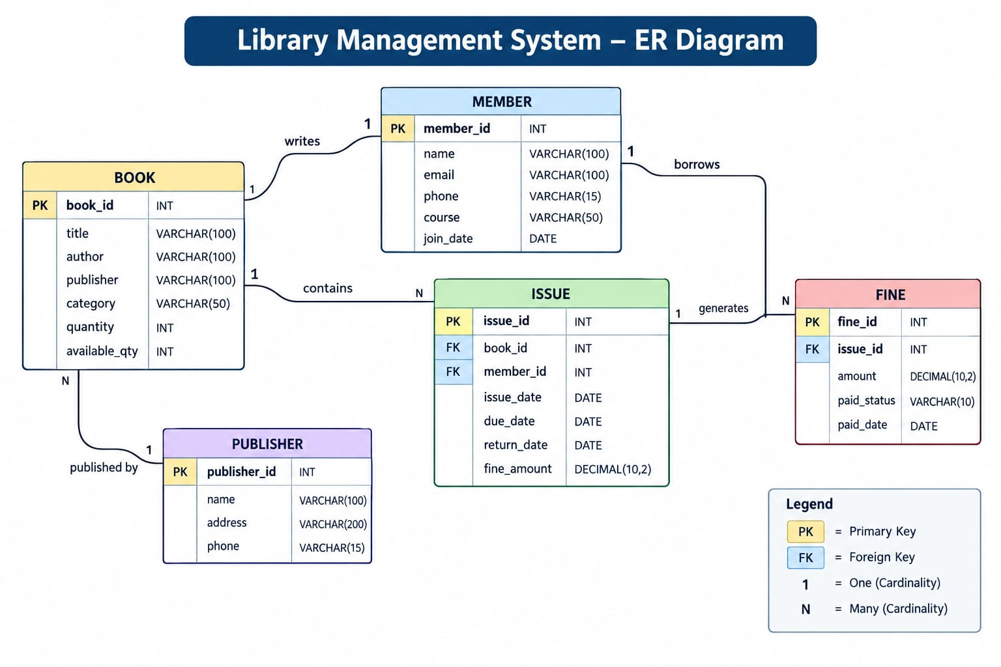
1.ER DIAGRAM

Slide 3

2. Setup of Database

Slide 4
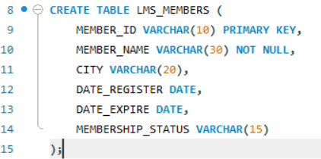
3. CREATE LMS_MEMBERS TABLE

Slide 5
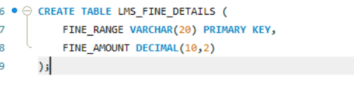
4. CREATE LMS_FINE_DETAILS

Slide 6
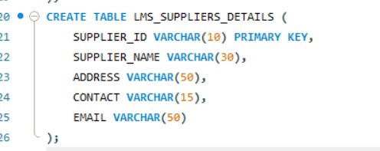
5.CREATE LMS_SUPPLIERS_DETAILS

Slide 7
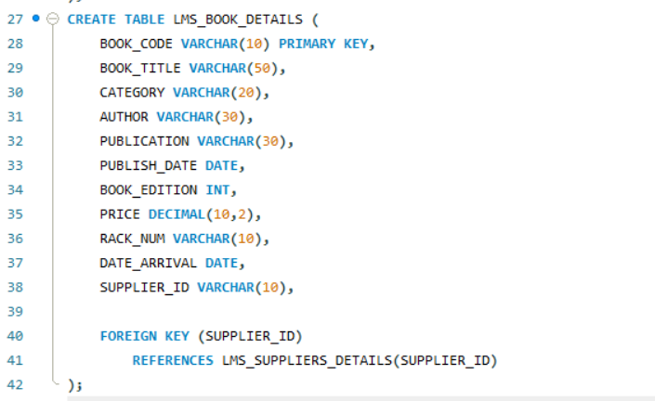
6.CREATE LMS_BOOK DETAILS

Slide 8
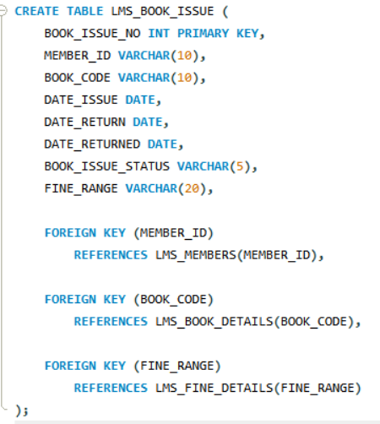
7.CREATE LMS_BOOK_ISSUE

Slide 9
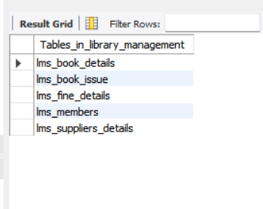
8.SHOW ALL TABLES

Slide 10
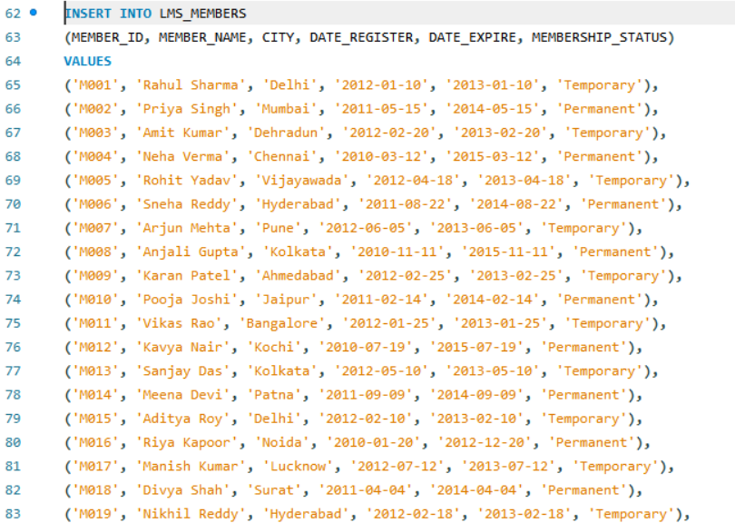
9.INSERTION DATA INTO LMS_MEMBERS

Slide 11
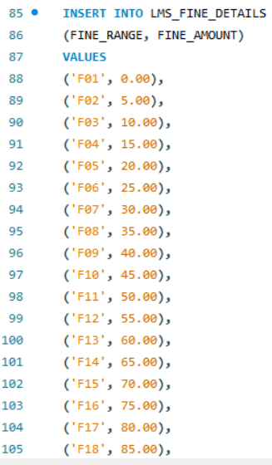
10.INSERTION DATA INTO LMS_FINE_DETAILS

Slide 12
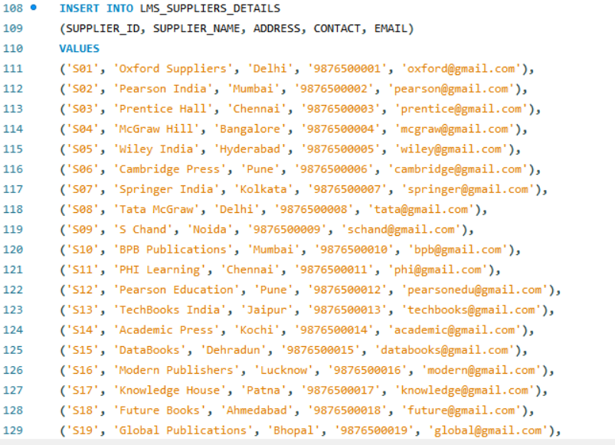
11.INSERTION DATA INTO LMS_SUPPLIERS_DETAILS

Slide 13
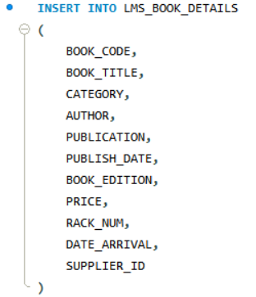
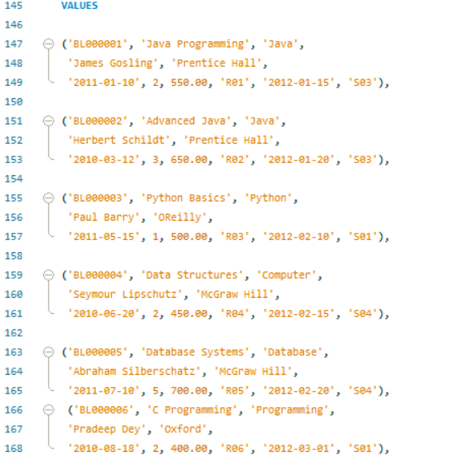
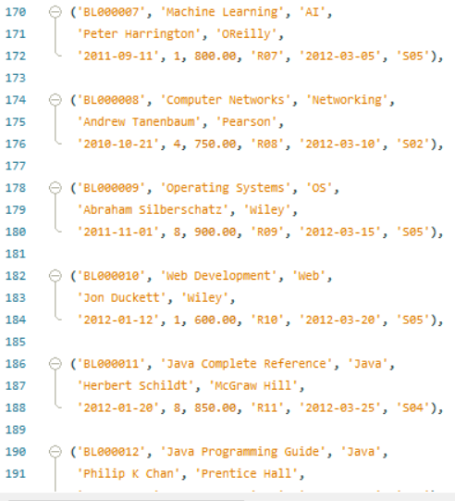
12. INSERTION INTO LMS_BOOK_DETAILS

Slide 14
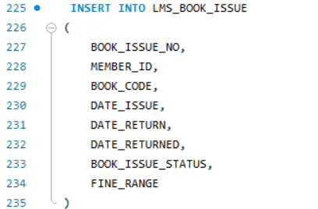
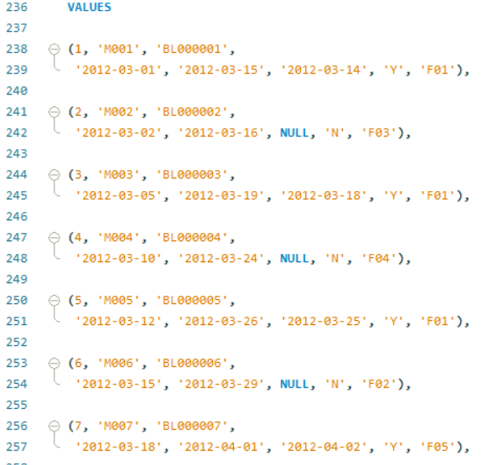
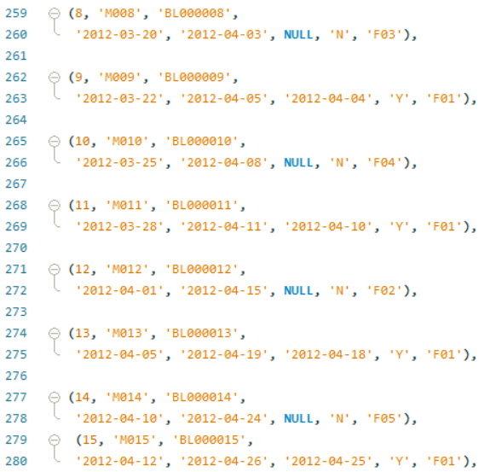
13. INSERTION INTO LMS_BOOK_ISSUE

Slide 15
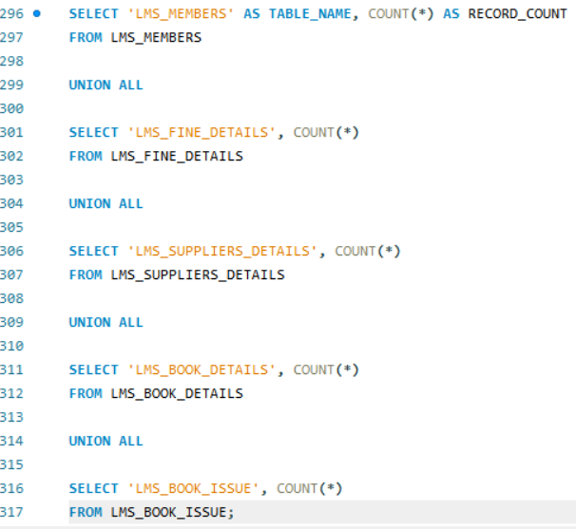
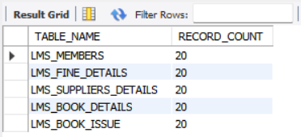
14.CHECK NO OF RECORDS IN EACH TABLE

Slide 16
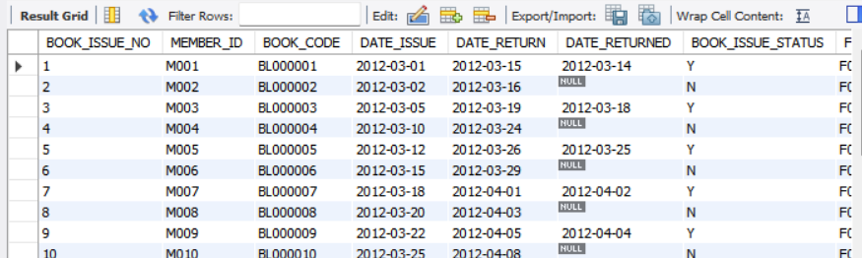
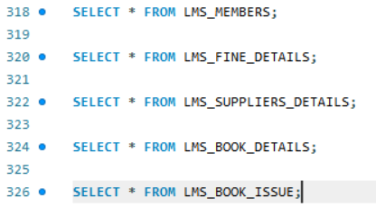
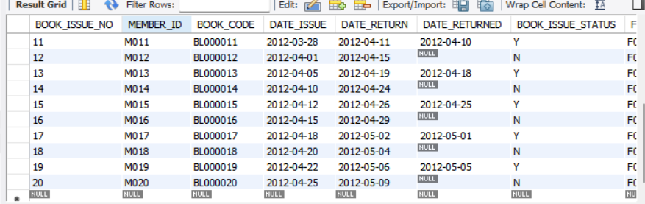
13v15. VIEW ALL 20 RECORDS

Slide 17
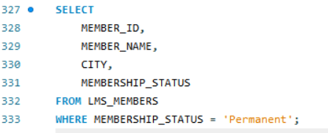
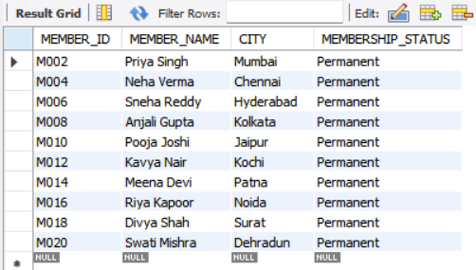
- QUERY 1
DISPLAY MEMBER ID, MEMBER NAME, CITY AND MEMBERSHIP STATUS OF MEMBERS HAVING LIFE TIME/PERMANENT MEMBERSHIP

Slide 18
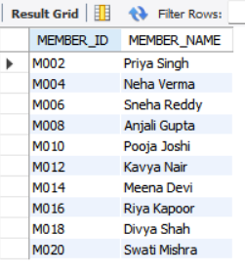
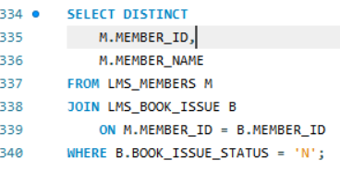
-QUERY 2
DISPLAY MEMBER ID AND MEMBER NAME WHO HAVE NOT RETURNED THE BOOKS

Slide 19
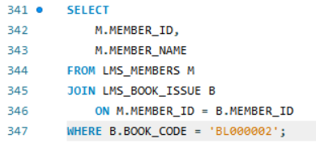
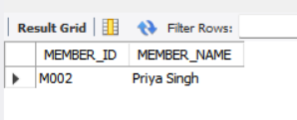
-QUERY 3
DISPLAY MEMBER ID AND MEMBER NAME WHO HAVE TAKEN BOOK CODE BL000002

Slide 20
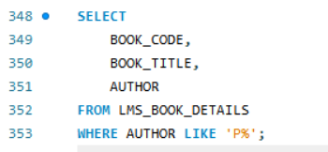
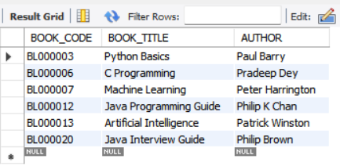
-QUERY 4
DISPLAY BOOK CODE, BOOK TITLE AND AUTHOR WHOSE AUTHOR NAME BEGINS WITH 'P'

Slide 21
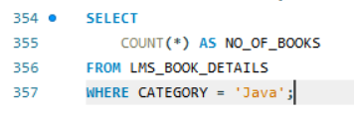
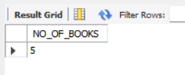
-QUERY 5
DISPLAY TOTAL NUMBER OF JAVA BOOKS ALIAS: NO_OF_BOOKS

Slide 22
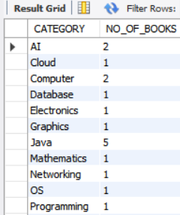
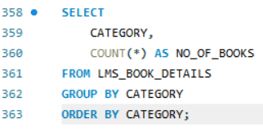
-QUERY 6
DISPLAY CATEGORY AND NUMBER OF BOOKS IN EACH CATEGORY

Slide 23
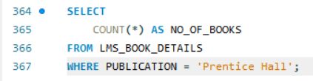
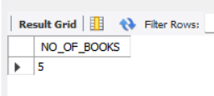
-QUERY 7
DISPLAY NUMBER OF BOOKS PUBLISHED BY PRENTICE HALL

Slide 24
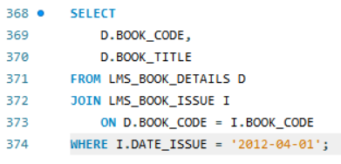
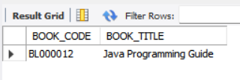
-QUERY 8
DISPLAY BOOK CODE AND BOOK TITLE OF BOOKS ISSUED ON 1st APRIL 2012

Slide 25
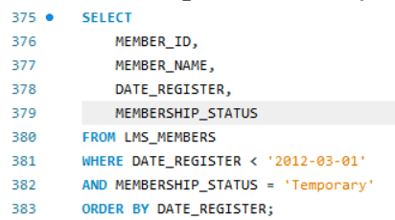
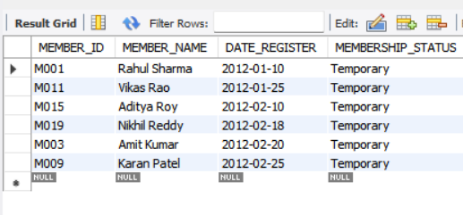
QUERY 9
DISPLAY MEMBER ID, MEMBER NAME, DATE OF REGISTRATION AND MEMBERSHIP STATUS OF MEMBERS REGISTERED BEFORE MARCH 2012 AND MEMBERSHIP STATUS IS TEMPORARY

Slide 26
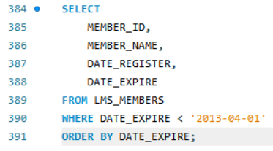
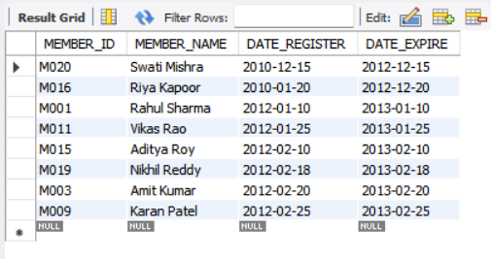
QUERY 10
DISPLAY MEMBER ID, MEMBER NAME, DATE OF REGISTRATION AND EXPIRY DATE OF MEMBERS WHOSE MEMBERSHIP EXPIRES BEFORE APRIL 2013

