Slide 1



Insurance Analysis
By
Group2
Under the Guidance of
Mahendra Singh

Slide 2



About the project
Domain : Insurance Domain
Dataset type : csv Data
Data set size : Each csv file has 250+ records.
Each data set having columns like Invoice Number, Invoice Date, Revenue Transaction Type, Branch Name, Solution Group, Account Executive, Income Class, Client Name, Policy Number etc.
Tools used for analysis :

Slide 3
Objective
Insurance data analysis aims to track Account Executives, Customers, Improvements for more reliable claims and more informed decision making, increase in revenue etc.
At the business level, it can identify top executives and simplify internal operations. Moreover insurance organizations and practitioners can get detailed models for optimum costs and best benefits.
Role
Collect or mine data
Build predictive models
Outcome
Improves efficiency in all fronts.
Evaluate raw data
Automate reports
Better data leads to better business.

Slide 4
Requirements
Deployment Environment.
Building of predictive healthcare models.
Use of various analytical methods:
Descriptive Analytics
Diagnostic Analytics
Predictive Analytics
Prescriptive Analytics

Slide 5

Problem overview
Identify the right Key Performance indicator(KPI) which helps the healthcare organizations to build a robust framework and deliver improved business performance.
Number of invoice by executives
Number of meetings
Target Vs Actual
Renewal Status
Top Open Opportunity

Slide 6
KPI-1
Number of Invoice by Executive

Slide 7
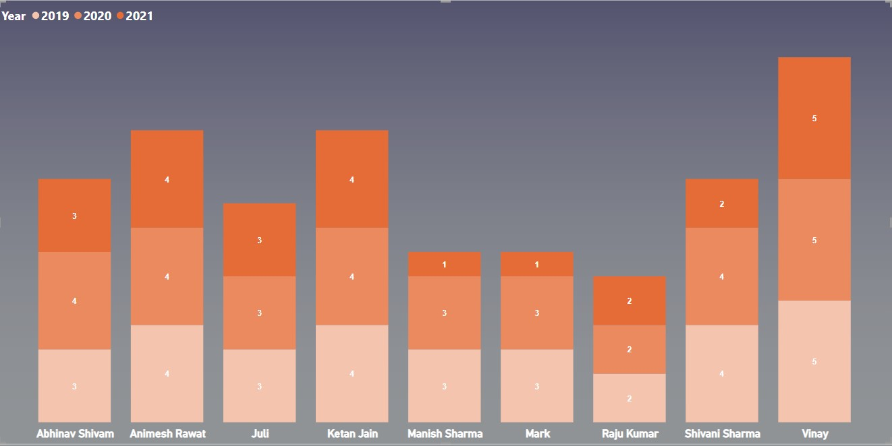
KPI-2
Number of Executive Meetings

Slide 8
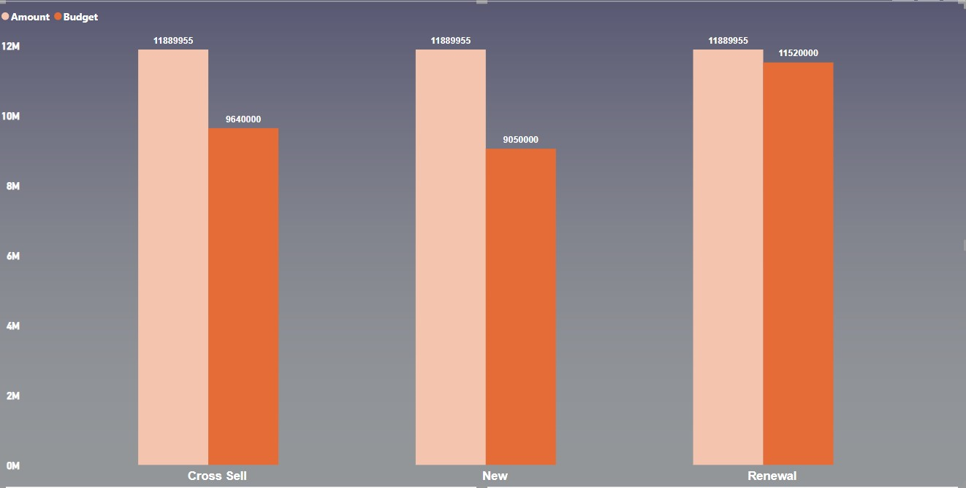
KPI-3
Target vs Actual

Slide 9
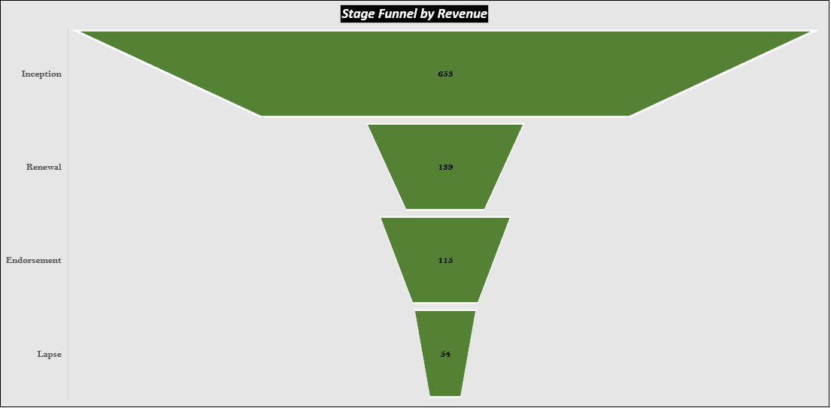
KPI-4
Renewal Status

Slide 10
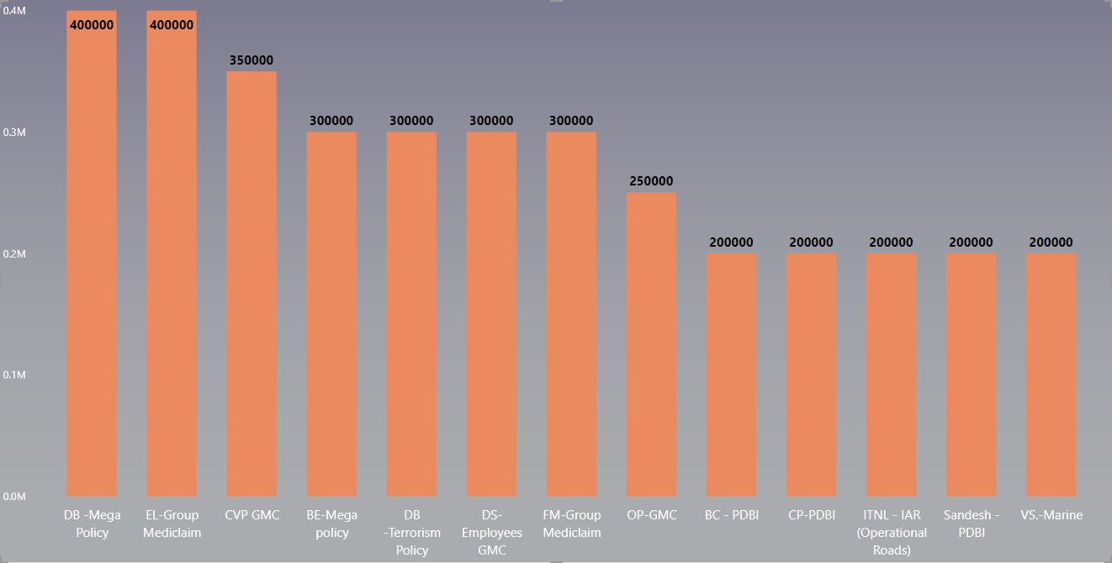
KPI-5
Top Open Opportunity

Slide 11
Conclusion
Analysis from the above dashboards, which uses current data helps to gain insights at macro and micro level in the insurance analysis.
Supports decision making at both the consumers and business level.

Slide 12

Thank you
Project Members:
Ankita Agarwal
Mounika Gandepalli
Nagajun Ati
Sakshi Modi
Siddesh Prakash Dhanve
Tejeswini
Yugandhar Suresh Bhokare

