Slide 1
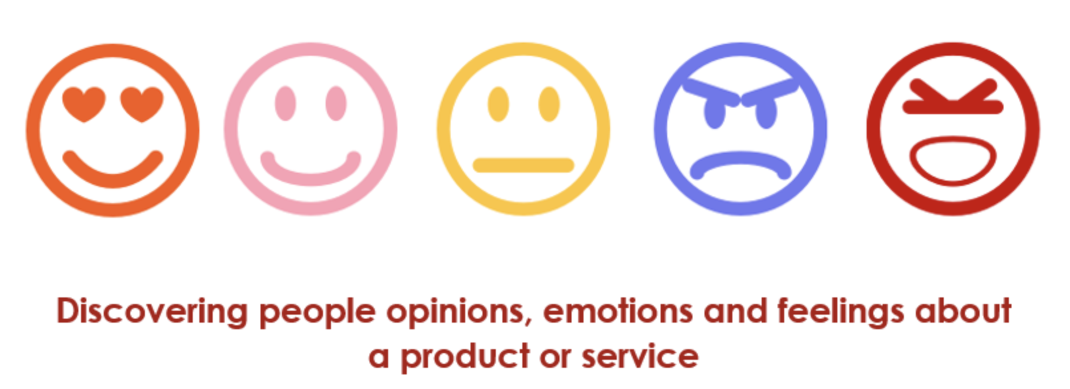
Natural Language Processing

Slide 2
What is Text Mining /NLP
Why NLP is relevant?
Applications
Complexity of unstructured text
Structured representation of text
Bag of Words
Vector Space Model
Feature Extractions
BoW
TF
TF-IDF
Word Embeddings

Slide 3
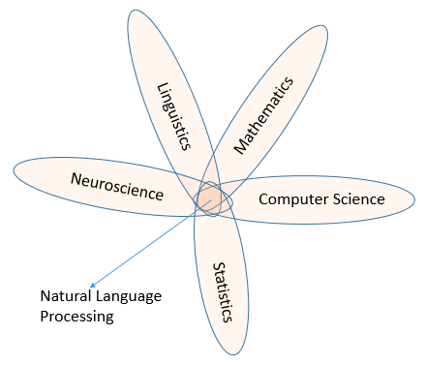
The research on how to make computers understand and manipulate natural languages draws from several fields, including computer science, math, linguistics, and neuroscience, and the resulting interdisciplinary area of research is called NLP

Slide 4
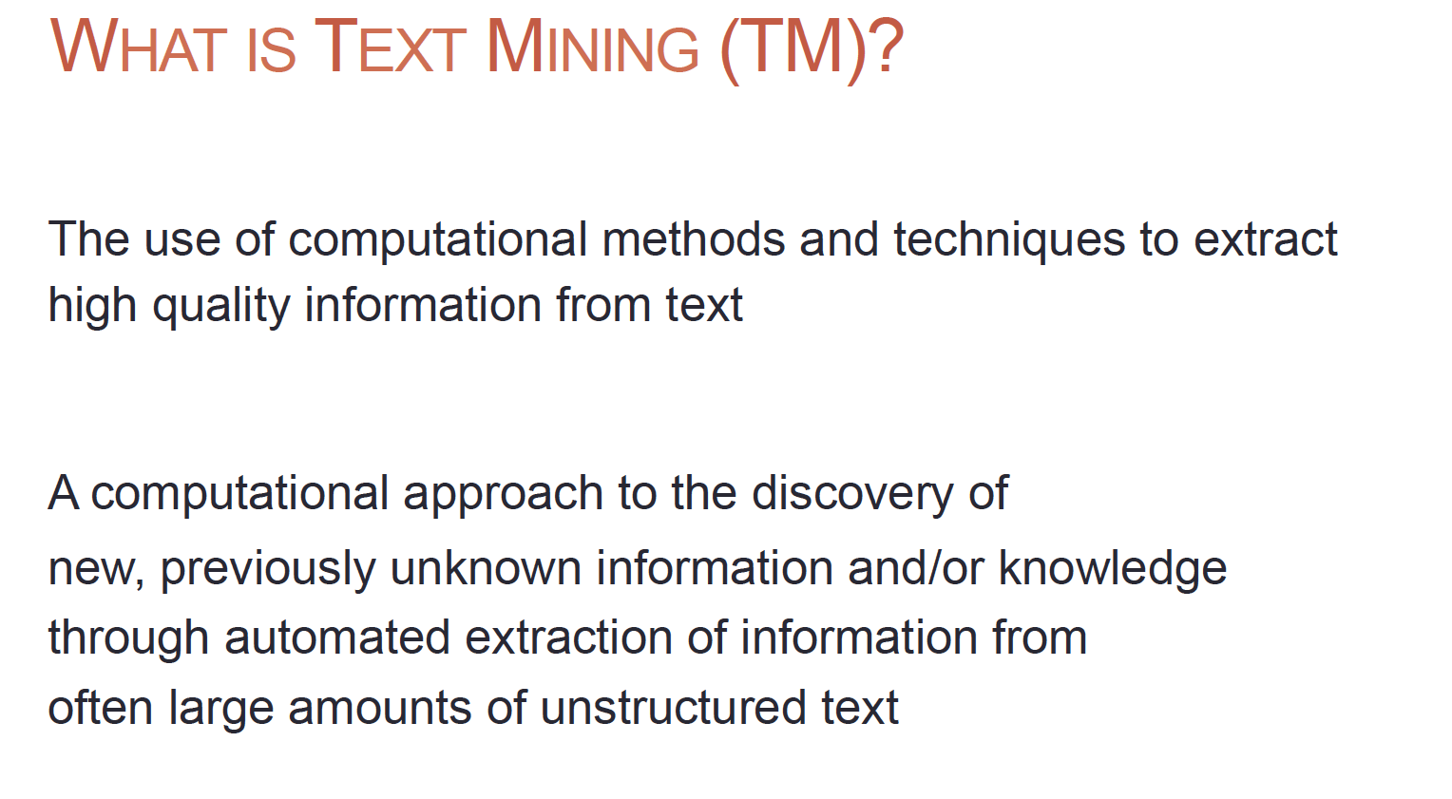

Slide 5
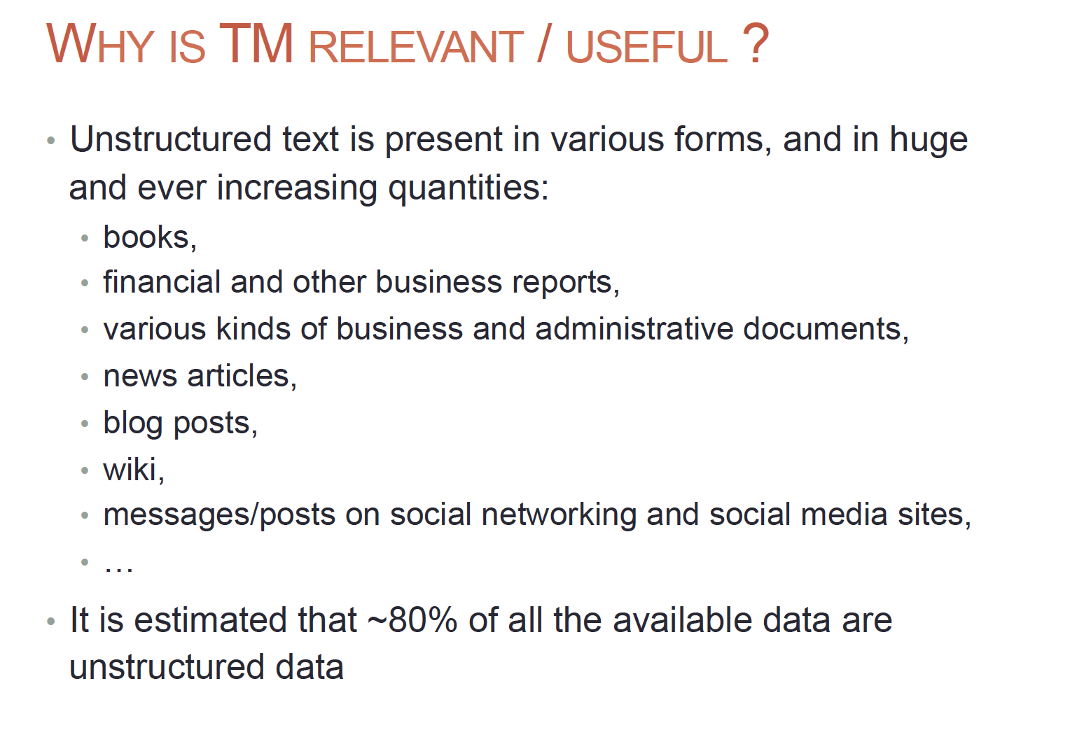

Slide 6
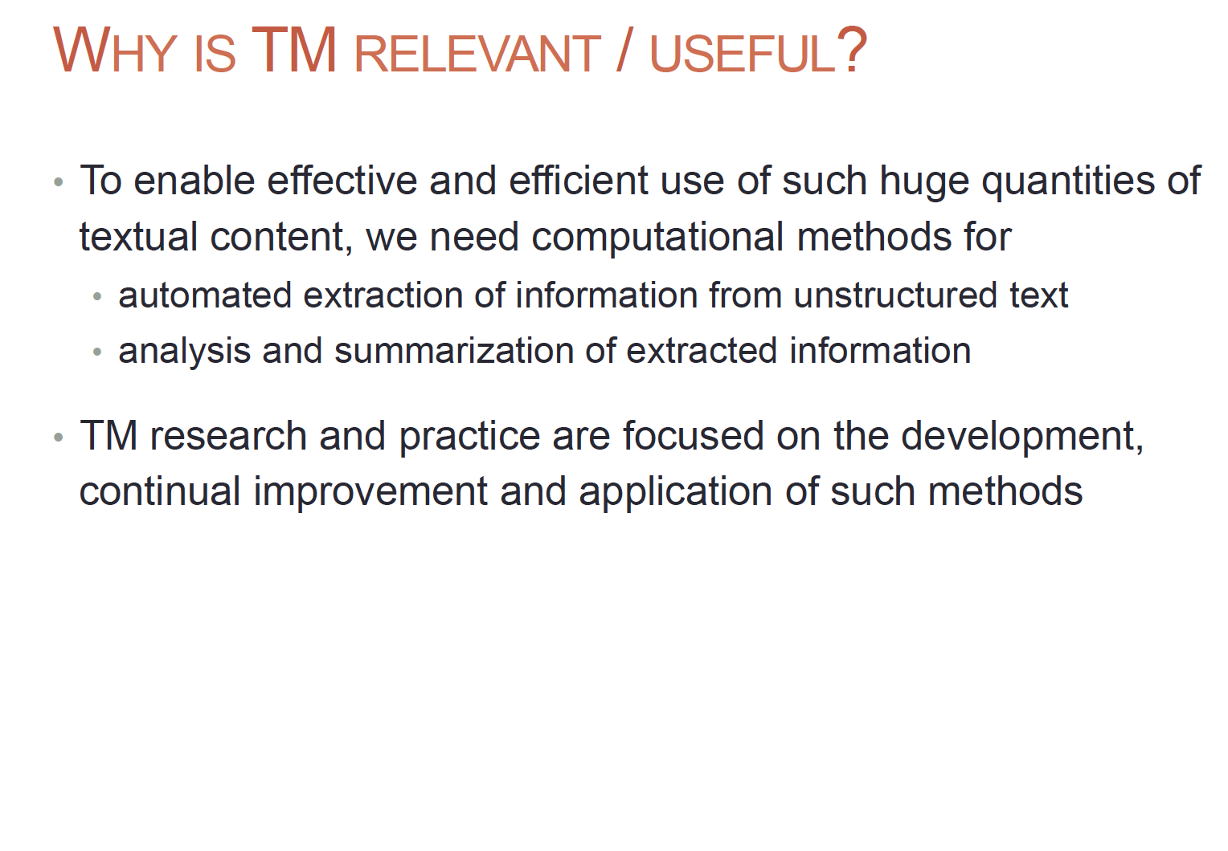

Slide 7
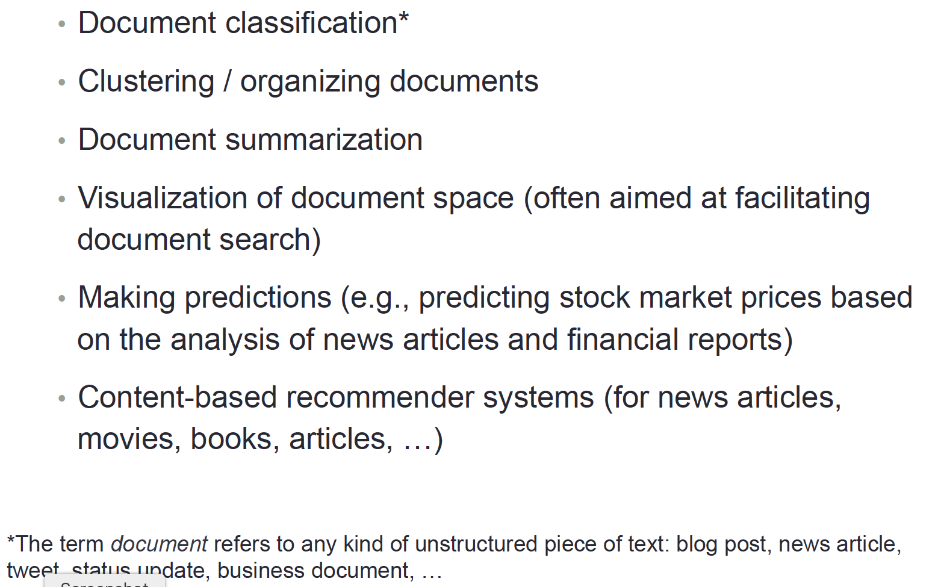
Applications of NLP

Slide 8
Applications of NLP
NLP applications are everywhere, and it is highly unlikely that you have not interacted with any such application over the past few days.
The current applications include:
Virtual assistants (Alexa, Siri, Cortana, and so on),
Customer support tools (chatbots, email routers/classifiers, and so on),
Sentiment analysers,
Translators, and
Document similarity systems.
The adoption of these tools is quickly growing, since the speed and accuracy of these applications have increased manifold over the years.

Slide 9
Applications of NLP : Demo
Sentiment analysis
Machine translation
https://www.paralleldots.com/sentiment-analysis
https://translate.google.co.in/
A stock investor scanning news about a company to assess overall market sentiment
An individual scanning tweets about the launch of a new phone to decide the prevailing sentiment
A political party analysing social media feeds to assess the sentiment regarding their candidate
The modern NLP approach toward document translation is rooted in DL and pattern
detection, which has significantly increased the accuracy of translations. Google Translate
(https://translate.google.co.in/ ) supposedly uses an Artificial Neural Network
(ANN)-based system that predicts the possible sequence of the translated words.

Slide 10
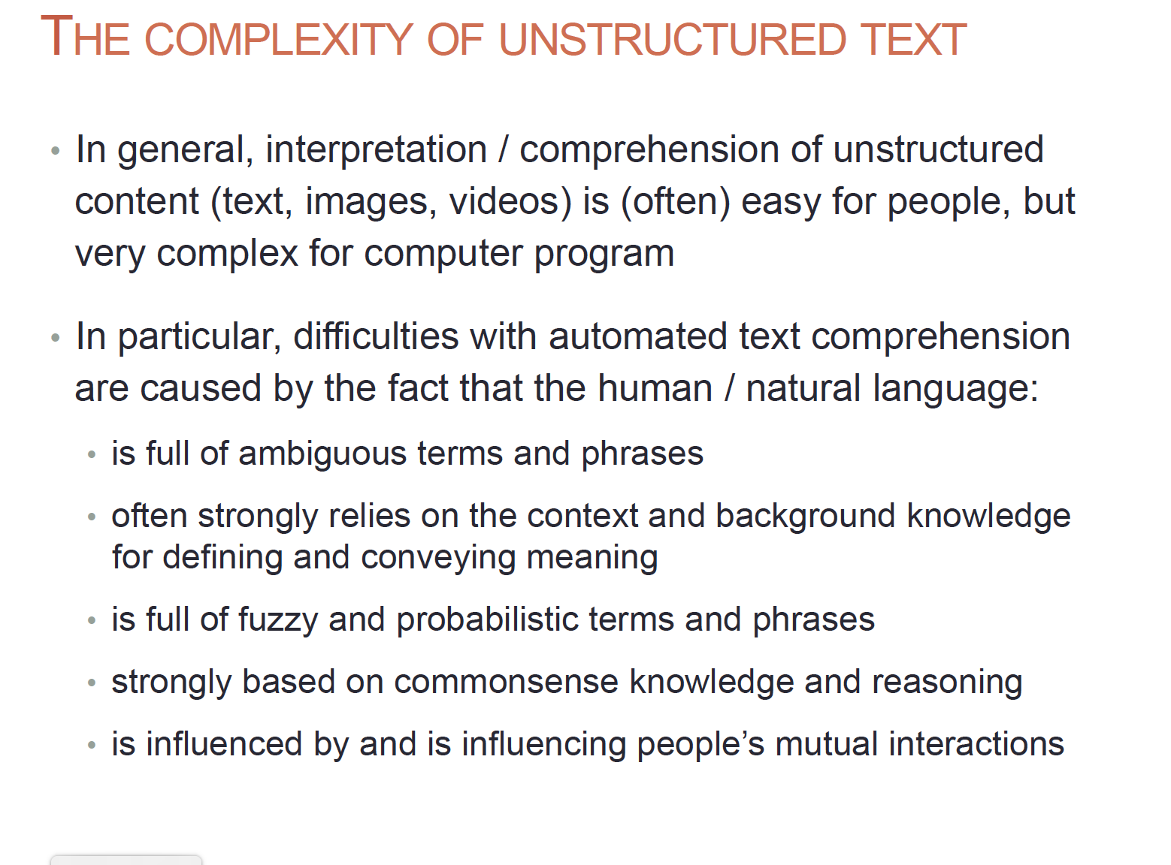

Slide 11
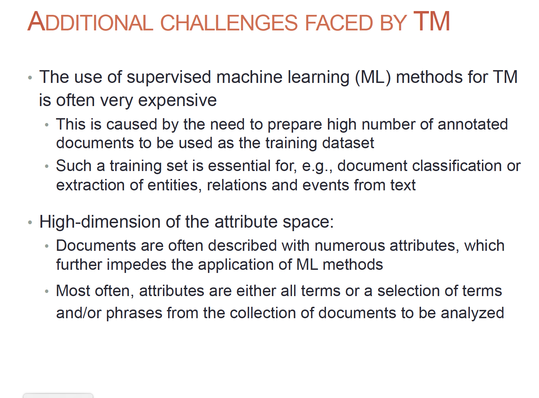

Slide 12
Transforming Text into Data Structures

Slide 13
Tokenization
Tokenization is one of the fundamental things to do in any text-processing activity.
Tokenization is breaking the documents or sentences into chunks called tokens. Each token carries a semantic meaning associated with it.
Tokenization can be thought of as a segmentation technique wherein you are trying to
break down larger pieces of text chunks into smaller meaningful ones.
Tokens generally comprise words and numbers, but they can be extended to include punctuation marks, symbols, and, at times, understandable emoticons
Sentence = "The capital of China is Beijing.”
Tokenization: ['The', 'capital', 'of', 'China', 'is', 'Beijing‘. ‘.’]

Slide 14
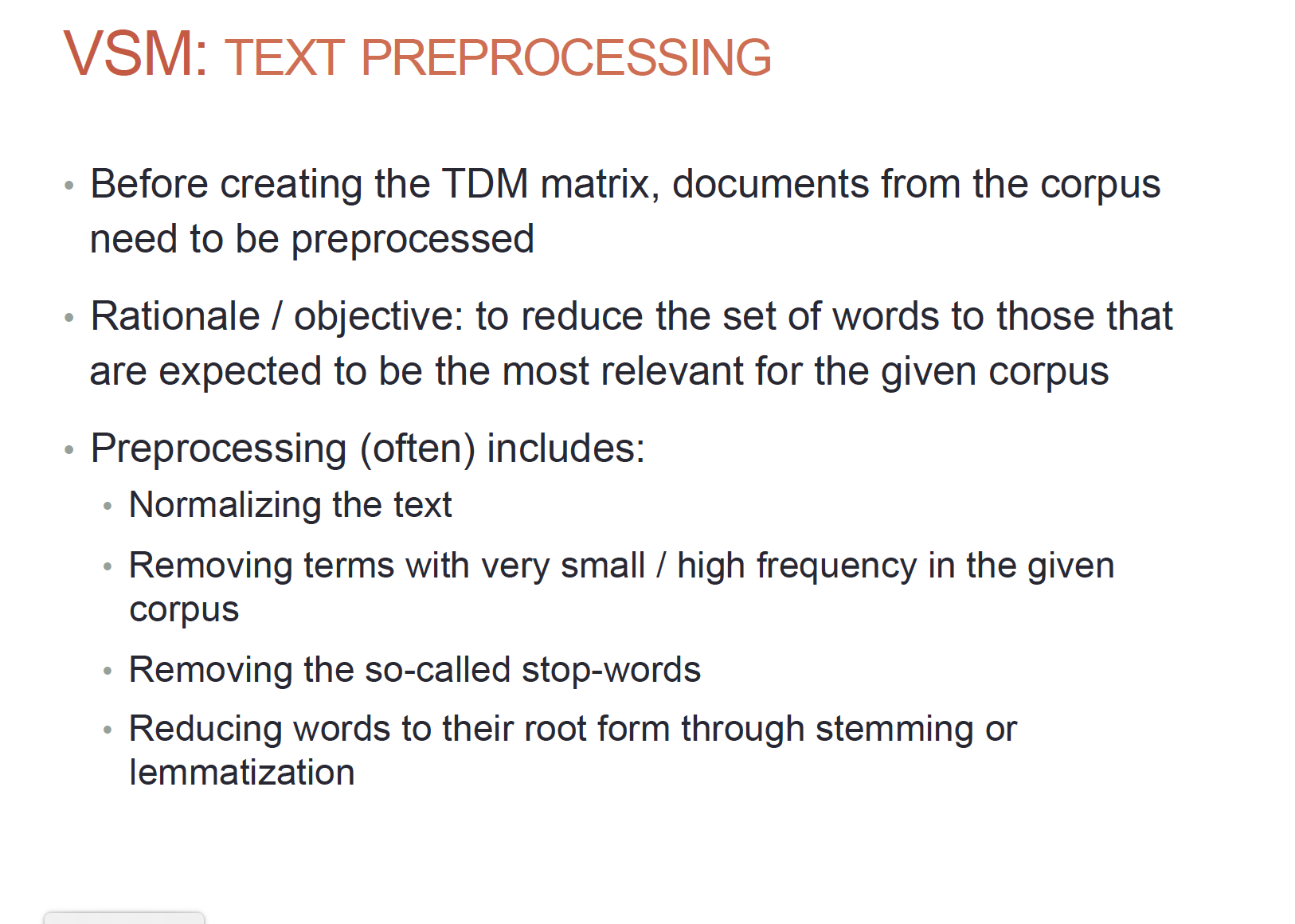

Slide 15
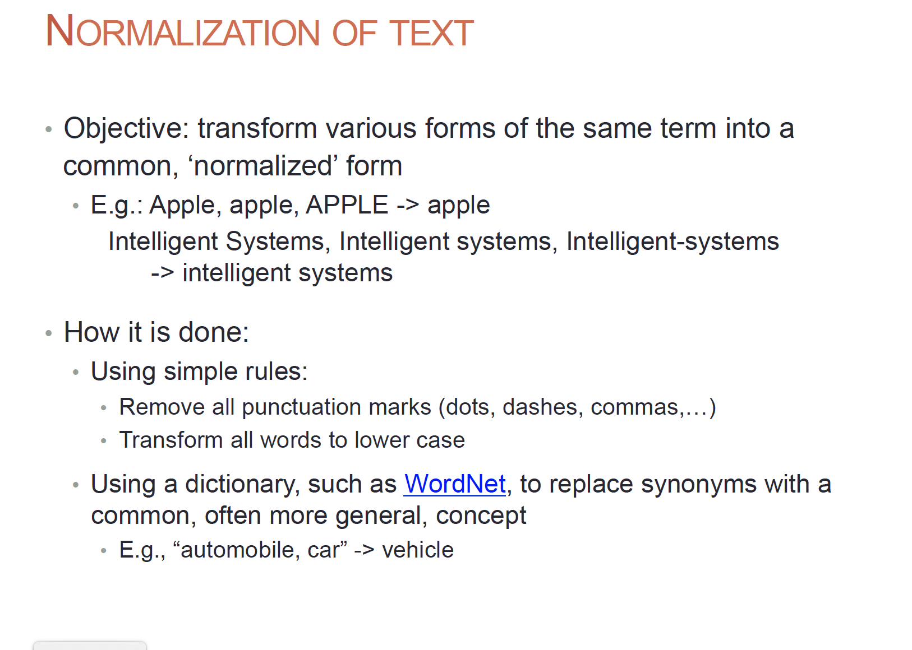

Slide 16
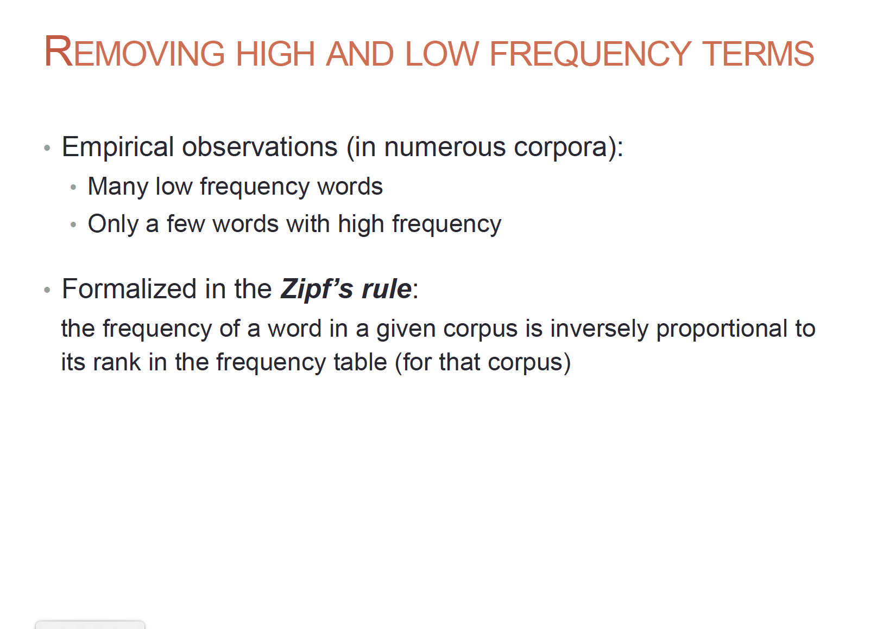

Slide 17
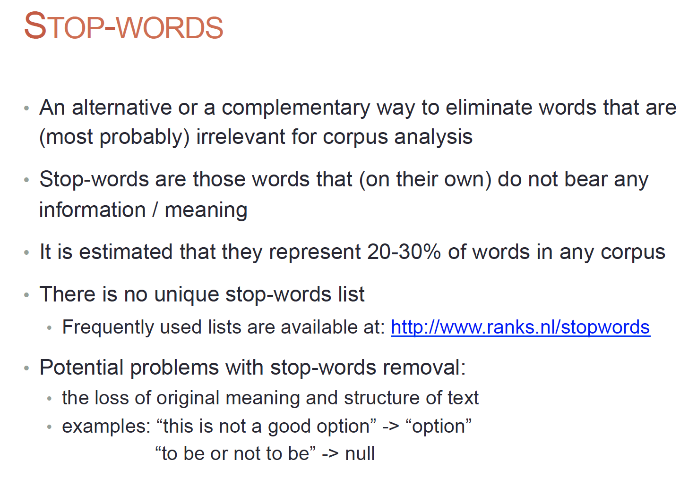

Slide 18
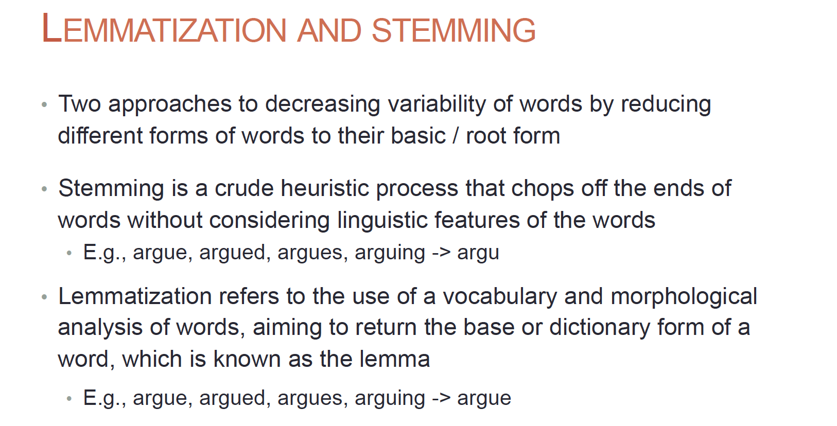

Slide 19
NLP: Feature Extraction

Slide 20
Text data offers a very unique proposition by not providing any direct representation available for it in terms of numbers. Machines only understand numbers.
Representing text using numbers is a challenge. At the same time, it is an opportunity to invent and try out approaches to represent text so that the maximum information can be captured in the process.
Steps toward transforming text data into mathematical data structures that will provide insights on how to actually represent text using numbers and, consequently, build Natural Language Processing (NLP) models.
Binary Weights
Exploring the Bag-of-Words (BoW) architecture
TF-IDF vectors
N-grams

Slide 21
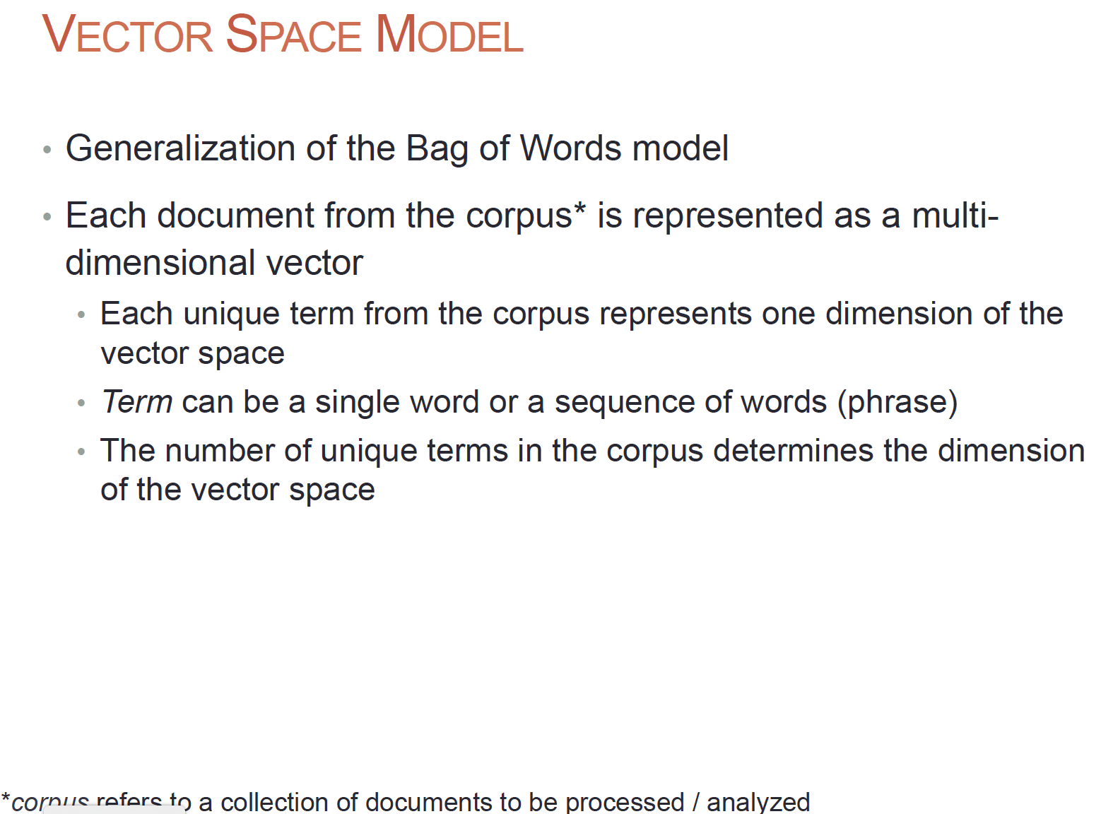
This is India. I live in india.
Tokenization = [‘this’, ‘is’, ‘india’, i, ‘live’, ‘in’] = 6 dimensional

Slide 22
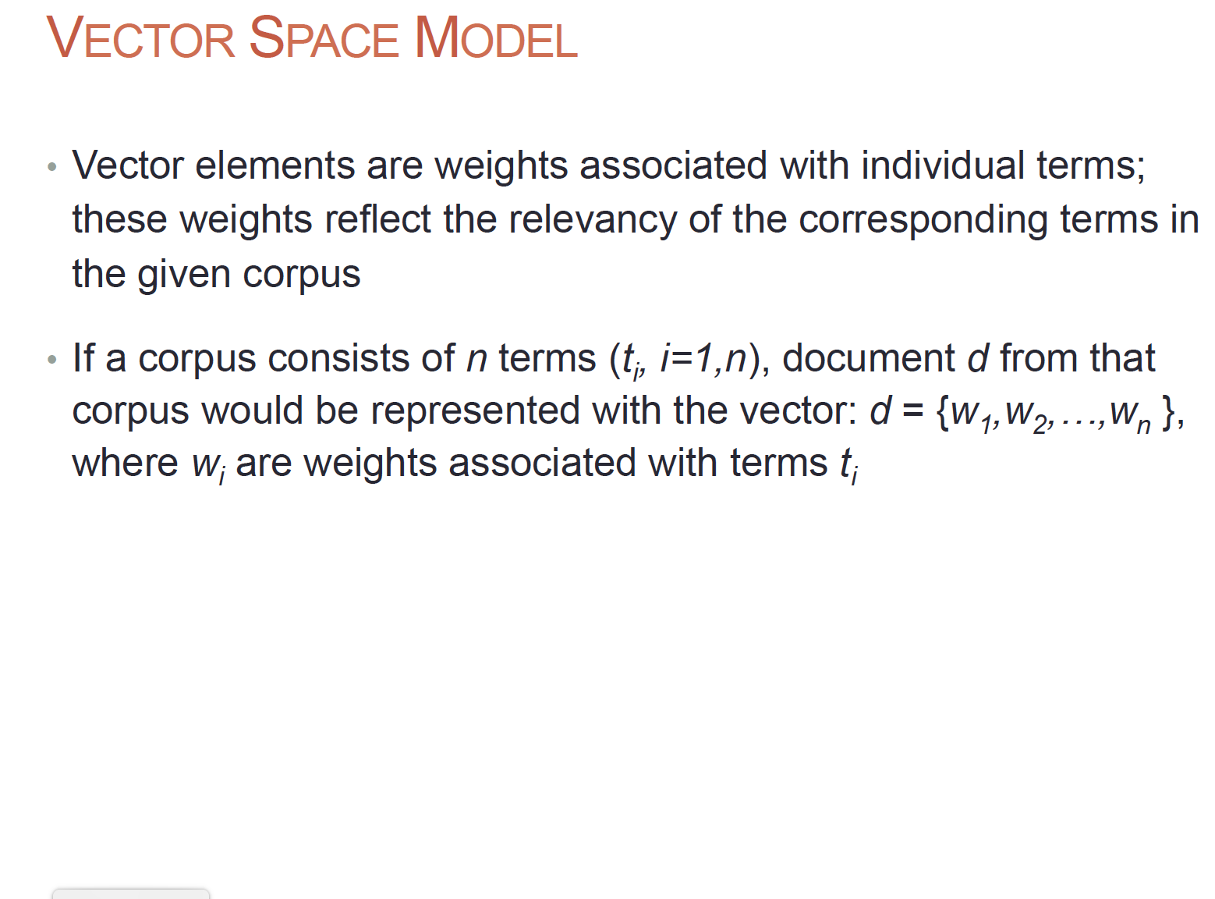

Slide 23
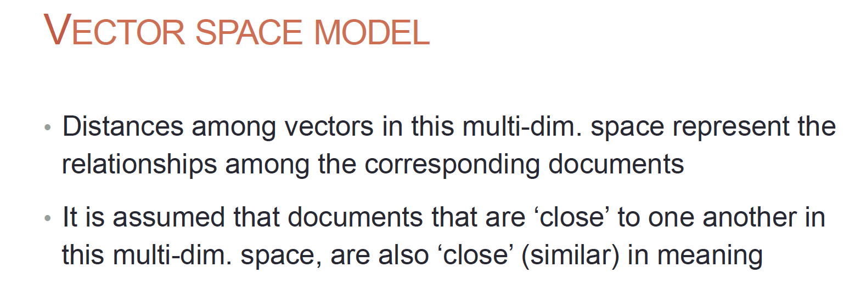

Slide 24
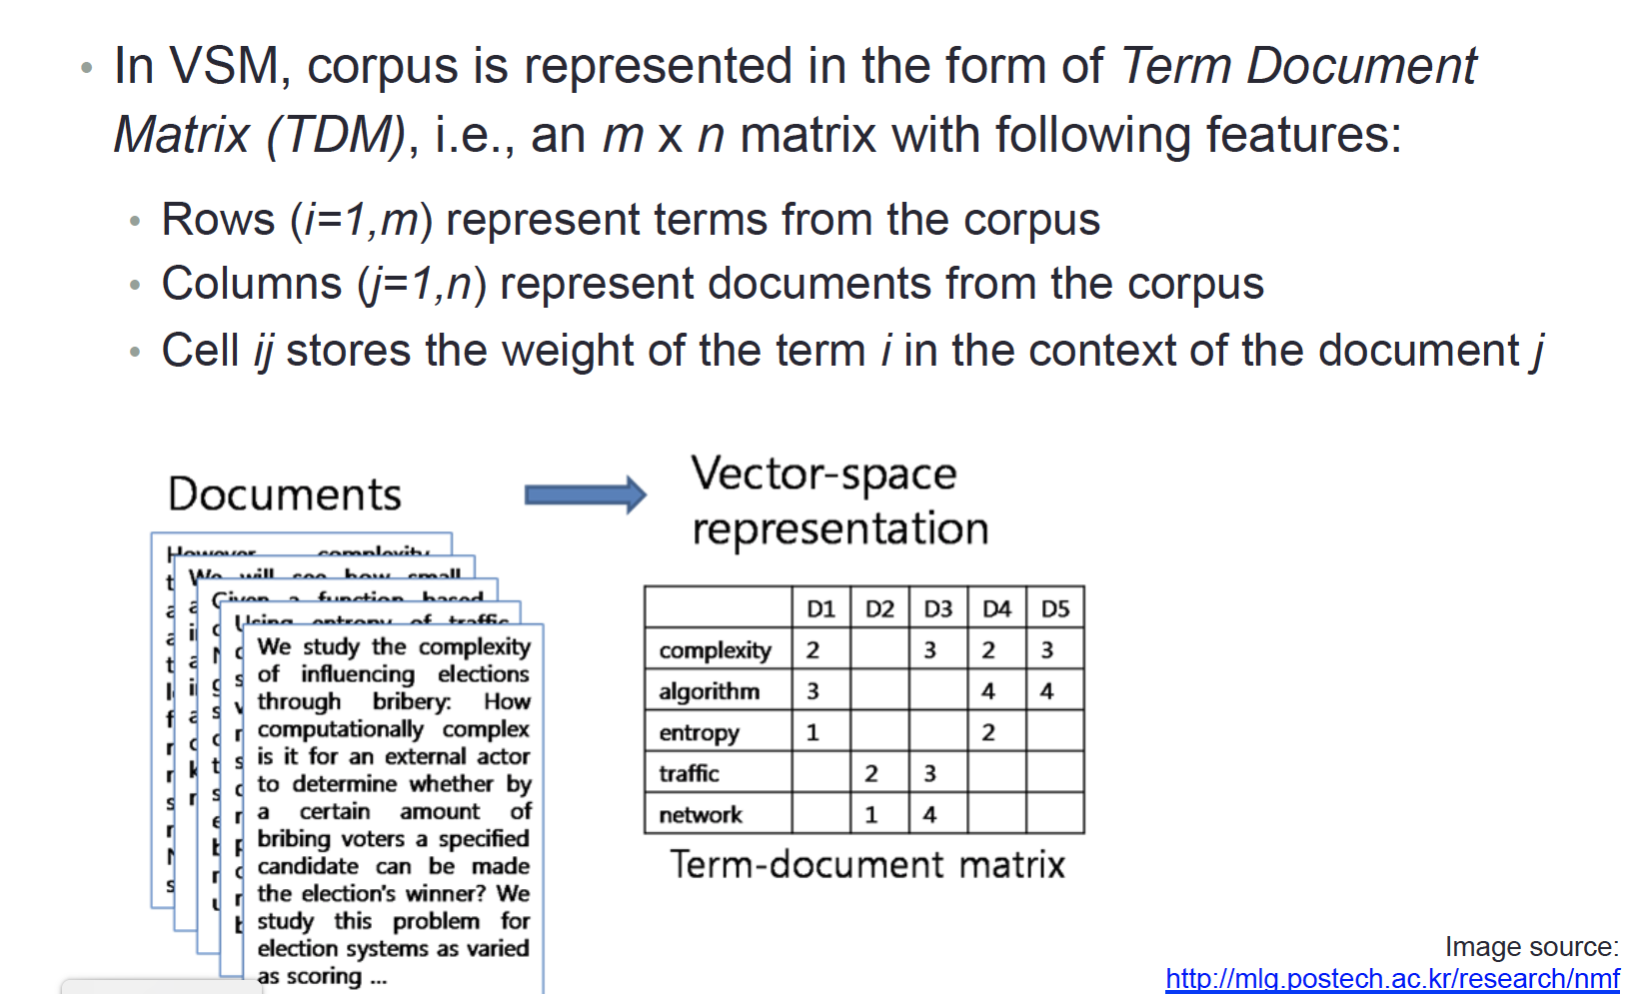
What are the features??

Slide 25
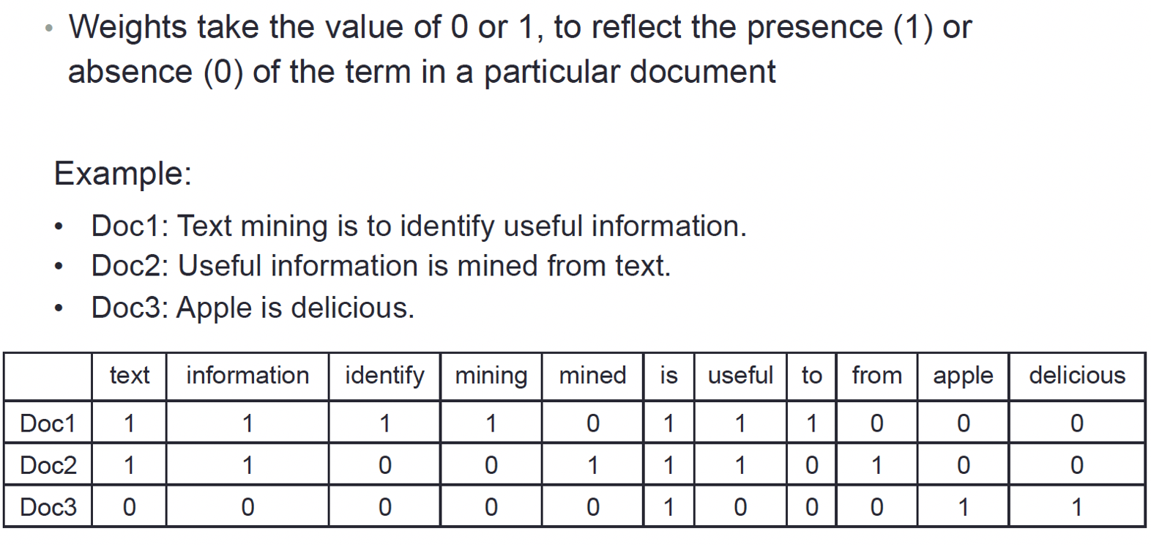
Binary Weight

Slide 26
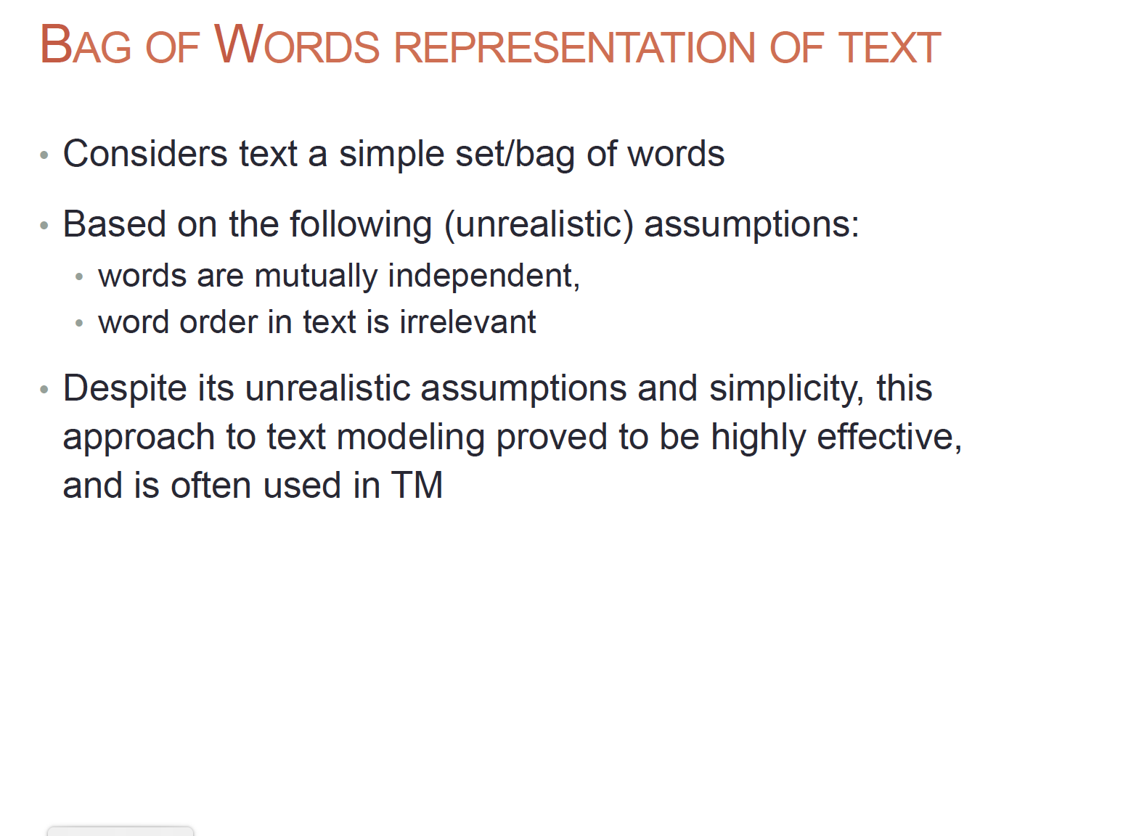

Slide 27
Bag-of-Words architecture
Each sentence can be represented as a vector. The length of this vector would be equal to the size of the vocabulary. Each entry in the vector would correspond to a term in the vocabulary, and the number in that particular entry would be the frequency of the term in the sentence under consideration. The lower limit for this number would be 0.
["We are reading about Natural Language Processing Here",
"Natural Language Processing making computers comprehend language data",
"The field of Natural Language Processing is evolving everyday"]
Processed data:
['read', 'natural', 'language', 'computers', 'everyday', 'data',
'evolve', 'field', 'process', 'comprehend', 'make’]
BOW matrix:
array([[1., 1., 1., 0., 0., 0., 0., 0., 1., 0., 0.],
[0., 1., 2., 1., 0., 1., 0., 0., 1., 1., 1.],
[0., 1., 1., 0., 1., 0., 1., 1., 1., 0., 0.]])

Slide 28
BoW / CountVectorizer
CountVectorizer is a tool provided by the sklearn or scikit-learn library in Python that provides application programming interfaces (APIs) that would conveniently help in building a BoW model.
It converts a list of text documents into a matrix such that each entry in the matrix would correspond to the count of a particular token in the respective sentences
CountVectorizer offers a lot of flexibility in terms of using a prebuilt dictionary of words instead of creating a dictionary based on the data. It provides options to tokenize text as well, along with the removal of stopwords. The CountVectorizer module provides the ability to do that without explicitly writing code, using an attribute named ngram_range

Slide 29
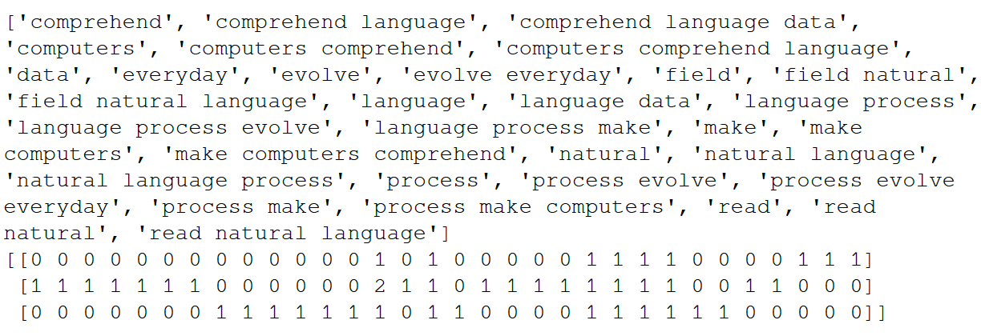
BoW: Unigrams ,Bi grams and Trigrams

Slide 30
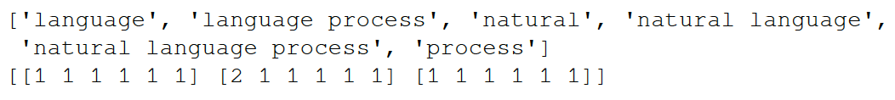
BoW: Curse of dimensionality
An extremely important thing to keep in mind while building a BoW model is to ensure that the vocabulary does not shoot up and become excessively large. This is because this would increase the dimensionality of the model largely, and a very big dimensionality does not convert into a very good model; rather, it can hamper the model's inference ability.
This is referred to as the curse of dimensionality and it can potentially lead to a condition
called overfitting.
Max_features:
The CountVectorizer functionality provides a parameter called max_features that will build a vocabulary such that the size of the vocabulary would be less than or equal to max_features ordered by the frequency of tokens occurring
in a corpus
max_features = 6

Slide 31
BoW: High frequency words and
Low frequency Words
A few Terms or phrases that have occurred very frequently in the text corpus. These phrases might occur very frequently in an individual document or may be present in almost all documents in the corpus and may not carry any pattern. One approach we have discussed so far to remove such terms is the removal of stop words.
Convenient technique that comes along with CountVectorizer is max_df, which will ignore terms having a document frequency higher than a provided threshold mentioned as part of the max_df parameter. Similarly, we can remove rarely occurring terms that occur fewer times in a document than a given threshold, using a min_df parameter.

Slide 32
Limitations of the BoW representation
The BoW model provides a mechanism for representing text data using numbers. However, there are certain limitations to it. The model only relies on the count of terms in a document. This might work well for certain tasks or use cases with a limited vocabulary, but it would not scale to large vocabularies efficiently
The BoW model also intrinsically provides possibilities for eliminating or reducing the significance of tokens or phrases that occur very rarely. These phrases might be present in a very small number of documents, but they can be very important in the representation of those documents. The BoW model does not support such possibilities.
The BoW model can also get extremely huge in terms of the vocabulary for a large text corpus. This can lead to vectors of huge sizes representing every document, which might cause a deterioration in the model's performance.
These models do not consider semantics or meanings associated with a token or phrases in a document. It ignores the possibility of capturing features from the neighborhood of a phrase that can hint at the context in which a word or phrase is being used. Therefore, it completely ignores the context involved.

Slide 33
TF-IDF vectors

Slide 34
The TF-IDF approach follows a weight scheme based on the high / low frequency of words for in a text corpus.
The TF-IDF approach is by far the most commonly used approach for weighing terms. It is found in applications, in search engines, information retrieval, and text mining systems, among others. TF-IDF is also an occurrence-based method for vectorizing text and extracting features out of it. It is a composite of two terms, which are described as follows
The weight of word w in document d is a product of the TF of word w in document d and the IDF of word w across the text corpus

Slide 35
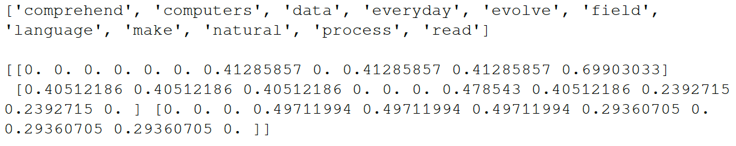
"We are reading about Natural Language Processing Here”.
"Natural Language Processing making computers comprehend language data”.
"The field of Natural Language Processing is evolving everyday"

Slide 36
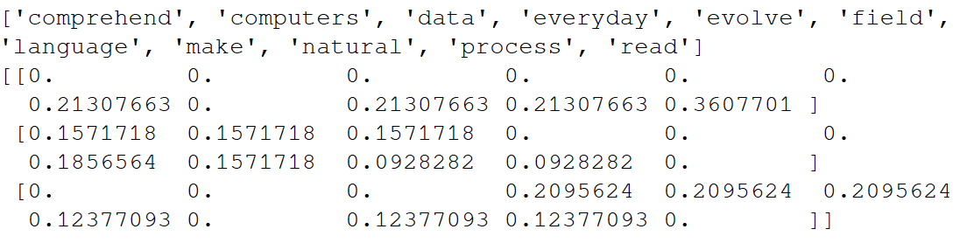
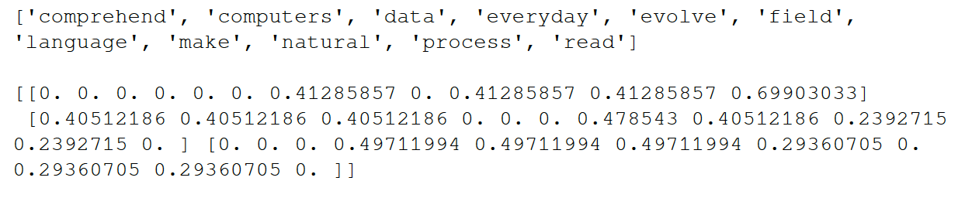
L1 and L2 norm in TF-IDF vectorizer
L1 Norm : The sum of absolute values of the vector elements is 1.
L2 norm, wherein the sum of squares of the vector elements is equal to 1

Slide 37
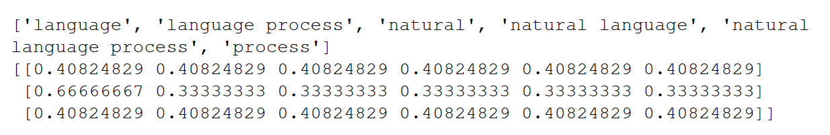
N-grams and maximum features in the TF-IDF vectorizer
Similar to our BoW CountVectorizer, the TF-IDF vectorizer offers the capability of using n-grams and max_features to limit our vocabulary
norm="l2",ngram_range=(1,3), max_features = 6

Slide 38
Limitations of the TF-IDF vectorizer’s representation
The TF-IDF vectorizer offers an improvement over (BoW) CountVectorizer by scaling the weights of the less frequently occurring terms as well as by using the IDF component. It is also computationally fast.
However, it still relies on lexical analysis and does not take into account things such as the co-occurrence of terms, semantics, the context associated with terms, and the position of a term in a document. It is dependent on the vocabulary size, like CountVectorizer, and will get really slow with large vocabulary sizes.

Slide 39
Word Embeddings

Slide 40
We discussed the bag-of-words and term-frequency and inverse document frequency-based methods to represent text in the form of numbers. These methods mostly rely on the syntactical aspects of a word in terms of its presence or absence in a document or across a text corpus.
However, information about the neighbourhood of the word, in terms of what words come after or before a word, wasn't taken into account in the approaches we have discussed so far.
The neighbourhood of a word carries important information in terms of what context the word is carrying in a sentence. The relationship between the word and its neighbourhood tends to define the semantics of a word and its overall positioning and presence in a sentence

Slide 41
Word embedding is a learned representation of a word wherein each word is represented
using a vector in n-dimensional space.
Words with similar meanings should have similar representations. These representations can also help in identifying synonyms, antonyms, and various other relationships between words.
We mentioned that embeddings can be built to correspond to individual words; however, this idea can be extended to develop embeddings for individual sentences, documents, characters, and so on.
Word2vec captures relationships in text; consequently, similar words have similar representations

Slide 42
Word2vec algorithm
How exactly we capture all of this information. It all boils down to the Word2vec algorithm
"A word is known by the company it keeps."
It is a model that enables the building of word vectors using contextual information from the neighborhood of a word. For every word whose embedding is developed, it's based on the words around it. Word2vec uses a simple neural network to build this architecture.
Word2vec is an unsupervised methodology for building word embeddings. In the Word2vec architecture, an attempt is made to do either of the following:
Predict the target word based on the context word: CBOW
Predict the context word based on the target word: Skip gram
Even though words are being predicted, the prediction component or the class attribute itself comes from the text or the corpus.
I live in Delhi and I love food.

Slide 43
Example
Once a Word2vec model is built properly and the embedding from it is obtained for these words, the following relationship is frequently obtained, provided that these words are actually a part of the vocabulary
King, Man, Queen, and Woman
vector (Man) – vector (King) + vector (Queen) = vector (Woman)
This equation boils down to the following relationship:
vector (Man) + vector (Queen) = vector (King) + vector (Woman)
The idea here is that the relationship of Man:King is the same as Woman:Queen.
The Word2vec algorithm is able to capture these semantic relationships when it devises an embedding for each of these words.
vector (France) + vector (Rome) - vector (Italy) = ??
The output would be vector (Paris).
Similar to the previous example, the analogy here is that the Italy: Rome relationship is
the same as the France: Paris relationship.

Slide 44
The output of the Word2vec algorithm is a |V| * D matrix, where |V| is the size of the
vocabulary we want vector representations for and D is the number of dimensions used to
represent each word vector.
As you may have guessed, each row in this matrix carries the embedding for an individual word in the vocabulary.
The value of D can be changed and played around with depending on several factors, such as the size of the text corpus and the various relationships that need to be captured. Generally, D takes values between 50 and 300 in real-life use cases.

Slide 45
Pre trained Model
There is a pretrained, globally available Word2vec model that Google trained on Google
News dataset. It has a vocabulary size of 3 million words and phrases and each vector has
300 dimensions.
This model is 1.5 GB in size and can be downloaded from
https://code.google.com/archive/p/word2vec/
Python's gensim library provides various methods to use the pretrained model directly or to fine-tune it. It also allows the Word2vec model to be built from scratch based on any provided dataset

Slide 46
Thank you

