Slide 1
ORACLE PACK RESEARCH

Slide 2
ORACLE PACK RESEARCH
NEED
New Brand development
Pack Change consideration

Slide 3
ORACLE PACK RESEARCH
CONTEXT
Pack research concerns itself with:
  the pack design (colours, fonts, crests, emblems, etc.)
  the pack type (HL, SC, BE etc)
  the pack size size (20’s, 10’s,7’s etc)

Slide 4
ORACLE PACK RESEARCH
BUSINESS RISKS
Pack research addresses 3 critical risk areas:
1. Synchronising with the Brand World/ Personality
2. Shelf noticeability
3. Sensorial impact

Slide 5
ORACLE PACK RESEARCH
STAGES
Packaging decisions can typically go through 4 sequential
stages
    1. Development
    2. Short listing
    3. Testing
    4. Test marketing

Slide 6
ORACLE PACK RESEARCH
DEVELOPMENT STAGE
Objective: Help design agencies and/or marketing to develop possible pack design
  it is not to decide what packs to select
Research brief could be to:
  to explore what font/lettering could cue greater contemporanity
  what colours cue greater masculinity
  in case of pack change, what elements are core and must be retained as opposed to what can be modified

Slide 7
ORACLE PACK RESEARCH
SHORTLISTING STAGE
Objective: to reduce the number of pack options from a large number developed to a manageable few (maximum 2-3)

Slide 8
ORACLE PACK RESEARCH
TESTING STAGE
Objective : Testing short listed packs against each other and against benchmark(s) to decide
  are any of the short listed options meeting the Marketing objectives on Imagery, Noticeability and Sensorial impact
  if more than one option meet the objectives: which one of the options should be selected?

Slide 9
ORACLE PACK RESEARCH
TEST MARKETING STAGE
Objective : To determine if the pack change results in meeting action standards on market share

Slide 10
ORACLE PACK RESEARCH
STAGES: SUMMARY
Pack development research ( under development)
Short listing of alternative pack designs
Pack testing of short listed alternatives
STM or Test Market

Slide 11
ORACLE PACK RESEARCH
SHORT LISTING STAGE

Slide 12
SHORT LISTING: RESEARCH DESIGN
Step 1 : Quantitative Research
  Option 1 : Packs shown via PC (CAPI interview)
  Option 2 : Mock ups shown in a standard face-to-face interview
Step 2 : Semiotic research - Qualitative study of the short listed packs to understand the consumers’ understanding / decoding of the changes.

Slide 13
SHORT LISTING STAGE: QUANTITIVE
For PC based interview:
  standardised graphics software package
  the process is intended to be interactive after the respondent has been given a short tutorial
  the software delivers the resulting database instantly
  the software is available in the Oracle Manual

Slide 14
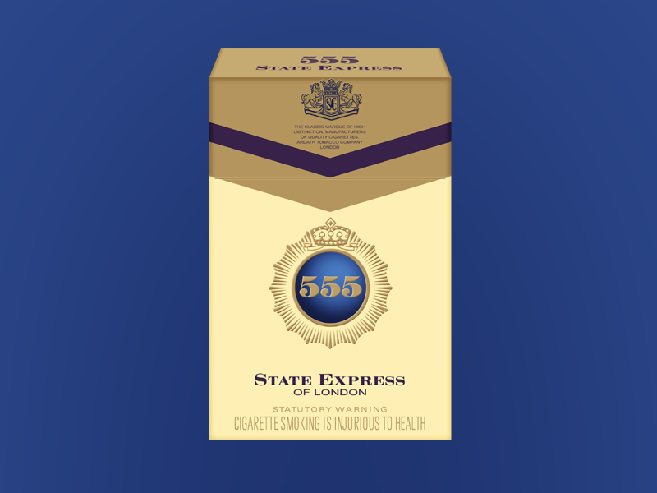

Slide 15


Slide 16
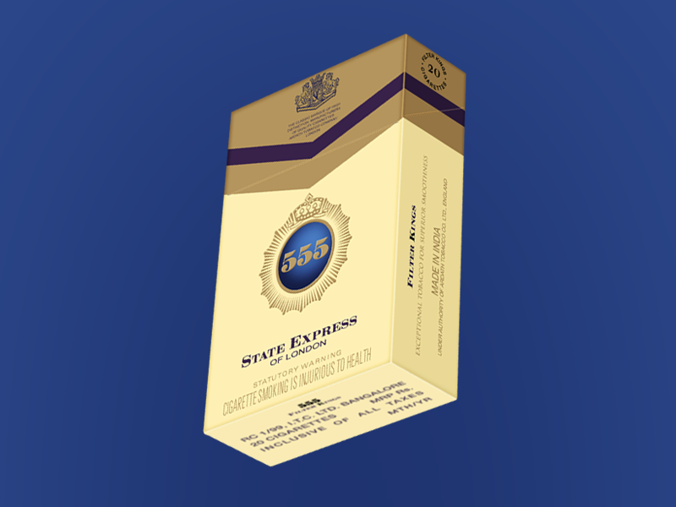

Slide 17
ORACLE PACK RESEARCH
SHORT LISTING STAGE
QUANTITATIVE RESEARCH

Slide 18
SHORT LISTING: QUANTITATIVE STAGE
Information Areas
  Overall preference: Current versus New packs
  Overall ranking of all new packs
  Ranking on action standard attributes ( which is most prestigious? Which is most modern looking? Etc.)
  Preferences between BROAD design elements that are different across all new packs ( e.g. colour, typeface, presence/absence of crest etc. ) ……. diagnostics
Only those new packs which are preferred over the current pack at all qualify to be short listed

Slide 19
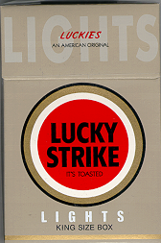
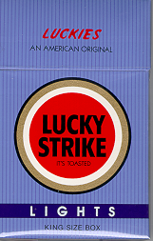
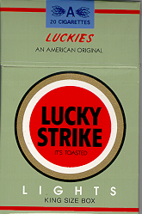
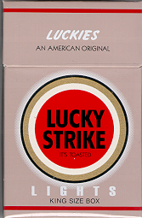
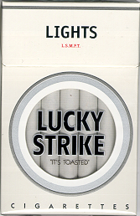
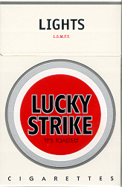
SHORT LISTING: EXAMPLE
CURRENT

Slide 20
SHORT LISTING: LIKES/DISLIKES
MONADIC
“This is the pack in which Lucky Strike Lights is currently available.
Is there anything that you particularly like about this pack?
Is there anything that you particularly dislike about this pack?”
One by one:
“This is a new pack for Lucky Strike Lights.
Is there anything that you particularly like about this pack?
Is there anything that you particularly dislike about this pack?”

Slide 21
SHORT LISTING: OVERALL PREFERENCE
DIRECT COMPARISON
CURRENT
Prefer more
than current
Prefer equally
to
current
Prefer less
than current
Don’t
Know/
Can’t
say
“What are the reasons for preference?”

Slide 22
SHORT LISTING: OVERALL PREFERENCE RAKING
1
2
3
4

Slide 23
SHORT LISTING: RAKING ON ACTION STANDARDS ATTRIBUTES - MODERN
DIRECT COMPARISON
CURRENT
More
MODERN
than current
Equally
MODERN
to
current
Less
MODERN
than current
Don’t
Know/
Can’t
say

Slide 24
SHORT LISTING: RAKING ON ACTION STANDARDS ATTRIBUTES - MODERN
1
2
3
4

Slide 25
SHORT LISTING: DESIGN ELEMENTS PREFERENCE
DIRECT COMPARISON
“Which pack colour do you prefer most?”

Slide 26
SHORT LISTING: DESIGN ELEMENTS PREFERENCE
DIRECT COMPARISON
“Which ‘Bull’s Eye’ type do you prefer?”

Slide 27
SHORT LISTING: DESIGN ELEMENTS PREFERENCE
DIRECT COMPARISON
“Which ‘Bull’s Eye ring’ colour do you prefer?”

Slide 28
SHORT LISTING: DESIGN ELEMENTS PREFERENCE
DIRECT COMPARISON
“Which position of ‘Lights’ descriptor do you prefer?”

Slide 29
CONJOINT ANALYSIS*
Conjoint is a trade-off analysis
  Consumers trade-off between different features whereby it is possible to compute the relative importance of the different features and arrive at an ‘ideal’ combination
LS example:
  Pack colour
  Bull’s eye colour
  Bull’s eye design details (circles colours)
  Position of ‘Lights’ inscription
  Etc.
Recommendation on ‘best combination’
* Conjoint would be an add-on to the short listing protocol, since it can be used only in a few of the cases

Slide 30
SHORT LISTING: QUANTITATIVE STAGE OUTCOME
If more than 3 qualify - select top 3 based on overall and attribute ranking
If no new pack design qualifies, use diagnostics to develop more designs and conduct second round of short listing

Slide 31
ORACLE PACK RESEARCH
SHORT LISTING STAGE
QUALITATIVE RESEARCH

Slide 32
SHORT LISTING: QUALITATIVE STAGE
INFORMATION AREAS
Semiotics is the study of signs and symbols of a given culture. The terms ‘signs’ and ‘symbols’ encompass the range of elements which comprise ‘communication’ e.g.: visual images, colours, pictures
Understand the decoding of the new pack symbols
Understand the actual response in relation to desired response
Exclude any of the short listed packs on inappropriate semiological interpretation

Slide 33
SHORT LISTING: OUTCOME
CURRENT

Slide 34
SHORT LISTING: OUTCOME
CURRENT

Slide 35
ORACLE PACK RESEARCH
STAGES : SUMMARY
Pack development research ( under development)
Short listing of alternative pack designs
Pack testing of short listed alternatives
STM or Test Market

Slide 36
ORACLE PACK RESEARCH
PACK TESTING STAGE
QUANTITATIVE RESEARCH

Slide 37
PACK TEST: NEW vs CURRENT
CURRENT
NEW

Slide 38
PACK TESTING STAGE
To decide whether the new pack (s) is good enough to be put through a STM or Test Market.
The criteria would be:
  overall consumer preference
  desired imagery
  shelf noticeability
  product perception

Slide 39
PACK TESTING: RESEARCH DESIGN
Quantitative Research:
1. Noticeability through a noticeability test
2. Overall Preference and Imagery
3. Product perception through a pseudo product test

Slide 40
PACK TESTING: RESEARCH DESIGN
Combination of methods:
  Matched panels for Notieability, Pseudo Product Test
  Sequential Monadic (Likes/Dislikes)
  Direct comparison for Preference/Imagery
Panel 1 (Test)
  Noticeability test of NEW
  Pack Preference/Imagery of CURRENT and NEW
  Pseudo Product Test of NEW
Panel 2 (Control)
  Noticeability test of CURRENT
  Pack Preference/Imagery of NEW and CURRENT
  Pseudo Product Test of CURRENT
SAME
CLT not necessary if noticeability test on laptop

Slide 41
PACK TESTING: NOTICEABILITY
Determine whether the new pack will be more/less/ equally noticeable in a typical shelf display then current
  Scanned packs through a computer display
  In one display, current pack would be shown in a clutter
  In another display, the new pack will be shown in exactly the same position as the current
  Respondent exposed to the display for a set period, e.g. 10 sec, after which he/she is asked to recall all the brands displayed

Slide 42
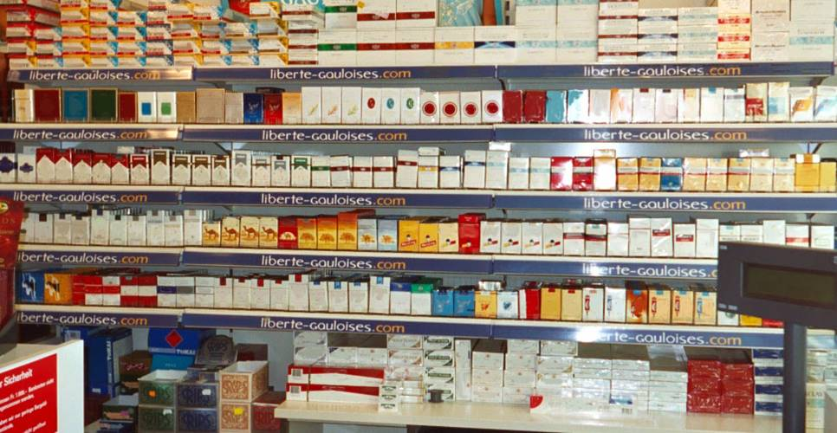
PANEL 1 (TEST)

Slide 43
PANEL 2 (CONTROL)

Slide 44
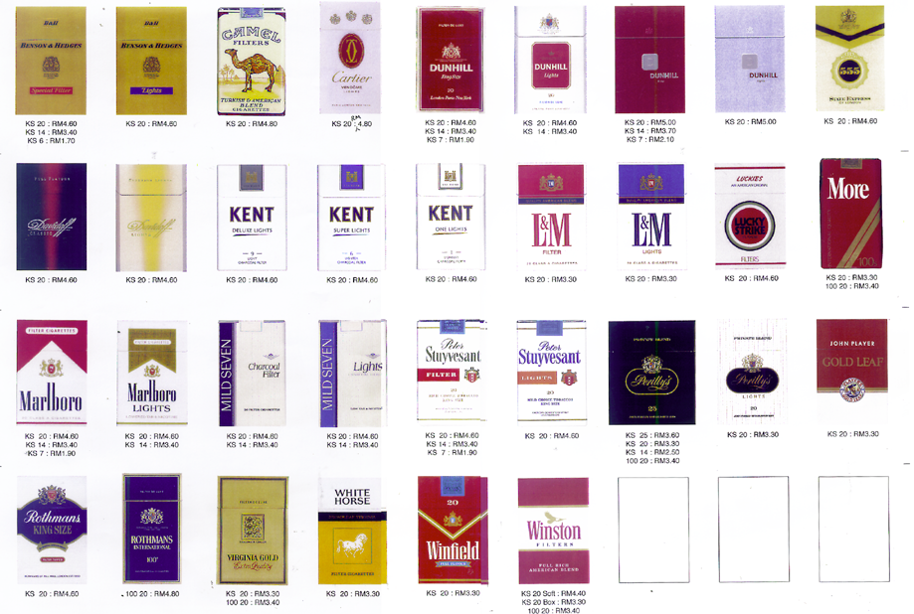
PANEL 1 (TEST)

Slide 45
PANEL 2 (CONTROL)

Slide 46
NOTICEABILITY QUESTION
“What brands do you remember seeing in the shop? Any others?”
  Probe to SKU level (without prompting)
“Did you notice any pack of Lucky Strike in the shop?”

Slide 47
PACK TESTING: PREFERENCE AND IMAGERY
Current pack versus New pack : Likes & Dislikes
Direct comparison on overall and action standard attributes: which pack is more modern? more prestigious? Etc.
Direct comparison on pack design elements : which of these two lettering style do you like? Which colour do you prefer? Etc.
Disposition towards pack change : happy, indifferent, unhappy but will continue with this brand or angry and may consider switching.
Pack imagery ratings with competitive brands on semantic differential scale

Slide 48
ORACLE PACK RESEARCH
PACK TEST: LIKES AND DISLIKES
MONADIC
“This is the pack in which Lucky Strike Lights is currently available.
Is there anything that you particularly like about this pack?
Is there anything that you particularly dislike about this pack?”
“This is a new pack for Lucky Strike Lights.
Is there anything that you particularly like about this pack?
Is there anything that you particularly dislike about this pack?”

Slide 49
PACK TEST: OVERALL PREFERENCE
DIRECT COMPARISON
“If Lucky Strike Lights could be made available in the markets in either one of these two packs, then which pack would you prefer, or would you have no preference?”
Answer options:
Prefer ‘Current’
Prefer ‘New’
No preference
“What are the specific reasons for preferring this pack?”

Slide 50
PACK TEST: IMAGERY - MODERN
“Do you feel that the packs look equally MODERN or is it that one pack looks more MODERN than the other?
Which of these two packs looks more MODERN?”
Answer options:
Current is more MODERN
New is more MODERN
Both equally MODERN
Don’t know/Can’t say
DIRECT COMPARISON

Slide 51
PACK TEST: DISPOSITION TOWARDS PACK CHANGE

Slide 52
PACK TEST: DISPOSITION TOWARDS PACK CHANGE
“Lucky Strike Lights is currently available in the market in this pack.
Now suppose, it is no longer available in this pack.”

Slide 53
PACK TEST: DISPOSITION TOWARDS PACK CHANGE
Regular smokers:
“In its place it starts to be available in this pack then
how would you fill about the change?”
Answer options:
I will be happy about the change
It will not matter much to me
I will be unhappy about the change, but will continue to smoke LS Lights
I will be anger about the change and may even consider smoking some other brand

Slide 54
PACK TEST: DISPOSITION TOWARDS PACK CHANGE
SOB smokers :
“…. will this change make a difference in your
intention to consider smoking LS Lights as your
regular brand?….”
Answer options:
It will make no difference tome
I will make me more likely to consider smoking LS Lights as my regular
It will make me less likely to consider smoking LS Lights as my regular

Slide 55
PACK TEST: SUITABILITY FOR THE BRAND
“How suitable do you think the pack is for
Lucky Strike Lights?”
Answer options:
Pack is very suitable
Pack is somewhat suitable
Pack is not suitable
“Why do you say that?”

Slide 56

PACK TEST: PACK IMAGERY VS COMPETITION - MODERN
DIRECT COMPARISON
Pack imagery ratings with competitive brands on semantic differential scale
To place the packs
on the scale
1
2
3
4
5
6
7
NOT
MODERN
MODERN

Slide 57
ORACLE PACK RESEARCH
PACK TEST: DESIGN ELEMENTS – PACK COLOUR
DIRECT COMPARISON
“Which pack colour do you prefer?”
Answer options:
Prefer Current
Prefer New
No preference
Repeated for as many different elements, as there are differences between the packs

Slide 58
PACK TEST: PSEUDO PRODUCT TEST
MATCHED PANELS
Panel 1 (Test)
Panel 2 (Control)
“Please compare the cigarette you have just smoked with the usual Lucky Strike Lights that is available in the market on (taste, quality, strength, mildness…)”
Answer options:
Similar
Better
Worse
Optional pack change communication
(e.g. ‘no change in product’)
How does pack
design influence
product perception?
Same product in both packs
1 stick branded, taken from the pack

Slide 59
STAGES: SUMMARY
Pack development research ( under development)
Short listing of alternative pack designs
Pack testing of short listed alternatives
STM or Test Market

Slide 60
ORACLE PACK RESEARCH
TEST MARKETING STAGE

Slide 61
TEST MARKETING STAGE
STM / TEST MARKETING to determine :
that the new brand or the existing brand with new packaging meets market share and brand image action standards

