Slide 1
e - FARMING
Under the guidance of
Mr M.Dileep kumar
Y.Tejkumar 10481A1287
V.Vanaja 11485A1208
D.Pavankumar 11485A1214
V. Sukhaveni Rao 10481A1285

Slide 2
Contents :
Introduction
Existing System
Proposed System
Advantages
Modules
Design
Requirements
Screen Shots

Slide 3
Introduction :
Provide facility for farmers to fertilize their crops in a procedural manner
Provides details about which pesticides are to be applied on what type of crops and at what time.

Slide 4
Existing System
Provides the static way of representation
Doesn’t Give information of all crops
Poor awareness

Slide 5
Proposed system :
User registration
Messages
Consideration of different types of soils

Slide 6
Modules :
Farmer module
Admin module
Expert Module

Slide 7
Farmer Module :
Farmer Register and logins into the site.
After he can View Information from site.
He can Post Queries regarding the yield.
Get Solutions through mailing and messaging.
He can participate in Video Conference.

Slide 8
Farmer UseCase :

Slide 9
Admin Module :
View the number of farmers and experts registered .
He View the queries posted by farmers.
Post solutions to queries either by mail or by message.
Video conference
He can Register the Farmer.

Slide 10
Admin Usecase :

Slide 11
Expert Module :
Expert Logins after registration
He adds Information about the fertilizers based on the soils and seasons.
He can modify the Information.

Slide 12
Expert UseCase :

Slide 13
Class :

Slide 14
Sequence :

Slide 15
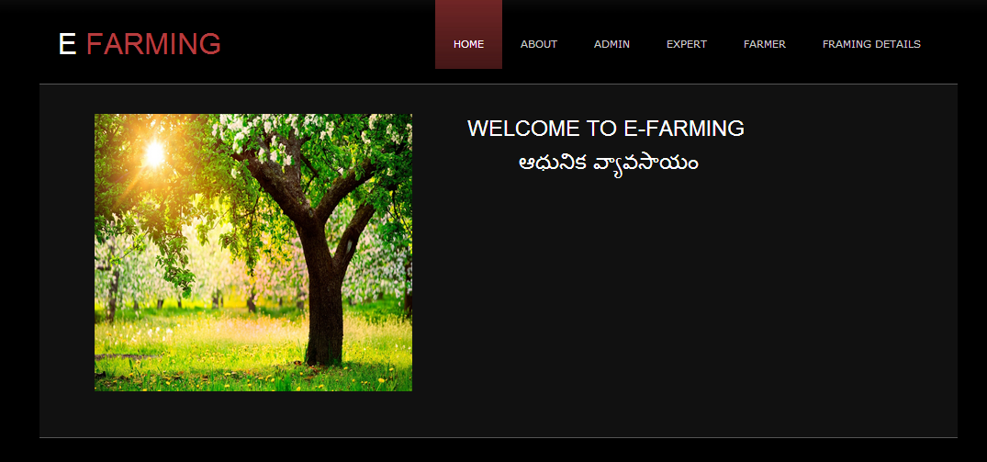
Design :
Home Page

Slide 16
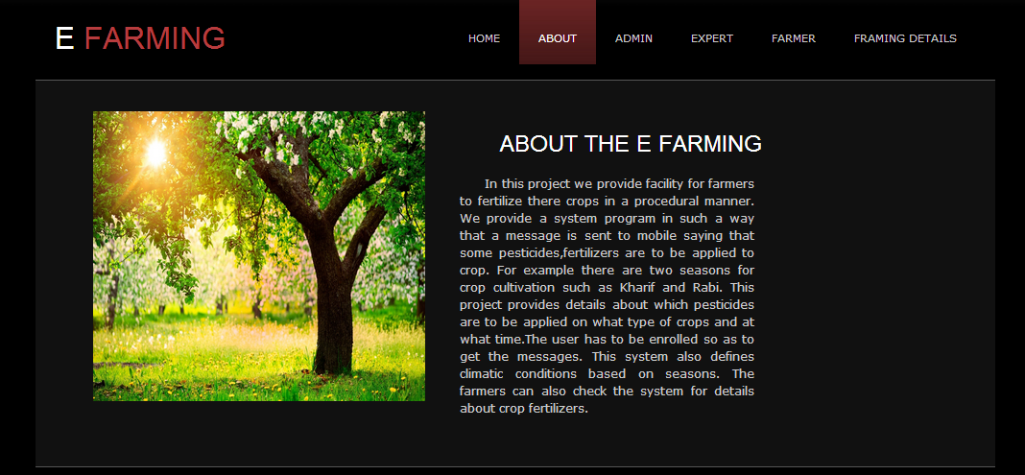
About :

Slide 17
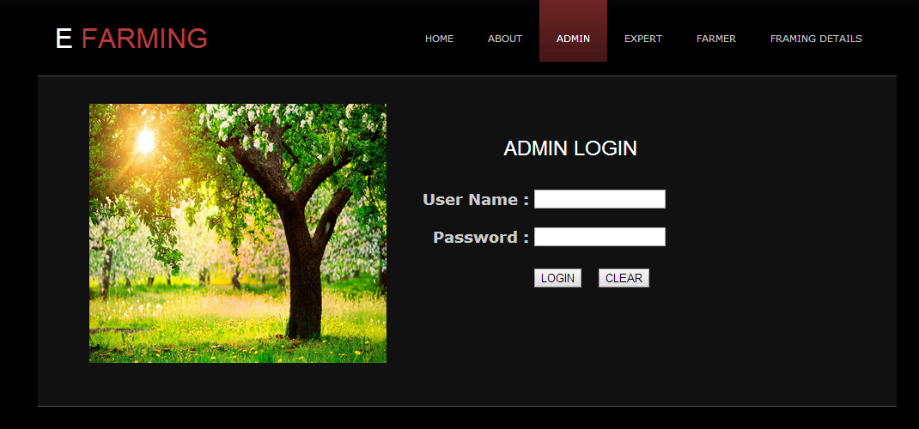
Admin :
Admin Login :

Slide 18
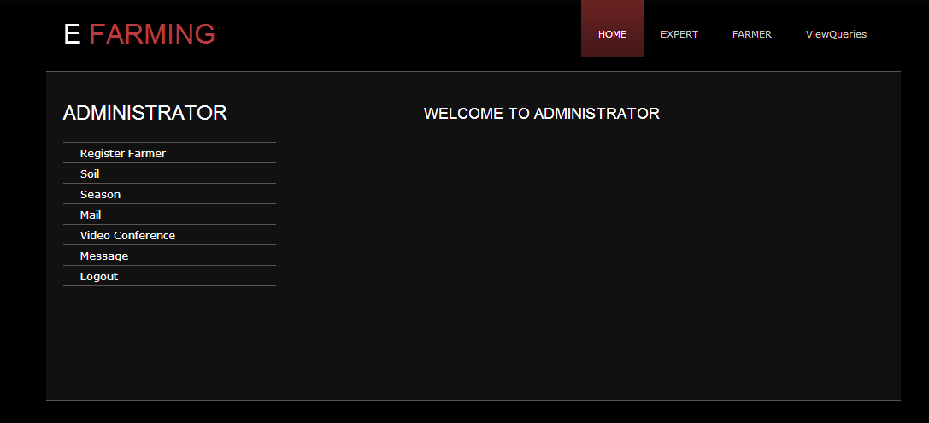
Admin Home :

Slide 19
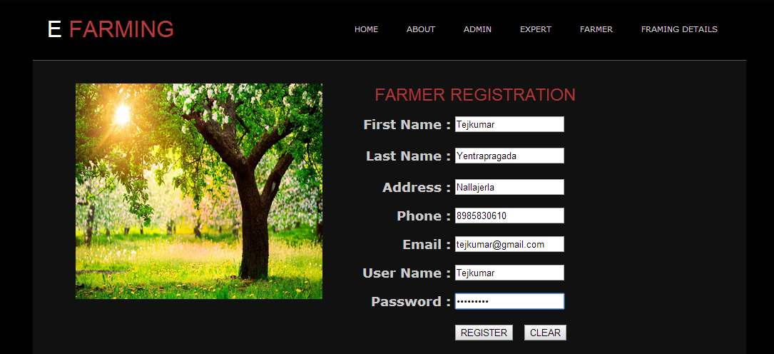
Farmer Registration :

Slide 20
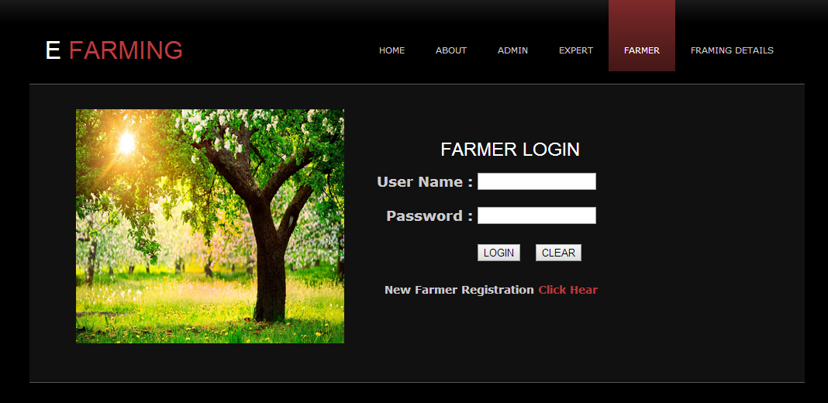
Farmer :
Farmer Login :

Slide 21
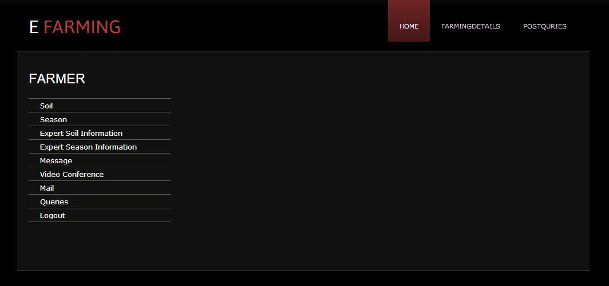
Farmer Menu :

Slide 22
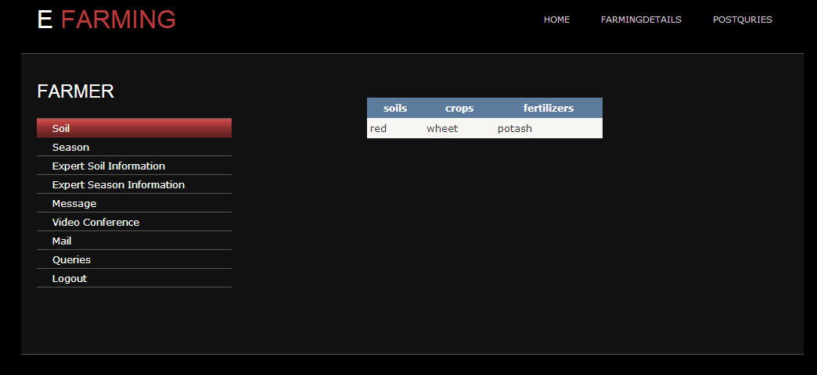
Soil Information:

Slide 23
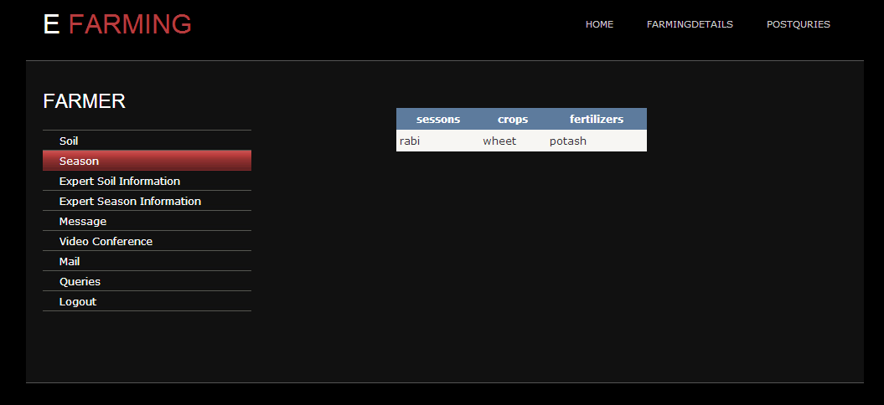
Season Information :

Slide 24
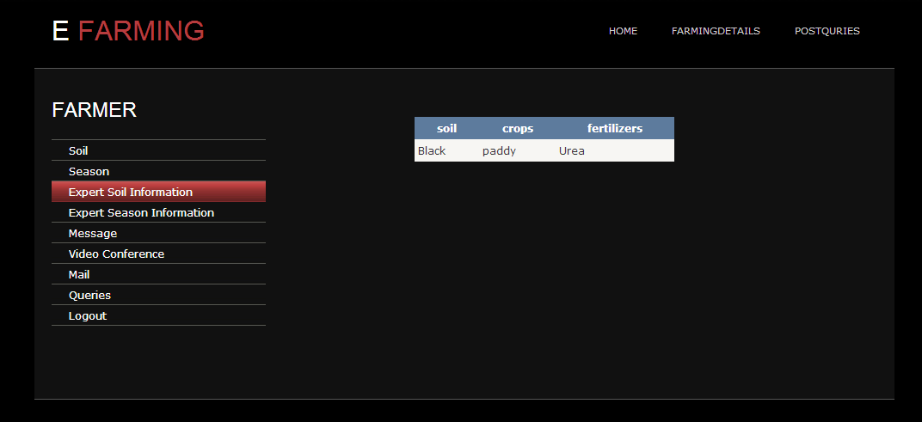
Expert Soil Info :

Slide 25
Expert Season Info :

Slide 26
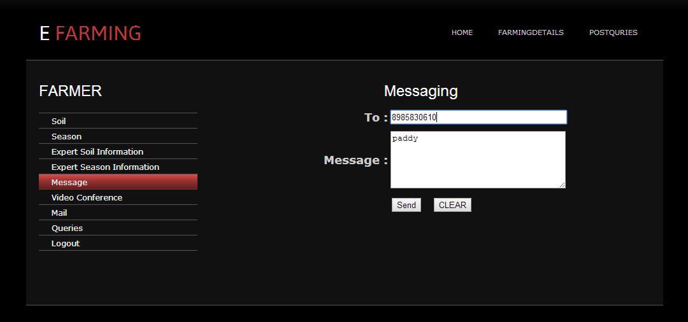
Messaging :

Slide 27
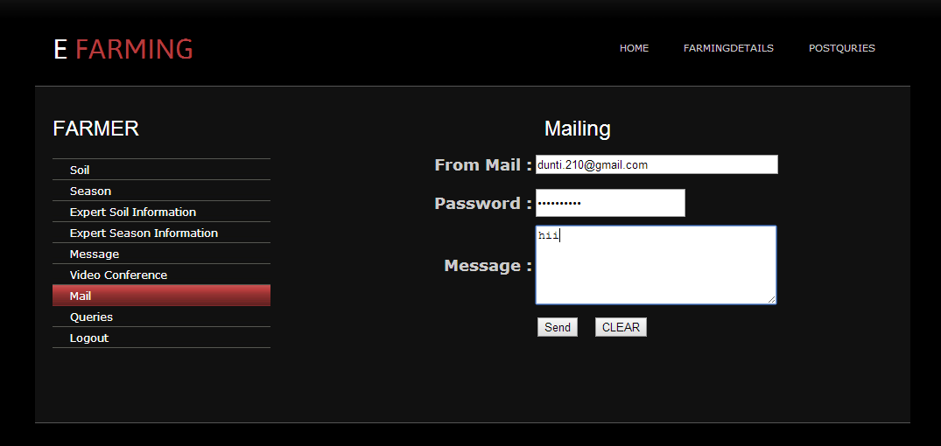
Mailing :

Slide 28
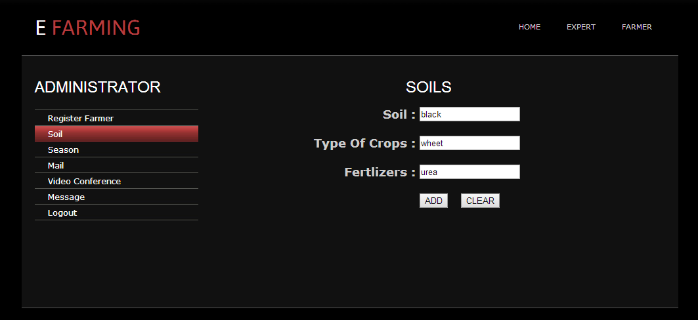
Admin Soil :

Slide 29
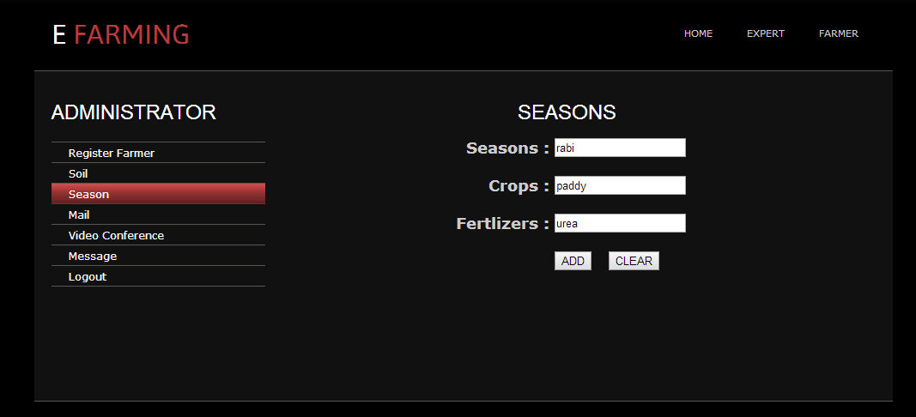
Admin Season :

Slide 30
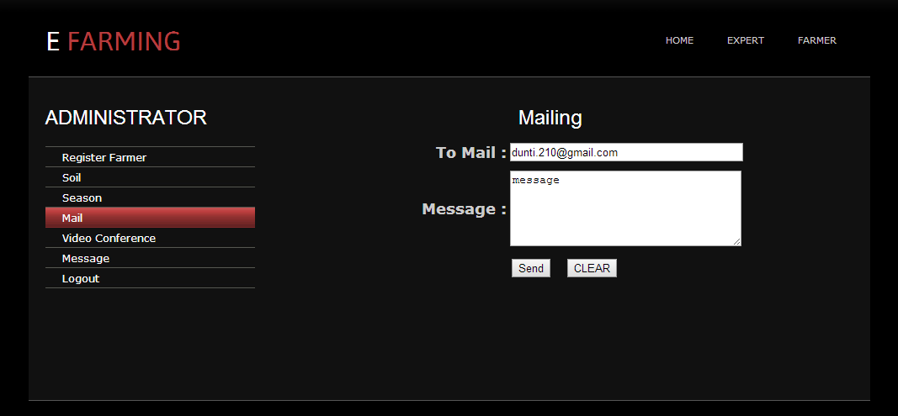
Admin Mail :

Slide 31
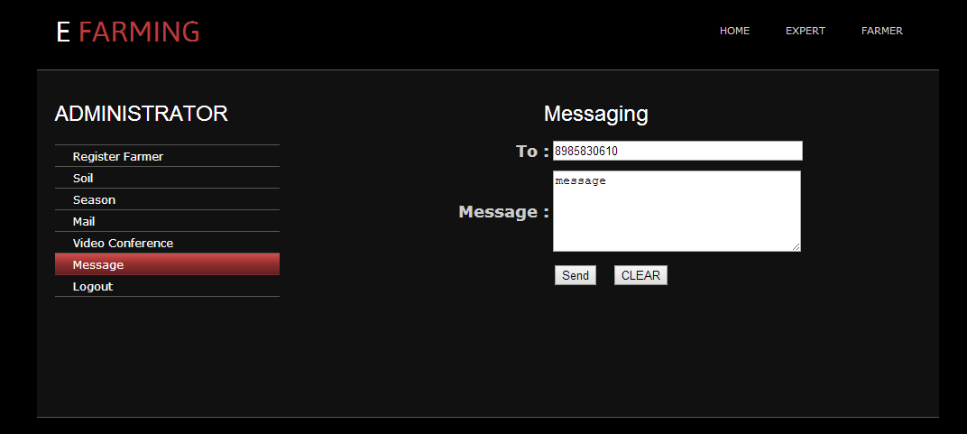
Admin Message :

Slide 32
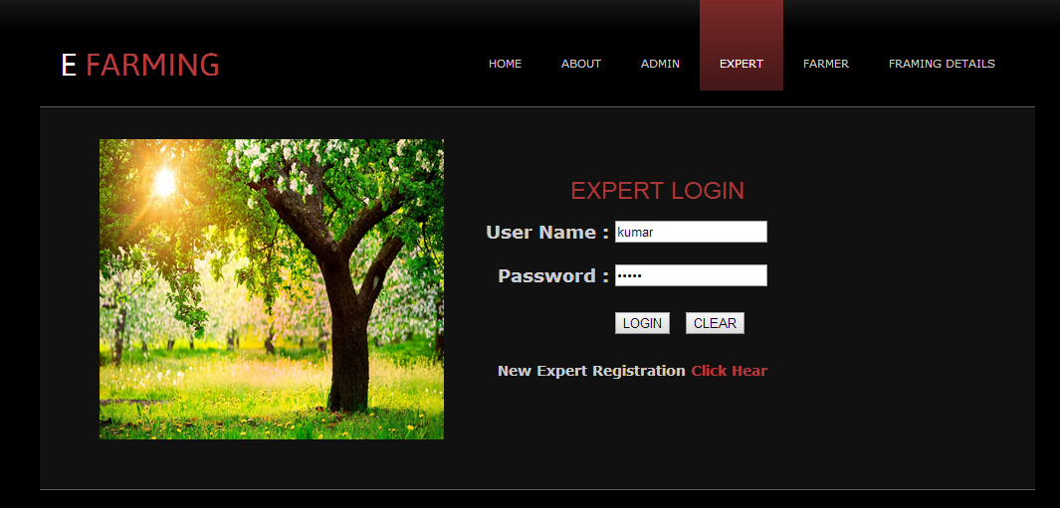
Expert :

Slide 33
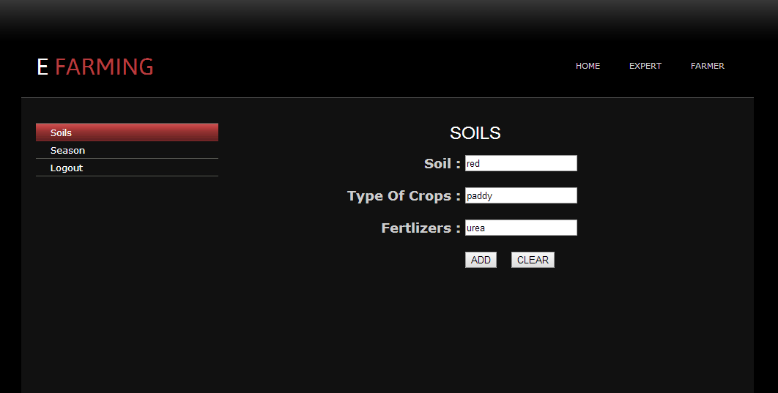
Expert Soils :

Slide 34
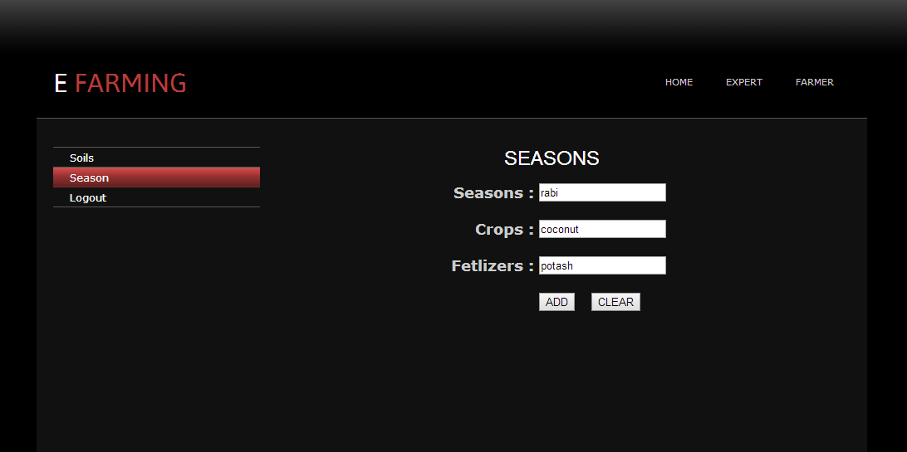
Expert Season :

Slide 35
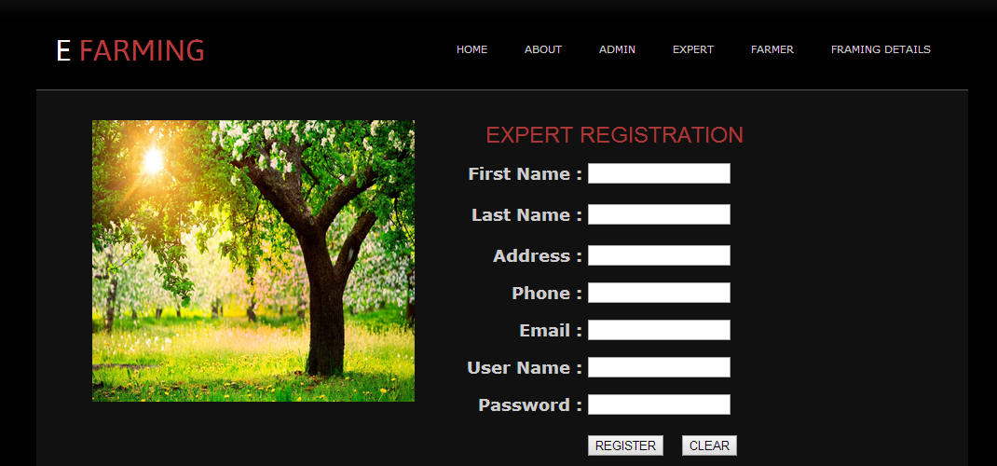
Expert Registration :

Slide 36
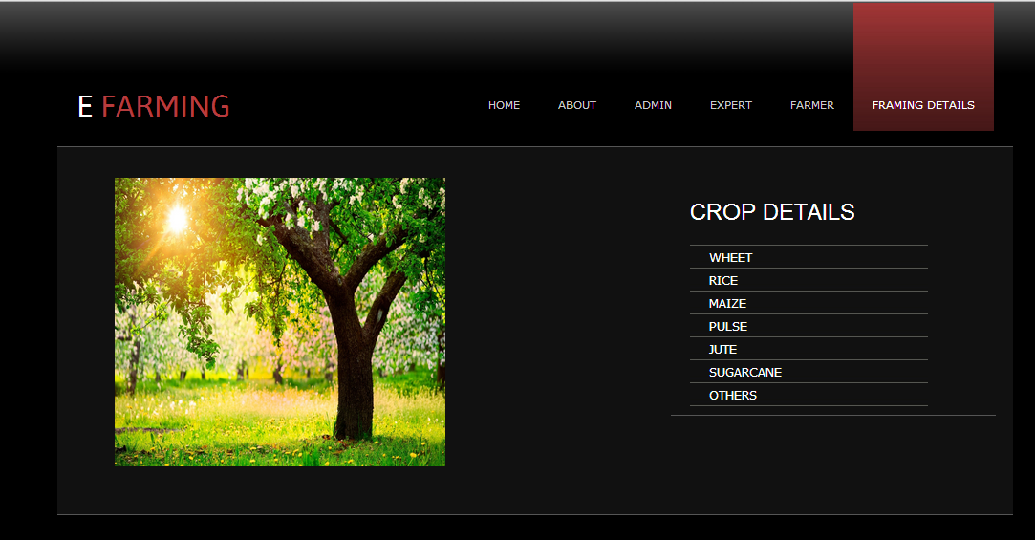
Farming Details :

Slide 37
Advantages :
Deals with maximum number of soils
May/Maynot have system knowledge
Gives the dyanamic way of representation
Gives better information.

Slide 38
Minimum Requirements
Hardware
Intel Pentium Dual core processor 1 GHz
4 GB of RAM
80 GB of Hard Disk Space
Software
Os : Windows 7/8
Microsoft Visual Studio 2010
MySql Server 2008

Slide 39
Suggestions?

Slide 40
Thank you!!

