Slide 1
NLP PROJECT · BANKING
Routing Desk
Understanding customer banking messages and sending each one to the right team, automatically
Payments
Cards
Loans
Account issues
Fraud
Notes:
Routing Desk reads a customer's message to a bank, works out what it is about, and sends it to the right team. It sorts messages into the five categories from our problem statement: payments, cards, loans, account issues and fraud.

Slide 2





Today, a person sorts every message by hand
Customers write to their bank all day: through the app, the website, live chat, email and phone. Before anyone can help, someone has to read each message and decide which team should handle it.
THE MANUAL WAY
“My card hasn't arrived”
“I didn't make this payment”
It is slow
Every message waits in one queue until someone reads it.
“How do I close my account?”
One person reads and forwards each message
It is repetitive
“What's the EMI on my loan?”
Staff spend their day forwarding messages instead of solving them.
Mistakes happen
The fraud report is third in line.
A message sent to the wrong team bounces around while the customer waits.
Whoever sorts the queue decides how fast each customer is helped.
Urgent cases wait too
A fraud report sits in the same queue as a question about fees.
Notes:
Think of a bank's inbox as one long queue. Someone has to read every message and pass it to the right team. That is slow, it is boring work, mistakes send customers to the wrong team, and an urgent fraud report waits behind ordinary questions.

Slide 3




OUR PROBLEM STATEMENT
“Develop an NLP-based system that automatically understands and classifies customer banking queries into relevant categories such as payments, cards, loans, account issues, and fraud. The system will help banks efficiently route customer queries to the appropriate service or department, reducing manual effort and improving response time.”
Understand
Classify
Route
Help the bank
Read a message written in everyday words
Put it in one of 5 categories
Send it to the right team
Less manual sorting, faster replies
Notes:
This is the official problem statement. It asks for four things: understand the customer's words, classify the message into one of five categories, route it to the right department, and in doing so reduce manual effort and improve response time.

Slide 4




Our solution: the journey of one message
1. Hide personal details
2. Understand the message
3. Apply the bank's rules
4. Create a ticket
Card numbers, account numbers, emails and phone numbers are replaced with labels like [CARD] before anything is saved.
The system picks one of 5 categories and one of 83 specific topics.
Unsure messages go to a person. Clear fraud phrases always go to the fraud team.
The right team gets it with a priority and a reply deadline.
Like a post office sorting desk: every letter is read once, stamped, and dropped into the right team's tray.
The message is sorted the moment it arrives, and an agent who corrects a mistake teaches the next version of the system.
Notes:
Here is what happens to one message. First we hide personal details. Then the system works out the category and the exact topic. Then the bank's rules are applied as a safety net. Finally a ticket goes to the right team with a deadline. It works like a post office sorting desk, but automatic.

Slide 5
The data: 13,083 real customer messages
We used Banking77, a free public dataset made by PolyAI (2020). It contains real questions customers wrote to a digital bank, with typos and short chat-style wording, already labelled with 77 topics.
77 topics grouped into our 5 categories
37
Payments
transfers, top-ups, refunds, fees
Real customer wording, not textbook sentences
All about banking
Free to use (CC BY 4.0 licence)
Already labelled, and widely used for this exact task
24
Cards
ordering, PINs, ATMs, card not working
10
Account issues
identity checks, details, closing
6
Fraud
The gap: Banking77 has no loan questions at all
payments not recognised, stolen card
We wrote 60 loan question templates across 6 loan topics. Test templates are kept apart from training ones. These are cleaner than real messages, so the loan score is optimistic.
6*
Loans
*from our 60 templates
Notes:
Our main data is Banking77: 13,083 real messages, 10,003 for training and 3,080 for testing, labelled with 77 topics. We grouped those topics into our five categories. Banking77 has no loan questions, so we wrote 60 loan templates across 6 loan topics. That gives 83 topics in total. We're honest that the loan data is cleaner than real messages.

Slide 6
After cleaning: 10,519 to learn from, 3,192 to test
We removed empty rows, duplicates, and any sentence that appeared in both sets, so the test is a fair exam the system has never seen.
10,519
messages to learn from
9,974 Banking77 + 544 loan + 1 agent correction
3,192
messages in the final test
never seen while learning
About half
of the training data is Payments
so small categories are given equal importance
Notes:
After cleaning we had 10,519 messages to learn from and 3,192 for the final test. Payments is about half of the training data and loans and fraud are small, so we told the system to give every category equal importance.

Slide 7
How the system understands a message
THE CUSTOMER WRITES
HOW IT LEARNED
“My card 4539 1488 0343 6467 was skimmed at the ATM”
It studied 10,519 labelled examples and learned which words and phrases point to which category.
PERSONAL DETAILS HIDDEN, TEXT TIDIED
“my card [CARD] was skimmed at the atm”
Example: words like “stolen”, “lost”, “this charge” lean towards Fraud; “pin”, “atm” and “card” lean towards Cards.
IT LOOKS AT WORDS, WORD PAIRS AND SMALL LETTER CHUNKS
“card”, “skimmed”, “at the atm”, “skim”… (letter chunks help with typos)
Training the whole system takes about one minute on a laptop.
Two models then make predictions
A category model picks 1 of 5 categories (this decides the team). A topic model picks 1 of 83 topics (this tells the agent the exact issue).
Notes:
The system doesn't understand words the way people do. It learns patterns. It first hides personal details and tidies the text, then looks at single words, pairs of words and small chunks of letters, which helps with typos. Two models use those patterns: one picks the category, one picks the exact topic.

Slide 8
We tested four approaches and kept the best
How we chose fairly
Each approach practised on the training data in 5 rounds, each time hiding a different fifth of it as a quiz.
We picked the winner on those practice scores, never on the final test.
Only then did we check it once on the final test.
Guessing alone gets 46.4%. Our model gets 97.3%.
Notes:
We compared four approaches. The simplest possible guess, always picking the biggest category, gets 46.4 percent. Logistic Regression won with 97.3 percent on the final test. Importantly, we chose it on practice rounds inside the training data, not on the test, so the test result is honest.

Slide 9
Results on 3,192 messages it had never seen
97.3%
Out of each category's real messages, how many it got right
of messages put in the right category
3,107 right, 85 wrong
230 of 240
fraud messages caught (95.8%)
the most important category
90.0%
exact topic out of 83
right topic in its top 3 guesses: 96.7%
Loans scores 100%, but its test messages come from our templates, so treat that as optimistic.
Notes:
On 3,192 messages it had never seen, the system put 97.3 percent in the right category: 3,107 right and 85 wrong. It caught 230 of 240 fraud messages. For the 83 detailed topics it is exactly right 90 percent of the time, and the right topic is in its top three guesses 96.7 percent of the time.

Slide 10
Where it gets confused
Real ↓ / Predicted → | Payments | Cards | Loans | Account issues | Fraud
Payments | 1430 | 27 | 0 | 11 | 12
Cards | 11 | 939 | 0 | 6 | 3
Loans | 0 | 0 | 113 | 0 | 0
Account issues | 3 | 2 | 0 | 395 | 0
Fraud | 7 | 2 | 0 | 1 | 230
How to read it
Coloured squares are correct answers. Pink squares are mistakes: the row is what the message really was, the column is what the system said.
Biggest mix-up: 27 payment messages read as card messages.
12 payment messages were sent to Fraud: a cautious mistake.
10 fraud messages were missed: 7 went to Payments, 2 to Cards, 1 to Account issues.
Notes:
Each row is what a message really was; each column is what the system said. The diagonal is correct. The largest mix-up is payments read as cards, which often use the same words. 10 fraud messages were missed, which is why we added a fraud safety net, shown next.

Slide 11



Safety nets for the cases that matter most
Not sure? A person checks
Every ticket gets a team and a deadline
If the system is less than 60% sure, the message goes to manual review instead of guessing.
Team | Priority | Reply within
Fraud & Security Team | Urgent | 1 hour
Payments & Transfers Desk | High | 8 hours
Card Services | Normal | 24 hours
Account Services | Normal | 24 hours
Lending Team | Normal | 48 hours
Manual review | Normal | 24 hours
Fraud safety net
Clear fraud phrases (“skimmed”, “cloned”, “scam”, “wasn’t me”) always go to Fraud. Weaker words like “fraud” only count if the system also gives fraud at least 10%.
Priority boosts
Bereavement and formal complaints are raised to high priority; account takeover to urgent.
Example: “My card was skimmed at the ATM”
On its own the system said Cards (100%). The fraud rule spotted “skimmed” and sent it to the Fraud & Security Team as urgent.
Notes:
Accuracy alone isn't enough for a bank, so we added safety nets. If the system is unsure, a person checks. Clear fraud phrases always go to the fraud team: for example, 'my card was skimmed at the ATM' would otherwise go to Cards. Every ticket also gets a reply deadline, one hour for fraud.

Slide 12

Live demo
Routing a message as you type
Switch to the app now
Notes:
Switch to the app here. Type a message, show it being classified live, then try 'My card was skimmed at the ATM' to show the fraud safety net, and create a ticket.

Slide 13
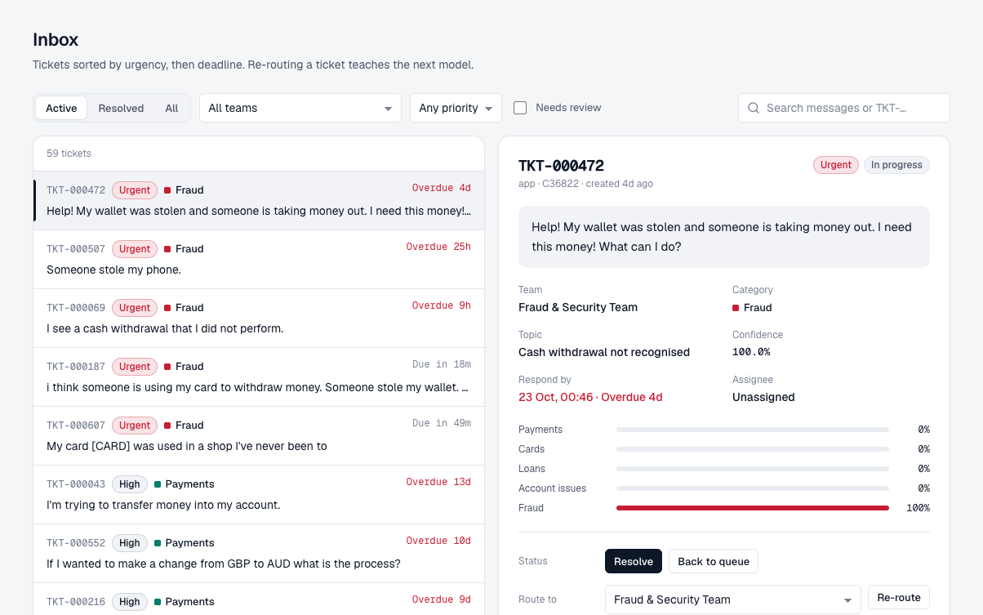
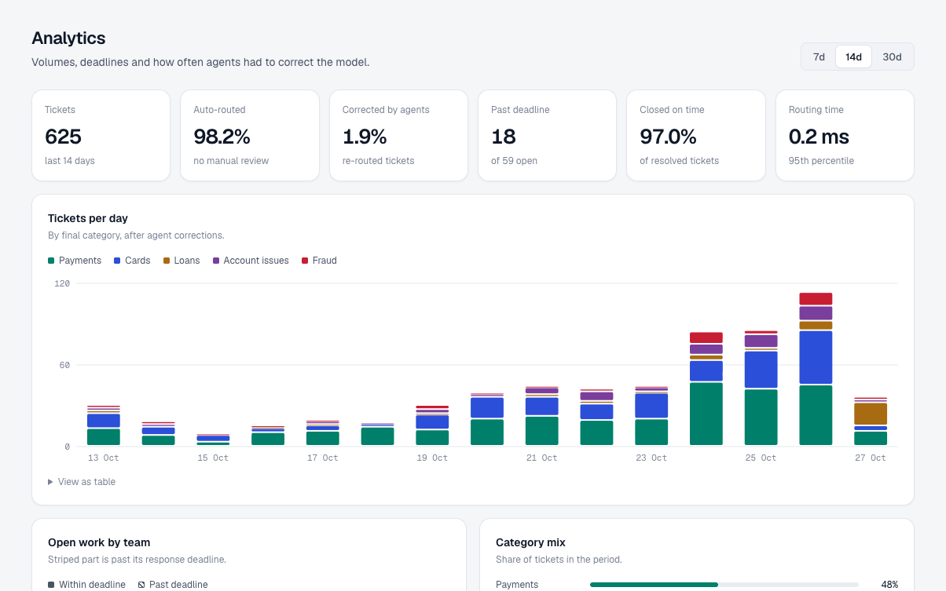
The agent inbox and the analytics view
Inbox: tickets sorted by urgency and deadline. Agents can re-route, assign and add notes.
Analytics: tickets per day, open work per team, missed deadlines and agent corrections.
Notes:
Inbox: tickets sorted by urgency and deadline. Agents can re-route, assign and add notes. Analytics: tickets per day, open work per team, missed deadlines and agent corrections.

Slide 14
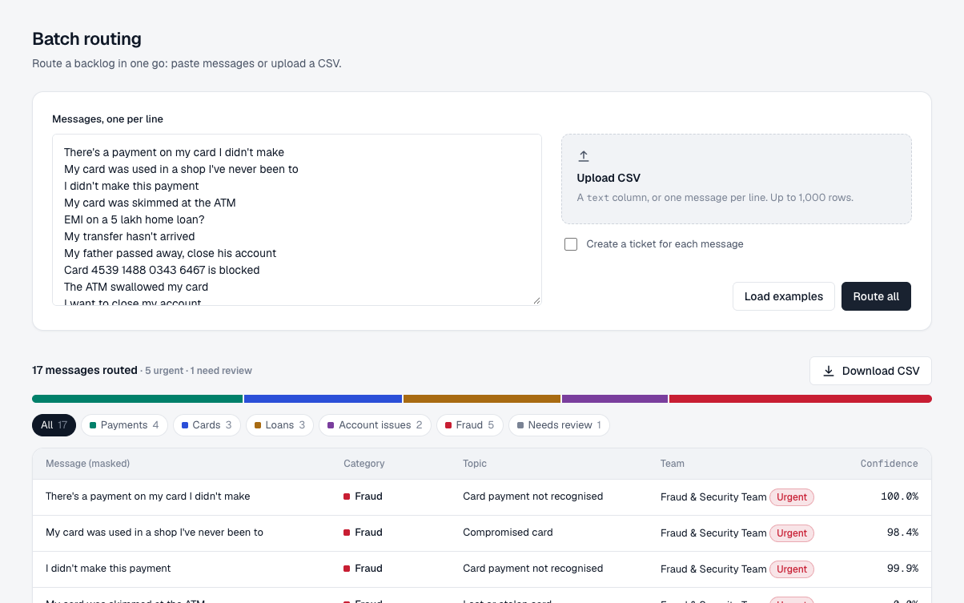
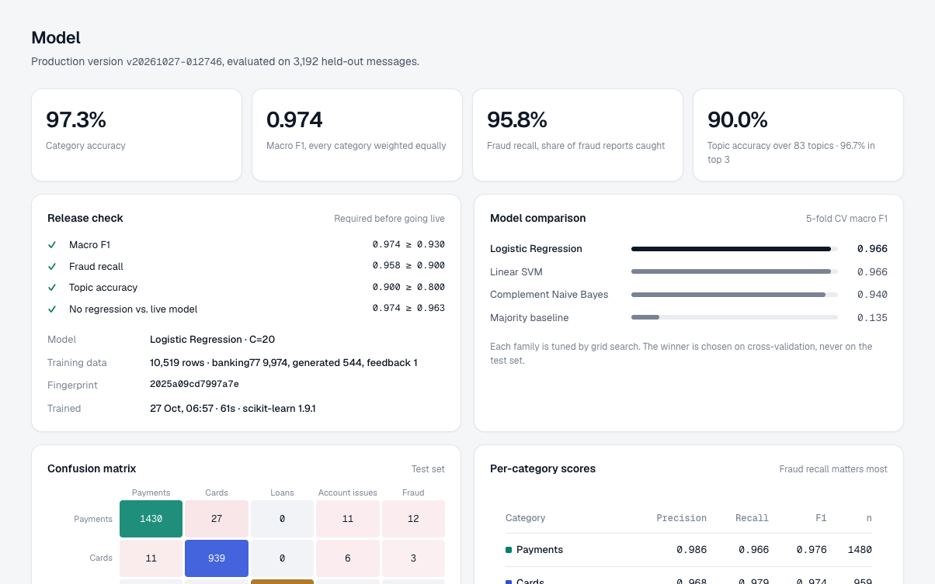
Batch routing and the model report
Batch: paste or upload up to 1,000 messages and download the results.
Model report: scores, model comparison, versions and the release check.
Notes:
Batch: paste or upload up to 1,000 messages and download the results. Model report: scores, model comparison, versions and the release check.

Slide 15






Built like a real product, not just a model
Privacy first
Release check
Learns from agents
Personal details are hidden before anything is saved or logged.
A new model goes live only if it scores at least 0.93 overall, catches at least 90% of fraud and gets topics right at least 80% of the time.
When an agent moves a ticket to another team, the correction is saved and used to teach the next version.
Checked automatically
Connects to other systems
Easy to run anywhere
49 automated tests run on GitHub every time the code changes.
Other bank systems can send messages to it through a web API, with access keys and request limits.
Packaged with Docker; works in light and dark mode and on phones.
Notes:
We built this the way a bank would need it: personal details hidden, a release check before any new model goes live, learning from agent corrections, 49 automated tests that run on every change, an API for other systems, and packaging that runs anywhere.

Slide 16




Honest limitations
Loan messages are generated
English only
Banking77 has no loan questions, so our loan data comes from 60 templates. Real loan messages would be messier.
The system was trained only on English messages.
One main category per message
It learns patterns, not meaning
Mixed messages get one main category; a second one is only shown as extra information.
On its own it missed “skimmed”, “cloned” and “scam”. The fraud rule now catches these, but a smarter model is the real fix.
Notes:
We want to be upfront about the limits. The loan data is generated. It only works in English. It gives one main category per message. And because it learns word patterns rather than meaning, it missed phrases like 'skimmed' on its own, which our fraud rule now covers.

Slide 17
Phase 2: what we will build next
1
A smarter language model
1–2 days
2
Change detection
1 day
A model that understands meaning (fine-tuned DistilBERT), competing through the same release check
Warn us when customers start writing differently, e.g. a new type of scam
3
Instant alerts
Half a day
4
Production database
Half a day
Slack or email alerts the moment an urgent fraud ticket arrives
Move to Postgres, with safe upgrades of its structure
5
Load test
Half a day
6
Project report
1 day
Measure how many messages per second it can handle
A notebook with full error analysis
Notes:
Phase 2 has six parts. The most important is a smarter language model that understands meaning, which should catch fraud phrases without needing rules. We will also add change detection, instant alerts for urgent tickets, a production database, a load test and a full project report.

Slide 18
Thank you
Questions?
97.3%
230 / 240
90.0%
49
right category
fraud caught
exact topic of 83
automated tests
Notes:
Thank you. To recap: 97.3 percent of messages go to the right category, 230 of 240 fraud messages are caught, the exact topic is right 90 percent of the time, and the whole system is covered by 49 automated tests. Happy to take questions.

