Slide 1
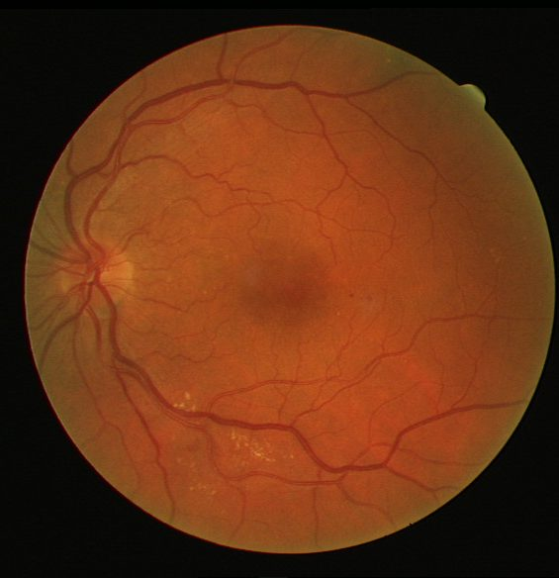
Does a topology-aware loss fix broken vessels?
Phase 2 review
Adding the clDice centre-line loss to Study Group Learning, and testing it honestly on DRIVE
Four models trained end to end · 20 test images · one variable changed
Notes:
Phase 1 ended with a hypothesis. This phase we implemented it, trained it, and measured it. The short version: the hypothesis is refuted on the numbers we promised, but the mechanism behind it is real and visible. I will show both.

Slide 2
Where phase 1 left us
01
Reviewed ten DRIVE papers
U-Net variants, training schemes, topology losses, lightweight models.
The hypothesis, as written
Replacing the pixel-wise loss with an equal mix of clDice and cross-entropy will:
02
Selected SGL as the base paper
Sensitivity
+2 to +5 pp
MICCAI 2021. Ships code, data, pseudo-labels and weights; the loss is a command-line flag.
F₁
+0.5 to +1.5 pp
03
Committed to a falsifiable hypothesis
Written with numbers, before any result was seen.
Specificity
no worse than −1 pp
04
Wrote the ablation plan
Four configurations so the loss is the only thing that moves.
Fixed throughout: network, data, split, pseudo-labels, optimiser, epochs.
Notes:
Phase 1 was reading and choosing. The important thing on this slide is the box on the right: we wrote down three numbers before we ran anything. That is what makes this phase a test and not a demo. If we had not written it down, we could have called any result a success.

Slide 3
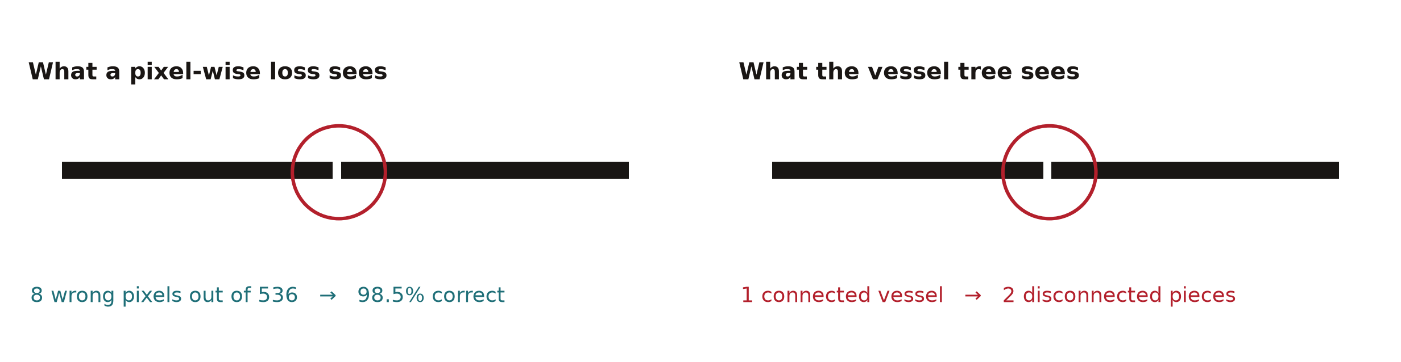
Why we expected the loss to matter
A pixel-wise loss scores every pixel the same way. Cutting a vessel in half barely moves that score — so nothing in the objective is defending connectivity.
clDice (Shit et al., CVPR 2021) scores the overlap of the two skeletons, not the two pixel sets. A gap is then expensive.
57 disconnected pieces per image in the baseline, where the human tracing has 3.
Notes:
This is the whole idea in one picture. On the left, a two-pixel gap: the pixel loss calls it 98.5 per cent correct, so it has almost no reason to close it. On the right, the same gap has turned one vessel into two. clDice measures the skeleton overlap, so that gap is expensive. And the baseline really does fragment: fifty-seven pieces per image against three in the human tracing.

Slide 4
What we built this phase
1
clDice loss
2
Four objectives, one flag
3
Topology metrics
Differentiable soft skeleton by iterated erode-minus-open, three steps.
bce · sgl · cldice · sgl_cldice, selected at the command line.
Binary clDice, β₀ fragmentation ratio, broken-branch count.
src/losses.py
src/train.py
src/metrics.py
4
SGL pipeline reproduced
5
Ablation driver
6
Vessel Studio
Four-fold pseudo-labelling, made resumable after a power loss.
Trains and scores all four rows, 8-way self-ensemble, resumable.
Local app that runs any checkpoint on any test image, live.
src/sgl_labeling.py
src/run_ablation.py
app/server.py
Notes:
Six pieces of work. The loss itself is the small one - about forty lines. Most of the effort went into the things that make the comparison trustworthy: the metrics that can see topology at all, and a driver that trains all four rows under identical conditions. The labelling was made resumable because we lost power halfway through it.

Slide 5
First: is our baseline trustworthy?
Before changing anything, we ran the authors' own published weights through our pipeline. If that does not reproduce, nothing measured afterwards means anything.
324 / 324
0.9886
0.8316
state-dict keys match the
published checkpoint
AUC from their weights,
scored by our code (paper ≈ 0.983)
F₁ from their weights,
scored by our code (paper ≈ 0.82)
What the two extra tensors were
Their checkpoint carries two tensors our model has no slot for. They belong to a final activation that is commented out in the authors' own forward pass — dead weight in the file, not a difference in the network. Architecture and scores both line up, so from here on any change is the loss, not the plumbing.
Notes:
This slide is the insurance policy. Every key matches, and their weights score 0.9886 AUC and 0.8316 F1 in our code against roughly 0.983 and 0.82 in the paper - slightly above, because we use the eight-way self-ensemble. If an examiner asks whether our baseline is really their baseline, this is the answer.

Slide 6
The experiment: one variable
Loss function
Cross-entropy only
Cross-entropy + clDice
B
no-SGL control
C
clDice only
Human labels
Plain BCE on the original tracings.
Isolates the loss from the labels.
Training labels
A
SGL baseline
D
SGL + clDice
SGL pseudo-labels
The paper, reproduced.
The proposed model.
Identical network, split, schedule, optimiser, augmentation and seed (123). 30 epochs each. α = 0.5, so clDice is half the objective.
Notes:
Two factors, two levels, four models. Row C was not in the original plan - we added it so we could tell the loss apart from the labels. Everything else is pinned, including the seed. The one number to remember is alpha equals one half: we gave clDice half the objective, which turns out to matter a lot.

Slide 7
Results: all four rows, plus the published weights
Model | SGL | clDice loss | Acc | AUC | Se | Sp | F₁ | clDice | β₀
R published weights | K=8 | – | 0.9705 | 0.9886 | 0.8380 | 0.9834 | 0.8316 | – | –
B human labels, BCE | no | no | 0.9695 | 0.9872 | 0.8012 | 0.9860 | 0.8200 | 0.8118 | 32.6
C clDice only | no | yes | 0.9599 | 0.9818 | 0.8677 | 0.9690 | 0.7904 | 0.8595 | 8.1
A SGL baseline | yes | no | 0.9630 | 0.9849 | 0.8713 | 0.9720 | 0.8038 | 0.8319 | 29.6
D SGL + clDice | yes | yes | 0.9422 | 0.9764 | 0.8833 | 0.9480 | 0.7274 | 0.8565 | 9.6
Read the β₀ column
Read the F₁ column
Fragmentation drops by two thirds wherever clDice is switched on — 32.6 → 8.1 without SGL, 29.6 → 9.6 with it. The loss does what it claims.
And it costs F₁ every time — 0.8200 → 0.7904 without SGL, 0.8038 → 0.7274 with it. That is at the fixed 100/255 threshold; how much of it is calibration is the next slide.
Notes:
Take the table in two columns. Beta-zero is fragmentation - lower is better - and it collapses whenever clDice is on, with or without SGL. F1 is the pixel score, and it falls whenever clDice is on, with or without SGL. Same cause, two opposite effects. One more thing worth noticing: A against B. SGL on its own cost us 1.6 points of F1 at thirty epochs, so the paper's own trick did not reproduce as a gain at our budget.

Slide 8
The hypothesis is refuted
All three predictions fail at the operating point we fixed in advance. F₁ fell on 20 of 20 images (Wilcoxon p < 0.001) — seven times our own 1-point noise floor.
predicted
observed
Sensitivity
+2 to +5 pp
+1.20 pp
F₁
+0.5 to +1.5 pp
−7.64 pp
Specificity
no worse than −1 pp
−2.40 pp
… but most of that gap is calibration, not capability
−7.64 → −1.40 pp
−2.96 → −1.49 pp
100/255 was chosen for a cross-entropy model; a clDice model is calibrated far higher. Let each row pick its own best threshold and four fifths of the F₁ gap disappears. Those thresholds are fitted on the test set, so they flatter every row equally — an upper bound, not a score.
D vs A, F₁ gap once each picks its
own threshold (125 and 170 / 255)
C vs B, the same correction
without SGL (85 and 165 / 255)
Notes:
We have to say this plainly: we were wrong. Sensitivity rose 1.2 points when we promised two to five. F1 fell 7.6 when we promised a rise. And it is not noise - F1 fell on every one of the twenty images. But the box at the bottom is the honest footnote, and you should raise it before anyone else does. We scored every row at one fixed threshold, and that threshold was picked for a cross-entropy model. clDice models are calibrated much higher - D wants 170 out of 255, not 100. Give every row its own best threshold and the gap falls from 7.6 points to 1.4. The verdict does not change, because we predicted F1 would rise and it still falls. But four fifths of the headline number was the operating point, not the model.

Slide 9
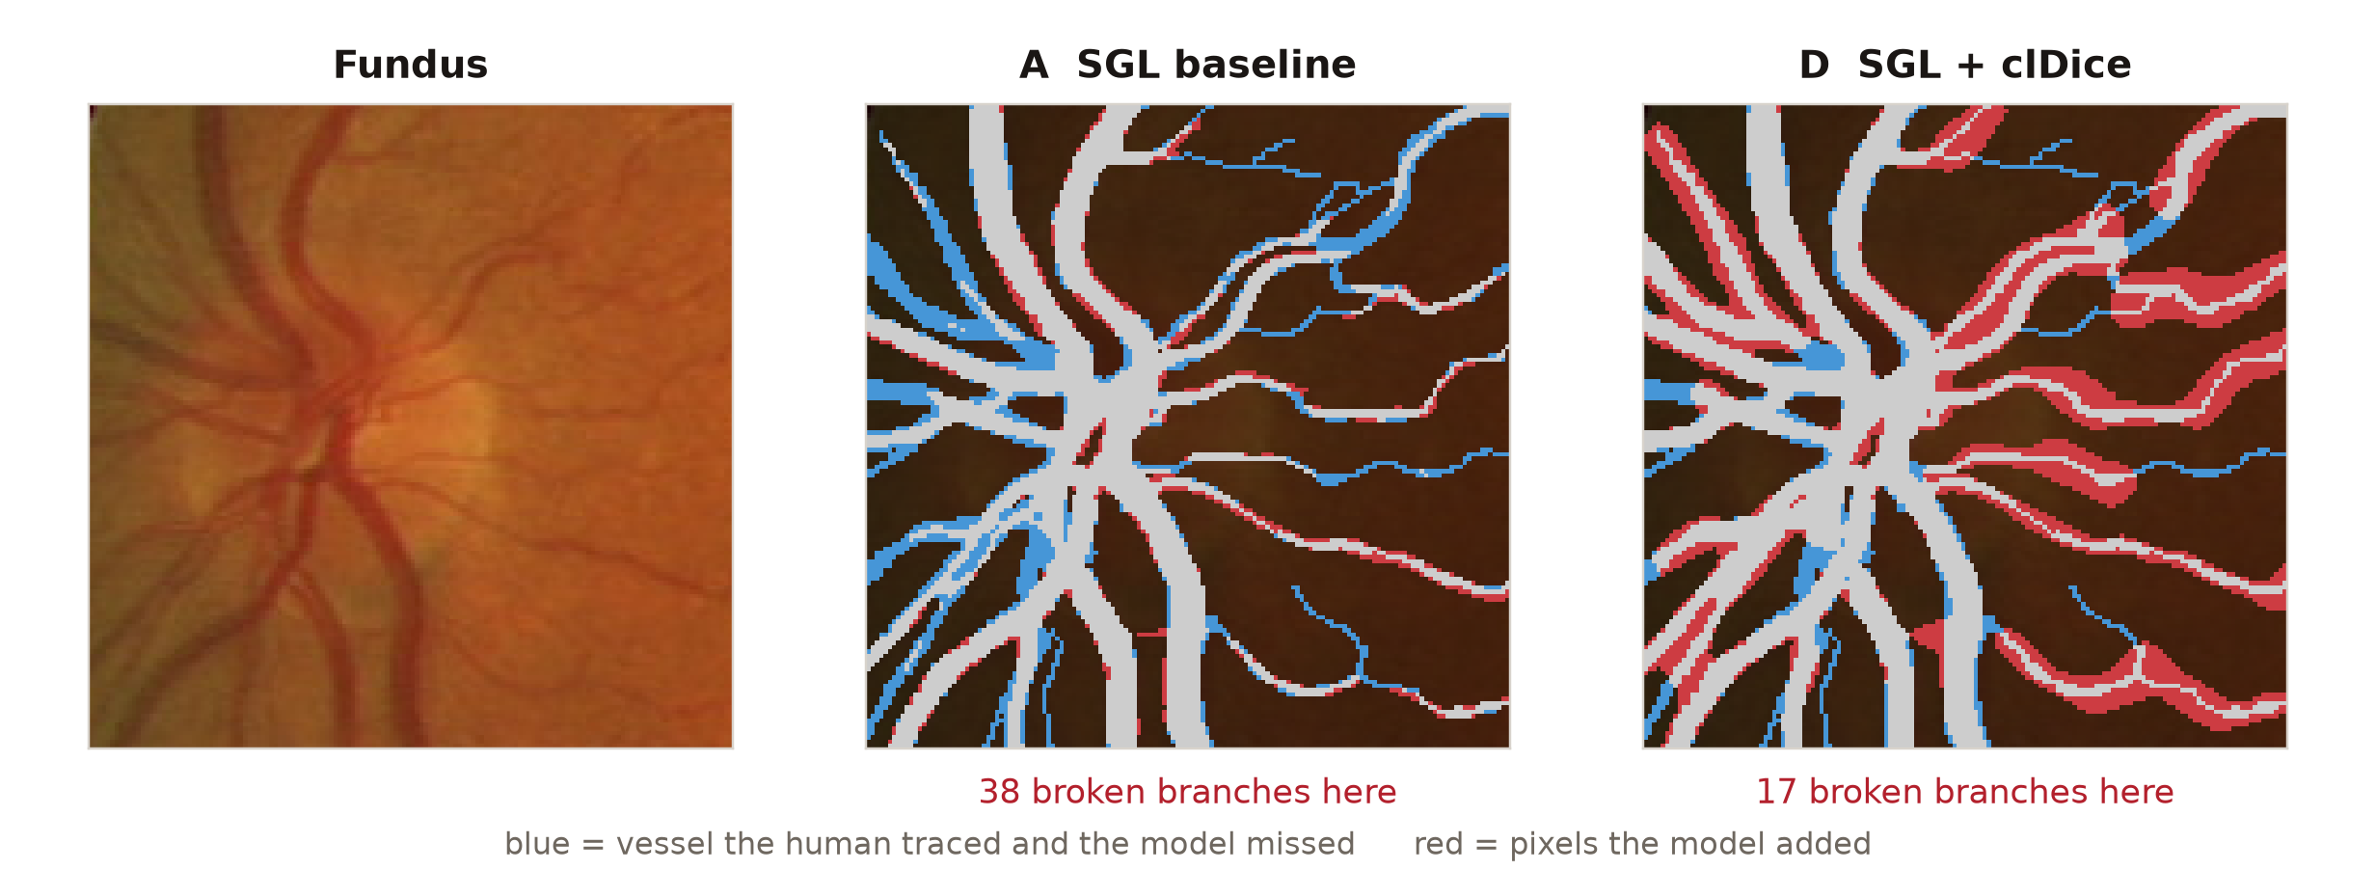
But the mechanism is real
Same region of test image 03, same scale. The proposed model completes branches the baseline drops — and pays for them in red.
141 → 97
broken branches per image
57 → 20
disconnected pieces per image
0.803 → 0.822
recall on thin vessels (≤ 1.5 px)
The diagnosis
clDice is scored on the skeleton, so thickening a vessel is a cheap way to keep it connected. At α = 0.5 that shortcut is worth more than the cross-entropy it breaks. The loss worked; the weight was wrong.
0.043 → 0.079
false-positive rate — the price
Notes:
Look at the middle panel against the right one. Blue is vessel the human traced and the model missed - there is much less blue on the right. In this window the baseline breaks thirty-eight branches and the proposed model breaks seventeen. Across the whole test set, broken branches fall from 141 to 97 and the tree goes from fifty-seven pieces to twenty. Thin-vessel recall goes up. But look at the red: false positives nearly double. That is the whole story. clDice is scored on the skeleton, so making a vessel fatter is a cheap way to keep it joined up, and at alpha one half that shortcut pays better than the cross-entropy it breaks.

Slide 10
What we take from this phase
01
The hypothesis fails as written
Every predicted number missed. At matched thresholds the F₁ cost is 1.4 points rather than 7.6 — smaller, but still a loss where we predicted a gain.
Next
Sweep α from 0.1 to 0.3, repeated across seeds. This run tested one weight, not the idea.
02
The mechanism behind it holds
A third fewer broken branches, a third of the fragments, better thin-vessel recall — on 20 of 20 images.
Fit the threshold on a validation split — ours was fitted on the test set, so it only bounds the gap.
03
SGL did not pay for itself here
At a 30-epoch budget the pseudo-labels cost 1.6 points of F₁ against plain BCE. An unplanned result worth reporting.
Report topology metrics beside F₁ — F₁ alone cannot see a broken vessel.
A negative result that is measured, pre-registered and explained is a result. The code, the four checkpoints, the per-image numbers and a live demo are all in the repository.
Notes:
Three things to take away. One: the hypothesis fails as written - every number we predicted was missed, and at matched thresholds it is a 1.4 point loss rather than 7.6, but it is still a loss where we predicted a gain. Two: the mechanism is real - the loss connected the tree on every image. Three, which we did not go looking for: SGL itself did not pay for itself at our budget. The obvious next experiment is the alpha sweep. We tested one weight, not the idea, and we should not claim more than that.

