Slide 1
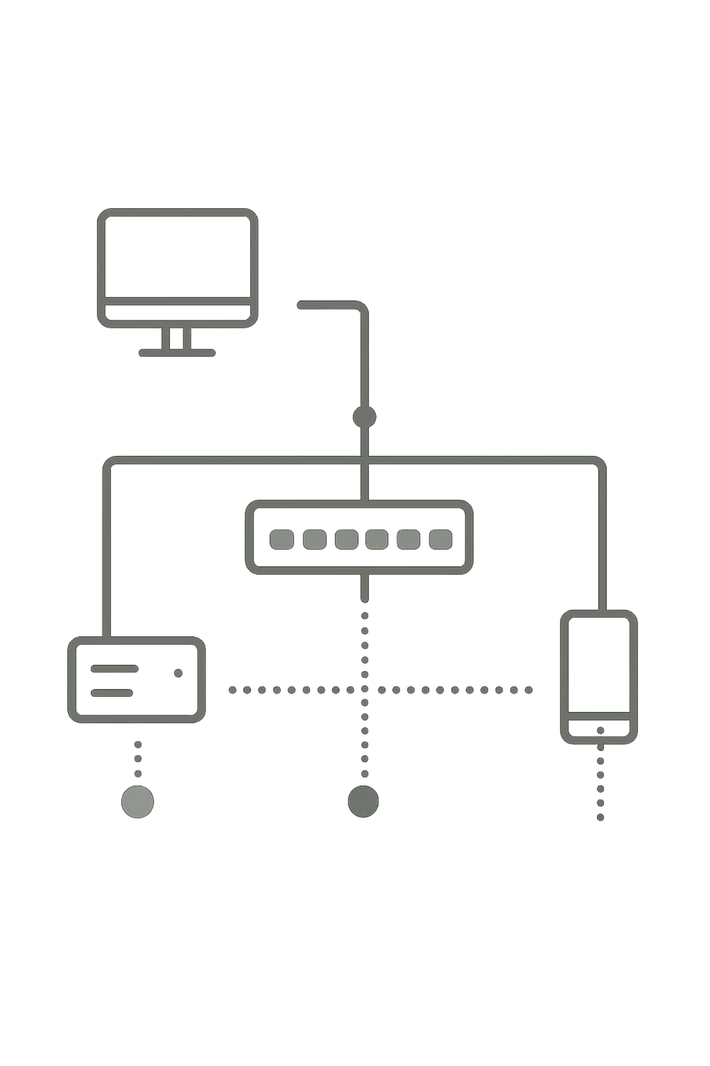
Customer Churn Analysis & Retention Strategy
A comprehensive analysis of telecom customer churn using Python, SQL, and Power BI — identifying key drivers and data-driven strategies to improve retention.

Slide 2

Dataset at a Glance
7,043 Customers
21 Columns
Key Numerics
Demographics, services, billing & churn status
Tenure, MonthlyCharges, TotalCharges, Rating
Total records analyzed

Slide 3


Data Preparation in Python
Handle Missing
Load Data
Verify Quality
Missing values in PhoneService and PaperlessBilling were imputed using column mode. No duplicate records were found across all 7,043 rows.

Slide 4
Who Are the Customers?
5,174
1,869
Retained
Churned
Customers who did not churn
Customers who left the service
1,142
3,555
Senior Citizens
Male
vs. 5,901 non-senior customers
vs. 3,488 Female customers

Slide 5
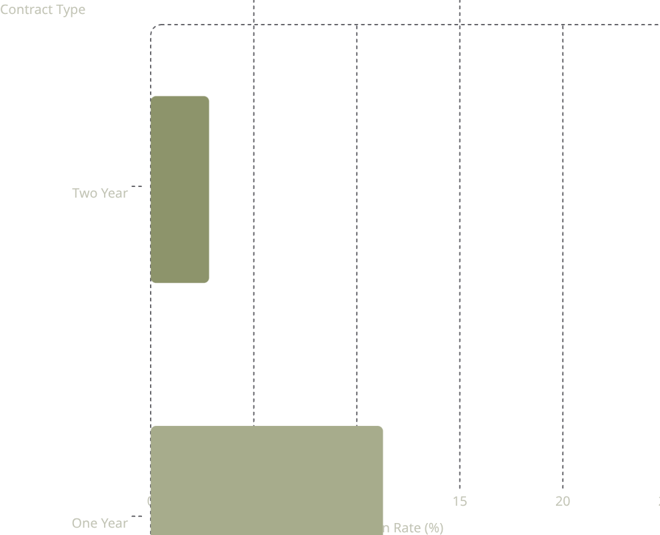
Contract Type & Churn Rate
Key Finding
Month-to-month customers churn at 42.71% — nearly 4× higher than one-year contracts and 15× higher than two-year contracts.
Long-term commitments are the strongest structural defense against churn.
2.83
11.3
42.7

Slide 6
Charges, Services & Payment Impact
Monthly Charges
Internet Service
Churned customers pay avg. $74.44/mo vs. $61.27 for retained. Highest churn in the $70–90 range at 37.95%.
Fiber optic users churn at 41.89% vs. DSL at 18.96% and no internet at 7.40%.
Payment Method
Paperless Billing
Electronic check users churn at 45.29% — nearly 3× the rate of automatic payment methods (~15–17%).
Paperless billing customers churn at 33.43% vs. 16.27% for paper billing customers.

Slide 7
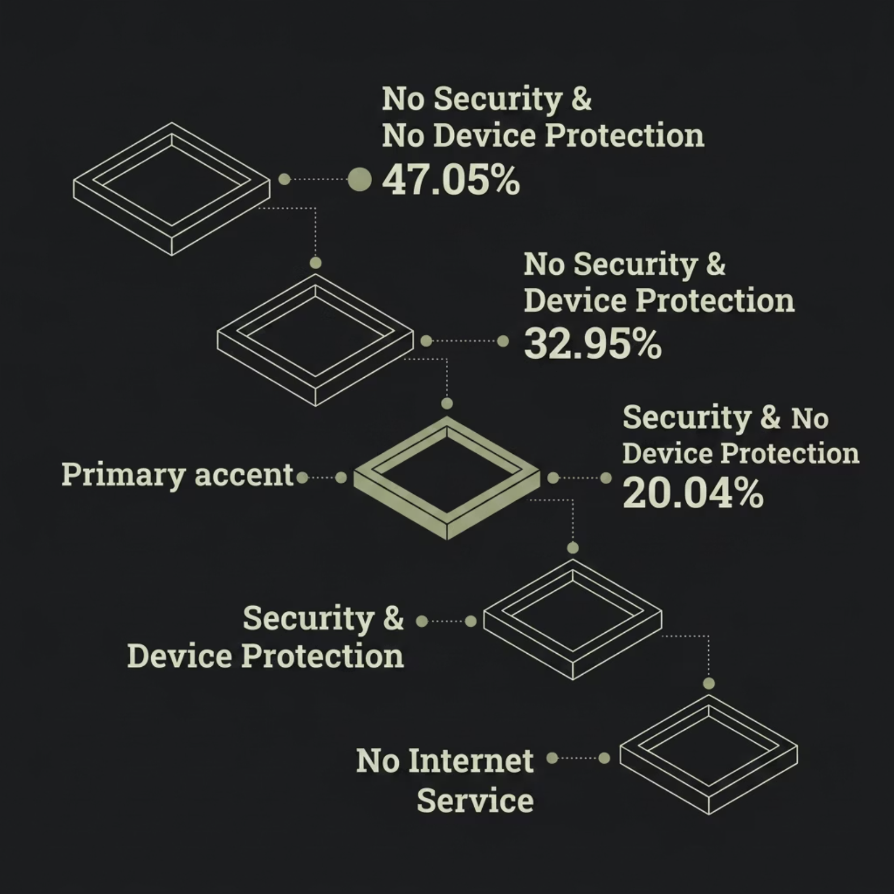

Support Services Dramatically Reduce Churn
Tech Support Effect
Customers without tech support churn at 41.64%. Those with tech support churn at just 15.17%.
Customers lacking both Online Security and Device Protection have the highest churn at 47.05% — nearly 7× lower when both are active.

Slide 8
Key Insights Summary
01
02
03
Contract Type
Monthly Charges
Tenure
Month-to-month contracts drive the highest churn.
Higher charges correlate strongly with increased churn.
New customers churn more; long-term customers stay loyal.
04
05
Support Services
Payment Method
Absence of tech support, security, or device protection raises churn significantly.
Electronic check users churn far more than automatic payment users.

Slide 9




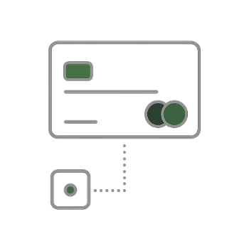
Retention Strategy Recommendations
Encourage Long-Term Contracts
Optimize Pricing
Focus on New Customers
Promote Support Services
Review high monthly charges and offer value-added benefits to retain at-risk customers.
Improve early onboarding experience — churn risk is highest in initial tenure.
Increase awareness of Tech Support, Online Security, and Device Protection.
Promote yearly and two-year plans with incentives to reduce month-to-month churn.
Improve Payment Convenience
Encourage automatic payment methods to reduce churn linked to electronic checks.

Slide 10

Conclusion
This analysis reveals that churn is not random — it is predictable and preventable. Contract flexibility, pricing pressure, lack of support services, and payment friction are the primary levers.
Lock In Loyalty
Add Value
Long-term contracts + auto-pay
Bundle security & support services
Nurture Early
Prioritize new customer experience

