Slide 1
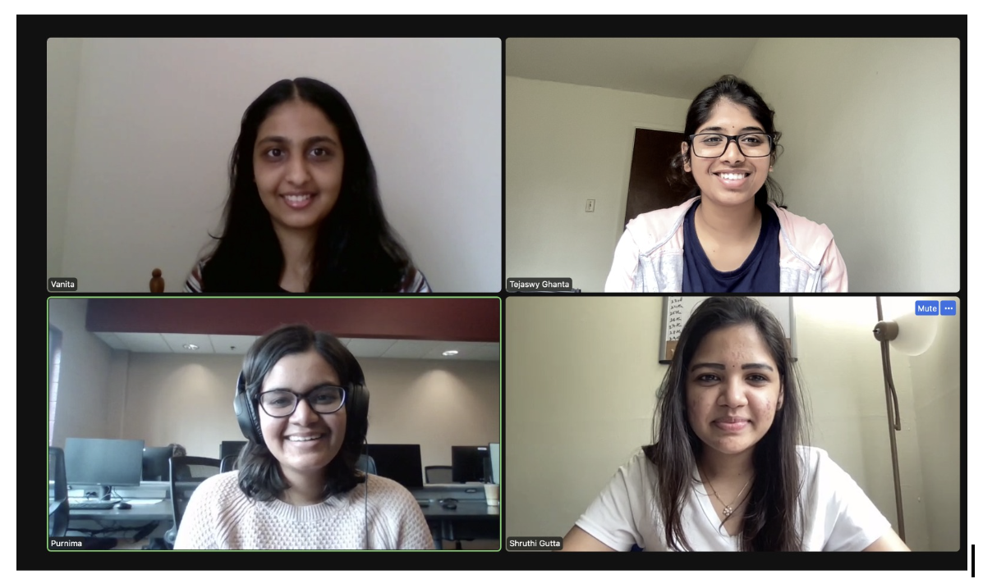
Home Credit Default Risk (HCDR) - Phase 3
Group 20
Group members
Shruthi Gutta
Tejaswy Ghanta
Purnima Surve
Vanita Lalwani
INDIANA UNIVERSITY

Slide 2
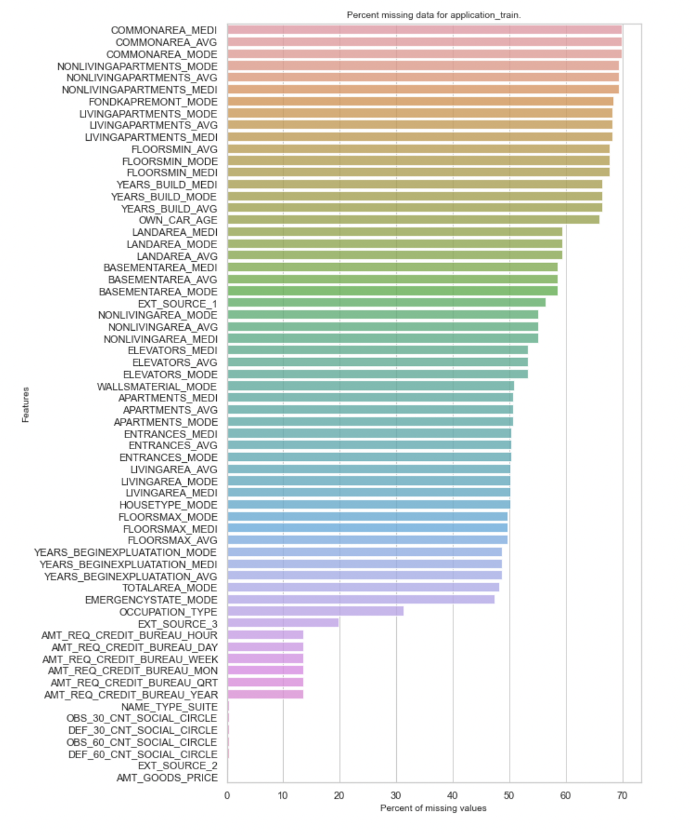
Data description
Data Analysis
Exploratory Data Analysis
Baseline Modeline - Linear Regression
Phase 1 Summary
Past - Summary EDA and Baseline Pipeline

Slide 3
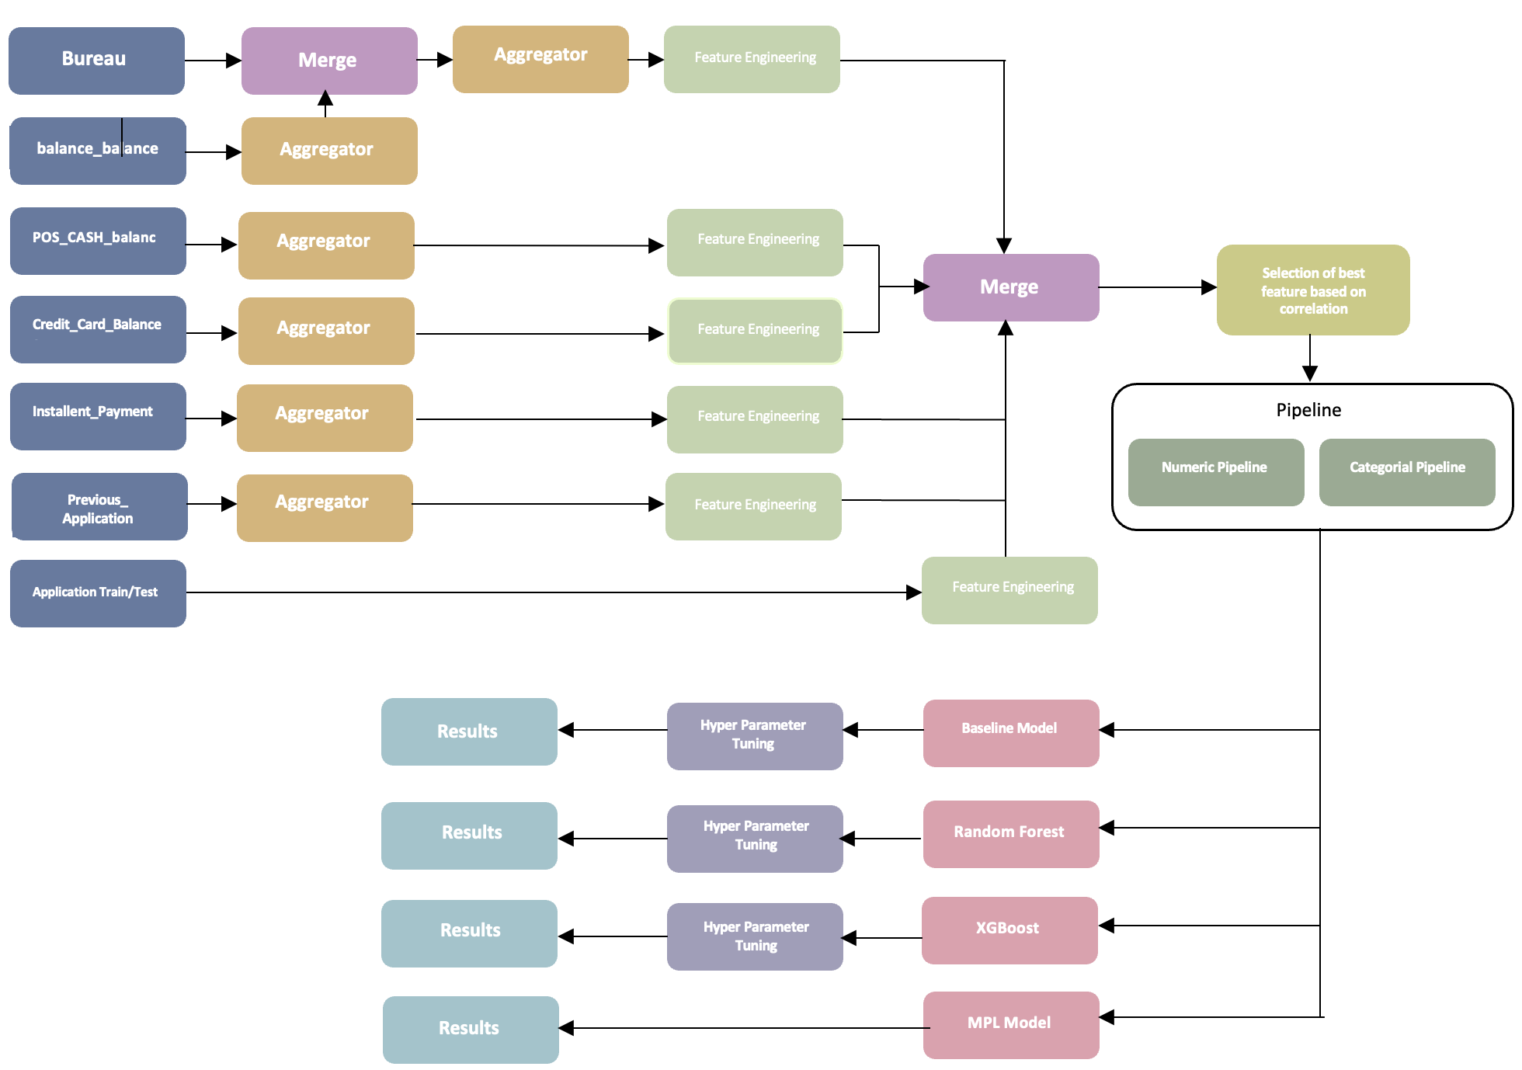
Our best performing algorithm was XGBoost with the best AUC ROC score as 71.85%. The lowest performing model was SVM. Related ensemble models, Gradient Boosting has shown lower results with AUC ROC score 71.52% validation. Our best score in Kaggle submission out of all four submission was 0.70237 for private and 0.70479 for public.
Phase 2 Summary

Slide 4
Phase 3

Slide 5
Implemented Neural Network model
We used XGBoost to predict loan default and were able to reach an AUC score of over 0.72 on our Kaggle submission. After focusing on exploratory data analysis. Along with building upon our additional features and developing boosted models, our team implemented multiple Multi Linear Perceptron models, experimenting with different architectures and activation types. Our top performing MLP model was built using Scikit-learn’s SVMN Classifier, yielding a validation AUC of 0.526, lower than our best performing, “soft voting classifier,” model.
Single Layer Neural network
Multi Layer Neural Network
MLP-model building and applying classification Technique

Slide 6
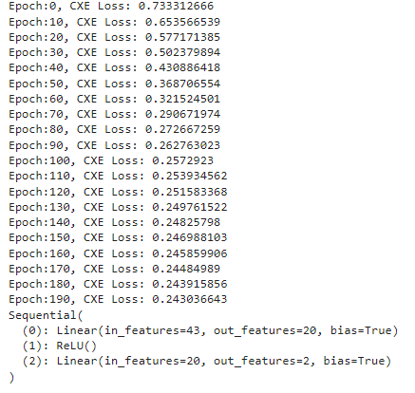
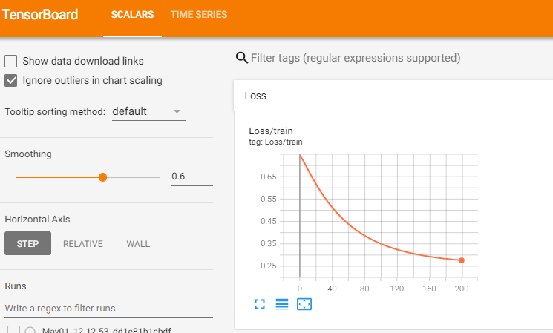
MLP

Slide 7
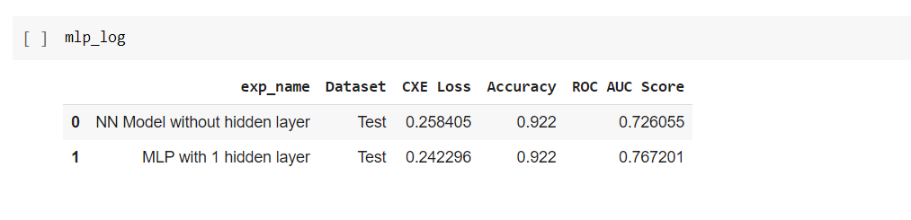
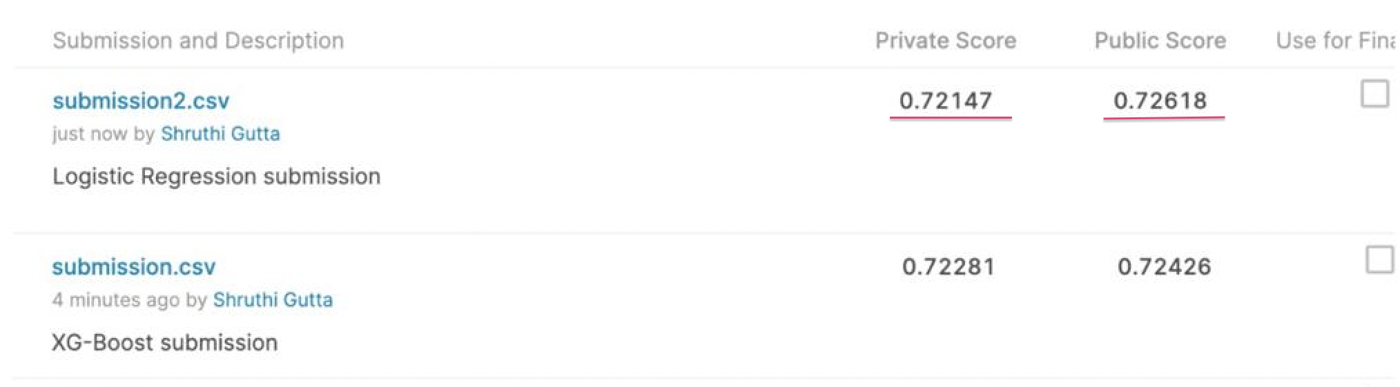
Final Results and Kaggle Submission:
We have implemented Neural Networks in phase 3 and our simple neural network ROC score
is 76.72% and multilayer neural network ROC score is 72.60%
We have implemented many classifiers in which logistic regression and XGBoost
has the highest scores.
The overall highest Private score is 72.28% and Public score is 72.61%.

Slide 8
Thankyou!

