Slide 1
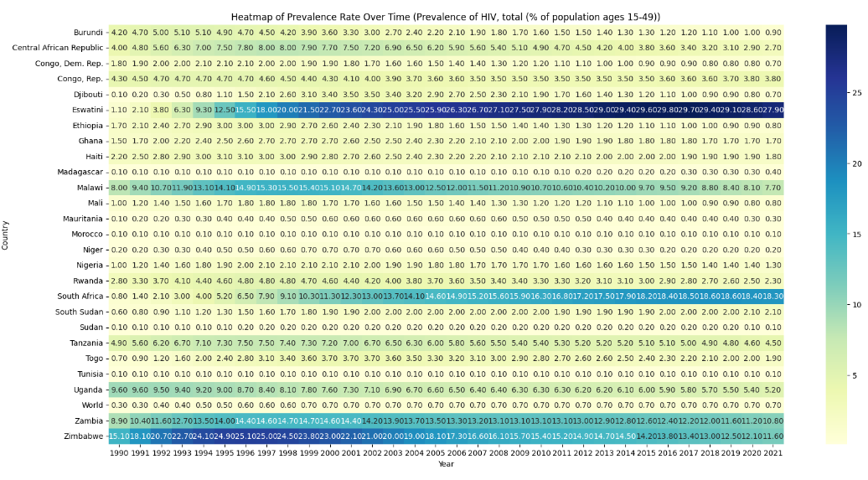
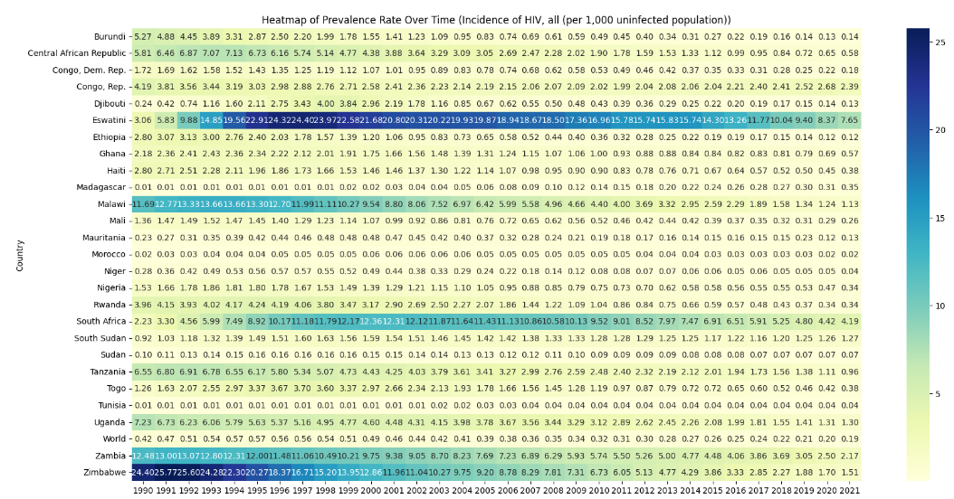
As you can see prevance is very high for esvatni as year passes on

Slide 2
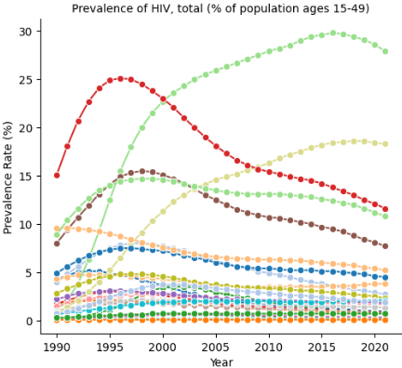

Slide 3
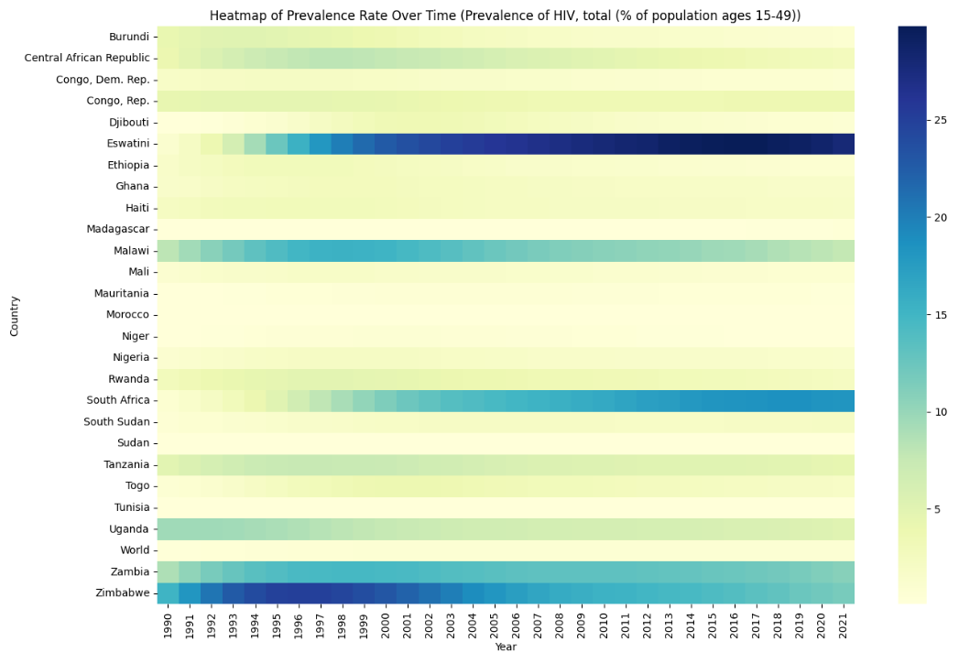
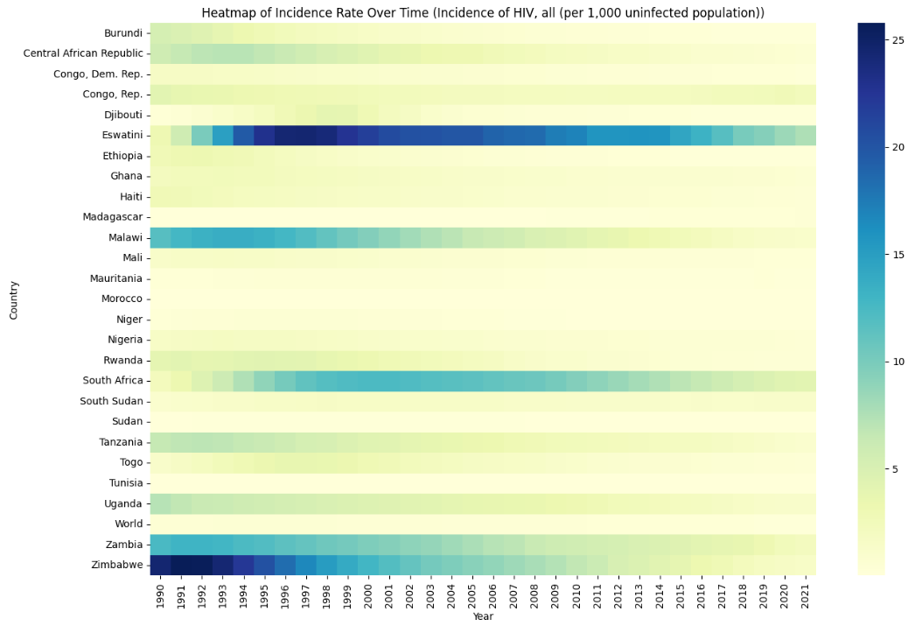
Prevalence rate of eswatini increases as time passes and incidence rate gradually reduced after 1997

Slide 4
