Slide 1

Itm vocational university
Build it for
ITMVU

Slide 2
project
“Ad+itm”
-By Tejashree Suryakant Mestry

Slide 3
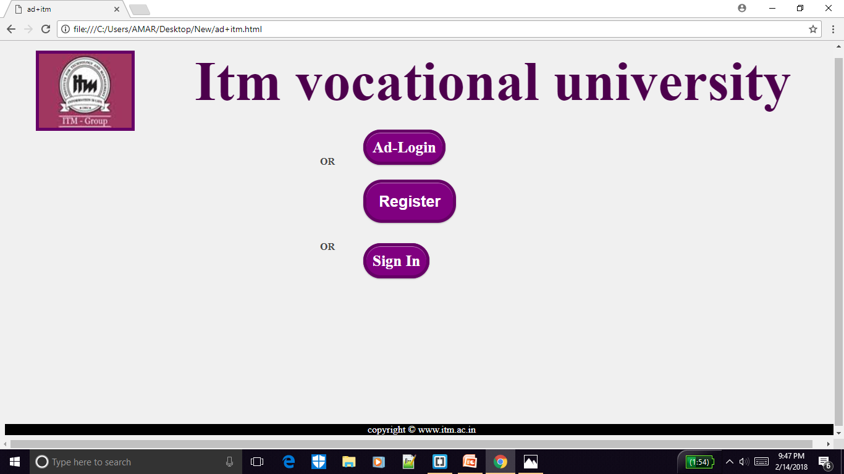
Connecting itm people with admin

Slide 4
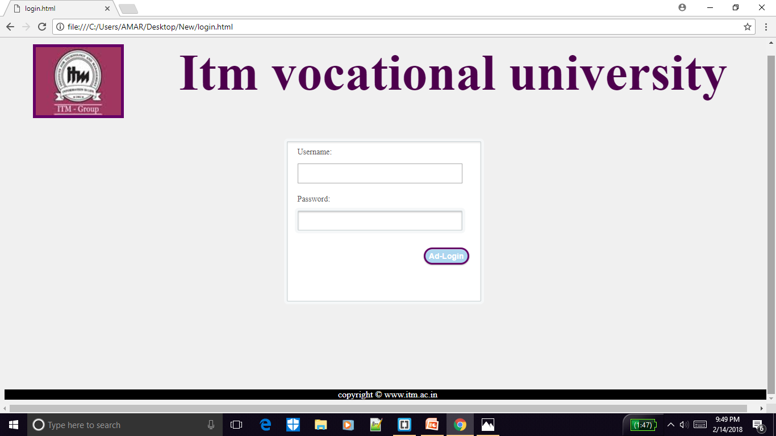
useful For admin to handle Only admin members can access it

Slide 5
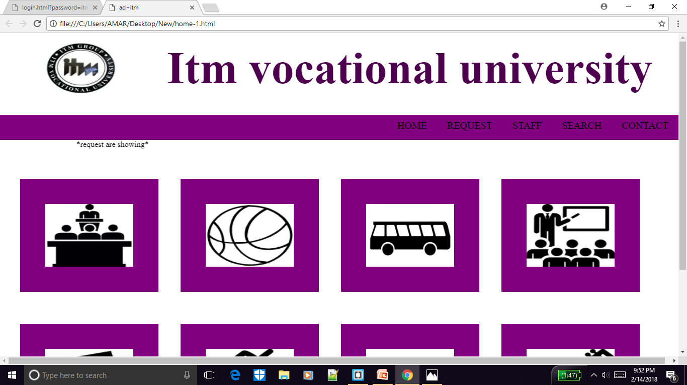
There are so many things that admin can handle

Slide 6
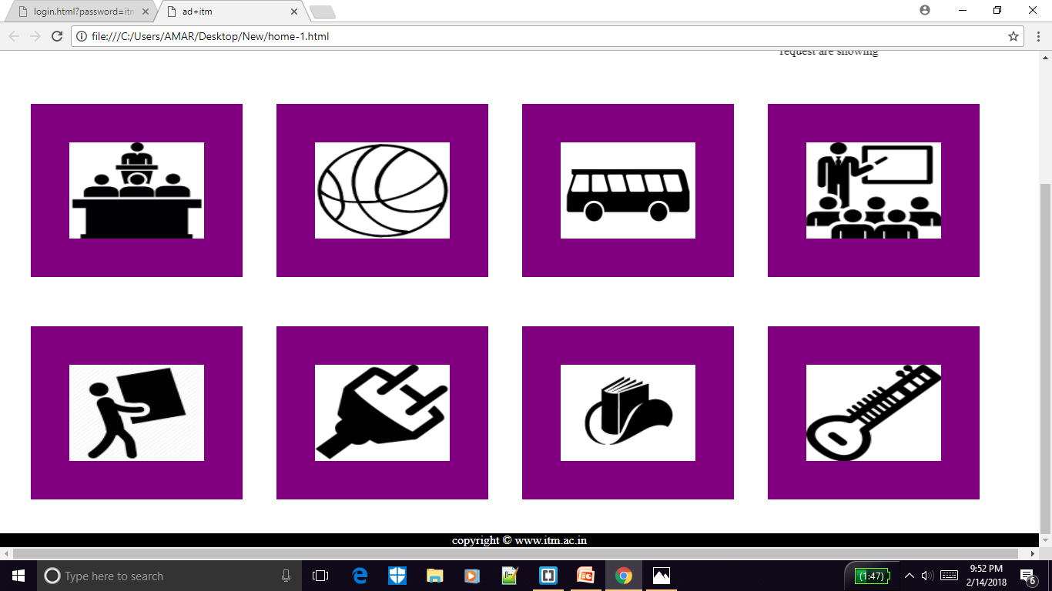
Seminar
Sports
Transport
Classroom
Labour
Electronics
Stationary
Music-instruments

Slide 7
just click on icon and manage the things at any time anywhere.

Slide 8
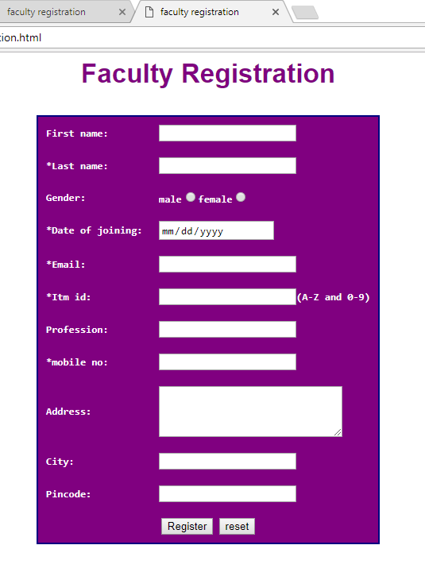
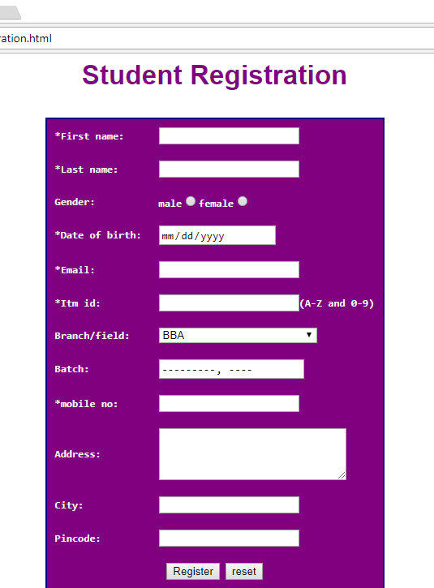
For itm people easy to access admin department
Just you have to register from itm_id

Slide 9
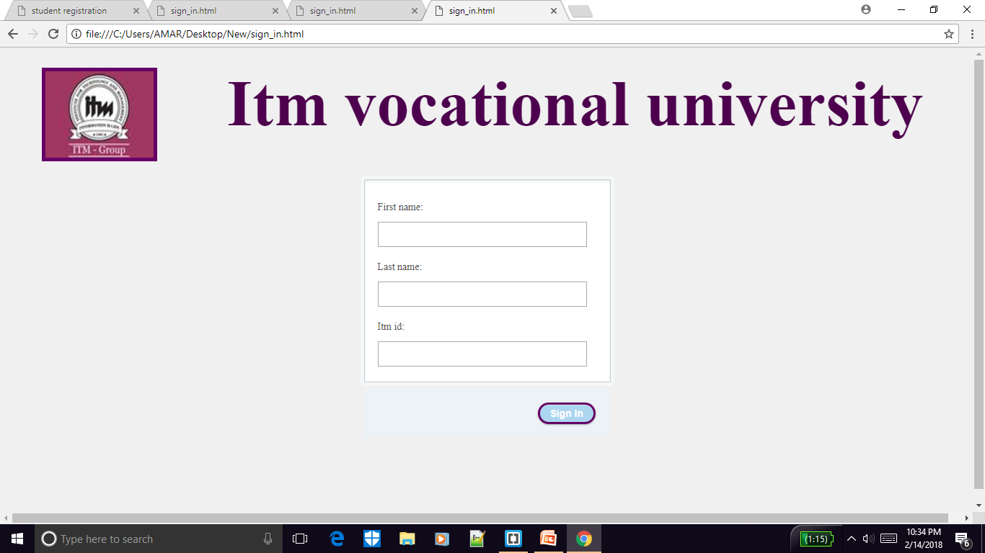
Then sign in for use!!!

Slide 10
COMMUNICATION WITH ADMIN IS BECOMING SIMPLE NOW ON ONE TOUCH

Slide 11
THANK YOU!!!

