Slide 1


CAPSTONE PROJECT
fake news detection using machine learning
Presented By
Student Name: tejaswini Digambar lende
College Name: yeshwantrao Chavan college of engineering,nagpur
Department: computer science and engineering
Email ID: tejaswinilende23@gmail.com

Slide 2
OUTLINE:
Problem Statement (Should not include solution)
Proposed System/Solution
System Development Approach (Technology Used)
Algorithm & Deployment
Result (Output Image)
Conclusion
Future Scope
References

Slide 3
problem StPatement:
In today’s digital world, a large amount of news is shared through the internet and social media platforms such as Facebook, Twitter (X), and WhatsApp. Many of these news articles are fake or misleading and spread quickly among people.Fake news can create confusion, spread false information, and negatively affect society. It is difficult for users to manually verify whether a news article is real or fake.Currently, there is no simple and fast method available for automatically identifying fake news.Therefore, there is a need to develop a system that can automatically detect fake news using machine learning techniques and help users identify trustworthy information

Slide 4
Proposed Solution:
The proposed system is a Fake News Detection System that uses Machine Learning to identify whether a news article is real or fake automatically.The system will analyze the news text and predict the result using a trained machine learning model. Steps of Proposed System
Data Collection
Collect fake and real news datasets from online sources.
The dataset contains news text and labels (Real or Fake).
Data Preprocessing
Remove unnecessary symbols and special characters.
Convert text into lowercase.Prepare the data for machine learning.
Feature Extraction
Convert news text into numerical form using TF-IDF method.
This helps the computer understand the text.
Model Training
Train a Machine Learning model such as Random Forest.
The model learns patterns of fake and real news.
Prediction
User enters news text.
System predicts whether the news is: Real News or Fake News

Slide 5
System Approach:
System Requirements
Hardware
Laptop / PC
4GB RAM minimum
Software
Python
Jupyter Notebook
Libraries Required
Pandas
Numpy
Sklearn
Matplotlib

Slide 6
Algorithm & Deployment:
Algorithm Used
Random Forest Algorithm
Random Forest is a machine learning algorithm used for classification.
It predicts whether news is:
✔ Real or Fake
Data Input
Input Features:
News Title
News Text
Output:Fake News Real News
Training Process
Load Dataset
Clean Data
Train Model
Test Model

Slide 7
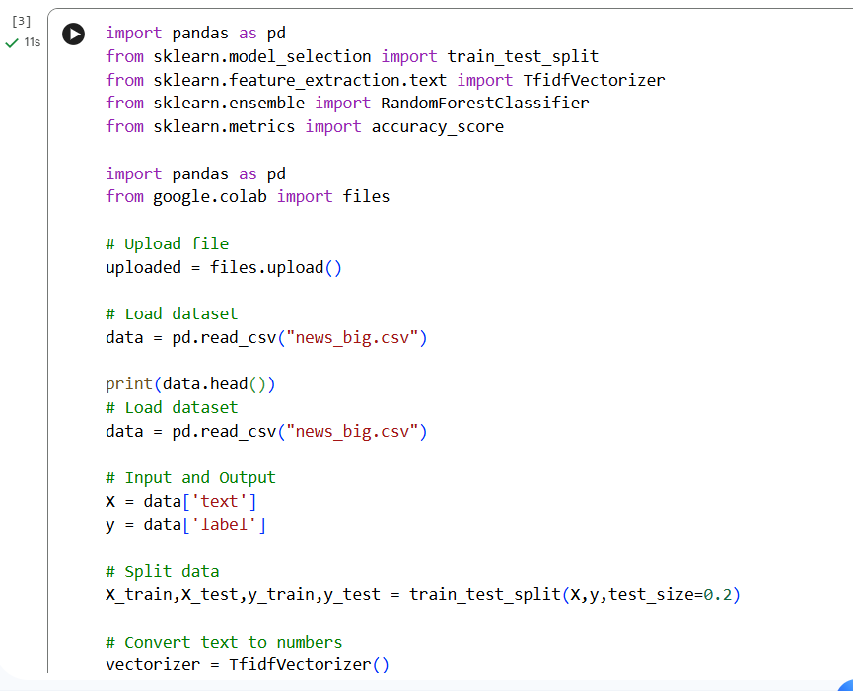
Result:

Slide 8
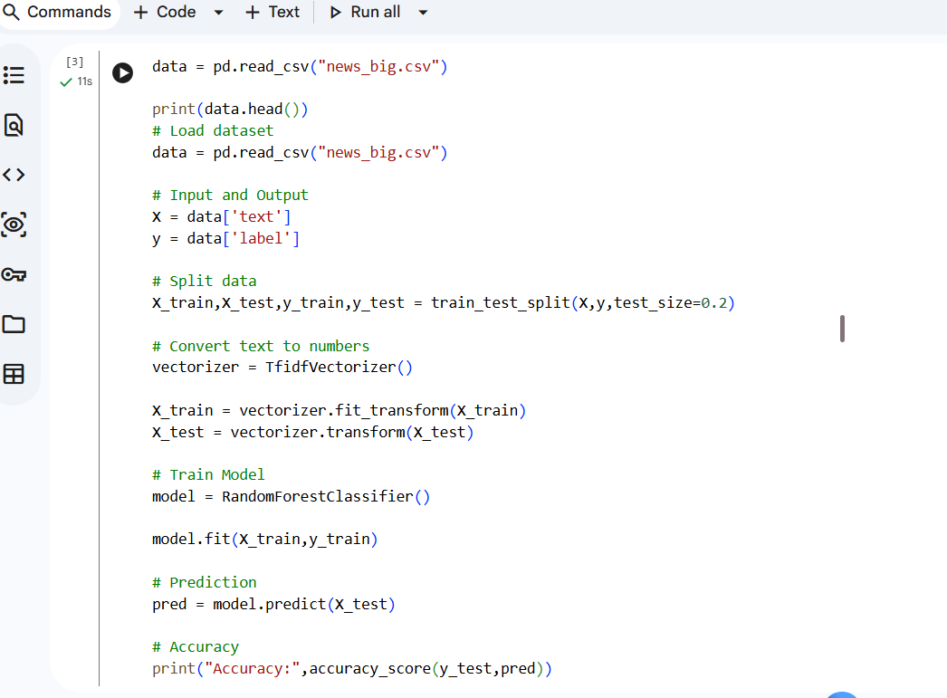
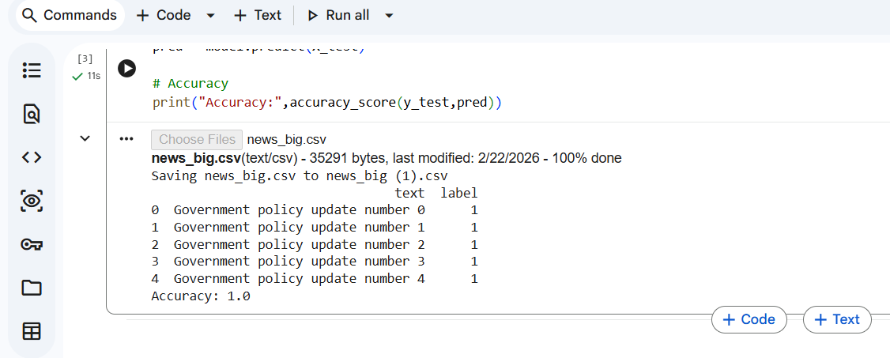

Slide 9
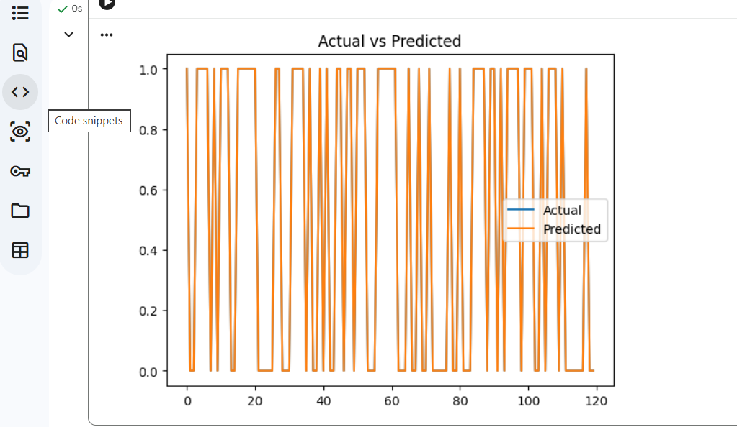
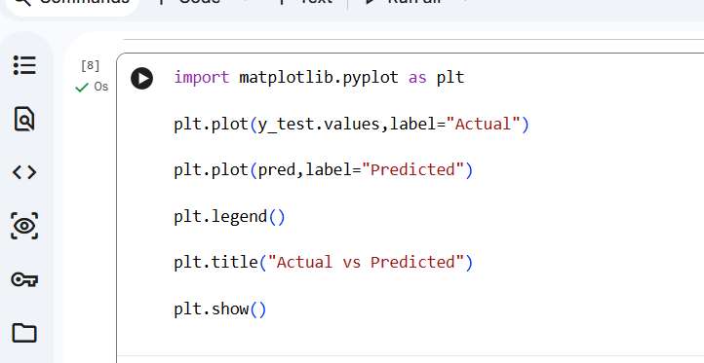

Slide 10
Conclusion:
The Fake News Detection system was successfully developed using Machine Learning techniques. The system can analyze news text and predict whether the news is real or fake.The project shows that machine learning algorithms such as Random Forest can help detect fake news with good accuracy. The system is simple, fast, and easy to use.This project helps users identify fake news and avoid spreading false information. It also saves time compared to manual checking.Overall, the Fake News Detection system is an effective solution for identifying reliable and trustworthy news.

Slide 11
Future scope:
The Fake News Detection system can be improved in the future by adding more features and advanced technologies.
Higher Accuracy
Improve the model by using larger datasets.Use advanced machine learning and deep learning methods.
2. Mobile Application
Develop a mobile app so users can check fake news easily.
3. Website Integration
Create a website where users can paste news and check results online.
4. Social Media Integration
The system can be connected to platforms like Facebook and WhatsApp to detect fake news automatically.
5. Real-Time Detection
The system can detect fake news instantly when news is uploaded.
6. Multiple Languages
Future systems can support multiple languages like English, Hindi, and Marathi.

Slide 12
References:
List and cite relevant sources, research papers, and articles that were instrumental in developing the proposed solution. This could include academic papers on bike demand prediction, machine learning algorithms, and best practices in data preprocessing and model evaluation.
GitHub Link: https://github.com/Teju290305/Fake-News-Detection

Slide 13
Thank You

