Slide 1

QUICK SORT,SHELL SORT, MAX PQ--BURGUNDY
Uma Maheshwari Kolluru
Tejaswi Kommareddy
Pranav Bhargav Reddy
Rohit Kumar Patwari
TaranPreet Singh
TejaVishnumolakala

Slide 2

Quick Sort
Quick Sort is a widely used sorting algorithm known for its efficiency.
It follows a divide-and-conquer approach, making it suitable for sorting large datasets.
The algorithm works by repeatedly partitioning the array and sorting the sub-arrays recursively.

Slide 3
Step 1: Pivot Selection
The first step in Quick Sort is choosing a pivot element from the array.
The pivot element is used to divide the array into two parts during partitioning.
The pivot can be selected randomly or by choosing the middle element.
The selection of a good pivot is crucial for efficient sorting.

Slide 4

Step 2: Partitioning and Sorting
Once the pivot is selected, the next step is to partition the array.
Elements are rearranged such that elements smaller than the pivot are on the left, and elements greater than the pivot are on the right.
After partitioning, the pivot is in its final sorted position.
The same process is then applied recursively to the left and right sub-arrays until all elements are sorted.

Slide 5
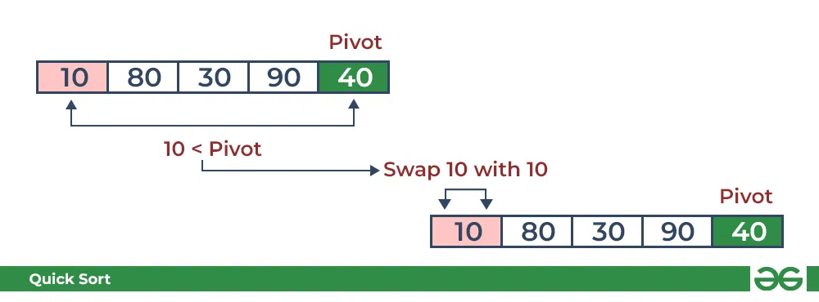
Consider arr[] = {10, 80, 30, 90, 40}. Compare 10 with the pivot and as it is less than the pivot arrange it accordingly.

Slide 6
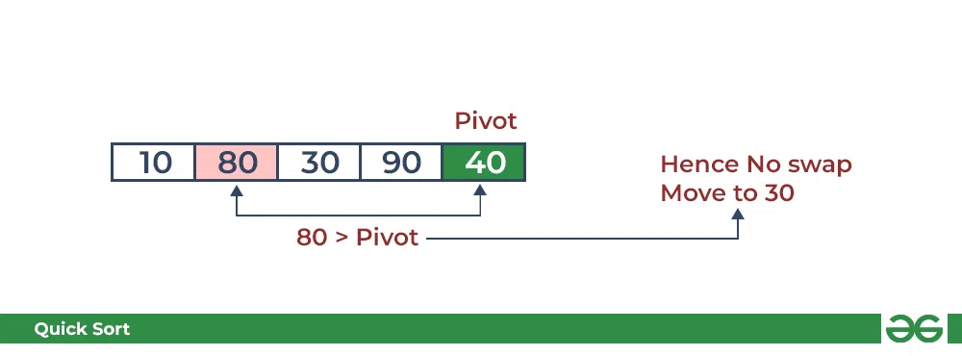
Compare 80 with the pivot. It is greater than the pivot.

Slide 7
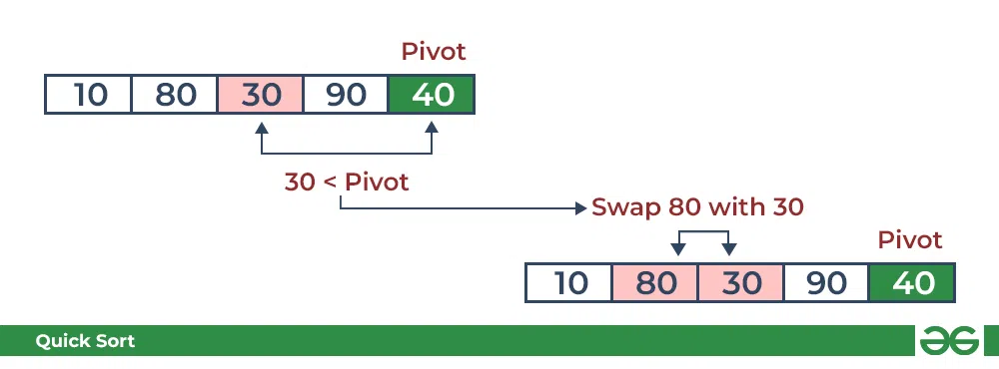
Compare 30 with pivot. It is less than pivot so arrange it accordingly.

Slide 8
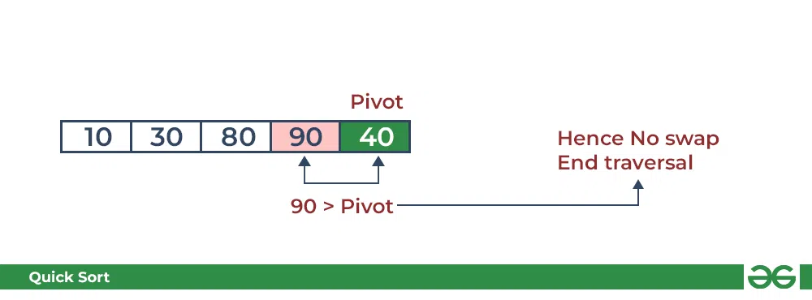
Compare 90 with the pivot. It is greater than the pivot.

Slide 9
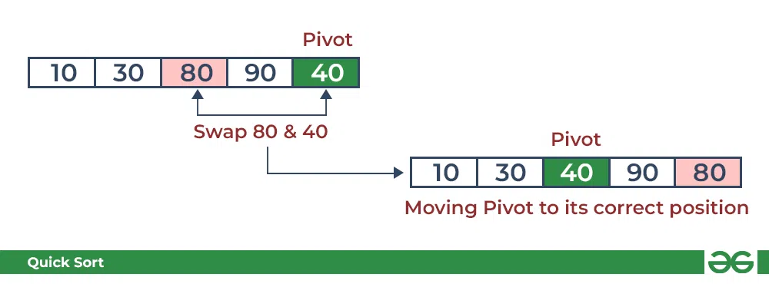
Arrange the pivot in its correct position

Slide 10
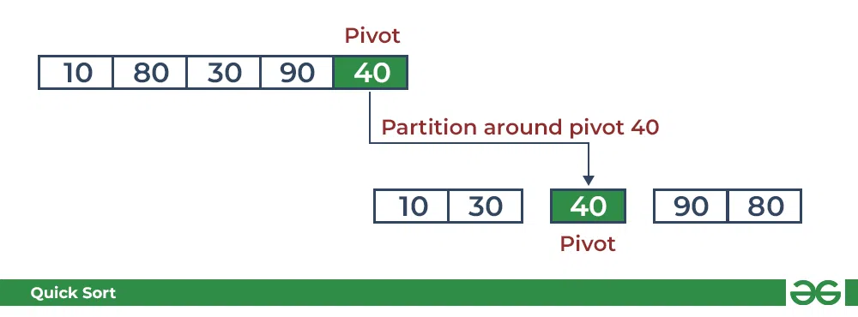
Initial partition on the main array:

Slide 11
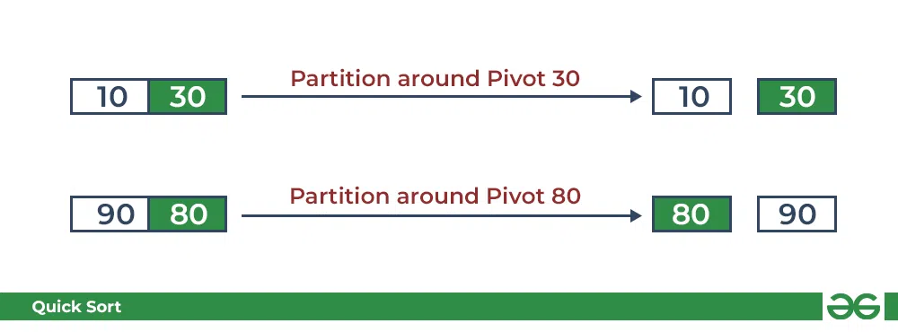
Partitioning of the subarrays:

Slide 12

Complexity Analysis
Quick Sort has an average time complexity of O(n log n) and is highly efficient for most cases.
Quick Sort has an average space complexity of O(log n) due to the recursive calls.
It is an in-place sorting algorithm, meaning it does not require much additional space.

Slide 13
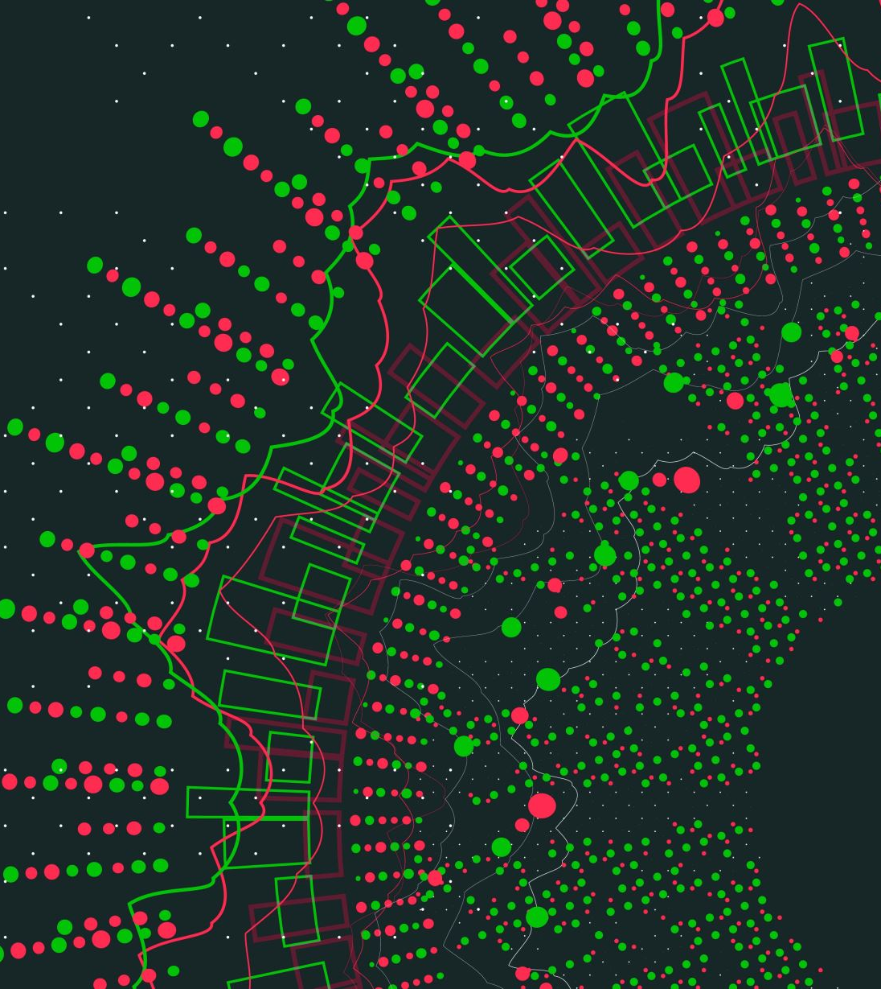
Introduction
It is a sorting algorithm that is an extended version of insertion sort.
Compare elements that are distinct apart rather than adjacent.
Spacing between the elements is known as Gap/Interval.
In every pass, Gap is reduced by 1 till we reach last pass when gap is 1.

Slide 14

Formula for Shell Sort
Gap= (N/2)
where N= numb.of elements in array

Slide 15
Advantages of Shell Sort
The advantages of the Shell Sort algorithm are:
It is efficient for large arrays or lists.
It is faster than Insertion Sort for larger lists.
It can quickly sort mostly sorted data.

Slide 16
Disadvantages of Shell Sort
The disadvantages of the Shell Sort algorithm are:
It can be difficult to determine the best gap sequence.
It has a worst-case time complexity of O(n^2).
It can be slower than other sorting algorithms for small lists.

Slide 17

Time Complexity
Best Case Complexity - It occurs when there is no sorting required, i.e., the array is already sorted. The best-case time complexity of Shell sort is O(n*logn).
Average Case Complexity - It occurs when the array elements are in jumbled order that is not properly ascending and not properly descending. The average case time complexity of Shell sort is O(n*logn).
Worst Case Complexity - It occurs when the array elements are required to be sorted in reverse order. That means suppose you have to sort the array elements in ascending order, but its elements are in descending order. The worst-case time complexity of Shell sort is O(n²).

Slide 18
unsorted array
Example
of
Shell sorting
12 | 19 | 20 | 31 | 15 | 41 | 30 | 38 | 24

Slide 19
a1 a2 a3 a4 a5 a6 a7 a8 a9
15 | 19 | 20 | 38 | 24 | 41 | 30 | 31 | 42
15 | 19 | 20 | 31 | 24 | 41 | 30 | 38 | 42

Slide 20
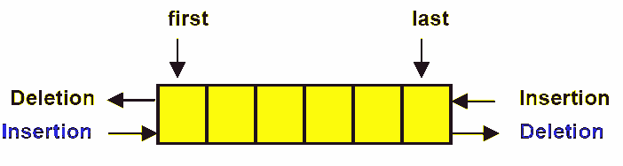
Maximum Priority Queue
A priority queue is a special type of queue in which each element is associated with a priority value.
Max Priority queue :
higher value has the highest priority
Primary Operations:
Insertion: Adding an element with its highest priority to the queue.
Deletion: Removing the element with the highest priority from the queue.
Peek/Top: Retrieve the element with the highest priority without removing it.
This Photo by Unknown author is licensed under CC BY-NC-ND.

Slide 21
Insertion
Let's assume we have the following max heap initially:
8
/ \
5 6
/ \ /
2 3 1
inserting the new element at the next available position in the heap, which is the leftmost position in the bottommost level:
8
/ \
5 6
/ \ / \
2 3 1 7

Slide 22
Insertion
Compare the inserted element (7) with its parent (6). Since 7 is greater than 6, we swap them to maintain the heap property:
8
/ \
5 7
/ \ / \
2 3 1 6
Now, we compare the inserted element (7) with its new parent (8). Since 7 is smaller than 8, we have successfully inserted the new element while maintaining the heap property.
8
/ \
5 7
/ \ / \
2 3 1 6

Slide 23
Deletion
9
/ \
7 6
/ \ / \
5 3 4 2
Start by removing the root element, which is the maximum element in the priority queue. In this case, the root element is 9.
2
/ \
7 6
/ \ /
5 3 4
Replace the root element with the rightmost element on the lowest level of the heap. In this case, the rightmost element is 2.

Slide 24
Deletion
Reorganize the heap by comparing the new root (2) with its children (7 and 6). Swap the root element with the larger child to maintain the heap property. In this case, 7 is the larger child, so we swap them.
7
/ \
2 6
/ \ /
5 3 4
Continue swapping the new root (7) with its larger child until the heap property is restored. In this case, no further swaps are needed, as the heap property is already satisfied.
7
/ \
5 6
/ \ /
2 3 4

Slide 25
Peek/Top
maximum priority queue (max heap) allows you to retrieve the element with the highest priority without removing it from the queue. Here's an example:
8
/ \
6 7
/ \ / \
2 5 3 4
Access the root element of the max heap, which is the element with the highest priority. In this case, the root element is 8.
Return the value of the root element.

Slide 26
Peek/Top
So, after performing the Peek-Max operation, the max heap remains as:
8
/ \
6 7
/ \ / \
2 5 3 4
Peek-Max operation allows you to peek at the element with the highest priority in the max heap without modifying the heap itself.

Slide 27

Thank You

