Slide 1
Optimization Machine Downtime

Slide 2
Contents
Problem Overview
Project Architecture
EDA
Data Visualization

Slide 3
Problem Overview
Business Problem – Unplanned Machine Downtime which is leading to the loss of productivity.
Business Objective – Minimize the unplanned machine downtime.
Business Constraint – Minimize cost.
Business Success Criteria – Reduce the unplanned downtime by at least 10%.

Slide 4
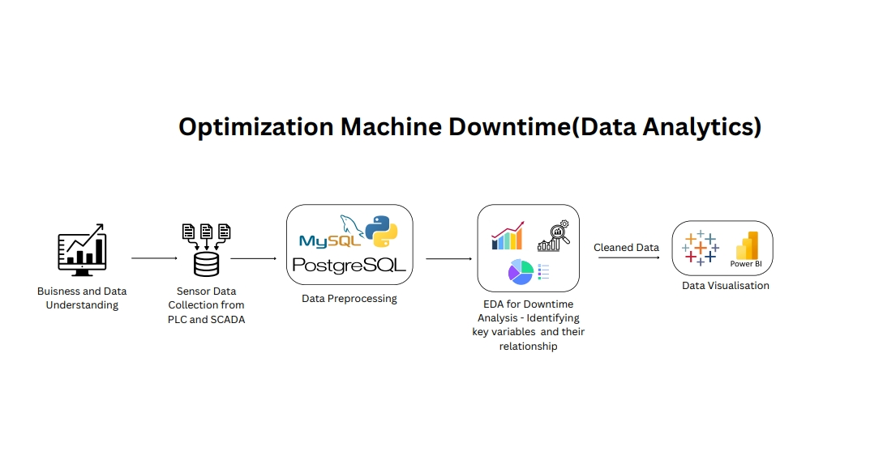
Project Architecture

Slide 5
Exploratory Data Analytics
Statistical Analysis:
Machine Failure is positively correlated to four sensor parameter – Coolant Pressure , Coolant Temperature, Spindle Speed, Cutting
Cutting Column data shows the highest corelation with the machine failure with the value of 0.45
Spindle Speed data shows the second highest corelation with the machine failure with the value of 0.3
Monthly Machine Failure were highest in March 2022.
These parameter are positively corelation among themselves (co-relation matrix).
Hydraulic Pressure data and Torque are Highly corelated with the no machine failure.

Slide 6
Exploratory Data Analytics
Business Insights:
From the box plot it can be conclude that 50% of the machine failure occurs when the cutting speed is between the values 2 and 3. So do not operate the machine with the cutting speed between 2 and 3.
From the box plot it can be concluded that 50% of the machine failure occurs when the spindle speed is between 16000 and the 22000. So do not operate the machine with the spindle speed between values 16000 and 22000.
From the box plot it can be concluded that 50% of the machine failure occurs when the coolant temperature is between values 10 to 22/22. So do not operate the machine with these values of coolant temperature.

Slide 7
Exploratory Data Analytics
From the box plot it can be conclude that 50% of the machine failure occurs when the coolant pressure is between 4 and 6. So do not operate the machine with these values of the coolant pressure.
From the box plot it can be conclude the 50% of the time machines doesn’t fail when the hydraulic pressure value is between 60 to 100. So operate the machine in this range.
From the box plot of the Torque it can be concluded that 50% of the time machine doesn’t fail when the torque value between 18 to 25. So operate the machine in this range.

Slide 8
Data Preprocessing
Correction of the date format.
Converting all the sensor column to floating point number with 2 decimal places.
Replaced the null values in the column with the mean of the column.

Slide 9
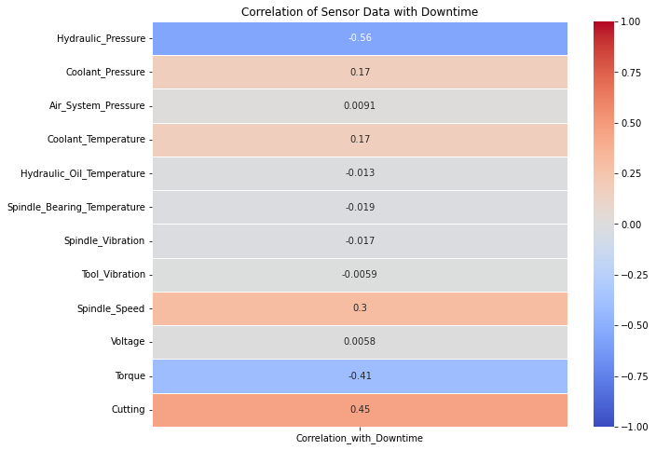
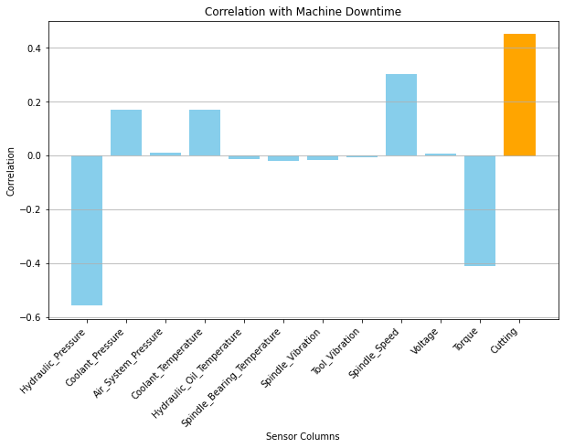
Data Visualization

Slide 10
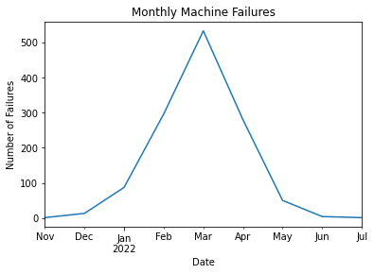
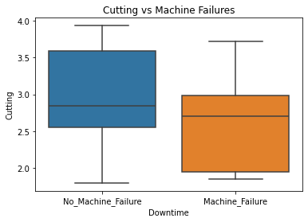
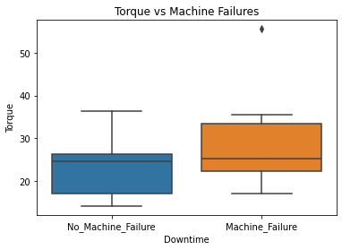

Slide 11
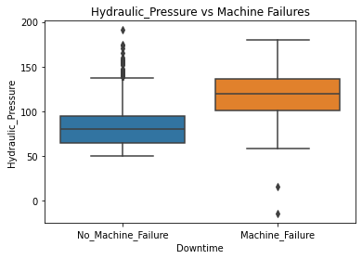
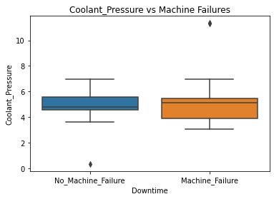
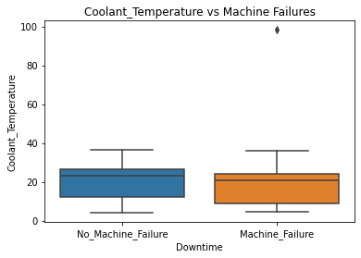
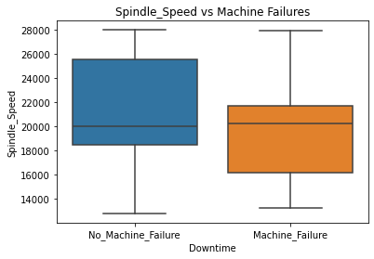

Slide 12
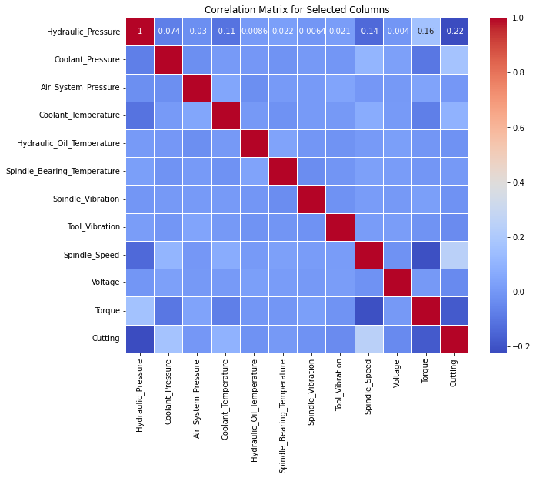

Slide 13
Thank you

