Slide 1
Aircraft Risk Assessment System
Tejus Bharadwaj
Department of Computer Science
University of Illinois at Chicago
Under The Guidance of:
Dr. Piotr Gymtrasiewicz

Slide 2
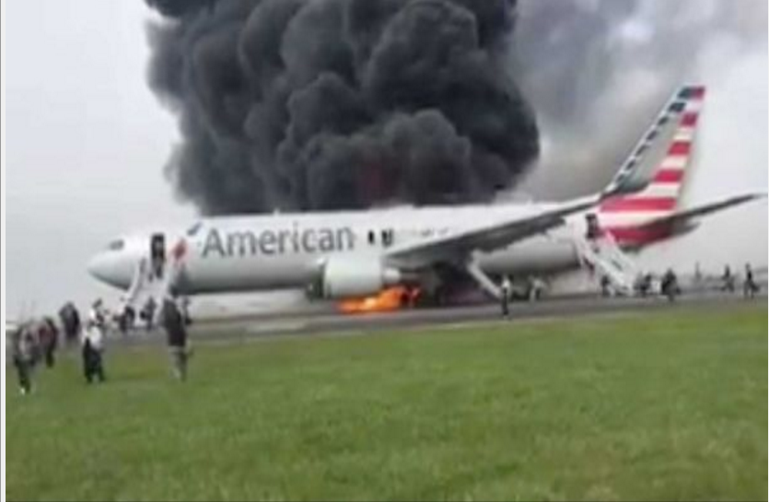
Notes:
O’Hare - 28 October 2016

Slide 3
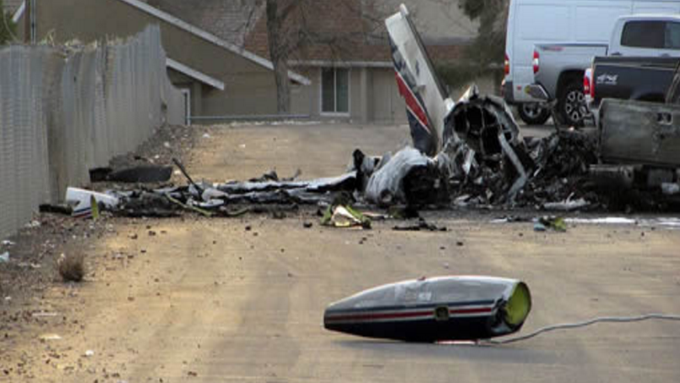
Notes:
Elko, Nevada -November 18, 2016

Slide 4
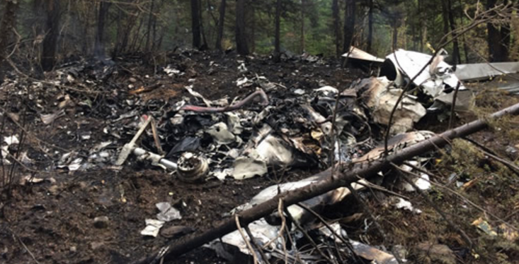
Notes:
Electrical ;
CANADA - October 13, 2016

Slide 5
Let’s Get into Economics !
Cost of Boing 737-800 - $72 Million
Operating - $ 5,308 per hour
Cost as Compensation - $7.5 Million
Airline Reputation
Loss of Life !

Slide 6
Aim of The Project
Help reduce the loss – Human and Economical
Create a “RISK ANALYSIS ASSESSMENT TOOL”
Anything Existing?
Ans : Yes !

Slide 7
Existing Tool
FAA (Federal Aviation Administration)
– Flight Risk Assessment Tool (FRAT)
A form to fill out → Calculate Score → Gives a Result
Drawback :
Filled out by the crew members before the flight
Takes only certain criteria such as the mental/ emotional status of the crew members on that day and the weather conditions
Manually entered
Not dynamic

Slide 8
Proposal
Develop Real – Time System
Dynamic – Monitor All The Time
Artificial Intelligence – Bayesian Network
Consider Several Criteria
Automatically take I/P from other Systems – Eliminate manual entry
Save lives and money

Slide 9
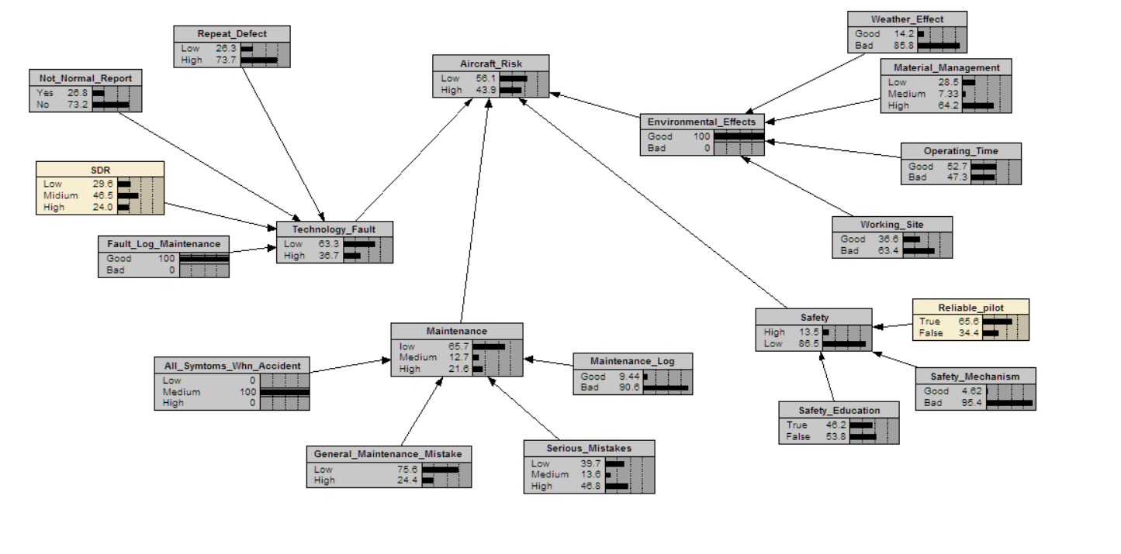
Network Prototype
Notes:
Reliable Piot – From the Other existing system –
Maybe JESS
SDR – Service Difficulty Report

Slide 10
Future Works
Implement the Individual systems
Increase the number of Relevant Attributes
Add security features

Slide 11
“Let’s Make Aircrafts Safer Than Our Homes.”
Thank you !

