Slide 1

Student Habits and Academic Performance - Exploratory Data Analysis
Prepared by: Project Team 01
Presentation Date: 29-06-2025

Slide 2
Contributors
Karthik Ramesh
Tejomay Swain
Yashwantha Gowda S
Mohammed Shehzan
Amit Jain

Slide 3
Introduction
The objective of this project is to perform a comprehensive Exploratory Data Analysis on a dataset of student habits vs academic performance. With 1,000+ synthetic student records and 15+ features including study hours, sleep patterns, social media usage, diet quality, mental health, and final exam scores.
The analysis follows a structured approach:
Data Cleaning and Pre-processing: Preparing the dataset by handling missing values, removing duplicates, and correcting data types
Exploratory Data Analysis (EDA): Conducting statistical analysis and creating visualizations to understand data distributions, identify relationships between variables, and detect patterns.
Insight Generation: Drawing meaningful conclusions from the analysis that could guide academic improvement strategies.

Slide 4
Dataset Description
- Dataset Name: student_habits_performance.csv
- Number of Rows: 1040
- Number of Columns: 19
- Key Features: Capturing students daily lifestyle habits such as study time, sleep, social media use, diet quality, mental health rating, and mapped against their final exam score.
Source:
https://www.kaggle.com/datasets/jayaantanaath/student-habits-vs-academic-performance

Slide 5
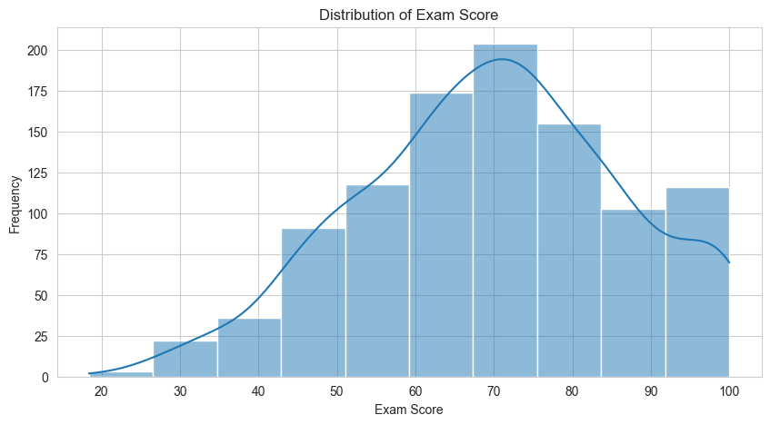
Insight Generation - Visualization(1/5)
Exam Score Distribution
The curve tending towards right defines that more students obtained the marks above 60.
We observed majority of students fall under the exam score in range
60 to 80.

Slide 6
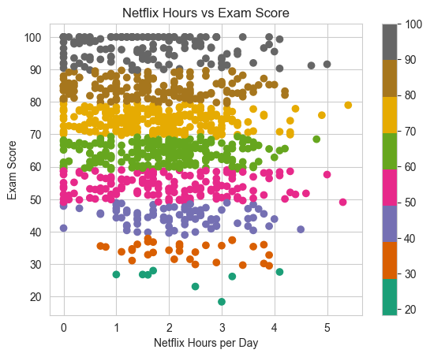
Insight Generation - Visualization(2/5)
Netflix vs. Exam score
We able to identify a negative correlation between Netflix hours and Exam score
Very fewer top scores beyond 3 hours of Netflix hours per day

Slide 7
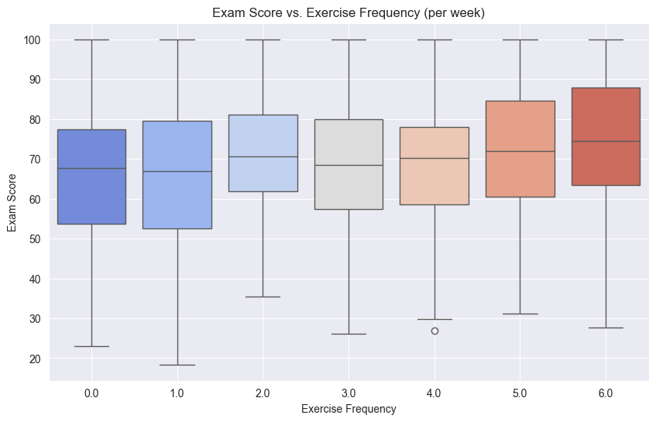
Insight Generation - Visualization(3/5)
Exam Score vs. Physical Exercise
Able to identify a positive impact on physical workout with exam score
Exercising 5-6 times a week gives a better score during exams

Slide 8
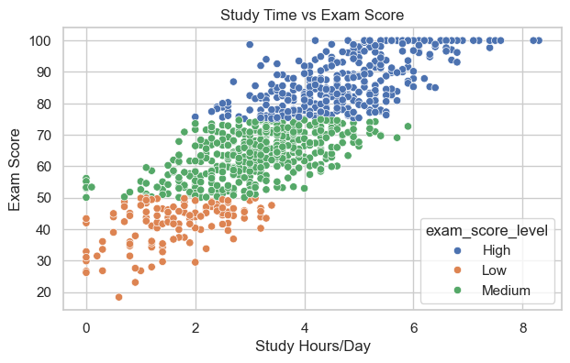
Insight Generation - Visualization(4/5)
Study time vs. Exam score
We observed that more the study hours there is better exam score
Also, this highly correlated fields

Slide 9
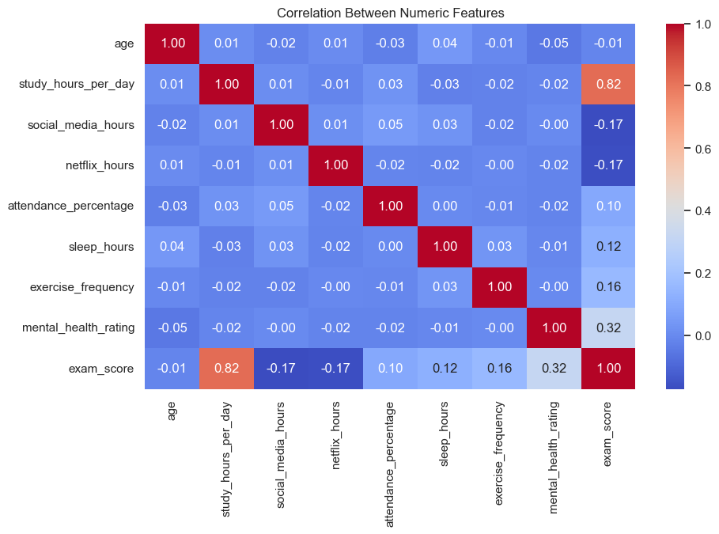
Insight Generation - Visualization(5/5)
Correlation Heatmap
Students who study more and maintain good mental health score higher.

Slide 10
Key Findings
Strong Positive Correlation: study_hours_per_day and attendance_percentage have a strong, positive correlation with exam_score.
Negative Impact of Screen Time: Hours spent on social_media and Netflix are negatively correlated with academic performance.
Influence of Parental Background: Students with parents holding higher education levels tend to achieve higher average exam scores.
Lifestyle Matters: A balanced lifestyle, including adequate sleep_hours and better diet_quality, shows a positive association with exam scores.

Slide 11
Conclusion
Impact of Study Habits
Effective study habits are crucial for improving academic performance and maximizing learning potential.
Positive Lifestyle Choices
Making positive lifestyle choices contributes to better focus, health, and overall academic success.
Mental Health
Healthy mental state allows for better concentration, memory, and problem-solving skills, all vital for academic work.

Slide 12



Potential Next Steps
- Implement predictive modeling to forecast student performance
- Expand analysis by incorporating external factors (e.g., socio-economic background)
- Improve data collection for better insights

