Slide 1
Patchwork Novels
By
Samuel Uganiza

Slide 2
Summary
“A website to create stories the fun way!”
An idea heavily inspired by a game called “One Word at a Time”
Users can submit short sentences or paragraphs called “snippets” to a grand collection.
These snippets are then used to create stories that others can read.
Users may then browse the website to find and critique these stories and snippets by commenting or liking them.
They may also add them to their favorites list.

Slide 3
Software Development Life Cycle

Slide 4
SDLC Overview
Process designed to allow developers to deliver high quality software by careful planning and test-driven development.
1. business analysis/requirement gathering (user stories)
2. design (ERD, UML diagrams, wireframes)
3. development
4. testing (JUnit)
5. deployment
6. maintenance

Slide 5
User Stories

Slide 6
User Stories
As a first time visitor to this website, I want to be able to sign up from the home page, so that I can create my own posts
As a user, I want to see the most popular entries from the home page, so that I can see if I'm interested in this website
As a user, I would also like to see the most recently posted stories, so that I am not limited to popular stories
As a user, I want to be able to see all the snippets, so that I can have an idea of what to make
As a user, I want to see all the stories made, so that I can choose to add to or read them
As a user, I want the snippet or story to be the focus of the page, so that I can immerse myself in the content
As a user, I would like to be able to read the story as a contiguous selection, so that I may be able to experience it as a whole piece

Slide 7
User Stories (cont.)
As a user, I want to be able to add comments to the snippet or story, so that I am able to share my opinions
As a user, I want to be able to create stories using pre-made snippets, so that I can compile my own creation and publish it
As a user, I want to be able to submit snippets to the database, so that I can contribute an idea to the pool
As a user, I want to be able to see all the snippets I have created, so that I can have ease of access and management
As a user, I want to be able to see all my posted stories, so that I can have ease of access of their management
As a user, I want to be able to freely delete any snippets or stories I have created, so that I can control what kind of content I post
As a user, I would like to be able to delete my account, so that I can control my own privacy
As a user, I want to be able to input a username and a secure password, so that I may return to this website with the same credentials in the future

Slide 8
Diagrams

Slide 9
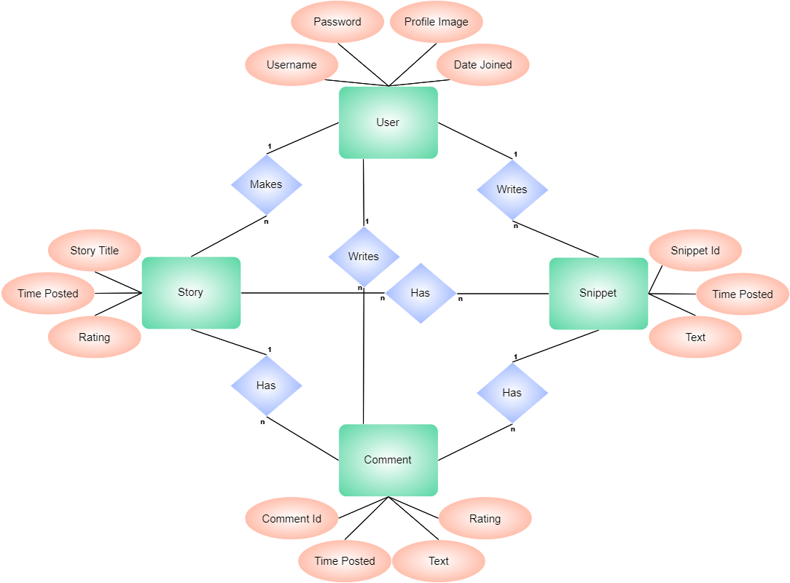
Entity Relationship Diagram

Slide 10
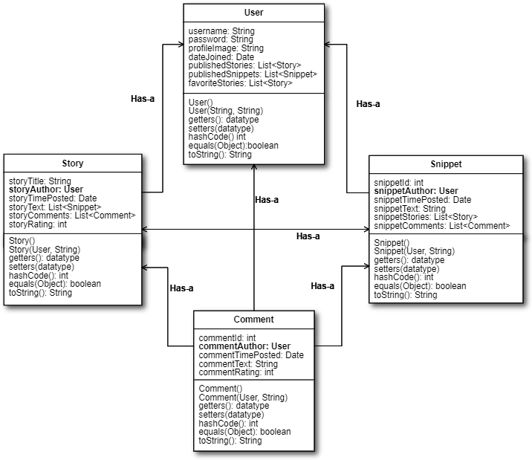
Java Class UML Diagram

Slide 11
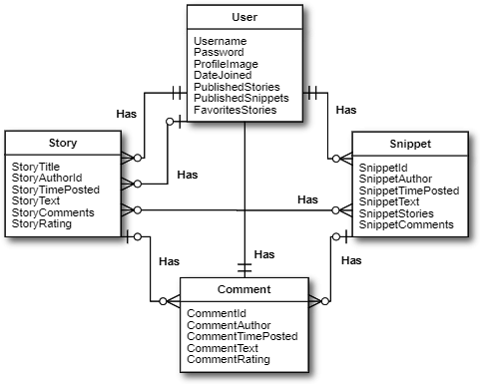
Relationship Diagram of Database

Slide 12
Wireframes

Slide 13
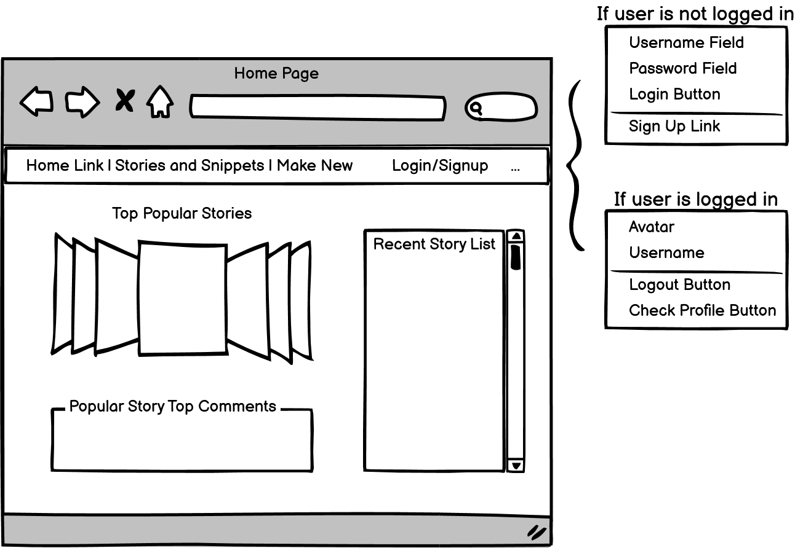
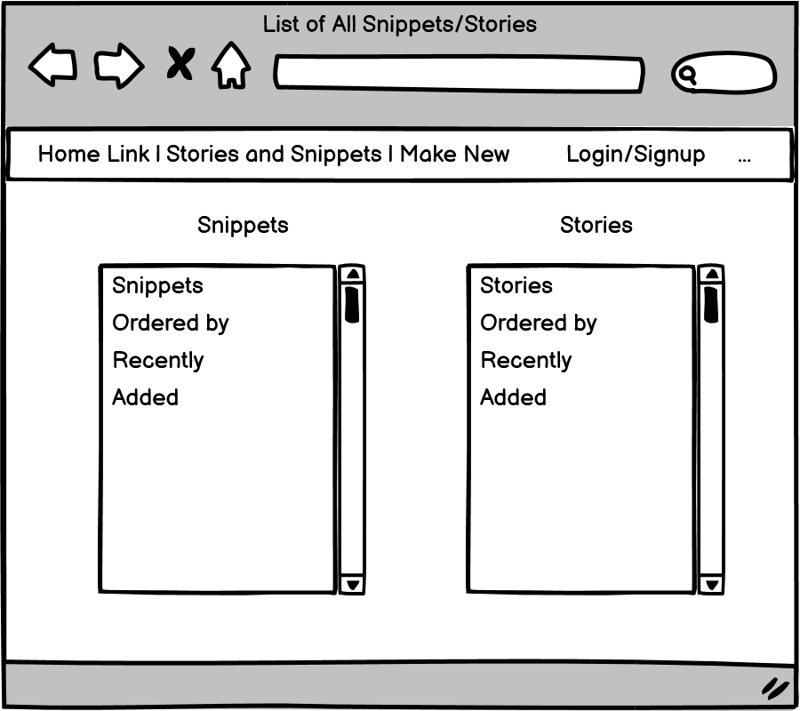
Wireframes

Slide 14
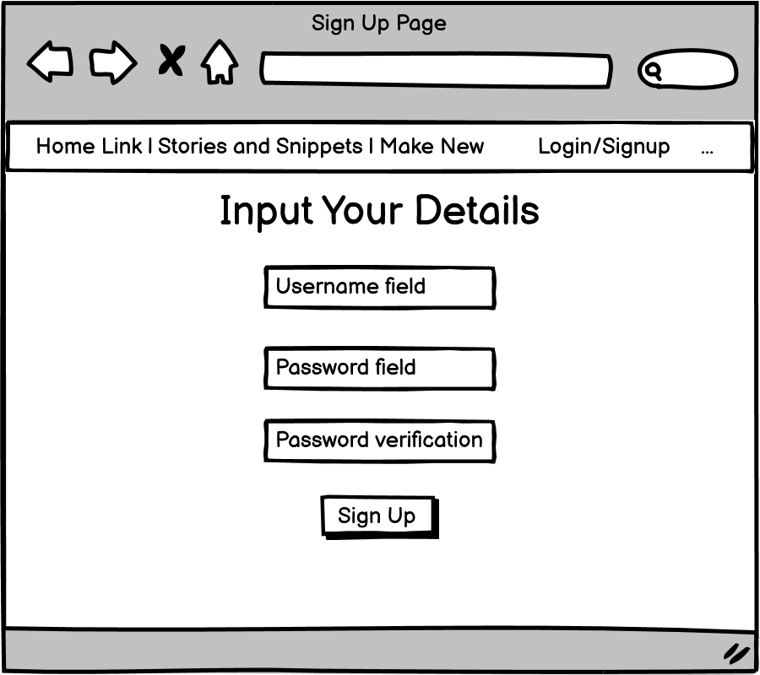
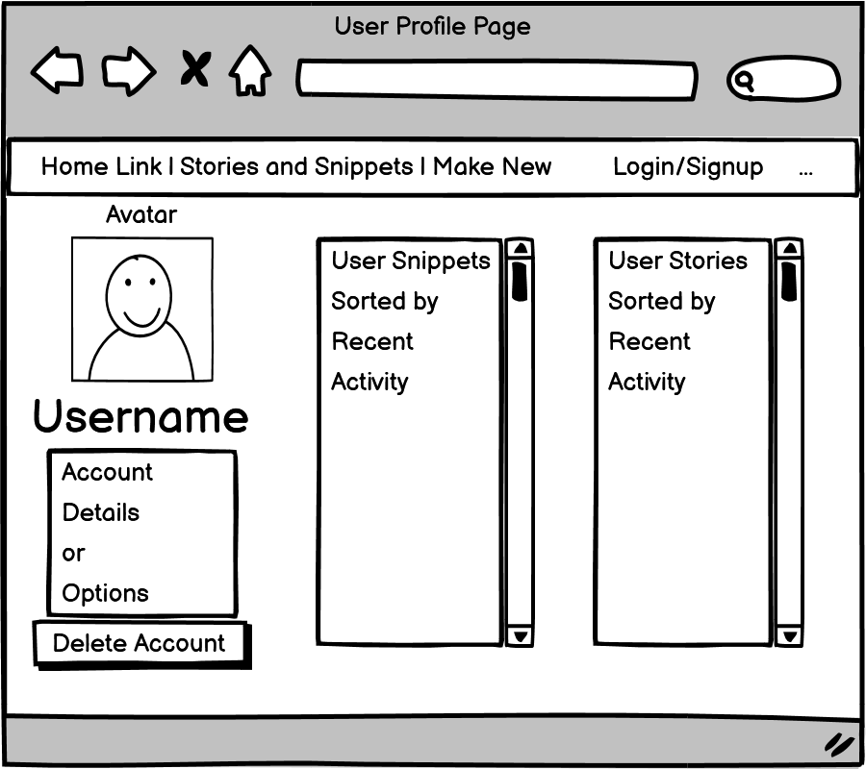
Wireframes (cont.)

Slide 15
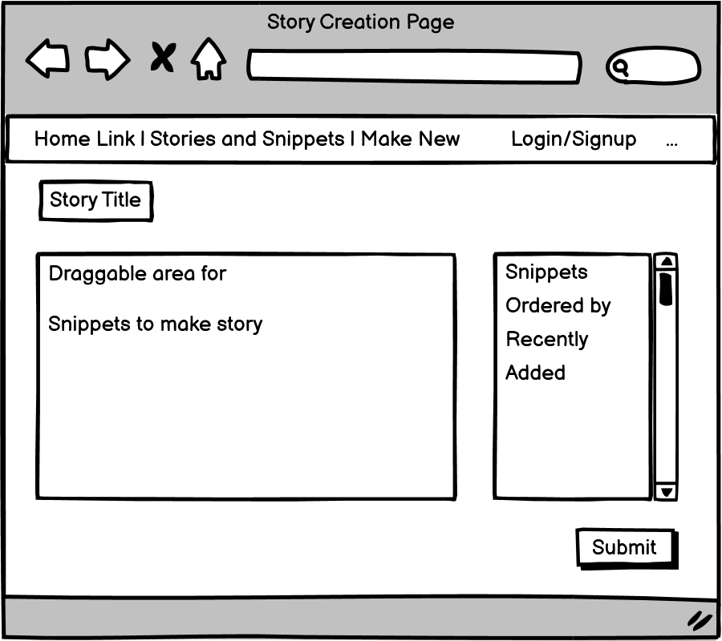
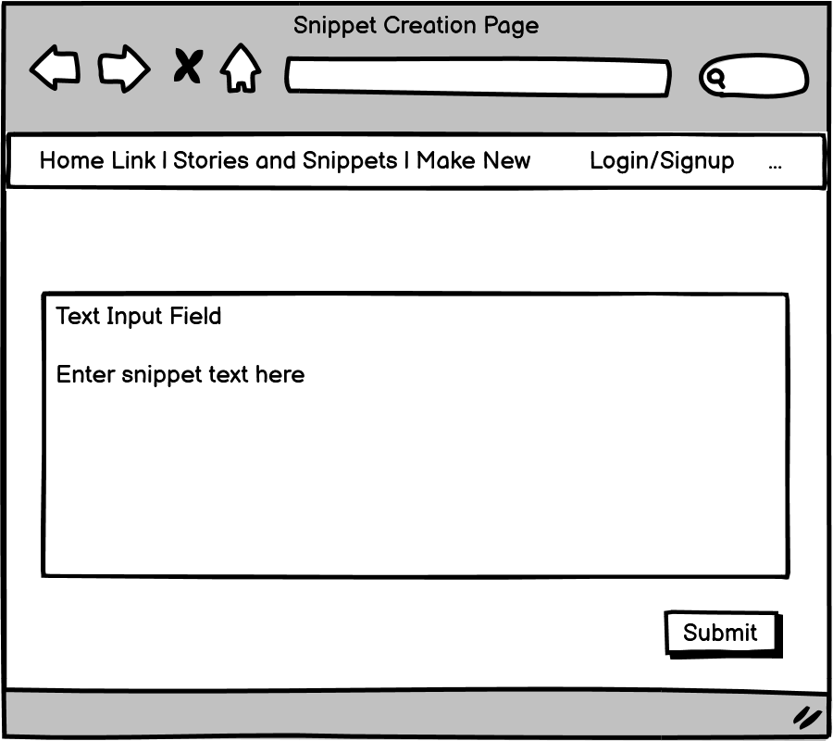
Wireframes (cont.)

Slide 16
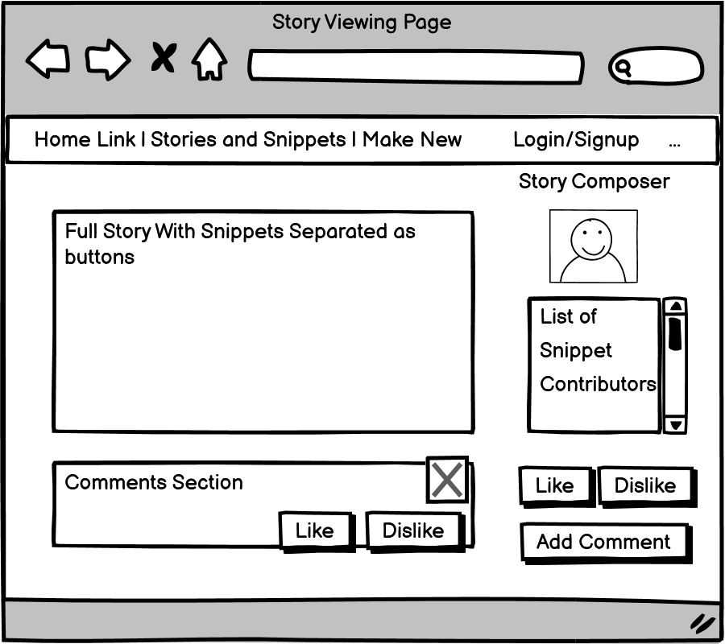
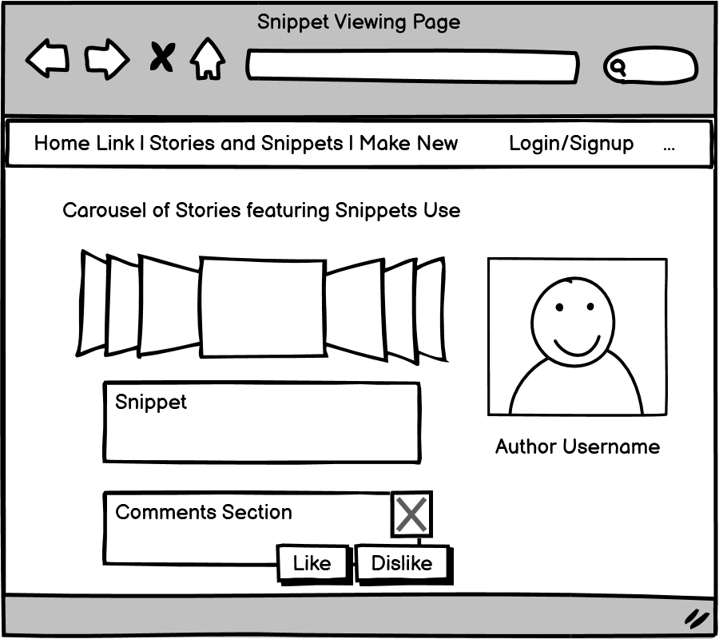
Wireframes (cont.)

Slide 17
Development

Slide 18
Development Overview
Developed with MVC framework:
Model – a Java representation of a real world object, AKA “entities”
View – the webpage in which a website user will interact with
Controller – the “wiring” that routes the pages to specific Java handlers

Slide 19
Development Overview (cont.)
To allow the controllers to interact with the database, a repository and a service can be used:
Repository – Java-side connector to the actual database
Service – a formal means of connecting the controllers to the database

Slide 20
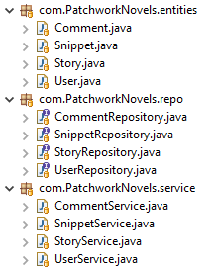
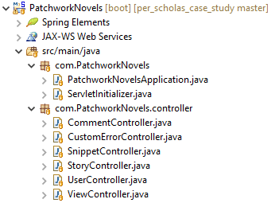
Project Structure
Models, Repositories, Services
Runner and Controllers

Slide 21
Testing

Slide 22
Testing
Allows developers to make sure all parts of coding are working as intended
Consistent testing enables development to go smoothly and as error-free as possible
Done concurrently with the development process to ensure that each part being developed works correctly

Slide 23
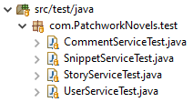
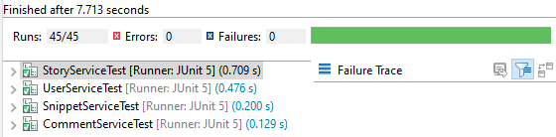
Testing (cont.)
Test Classes for JUnit

Slide 24
Tech Demo

Slide 25
Tech Stack

Slide 26


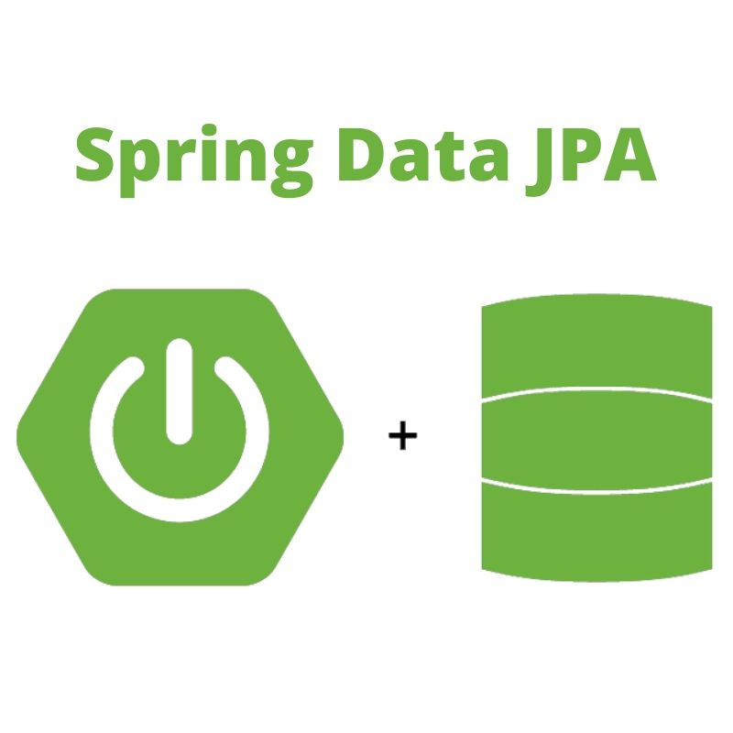
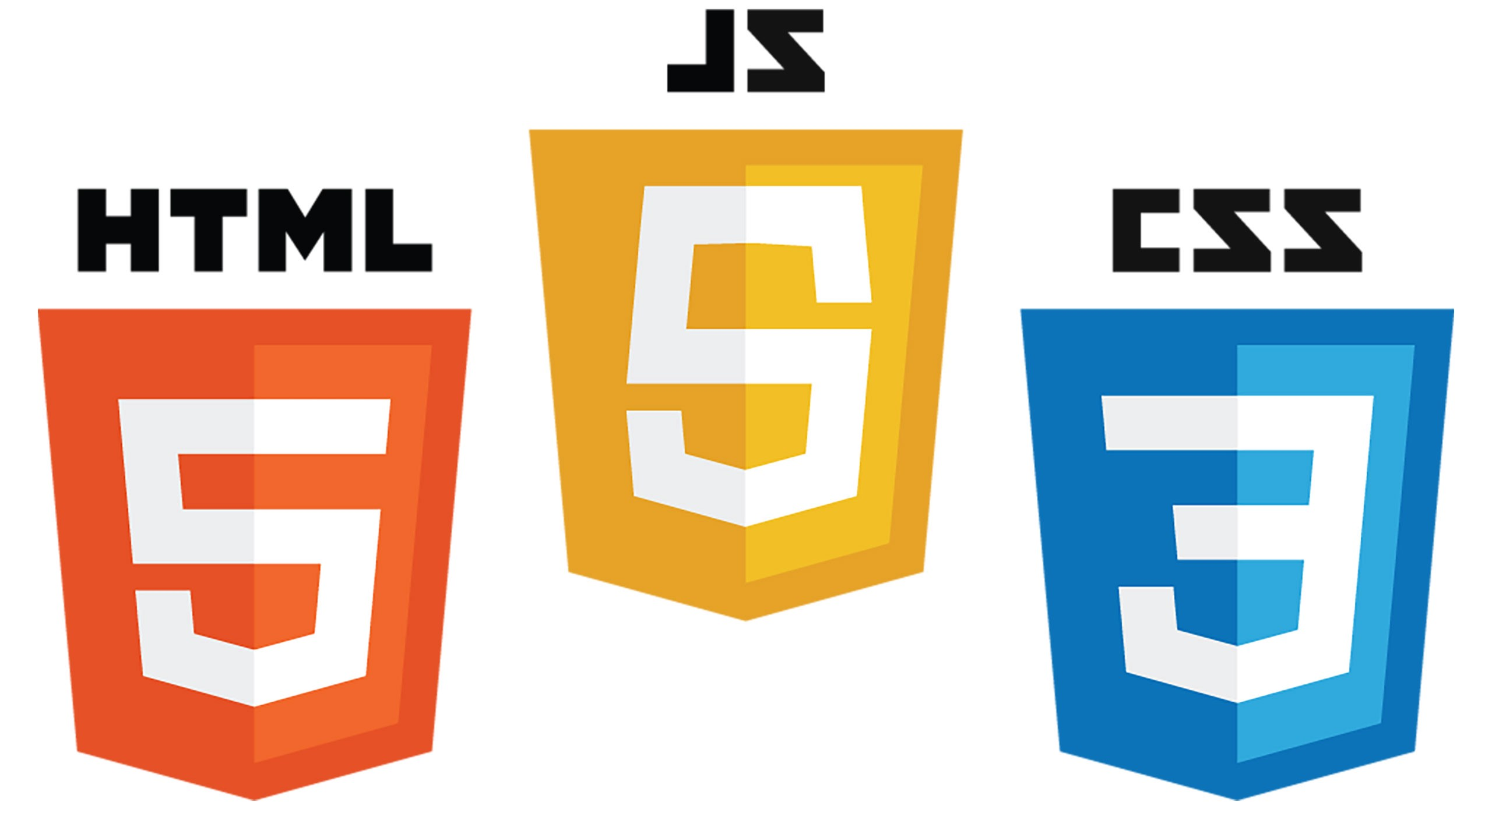






The Tech Stack
Front-End
Back-End

Slide 27
Thank You

