Slide 1
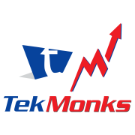
XBIN HTTPS://XBIN.APP
ENTERPRISE CONTENT PLATFORM: SHARING AND MANAGEMENT

Slide 2
CONTENTS
About TekMonks
The Enterprise Content Platform problem
Solution: XBin
XBin Explained
Benefits
Use Cases
Conclusion

Slide 3

ABOUT TEKMONKS
A full service, fast growing, and highly skilled technology firm.
US founded and headquartered in Washington DC
Work with largest Fortune 500 companies worldwide
Zero debt company with a de-risked operating model, maintaining two years of operating cash reserves.
98% rate of repeat business, history of success and satisfied clients.
ISO 9001:2015 QMS certified
Strong partnerships with AWS, Azure, Microsoft, IBM etc.
Vision Statement
To be a reputable Global
Corporation providing
quality solutions for
business issues using
technology and
highly skilled people.

Slide 4
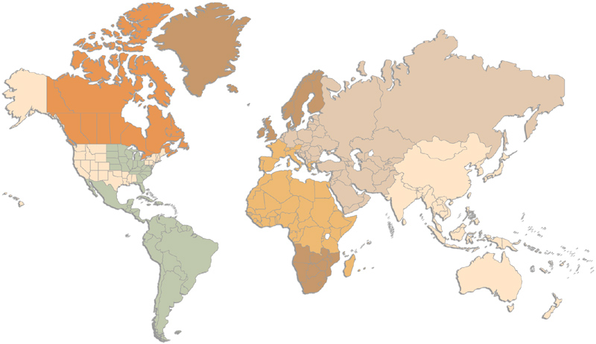
TekMonks Operates from 7 Countries, 8 Major Cities
Europe – U.K - LONDON
1 Development Center
1 Office
CANADA - TORONTO
1 Development Center
1 Office
INDIA – NEW DELHI, BANGALORE
3 Development Centers
2 Offices
JAPAN - TOKYO
1 Development Center
1 Office
Thailand – Bangkok
1 Development Center
1 Office
USA – Chicago, DC, San Francisco
1 Development Center
3 Offices
AUSTRALIA – Sydney Opening (3Q 2020)
1 Development Center
1 Office
SINGAPORE
1 Development Center
1 Office

Slide 5
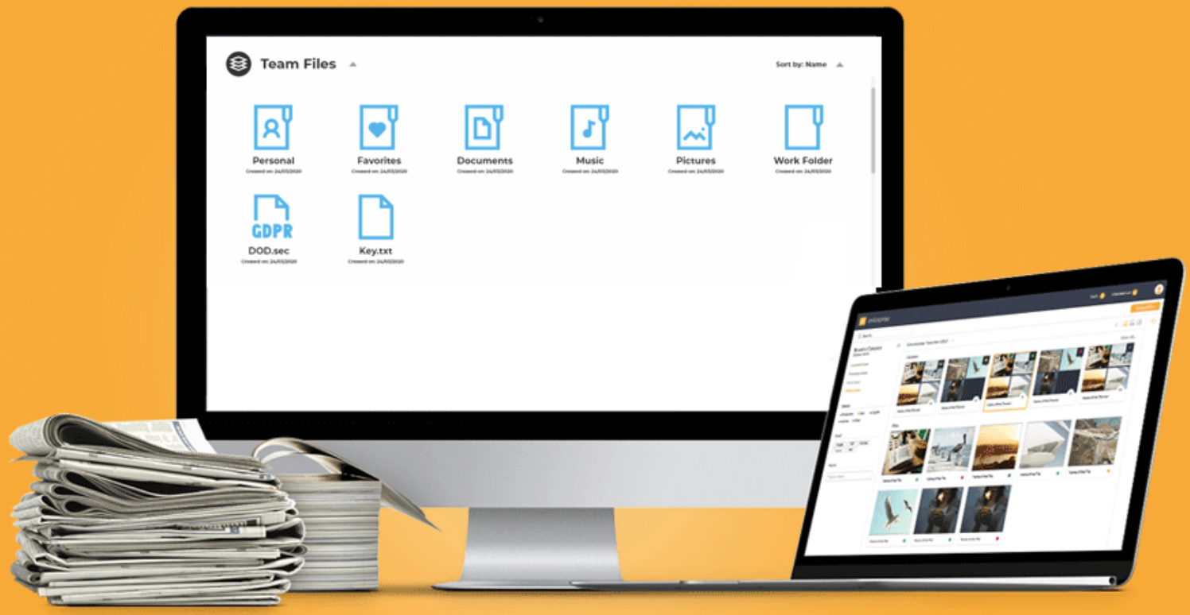
ENTERPRISE CONTENT PLATFORM
The Modern Enterprise Content Problem
The modern enterprise is online, shared across geos, clouds, and hyper-connected. Content is everywhere.
Modern Enterprise is mobile, spread across clouds, accessible from anywhere.
Modern Enterprise is also hyper-connected, and social. With business partners, associates, contractors, employees, spread across the globe and creating and sharing content.
Content is spread – NAS drivers, shared folders, online file storage services like Dropbox, Google drive, WebDAV, SharePoint etc.
It is impossible to have a single view of content, with Enterprise controls, data leakage prevention
Compliance with standards like HIPAA, GDPR is impossible with a proper Enterprise Content Platform
The future of digital content and big data requires proper Enterprise Content platform to manage content

Slide 6
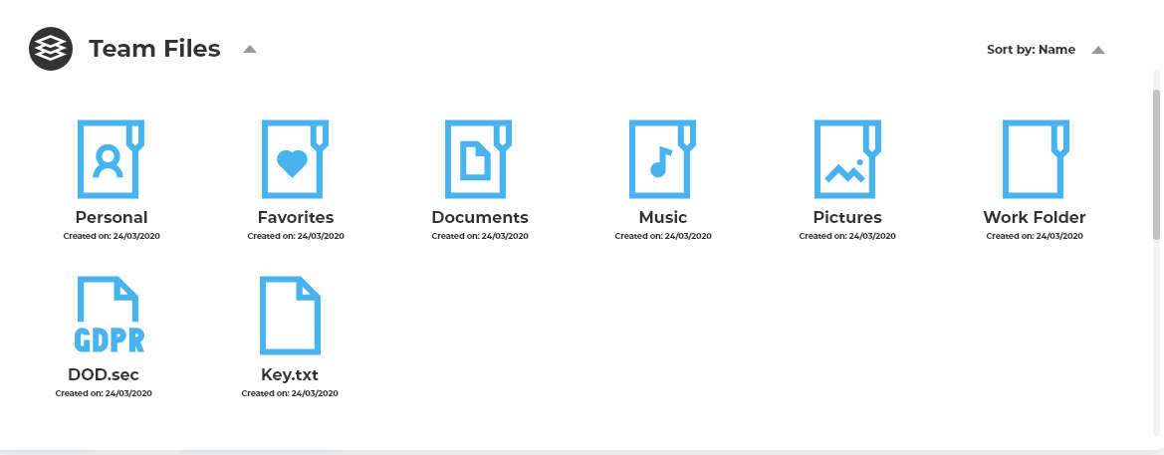
WHY XBIN?
Enterprises have lost control of their content – dropbox links, various drives, shared files over chats, emails, data residing on partner’s systems.
The modern hyper-connected Enterprise can no longer track, much less control their content.
Audits and standards like PCI, HIPAA, GDPR require the Enterprise data to be secured, and encrypted, and yet be available instantly to the employees and applications.
Enterprises need a solution to
Unify all data sources
Allow sharing of data between employees, partners, and collaborators – across devices, including social platforms
Yet, apply Enterprise controls, and cloud level controls over the data

Slide 7

THE SOLUTION XBIN.APP
XBin is the only EC platform built ground-up to meet these requirements.
It includes “OneView” feature which combines data across applications, cloud and on-prem into a single, unified controlled storage solution, and…
Applies the same access controls no matter where the data resides or is downloaded to
Allows modern cloud-based access sharing across devices, people, and geos.

Slide 8

THE SOLUTION MESSAGE DRIVEN API SERVICE BUS
XBin Can …
Unify all data sources
Windows and Mac Desktops continuous file sync
SMB, WebDav, NFS, SFTP support for legacy applications, and Windows servers.
Integrate Dropbox, Box.com, Gdrive, OneDrive, and SharePoint
Transparent integration with Amazon S3 and Azure Storage for terabytes of data storage and objects.
Integration with NAS and SAN for internal storage.
Rsync based file synchronization for gigabytes of file sync in seconds.
Data controls, including data expiry policies for securely sharing files and data with remote employees and business partners.

Slide 9
THE SOLUTION MESSAGE DRIVEN API SERVICE BUS
XBin Has …
Full compliance with PCI, HIPAA, GDPR and many other government regulations with AES-256 encryption
Widest support across platforms – Windows, Mac, iPhone, iPad, Android, Linux and Chrome OS.
Define rich access control policies - Team level access, Departmental access, User level access, Sharing policies
Cloud level access controls not possible with other platforms
Who can upload?
Who can download?
Who can rename, edit, modify?
Who can view only?

Slide 10


Provide remote access, and …
Solve the last mile DLP problem

Slide 11

ASB BENEFITS
Flexibility Flexibility to share data across platforms, devices and partners
Security Unify Enterprise Content retention, encryption and sharing policies, no matter where the content resides.
OneView Unify the view of the content, into a single view, by integrating content storage platforms into a modern, cloud enabled, content sharing platform.
Very High Scalability Streaming I/O support and Rsync allow for data scalability, even if the network itself is slow.
Synchronization Content is always up to date and synchronized across platforms and devices.
DLP Apply Data Loss Prevention, encryption and virus definition policies no matter where the content resides, or where it is shared or downloaded to.

Slide 12
NEXT STEPS
Ask us for a no obligation POC.
Don’t build from scratch, let us help you…
Email: sales@tekmonks.com

Slide 13
THANK YOU
‹#›

