Slide 1


XBIN
USE CASE

Slide 2
Malaysia Takaful Company Limited referred to as Syarikat Takaful or Takaful Malaysia is a Malaysian takaful company. Recently restructured to Syarikat Takaful Malaysia Keluarga Berhad (STMKB) which will continue to operate the Family Takaful business. A new company by the name of Syarikat Takaful Malaysia Am Berhad (STMAB), a wholly-owned subsidiary of STMKB on the other will be handling the General Takaful businesses.

Slide 3
A co-operative system of reimbursement or repayment in case of loss, organized as an Islamic or religious law compliant alternative to conventional insurance. Under Takaful, people and companies concerned about hazards make regular contributions (“donations”) to be reimbursed or repaid to members in the event of loss and managed on their behalf by a Takaful Operator.
Is an Arabic word sometimes translated as “solidarity” or mutual guarantee

Slide 4
Challenges
The recent restructuring brought about a concern on content and digital asset management.
Content and digital assets are mobile and spread across clouds that is accessible from anywhere.
Also spread in NAS drives, shared folder, online files storage devices (Dropbox, Google Drive, WebDAV, SharePoint).
Hyper- Connected and Social with major shareholder BIMB Holdings Berhad (BHB) and subsidiary Syarikat Takaful Malaysia Am Berhad (STMAB)

Slide 5
Requirements
Enterprise Content platform for their digital content and big data for proper management.
An efficient, single view of content with Enterprise controls and data leakage prevention.
Solution complaint with audits and standards:
- Payment Card Industry
- Health Insurance Portability and Accountability Act

Slide 6
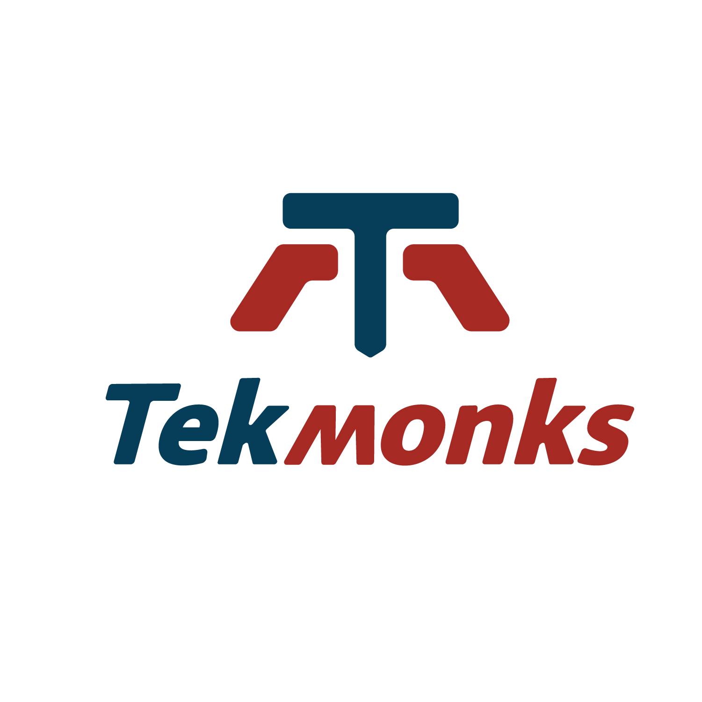
Solution
XBIN, was selected after an a comprehensive evaluation and pilot to meet the secure document sharing and management requirements of Takaful Malaysia.
The “OneView” feature combined data across applications, cloud and on-prem into a single and unified controlled storage solution. Yet applies the same access control no matter where the data resides or is downloaded to allow a modern cloud-based access sharing across devices, people, and geos. This was especially useful for insurance use cases where integrity and privacy of data and files is paramount.

Slide 7
XBIN Features
Unified all data sources from Server Message Block (SMB), WebDav, Network DFile System (NFS), SSH File Transfer Protocol (SFTP) support for legacy applications, and Windows servers.
Integrated Dropbox, Box.com, Gdrive, OneDrive, and SharePoint
Transparently integrated with Amazon S3 and Azure Storage for terabytes of data storage and objects.
Integrated with NAS and Storage Area Network (SAN) for internal storage.
In-built workflow engine which can provision pre-built workflow templates, e.g. approval flows, or create custom workflows.
Data controls, includes data expiry policies for securely sharing files and data with remote employees and business Partners.

Slide 8
XBIN Benefits
Flexibilty
Share data across platforms, devices, and partners.
Security
Unifies Enterprise Content retention, encryption, and sharing policies no matter where the content resides.
OneView
Unifies the content into single view by integrating content storage platforms into a modern, cloud enables, content sharing platform.
Scalability
Streaming I/O support and Rsync allowing data scallabilty, even if the network itself is slow
In-built workflow engine which can provision pre-built workflow templates, e.g. approval flows, or create custom workflows.
Workflows
Data Loss Prevention
Application, encryption, and virus definition policies no matter where the content resides, or where it is shared or downloaded to.

Slide 9
Thank you!

