Slide 1
IoT BASED LIVESTOCK FEEDER

Slide 2
What is IoT?
The Internet of things (IoT) describes the network of physical objects—“things”—that are embedded with sensors, software, and other technologies for the purpose of connecting and exchanging data with other devices and systems over the Internet.

Slide 3
Project description
The IoT based feeder is a livestock feeder designed to help farmers feed livestock remotely from anywhere around the world. This aim can be achieved as long as there is good access to internet where the farmer is.

Slide 4
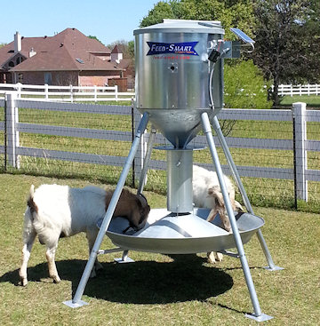
The feeder

Slide 5
How the IoT based livestock feeder works
Power source
Sensors
Lighting
Mobile app

Slide 6
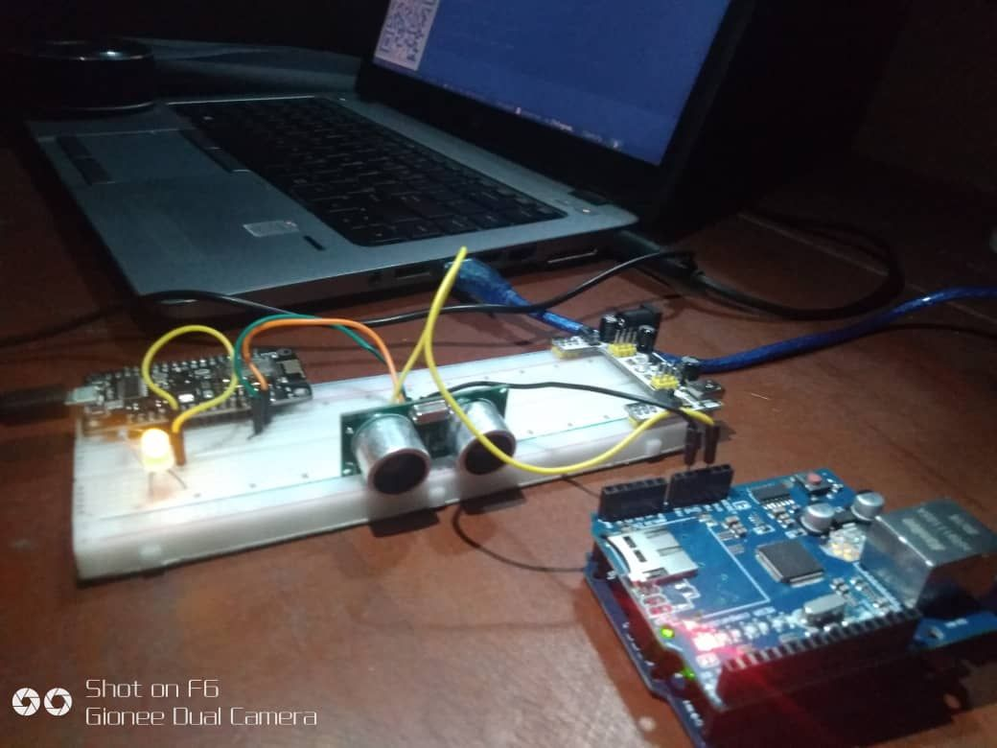

Slide 7
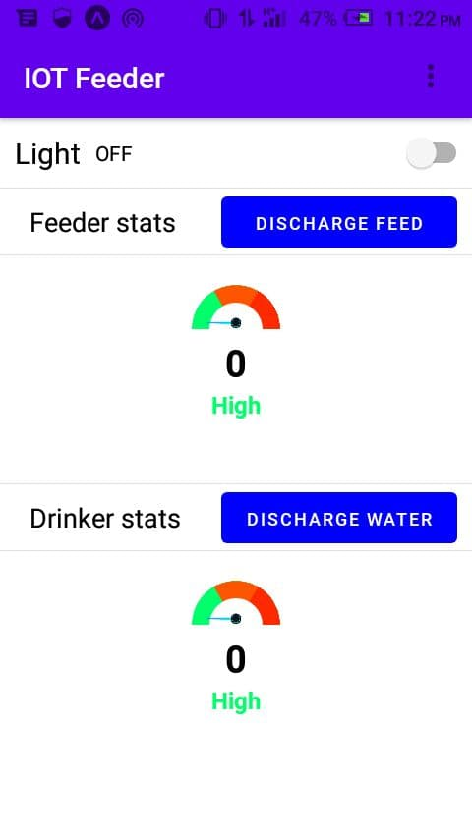

Slide 8
What the IoT based livestock feeder does
The IoT based livestock feeder feeds the livestock of farmers. It also has a drinker where the livestock drink water. The IoT based livestock feeder helps the farmer to discharge feed and water to the livestock when it is time to feed. And it has a lighting system to provide light for the animals as they will need light to eat.

Slide 9
The benefits of the IoT based livestock feeder
Gives the farmer control of the farm from anywhere in the world be it Europe, America, India etc.
Time Management for the farmer.
It helps to save the farmers the stress of feeding too many livestock at the same time.
It ensures responsible consumption and production in compliance to the sustainable goal 12 established by the United Nations in 2015.

Slide 10
THANK YOU

