Slide 1

8 Pillars of PAPDA Accounting
Complete life-cycle from legal setup to donor reporting — eight integrated pillars to configure Odoo 18 for PAPDA.

Slide 2

Pillar 1 — Fiscal Localization & Company Data
Localization
Company Data
Install Ethiopia package to load COA, tax rates (VAT/WHT) and legal report formats.
Set PAPDA name, head office address, TIN, currency ETB, and upload logo for donor invoices.
Warning
Change localization only before any journal entries are posted.

Slide 3

Pillar 2 — Fiscal Periods (The Calendar)
Define Fiscal Year & Lock Dates
Set fiscal year end (e.g jan 1 – 31 dec, or EFY ). Use Lock Dates (Journal Entries, Tax Return, All Users) to prevent post-close edits.
Staggered fiscal years supported for donor-specific cycles.

Slide 4
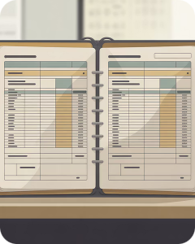
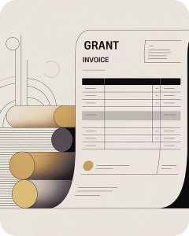
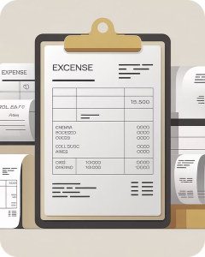
Pillar 3 — Chart of Accounts (Foundation)
Assets & Banks
Income
Expenses & Liabilities
Define asset codes (e.g, 120100 IT Hardware), bank accounts per project (110010, 110020, pool account).
Separate grant accounts (401000, 402000, donor-specific 404XXX) to ensure restricted fund tracking.
Use detailed expense codes (601100–602400) and liabilities (Withholding, pension) with reconciliation where required.

Slide 5

Pillar 4 — Taxes (Compliance)
WHT 30%
Non‑staff Per Diem 30%
WHT 3% (VAT‑inc)
Staff Per Diem Brackets
Configure VAT 15%, WHT rules (WHT 3% as -2.6087% when VAT-inclusive), and staff/non-staff per diem sequences to automate deductions per legal brackets.

Slide 6
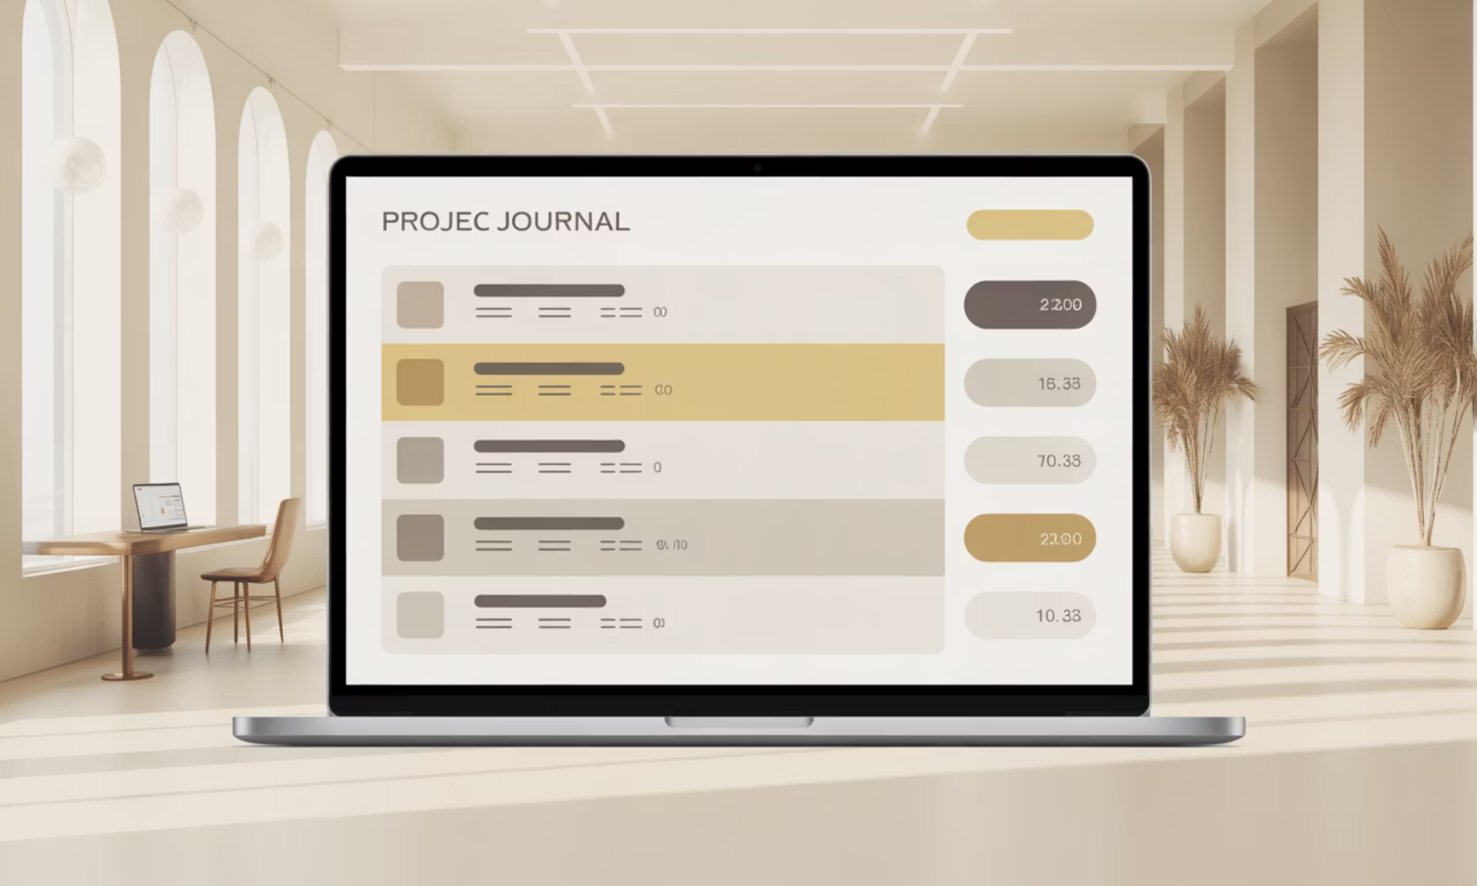
Pillar 5 — Journals (Filing Cabinets)
Project Bank Journals
Create a separate bank journal per project (unique short code, currency per donor).
Pool & Misc
Pool account for shared costs; Misc journal for accruals and adjustments.
Internal Transfers
Use Bank/Cash Clearing (100200) as bridge with two-step matching to leave bridge at zero.

Slide 7




Pillar 6 — Analytic Accounting (3 Plans)
Plan 1: Projects
Plan 2: Activities
Plan 3: Funding
Track each grant (e.g. DTP, GAVI) with one analytic account per project.
47 budget lines as analytic accounts for activity-level tracking and spending limits.
Record donor vs PAPDA co-fund splits using analytic distribution (e.g., 72% donor / 28% PAPDA).

Slide 8
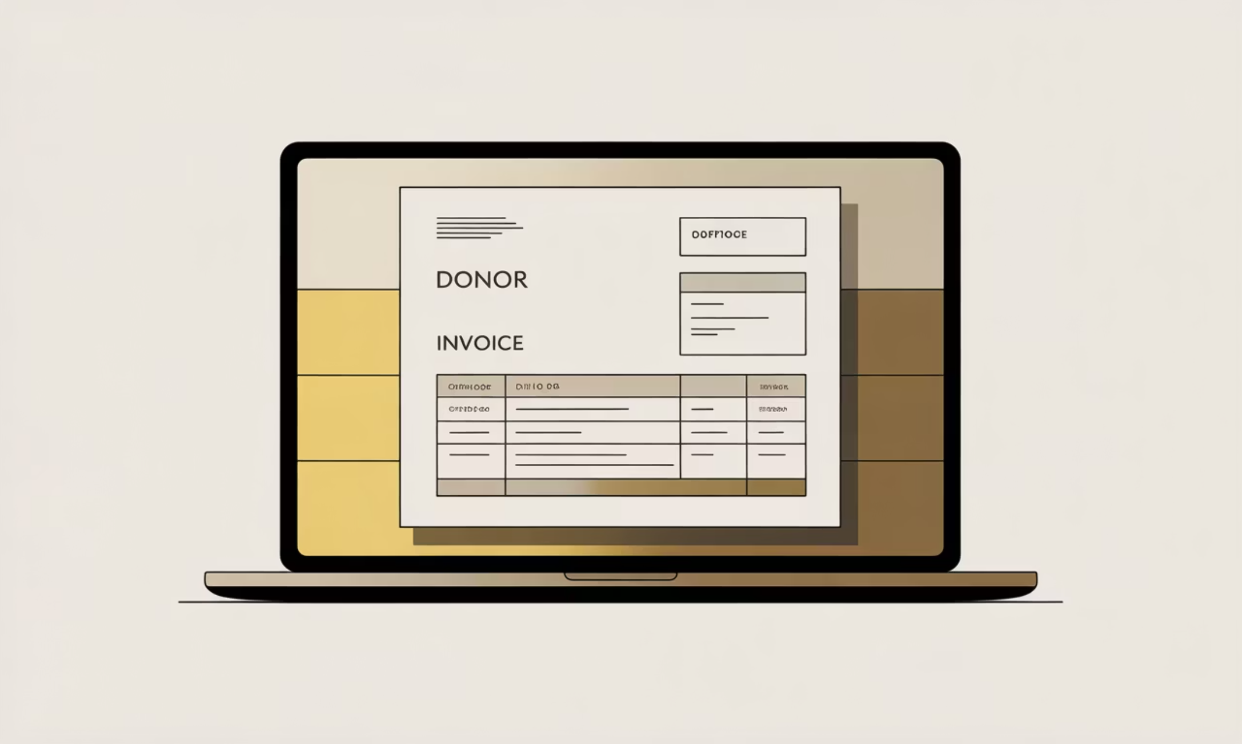
Pillar 7 — Transactions: Money In & Out
Money In
Customer Invoices for donor grants (tag project); Customer Receipts for PAPDA co-funding (use 402000).
Money Out
Vendor Bills, Internal Transfers, Payroll. Always tag Activity + Funding analytic accounts and use project-specific payment journals.

Slide 9

Pillar 8 — Reporting (Output for Donors & Auditors)
Financial Reports
Analytic Reports
Audit Tools
Balance Sheet, P&L, Partner Ledger for legal, audit-ready statements.
Project Profitability and Budget vs Actual per activity (Planned, Committed, Achieved).
Journal Audit and Audit Trail (who did what and when) for donor assurance.

Slide 10




Configuration Checklist & Next Steps
Complete Setup
Install Ethiopia localization, load COA, set company data, define fiscal periods and lock dates.
Configure Taxes & Journals
Create VAT/WHT rules (including -2.6087% WHT incl. VAT), and bank journals per project with payment sequences.
Enable Analytics & Reports
Create 3 analytic plans (Projects, Activities — 47 lines, Funding), set budgets, and verify Budget vs Actual reporting.
Prioritize initial localization before posting entries, train accountants on analytic distribution and lock-date discipline to secure donor confidence.

